Slide 1

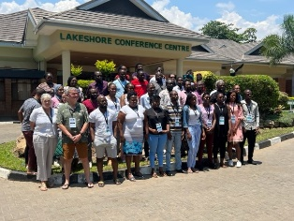


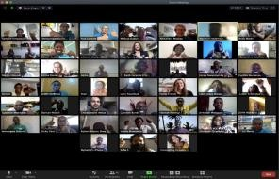
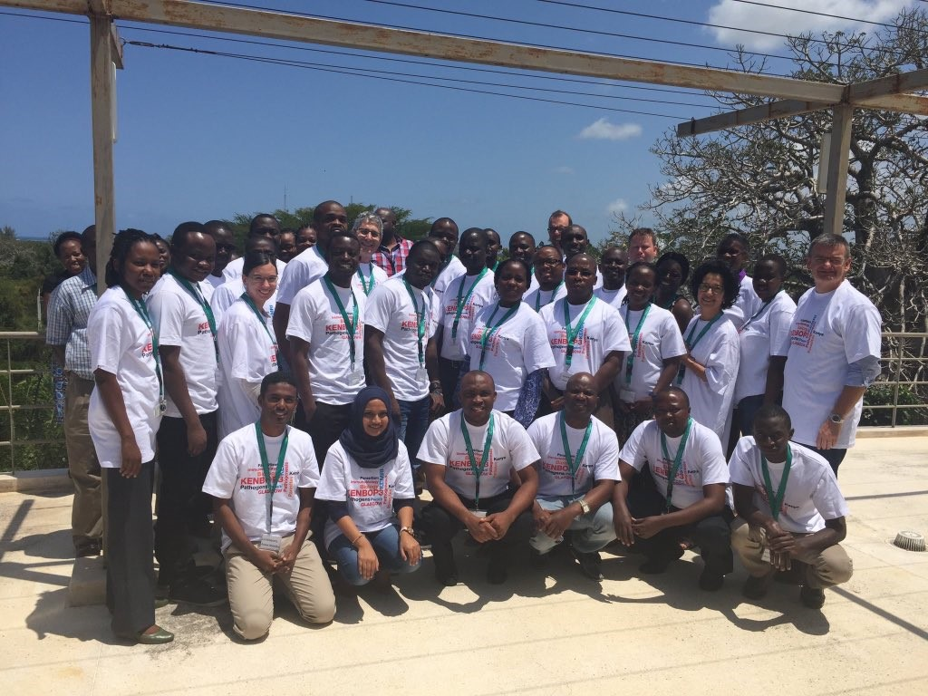
course and expert symposium on advances in the Immunobiology of Parasites, Pathogens and Pathogenesis
Compulsory
Grant
Writing
Course
2022
5th - 9th February 2024
KEMRI WELLCOME TRUST, KILIFI
Course Detail
A week-long course targeted at PhD students and early postdocs who have a strong interest in the interaction between the immune system and pathogens, and how this underlies the pathogenesis of a wide range of infectious and non-communicable diseases. The course consists of intensive interactive learning sessions and symposia on the most recent advances in immunology, immune disease and the consequences of chronic immune activity on human health. The parasitology of malaria, HIV, TB, helminths, HPV and other viruses including covid19 will also be covered. Delivered by some of the leading researchers in the field, participants will also benefit from grant writing, science communication and career-mentoring sessions.
Eligibility
Priority will be given to PhD students and Early Postdocs (within 5 years of PhD)
from Africa. Limited slots are available for students from other parts of the world.
Course Registration
The course is free for all participants. In addition, a compulsory grants writing
course as well as optional Bioinformatics & Flow Cytometry courses will be
available in the week following the main course.
Application Procedure
Applicants should complete the course application form here:
https://jobs.kemri-wellcome.org/webform/africa-bop-application-form.
YOU’LL BE REQUIRED TO FIRST CREATE AN ACCOUNT TO ACCESS & COMPLETE THE APPLICATION FORM!
Online 2020 & 2021
2019
2018
2017
Application Deadline: 20 September 2023
Further information
Dr. Dorcas Mbuvi dmbuvi@kemri-wellcome.org (KEMRI-Wellcome Trust)
Alex Mackay alex.mackay@glasgow.ac.uk (University of Glasgow)
AfrIBoP is funded and organised by: KEMRI-Wellcome Trust through IDeAL (Initiative to Develop African Research Leaders), Pwani University, Malawi Liverpool Wellcome, EULAR, Wellcome Centre for Integrative Parasitology, University of Glasgow and Immunopedia.
2016
#AFRIBOP2024

