Slide 1



Timetabling Project
AY 24/25 Roadshows
January 2024
Please have a mobile device to hand to take part in our interactive sections using Menti.
P

Slide 2

Timetabling AY24/25

Slide 3



Our Goal:
To achieve efficient and flexible utilisation of the University teaching estate.
AY24/25 is the first of a multi-year project to improve our end-to-end process, focusing on achieving the above.
Student
Experience
Efficiency
Staff
Experience

Slide 4

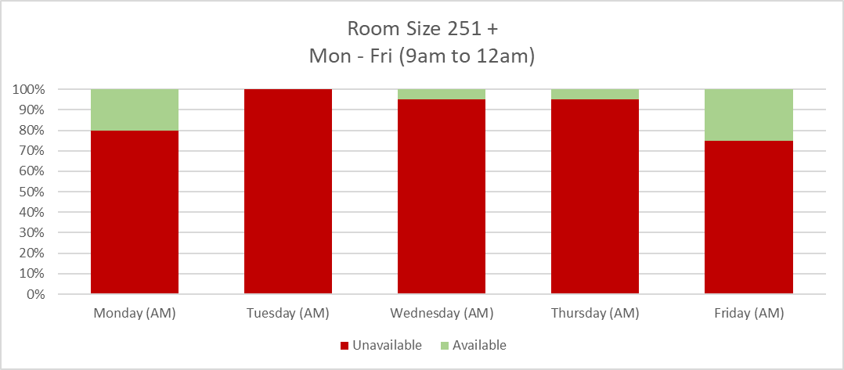
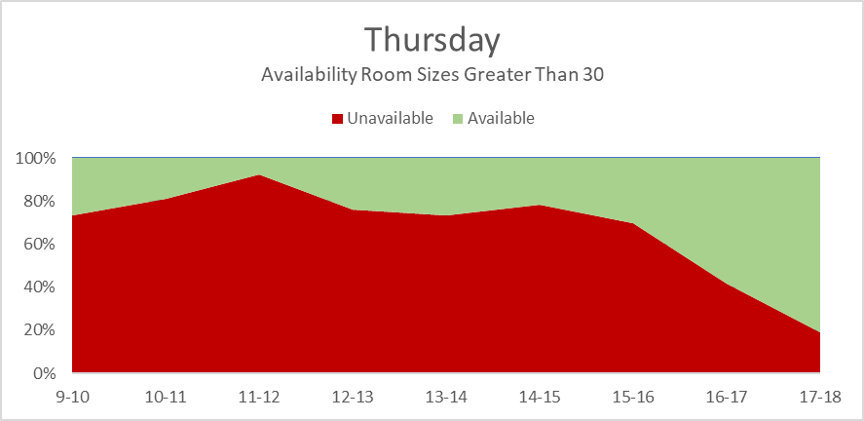
Utilisation of the estate (AY 23/24)
To achieve efficient and flexible utilisation of the University teaching estate
Examples
Please note: Heatmap represents capacity in centrally-managed teaching space for AY23/24 as at August 2023, i.e. when 96% of demand was met.
Rooms are allocated based on a minimum 80% fit (course size to room capacity).
Although the outcomes are improved from pre AY23/24 we must :
Continue to drive more efficiency from our estate to maximise flexibility and growth.
Engineer efficiency into the process: reducing scale of effort required and removing need to create additional new space
Reduce the overall staff effort required to produce a timetable for UofG.

Slide 5
AY 23/24 Roles and Responsibilities
To achieve efficient and flexible utilisation of the University teaching estate
Ask from our Teaching Staff Pre-Rooming
Engage with the ‘Right First-Time’ approach
Building relationships and working collaboratively.
Be timely
The earlier we are notified of high impact changes the better. Timetabling requirements for AY24/25 should be submitted to Professional Services staff in a timely manner, right first time, to allow ample time for documenting in CMIS.
Changes should be aligned with the overall learning & teaching strategy. Be aware of moving demand into peak times.
Be flexible
Flexibility will help to support in the resolution of clashes.
As an example, this may mean moving date or time, or reviewing class sizes, to get the best outcome for our students.
Please note where we cannot accommodate a change in the timetable, your local Professional Services contact will be in touch alongside the relevant academic staff to understand the impact on not going ahead with this change.
We cannot guarantee we can accommodate all change.

Slide 6
AY 23/24 Roles and Responsibilities
To achieve efficient and flexible utilisation of the University teaching estate
Ask from our Professional Services Staff Pre-Rooming
Engage with the ‘Right First-Time’ approach
Building relationships and working collaboratively.
Work with nominated representatives
Nominated School Timetabling representatives from each area will act as points of contact for the Timetabling process in the pre-rooming stage. They will also help maintain standards of data quality within CMIS events, and help the project understand how course requirements are gathered.
Discuss
‘Higher Impact’ Changes
Higher impact changes, should be entered into CMIS only after discussions in the weekly calls and in accordance with the agreed outcome.
This may include discussions with representatives from other Schools and Colleges.
Please note where we cannot accommodate a change in the timetable, your local Professional Services contact will be in touch alongside the relevant academic staff to understand the impact on not going ahead with this change.
We cannot guarantee we can accommodate all change.

Slide 7
AY 23/24 Roles and Responsibilities
To achieve efficient and flexible utilisation of the University teaching estate
Ask from our Teaching Staff Post-Rooming
Consider
‘Is it needed?’
We will be requesting that only essential changes are requested post rooming.
Changes post rooming can cause a significant impact on the timetable.
Be flexible
Flexibility will help to support in finding rooming solutions.
As an example, this may mean moving date or time, or reviewing class sizes, teaching to achieve a resolution.
Please note where we cannot accommodate a change in the timetable, your local Professional Services contact will be in touch alongside the relevant academic staff to understand the impact on not going ahead with this change.
We cannot guarantee we can accommodate all change.

Slide 8
AY 23/24 Roles and Responsibilities
To achieve efficient and flexible utilisation of the University teaching estate
Ask from our Professional Services Staff Post-Rooming
Work together to support resolutions
Engage with colleagues across Schools, Colleges and Space Management and Timetabling to review and resolve unroomed events.
Be aware of moving demand into peak times.
Engage with the ‘Right First-Time’ approach
With any new or changed requirements gathered since May.
We will be requesting that only essential changes are requested post rooming.
The Availability Checker should be used once the timetable is released to find a slot on the timetable ahead of requesting a change or making any amendments
Please note where we cannot accommodate a change in the timetable, your local Professional Services contact will be in touch alongside the relevant academic staff to understand the impact on not going ahead with this change.
We cannot guarantee we can accommodate all change.

Slide 9
AY 24/25 High Level Process
“Right First Time”
To achieve efficient and flexible utilisation of the University teaching estate
Pre-Planning
January
Course Requirements / Edit & Prep
Mid-February - April
Rooming
May
Un-roomed
June
Change Requests
July Onwards
Awareness of Controlled Change
Teaching Staff Consulted on requirements
Central Rooming
Un-roomed Event Resolution (CMIS Reopens)
Essential Change Request Process
Reg-Enrolment
AY
24-25
AY 24-25
Critical historic clashes identified
Edit data on timetabling systems
Accessibility For continuing Students & Staff
Dedicated school TT contact
Move from minimal change to controlled change.
We cannot guarantee all changes accommodated.
We will support changes aligned with the overall Learning & Teaching strategy.
Ensure we resolve known clashes or conflicts
Our focus for AY24/25 is to foster close working relationships to facilitate "right first time" processing.

Slide 10
AY 24/25 High Level Process
“Right First Time”
To achieve efficient and flexible utilisation of the University teaching estate
Pre-Planning
January
Course Requirements / Edit & Prep
Mid-February - April
Rooming
May
Un-roomed
June
Change Requests
July Onwards
Teaching Staff Consulted on requirements
Awareness of Controlled Change
Teaching Staff Consulted on requirements
Reg-Enrolment
Central Rooming
Reg-Enrolment
Central Rooming
Un-roomed Event Resolution (CMIS Reopens)
Essential Change Request Process
Un-roomed Event Resolution (CMIS Reopens)
Essential Change Request Process
AY
24-25
AY 24-25
Critical historic clashes identified
Edit data on timetabling systems
Edit data on timetabling systems
Accessibility For continuing Students & Staff
Dedicated school TT contact
Dedicated school TT contact
Controlled Change
Pre rooming, we will try and accommodate required change where possible. Visibility on the level of change across schools is important to mitigate against rooming results returning to pre AY23/24 levels. Weekly college meetings will take place supported by Transformation and SMTT.
We cannot guarantee all changes can be accommodated. Our focus will be on ensuring right first time during this period.
Critical Historical Clashes Identified
Where we have known existing clashes, we will work with the relevant stakeholders to identify and reduce these.
Accessibility for Continuing Students and Staff
We will build on the work started last year with continuing students and also will look to ensure where possible staff requirements are built into the edit & prep stage of the process.
Pre-Planning
January
Inform :
Low impact changes to the timetable.
Consult :
High impact changes to the timetable.

Slide 11
AY 24/25 High Level Process
“Right First Time”
To achieve efficient and flexible utilisation of the University teaching estate
Pre-Planning
January
Course Requirements / Edit & Prep
Mid-February - April
Rooming
May
Un-roomed
June
Change Requests
July Onwards
Awareness of Controlled Change
Teaching Staff Consulted on requirements
Awareness of Controlled Change
Reg-Enrolment
Teaching Staff Consulted on requirements
Central Rooming
Un-roomed Event Resolution (CMIS Reopens)
Essential Change Request Process
Reg-Enrolment
Un-roomed Event Resolution (CMIS Reopens)
Essential Change Request Process
AY
24-25
AY 24-25
Critical historic clashes identified
Edit data on timetabling systems
Critical historic clashes identified
Edit data on timetabling systems
Accessibility For continuing Students & Staff
Accessibility for continuing students
Dedicated school TT contact
Dedicated school TT contact
Rooming
May
Central Rooming
Central rooming by the Space Management and Timetabling Team will take place in May and continue as normal.

Slide 12
AY 24/25 High Level Process
“Right First Time”
To achieve efficient and flexible utilisation of the University teaching estate
Pre-Planning
January
Course Requirements / Edit & Prep
Mid-February - April
Rooming
May
Un-roomed
June
Change Requests
July Onwards
Awareness of Controlled Change
Teaching Staff Consulted on requirements
Awareness of Controlled Change
Reg-Enrolment
Central Rooming
Reg-Enrolment
Teaching Staff Consulted on requirements
Central Rooming
Un-roomed Event Resolution (CMIS Reopens)
Essential Change Request Process
Essential Change Request Process
AY
24-25
AY 24-25
Critical historic clashes identified
Edit data on timetabling systems
Critical historic clashes identified
Edit data on timetabling systems
Accessibility For continuing Students & Staff
Accessibility for continuing students
Dedicated school TT contact
Dedicated school TT contact
Un-roomed Event Resolution
We will continue with the un-roomed events process followed for AY23/24.
Nominated role holders in each of the schools will support the resolution of the remaining un-roomed events throughout a focus period in June.
All un-roomed events will be split into two categories :
Large & Time Critical Events which will be managed by SMTT
Smaller & Non Time Critical Events, led by nominated Professional Services colleagues.
Input will be required from academics on the suitability of potential options, staff across colleges will need to be flexible to find rooming solutions
Un-roomed
June

Slide 13
AY 24/25 High Level Process
“Right First Time”
To achieve efficient and flexible utilisation of the University teaching estate
Pre-Planning
January
Course Requirements / Edit & Prep
Mid-February - April
Rooming
May
Un-roomed
June
Change Requests
July Onwards
Awareness of Controlled Change
Teaching Staff Consulted on requirements
Awareness of Controlled Change
Central Rooming
Reg-Enrolment
Teaching Staff Consulted on requirements
Central Rooming
Un-roomed Event Resolution (CMIS Reopens)
Essential Change Request Process
Un-roomed Event Resolution (CMIS Reopens)
AY
24-25
AY 24-25
Critical historic clashes identified
Edit data on timetabling systems
Critical historic clashes identified
Edit data on timetabling systems
Accessibility For continuing Students & Staff
Accessibility for continuing students
Dedicated school TT contact
Dedicated school TT contact
Essential Change Request Process
After rooming we will revert to essential changes only on the timetable.
The accepted reasons for change will remain in line with AY23/24.
Approvals
Essential changes will not need pre-approval, but where a change makes a significant impact on the timetable, we may need to reach out to the stakeholder involved to understand the impact of not making the changes, we cannot guarantee all changes can be accommodated.
Change Request Reasons
1.Room no longer required
2. Central room request
3. Use of another area's local space
4. Accessibility requirement not known at the time of rooming
5. Change in size post enrolment
6. New course/event introduced
7. Essential Time/Day change
8. Challenge with the original equipment and features allocated
9. 'Opt-out' of lecture recording (as per policy)
Change Requests
July Onwards

Slide 14
AY 24/25 High Level Process
“Right First Time”
To achieve efficient and flexible utilisation of the University teaching estate
Pre-Planning
January
Course Requirements / Edit & Prep
Mid-February - April
Rooming
May
Un-roomed
June
Change Requests
July Onwards
Awareness of Controlled Change
Teaching Staff Consulted on requirements
Awareness of Controlled Change
Reg-Enrolment
Central Rooming
Reg-Enrolment
Central Rooming
Un-roomed Event Resolution (CMIS Reopens)
Essential Change Request Process
Un-roomed Event Resolution (CMIS Reopens)
Essential Change Request Process
AY
24-25
AY 24-25
Critical historic clashes identified
Critical historic clashes identified
Edit data on timetabling systems
Accessibility For continuing Students & Staff
Accessibility for continuing students
Dedicated school TT contact
What are we trying to achieve in this period :
Gain visibility on the proposed level of change
    understand likely impact to timetable.
Engage with Schools early to identify courses with low/ no change and those with high impact change
On high impact changes, work collaboratively across Schools to get it right first time and avoid clashes
Weekly engagement with nominated timetablers provides a forum to raise known/ historic clashes.
Course Requirements / Edit & Prep
Mid-February - April

Slide 15






Course Requirements / Edit & Prep – 19th of February to 26th of April
To achieve efficient and flexible utilisation of the University teaching estate
Inform
Course no longer running
Locally owned rooming (no change to time)
Room equipment & features change
Accessibility requests (staff & student)
AY24/25 Requirements Gathered
Inform the project through your representative.
Update CMIS immediately
The earlier, the better!
High impact change:
Provide more time for collaborative discussion
Change fully documented in CMIS
  Right First Time
Increase chances of being Roomed
Low/ no change:
CMIS update can be completed efficiently to highest possible standard
  Right First Time
More time for complex changes
Consult
Consult through your representative.
Update CMIS after consultation process.
During the consultation we will look at
  Based on AY23/24 timetable are you likely to get a room of the size and spec.
  Based on AY23/24 timetable are you likely going to create a clash via your change.
Change to mode of delivery.
Change in size.
New course or event (additions to the timetable)
Day & time (incl. semester changes)
Please note where we cannot accommodate a change in the timetable, your local Professional Services contact will be in touch alongside the relevant academic staff to understand the impact on not going ahead with this change.
We cannot guarantee we can accommodate all change.
Academic Colleague
Professional Services Colleague

Slide 16
Course Requirements / Edit & Prep – Representatives
To achieve efficient and flexible utilisation of the University teaching estate
Representatives
College of Arts
College of Science & Engineering
College of MVLS
College of Social Sciences
Ruth Burke (Humanities)
Cara Graham (MLC)
Helen Mclaughlin (Critical Studies)
Michael Bristow (CCA)
Jill Tait (Engineering)
Sian Barnes (Engineering)
Angela Woolton (Chemistry)
Lynne Stewart (Physics & Astronomy)
Tom Rielly (Physics & Astronomy)
Gail Reat (Computing Science)
Jean Jackson (Maths & Stats)
Shazi Rafiq (Maths & Stats)
Anne Dunlop (GES)
Laura McMichael (BSc MedSci)
Nicola Cumming (UG Medicine)
Veronika Flaskarova (UG Medicine)
Theresa Taylor (UG Life Sciences)
Emma Craddock (PGT)
Lynda Young (Psych & Neuro)
Donna Carrick (Psych & Neuro)
Leigh-Anne Dragness (Dentistry)
Arlene McCrae (BOVHM)
Lumba Chirwa (BOVHM)
Renata Boschi (Nursing)
Claire Cameron (ASBS)
Thomas Heraghty (Law)
Sabine Mohan (Education)
Gillian Gordon (Education)
Clair Clarke ( SPS)
Victoria Robinson (SPS)

Slide 17
AY 24/25 Timelines & Key Dates
“Right First Time”
To achieve efficient and flexible utilisation of the University teaching estate
Pre-Planning
January
Course Requirements / Edit & Prep
Mid-February - April
Rooming
May
Un-roomed
June
Change Requests
July Onwards
CMIS Closed for editing
26th April
CMIS reopens. Timetable available online
10th June
Timetable change requests opens
8th July
Student Registration & Enrolment opens
Mid-August
Roadshow 1
CoAH
16th January
CMIS Open for editing
19th February
Roadshow 2
CoSS
17th January
Weekly Timetabler meetings begin
Fortnightly College sessions
Roadshow 3
CoSE
18th January
Timetabling & Teaching Group
Roadshow 4
MVLS
23rd January
Roadshow 5
All Colleges
24th January
Pre – Planning Sessions
Engagement
Townhall
All Staff
15th February
Key Process Milestones

Slide 18
CMIS Training will be available during the Edit & Prep Period for all CMIS Users through the Space Management and Timetabling team.
SMTT will share invitations for training sessions in February when CMIS opens.
Training sessions will cover a range of CMIS topics.
These will be held online and will run twice weekly until CMIS closes at the end of April.
Please note we have reached our capacity for CMIS licenses and will be unable provide additional CMIS access for Schools and Colleges

Slide 19
THANK YOU!
AY24/25 Timetabling Townhall:
15th February
Ask a Question:
TimetablingProject@glasgow.ac.uk

