Slide 1

Assessment Changes Workshop:
Inclusive Assessment and Measures to Protect Against AI Misuse

Slide 2
First things first: Why are we here?
Inclusivity and Generative AI
When we talk about our concerns with AI, we’re talking about academic dishonesty, which mean systemic solutions to AI concerns start with solutions to academic dishonesty…but not always the ones you think
When we talk about inclusive assessment, we’re not talking about making assessments easier.
  We are talking about not making assessments hard for the wrong reasons
Comprehensive syntheses of research, including those done by AdvanceHE, allows us to infer that inclusivity promoted by removing psycho-social barriers to engagement.
Risks to inclusivity & academic dishonesty using AI may seem like different issues, but growing research along with theory tell us that these issues share root causes that can be addressed by communication and assessment design.

Slide 3
First things first: Why are we here?
Evidence based propositions for today
Correlation is not causation: the availability of technology does not cause cheating. There is no validated study that says otherwise
  Academic dishonesty has been more substantially linked to an absence in constructive alignment (CA), and aspects of the learning experience that allow for effective CA, such as clear expectations and visible scaffolding
Shared solutions: Growing research suggest that inclusivity is systemically enabled through meaningful assessment, a form of constructive alignment rooted in situated learning
Assessing what matters: Both solutions are focused on reducing barriers to demonstrating learning, specifically those barriers which are not inherent to the subject matter

Slide 4

Using Learning Through Assessments as a foundation for assessment design

Slide 5
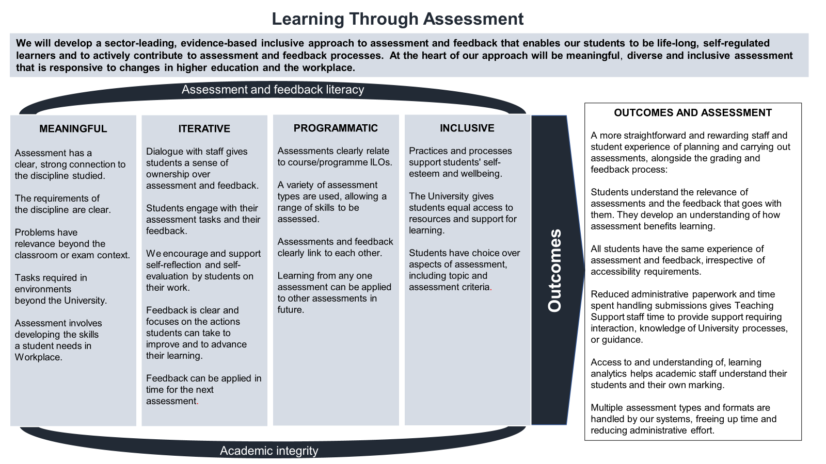

Slide 6

Constructive Alignment
Although not specifically mentioned in the LTA, CA is an important part of the design process.
Constructive alignment is the process of linking:
  Intended Learning Outcomes (ILOs)
  Teaching and learning
  Assessment
CA is one of the most common models used by academic staff in universities

Slide 7

What we mean by inclusivity?

Slide 8
Promoting Inclusivity is About Identifying Exclusion
The way we talk about inclusivity now is greatly informed by Michael Foucault’s “The Order of Discourse” (Foucault, 1970)
It began as a conversation about teaching, learning, and research
“Inclusivity” is not a word used – the focus is on exclusion
  How it inhibits the creation and flow of knowledge
  Why it is dangerous and what it deprives us of
  How to spot it

Slide 9
Inclusivity IS high quality teaching
Social Constructivism: Learning is what happens as our brains “build a meaningful model” of reality inside of us, by interacting with other people and the world outside of us.
  Social: Using skills and abilities for interaction, like senses, movement, communication to collect information and ideas
  Constructivism: Making meaning by connecting different pieces of ideas and information the way they seem connected in reality.

Slide 10


Inclusivity IS high quality teaching
The Brain interacts with the world and makes meaning using:
Lateral Prefrontal Cortex
Anterior Cingulate Gyrus
Dorsal Anterior Cingulate
Broca’s Area
The Limbic System
=
Language and symbols
Body Language
Importance
Values
B
A
Summary: The Parts of the brain that we use for learning have also been associated with the cognitive processes that help us determine when and don’t belong, which dramatically impacts learning and has even been linked to impacts on the development of the brain itself.

Slide 11
Inclusivity IS High Quality Learning
Inclusivity in teaching is not
A trend
A courtesy
An addition or a “bolt-on”
Teaching cannot be effective if it is not inclusive.
Decisions made to facilitate learning are inherently compromised when the inclusivity is not a factor in the design of a learning experience.
A feeling of being included is a key indicator that a learning experience was designed and delivered effective.

Slide 12
How to reduce the 3 Types of Exclusion
(not extensive):
Make no assumptions about who/what belongs in and enriches your discipline, whether its ideas, situations, contexts, or people.
1
Be accountable in your rationale, and specific in your wording and objectives.
2
Maintain focus on your purpose: enabling learning.
3

Slide 13

How is Inclusivity Engagement?

Slide 14
Student Engagement with Learning: The Basics
What Student Engagement ISN’T
Coming to class or participating in class
Signing on to Moodle frequently or spending time in the library
Communicating with the lecturer or doing the homework
Attending social activities
Easily measurable
That different from anyone else’s engagement in any other context

Slide 15
Student Engagement with Learning: The Basics
What Student Engagement is:
A state of being that determines how we experience and respond to the world around us
Is always being influenced and always producing consequences
Is often mistaken for its influences and consequences
A substantially researched psychosocial concept, which can be fedelitously applied in learning and assessment context (though it often isn’t)

Slide 16
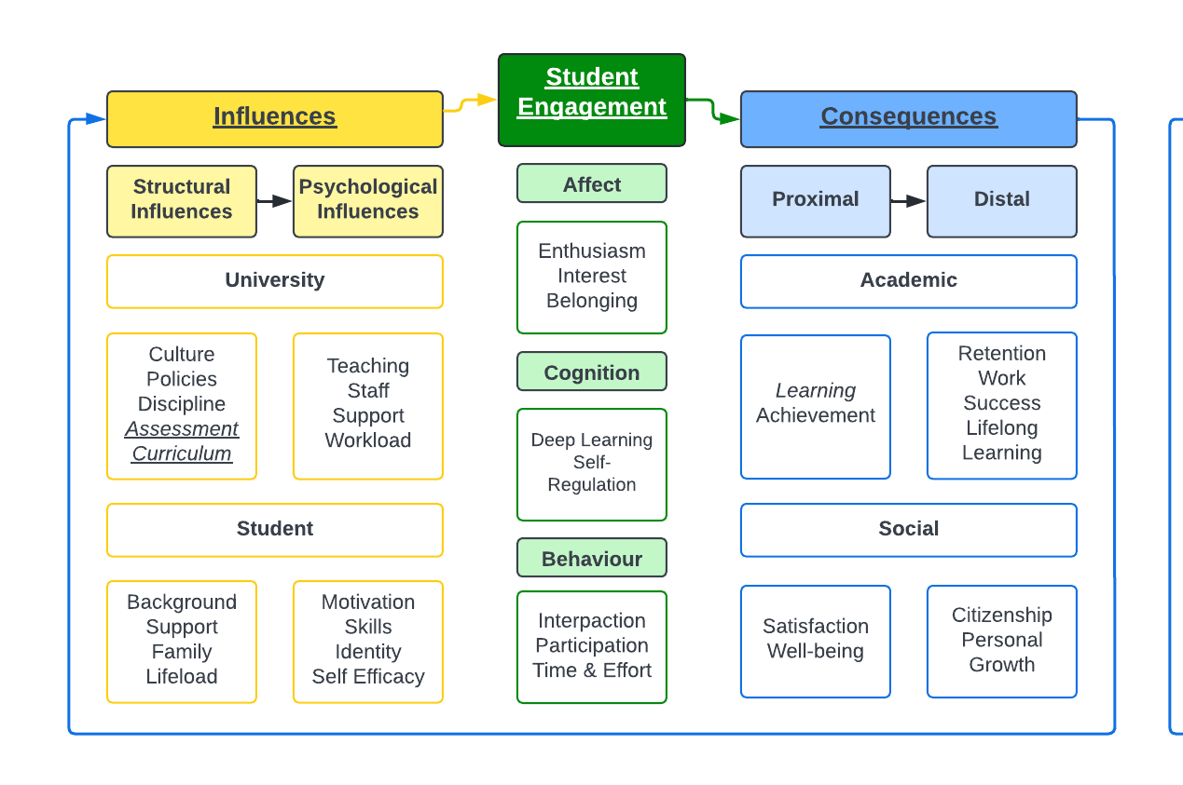
Simple
Model (broken down)
All major components of Student Engagement
  Influences = yellow;
  State of engagement = green
  Consequences of engagement =blue
Arrows indicating direction of general influences
Look at the influences and different types of engagement? How would this framework be relevant to inclusivity?
Notes:
Pay attention to the colours, because that’s going to make it easier to follow as we see how this applies specifically to understanding engagement with assessment
First thing we’re going to do is get rid of the components that aren’t specific to assessment

Slide 17
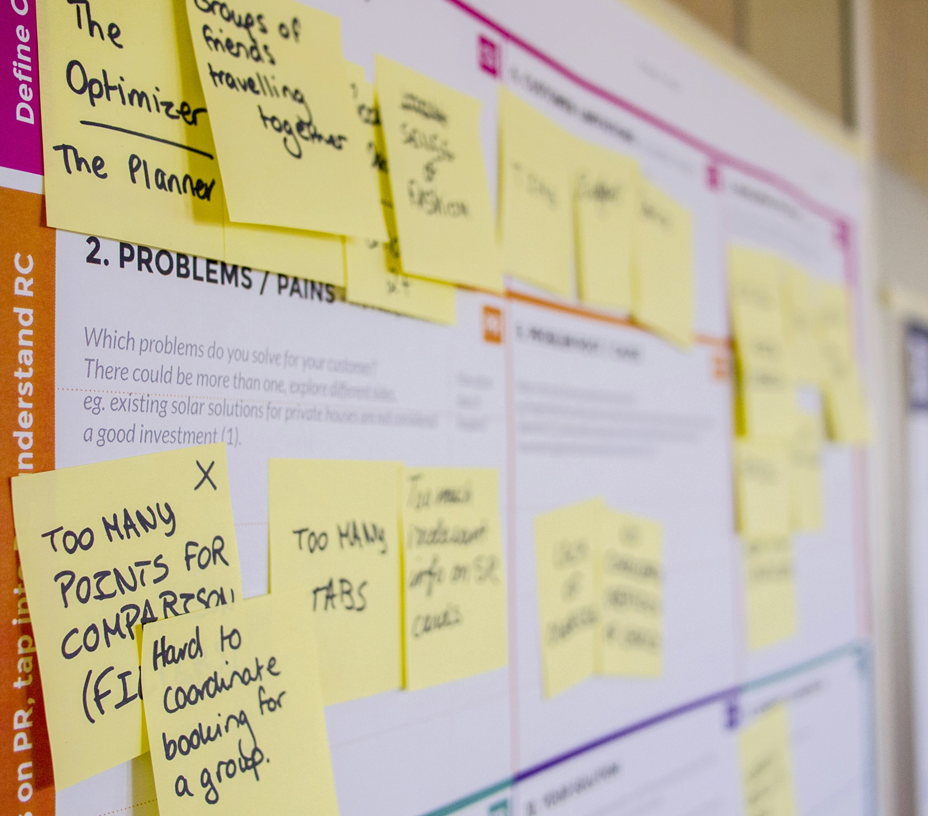
Appropriate Assessment Methods: Choosing Them in the Long Term, Learning From Them in the Short Term

Slide 18
Tools and Support
Long Term changes
Inclusive Constructive Alignment
  Available on the A&F Hub
  This includes the Assessment Biogrpahy and the work that you started for today
  Will allow you to rewrite your ILOs and design out engagement issues and select the most appropriate assessment method for your students
Methods of Assessment of the Reducing and Removing High Stakes Assessment
Short Term Changes (things we will start today)
Reflective exercise- describe a scenario where a professional inhabits your ILOs. Identify skills, optimal engagement levels, and whether current practice in thus scenario uses or can use AI.
Assessment value reflective exercise - who needs graduates from your course and why?
Adapting assessment activity: using reflection to rewrite existing questions and prompts

Slide 19
Reflection on Skills
Consider your Assessment Biography, and your Target ILO’s, and their rationale
Describe a scenario in professional practice that perfectly captures your ILO, why its important, and why it’s difficult.
Is AI starting to be used in this kind of situation? How?

Slide 20
Reflection on Value
We understand the value of our knowledge better than students, so it falls upon us as educators to be as clear as possible about why our teaching and assessment is valuable to them. Consider how the use of AI can help or hinder these skills
1. Who/what needs students who can pass your assessments?
Your Local Community?
Your Disciplinary Culture?
Your Disciplinary Practice?
Your Disciplinary Research?
An Industry, or an Industry Standard?
Something not in this list?
2. Why do they need people who can pass your assessments? Is there...
A social, ethical, or moral imperative?
A gap in the market
A need progress in the field?
Anything not in this list?
Write a few sentences that explains your answers and share it with your partner.

Slide 21
Designing Effective Questions
Clearly define the intended learning outcome to be assessed by the item.
Avoid using essay questions for intended learning outcomes that are better assessed with other kinds of assessment.
Clearly define and situate the task within a problem situation.
Present a reasonable task to students.
The task can be written as a statement or question.
Specify the relative point value and the approximate time limit in clear directions.
State the criteria for grading
Use several relatively short essay questions rather than one long one.
Short term changes to your assessments can be made now.

Slide 22
Designing Effective Questions
Intended learning outcome: Analyze the impact of America at war on the American economy.
Less effective essay question:
Describe the impact of America at war on the American economy.
More effective essay question:
Analyze the impact of America at war on the American economy by describing how different effects of the war work together to influence the economy.

Slide 23
Designing Effective Questions
Less focused essay question:
  Evaluate the impact of the Industrial Revolution on England.
More focused essay question:
  Evaluate the impact of the Industrial Revolution on the family in England.
More focused essay question:
  Evaluate the impact of the Industrial Revolution on the role of fathers in poor communities of England.
More focused essay question:
  Evaluate the impact of the Industrial Revolution on the role of fathers in poor communities of England based on whether or not the Industrial Revolution improved fathers’ abilities to provide the material necessities of life and education and training for their children.

Slide 24

Q&A

Slide 25
Thank you
Have more questions? Feeling a bit stuck?
Contact:
afpp-workstream@glasgow.ac.uk

