Slide 1
School of Physics & Astronomy
Class & Lab Head Guidance
Dr Peter H. Sneddon
Peter.Sneddon@Glasgow.ac.uk

Slide 2
INTRODUCTION TO THE ROLE ASSESSING YOUR COURSE

Slide 3
Content
What does the role of Class and Lab Head entail?
Types of assessment
Components of assessment
Aggregation of marks
Calculating grades
Providing feedback
Late submission penalties
Structure and length of examinations

Slide 4
INTRODUCTION TO THE ROLE

Slide 5
The role of Class and Lab head
These are ADMINISTRATIVE roles
There is no teaching-time attached officially to the position
Common for class heads to also lecture on their course
Common for lab heads to be demonstrators on their course
In both instances, though, you will have additional workload allocation for those duties
Your job is to make sure everything happens, NOT to do everything yourself.
If a class or lab only functions because of your presence/work alone – it is not functioning properly.

Slide 6
Responsibilities
 | CLASS HEAD
 | Non-Honours (P1, A1, P2, A2, ExC1XY, SciSkills, MA, P2T) | Honours (P3, P45, A345, PGT)
Creation of lecture timetable | ✔️
Selection of Class Representatives | ✔️ | ✔️
Processing Good Cause Claims (non-labs) | ✔️ | ✔️
General class administration | ✔️ | ✔️
Class assessment | ✔️
Finalisation of class grades and presentation of these to exam board | ✔️
Tracking of attendance at lectures | ✔️ | ✔️

Slide 7
Responsibilities
 | LAB HEAD
 | Non-Honours (P1, A1, P2, A2, ExC1XY, SciSkills, MA, P2T) | Honours (P3, P45, A345, PGT)
Creation of lab timetable | ✔️
Selection of Class Representatives |  | ✔️?
Processing Good Cause Claims (labs) | ✔️ | ✔️
General class administration | ✔️ | ✔️
Class assessment | ✔️ | ✔️
Finalisation of class grades and presentation of these to exam board | ✔️ (Presented to class head) | ✔️
Tracking of attendance at labs | ✔️ | ✔️
Train your demonstrators in what they be asked to do and how they should act.

Slide 8
ASSESSING YOUR COURSE

Slide 9
Assessment
Assessing students – formative and summative
Formative assessment provides material for feedback to students and teachers
Summative assessment should result in evidence of achievement and will be used to make decisions about progress or qualification.
Basically … summative counts to the final course grades, formative does not.
All assessment should always be designed to address the course Intended Learning Outcomes (ILOs).
A student’s grade for a course is based on their performance in the summative assessment, which typically consists of a weighted combination of several “Components of Assessment”.

Slide 10
Components of Assessment
Can consist of individual assessments, or groups of related “sub-components”.
E.g. Physics 1 has 5 Components of Assessment. Three of these have sub-components, two do not. The table below details these.
Component | Sub-Components? | Detail | Total weighting of component of assessment
Examination | Yes | Paper 1 Paper 2 | 50 %
Class Test | No | - | 10 %
Check Point Quizzes | Yes | Quiz 1 Quiz 2 Quiz 3 Quiz 4 | 10 %
Physics Comm Project | No | - | 5 %
Labs | Yes | 15 lab exps & project components | 25 %

Slide 11
Components of Assessment
Each of the five Components carries an assessment weighting.
Once a final grade for each component has been calculated, those grades are then weighted and added together to calculate the final grade.
More detail on how this is done follows later.
The Components of Assessment, and their weightings, must be spelled out in course documentation – this includes the official PIP documents.
And it is essential that the information presented in the various documents is consistent.

Slide 12
Aggregation of components
In the School of Physics and Astronomy, all components of assessment are marked on “Schedule A” – this is otherwise known as the “22pt scale”.
This is an alpha-numeric grading scale, where each grade has a corresponding grade point.
The table gives the grades and points.
Grade | Grade Point |  | Grade | Grade Point
A1 | 22 |  | E1 | 8
A2 | 21 |  | E2 | 7
A3 | 20 |  | E3 | 6
A4 | 19 |  | F1 | 5
A5 | 18 |  | F2 | 4
B1 | 17 |  | F3 | 3
B2 | 16 |  | G1 | 2
B3 | 15 |  | G2 | 1
C1 | 14 |  | H | 0
C2 | 13
C3 | 12 |  | MV | NA
D1 | 11 |  | CW | NA
D2 | 10 |  | CR | NA
D3 | 9 |  | 7 | NA

Slide 13
Aggregation of Assessment
Aggregation of components of assessment
If your course has more than one Component of Assessment then you need to determine a mark on the 22pt scale for EACH Component, and THEN apply the % weighting factor.

Slide 14
Aggregation Example
E.g. Physics 1 …
Student A gets a 21 for the exam, 16 for the labs, 17 for the class test, 15 for the communication project and 20 for the quizzes.
The weightings for these Components are 50 %, 25 %, 10 %, 5 % and 10 %, respectively, so …
Their overall grade is …
(0.5 x 21) + (0.25 x 16) + (0.10 x 17) + (0.05 x 15) + (0.10 x 20)
= 10.5 + 4 + 1.7 + 0.75 + 2 = 18.98
This is rounded to the nearest integer – 19 in this case – and the student is awarded an A4 grade overall in MyCampus.

Slide 15
Calculating a grade
Calculating the grade for a component of assessment
Whilst an overall component of assessment must eventually be graded on the 22pt scale, sub-components can be determined in a variety of ways.
Directly on the 22pt scale – e.g. a lab report or a project dissertation
Marked numerically
Here the grade would be converted to a % and then a standard conversion table used to turn this into a mark on the 22pt scale. Exam boards will make this conversion table known to you as exams approach.
An example table follows … the exam boards will let you know each year what conversions you should use.

Slide 16
Example conversion table
% | Band | Points |  | % | Band | Points |  | % | Band | Points |  | % | Band | Points |  | % | Band | Points |  | % | Band | Points
100 | A1 | 22 |  | 82 | A2 | 21 |  | 64 | B2 | 16 |  | 46 | D2 | 10 |  | 28 | F1 | 5 |  | 10 | G2 | 1
99 | A1 | 22 |  | 81 | A2 | 21 |  | 63 | B3 | 15 |  | 45 | D2 | 10 |  | 27 | F1 | 5 |  | 9 | G2 | 1
98 | A1 | 22 |  | 80 | A2 | 21 |  | 62 | B3 | 15 |  | 44 | D2 | 10 |  | 26 | F2 | 4 |  | 8 | G2 | 1
97 | A1 | 22 |  | 79 | A3 | 20 |  | 61 | B3 | 15 |  | 43 | D3 | 9 |  | 25 | F2 | 4 |  | 7 | G2 | 1
96 | A1 | 22 |  | 78 | A3 | 20 |  | 60 | B3 | 15 |  | 42 | D3 | 9 |  | 24 | F2 | 4 |  | 6 | G2 | 1
95 | A1 | 22 |  | 77 | A3 | 20 |  | 59 | C1 | 14 |  | 41 | D3 | 9 |  | 23 | F3 | 3 |  | 5 | H | 0
94 | A1 | 22 |  | 76 | A4 | 19 |  | 58 | C1 | 14 |  | 40 | D3 | 9 |  | 22 | F3 | 3 |  | 4 | H | 0
93 | A1 | 22 |  | 75 | A4 | 19 |  | 57 | C1 | 14 |  | 39 | E1 | 8 |  | 21 | F3 | 3 |  | 3 | H | 0
92 | A1 | 22 |  | 74 | A4 | 19 |  | 56 | C2 | 13 |  | 38 | E1 | 8 |  | 20 | F3 | 3 |  | 2 | H | 0
91 | A1 | 22 |  | 73 | A5 | 18 |  | 55 | C2 | 13 |  | 37 | E1 | 8 |  | 19 | G1 | 2 |  | 1 | H | 0
90 | A1 | 22 |  | 72 | A5 | 18 |  | 54 | C2 | 13 |  | 36 | E2 | 7 |  | 18 | G1 | 2 |  | 0 | H | 0
89 | A1 | 22 |  | 71 | A5 | 18 |  | 53 | C3 | 12 |  | 35 | E2 | 7 |  | 17 | G1 | 2
88 | A1 | 22 |  | 70 | A5 | 18 |  | 52 | C3 | 12 |  | 34 | E2 | 7 |  | 16 | G1 | 2
87 | A1 | 22 |  | 69 | B1 | 17 |  | 51 | C3 | 12 |  | 33 | E3 | 6 |  | 15 | G1 | 2
86 | A1 | 22 |  | 68 | B1 | 17 |  | 50 | C3 | 12 |  | 32 | E3 | 6 |  | 14 | G1 | 2
85 | A1 | 22 |  | 67 | B1 | 17 |  | 49 | D1 | 11 |  | 31 | E3 | 6 |  | 13 | G1 | 2
84 | A1 | 22 |  | 66 | B2 | 16 |  | 48 | D1 | 11 |  | 30 | E3 | 6 |  | 12 | G2 | 1
83 | A1 | 22 |  | 65 | B2 | 16 |  | 47 | D1 | 11 |  | 29 | F1 | 5 |  | 11 | G2 | 1

Slide 17
Calculating a grade
Use of multiple criteria
One component of assessment can contain a number of separately assessed criteria.
e.g. a lab report may have criteria on “Content”, “Presentation”, “Conclusions” etc.
You can choose to return one over all grade explicitly for the piece of work, or provide separate marks for each criteria
The latter is the preferred default, but not mandatory.
Default assumption is that each separate criteria are equally weighted. If this is NOT the case, you must make the actual relative weightings clear to students.

Slide 18
Providing feedback
Students must receive some level of feedback on all forms of summative assessment they carry out, and ideally on all forms of formative feedback too.
University has various schemes and policies to help support the provision of quality feedback – below are some useful links for you to explore.
Assessment and Feedback Toolkit: https://www.gla.ac.uk/myglasgow/add/aftoolkit/
University Assessment Policy: https://www.gla.ac.uk/myglasgow/apg/policies/assessment/assessmentpolicy/
Feedback following summative exams: https://www.gla.ac.uk/myglasgow/apg/policies/assessment/feedbackfollowingsummativeexaminations/

Slide 19
Feedback timescales
The key point is that the default position is that students will receive their feedback within 15 working days of the assessment deadline.
If the return of feedback will be after that time students must be informed as soon as the delay is identified.
E.g. if a marker is on holiday for one week during the default 15 working days, then students will not likely receive their feedback until 20 work days after submission.
That is absolutely fine, but students should be told this will happen.

Slide 20
Late submission penalties
If a piece of work is submitted late then it will be subject to a reduction in the grade by two secondary bands per working day (or part of a working day) up to 5 working days.
If the work is submitted after feedback and/or grades have been returned to the cohort, or after 5 working days, then the submitted work will receive an H.
If work is marked numerically, then the daily reduction is 10 %, again up to 5 days max.

Slide 21
Structure of examinations
You will inherit a structure when you take over the course.
Do NOT change this without consulting with the L&T Committee.
If you are designing a brand new course, consult L&T Committee when designing the assessment.

Slide 22
Length of examinations
Laid out in the University’s Code of Assessment https://www.gla.ac.uk/myglasgow/apg/policies/assessment/codeofassessment/ https://www.gla.ac.uk/myglasgow/apg/policies/uniregs/regulations2023-24/feesandgeneral/assessmentandacademicappeals/reg16/#timinganddurationofexaminations

Slide 23
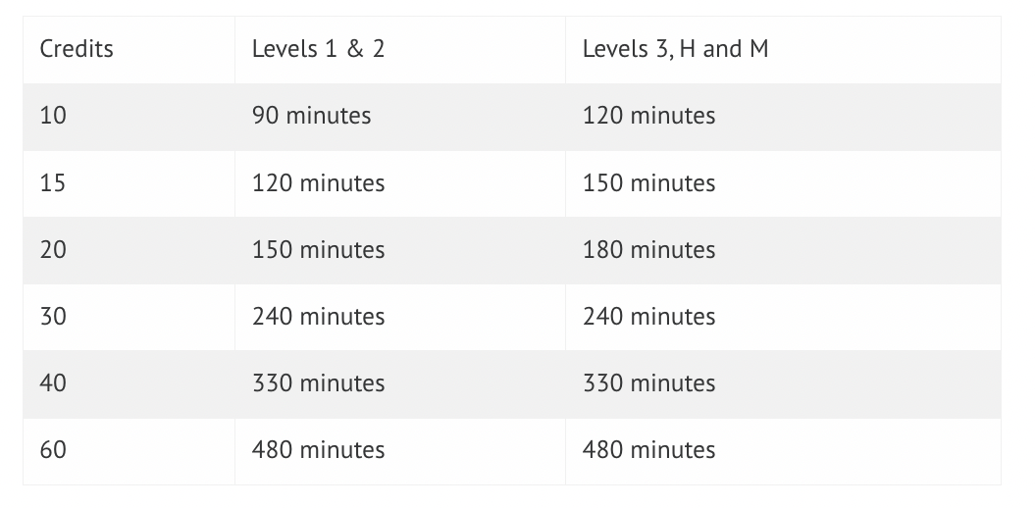
Lengths of examinations
Depends on the level of the course, the number of credits the course is worth and what the weighting of the exam is. The maxima are …
The above assumes exam represents 100 % of course assessment.
If this is not the case, you scale by the assessment weighting.

Slide 24
Lengths of examinations
Example: Physics 1 – level 1 course, 40 credits, 50 % of assessment in exams, 2 papers
So max duration allowed across both papers is 0.5 x 330 minutes = 165 minutes
That would be 82.5 minutes each, but papers must be multiples of 30 minutes (minimum 60, maximum 180) so we run …
2 90-minute papers.

Slide 25
Useful contacts
Learning & Teaching Committee: Convenor Sarah Croke sarah.croke@glasgow.ac.uk
Teaching Support Team: Lead by Lynne Stewart phas-teachingsupport@glasgow.ac.uk
Technician Team: Led by Tom Queen phas-teaching-techs@glasgow.ac.uk
Student Support Officer: Mara Dougall phas-studentsupport@glasgow.ac.uk
Senior Adviser of Studies for School: Jörg Goette phas-senioradviser@glasgow.ac.uk
Good Cause Claims: Me peter.sneddon@glasgow.ac.uk
General queries: Also me peter.sneddon@glasgow.ac.uk

