Slide 1
School of Physics & Astronomy
Class & Lab Head Guidance
Dr Peter H. Sneddon
Peter.Sneddon@Glasgow.ac.uk

Slide 2
THE DUTIES OF A CLASS/LAB HEAD – A TIMELINE
PART 1
NOTE:
Timeline discussed here assumes course you are running lasts through Semester 1 and 2.
Details of duties etc is broadly identical if your course only runs for one semester, but specifics for times may differ. If you are uncertain about timings, please consult previous class head, or feel free to speak to myself or the School’s Convenor of Learning & Teaching.

Slide 3


August: Everything starts
Course enrolment opens through MyCampus
  ~10th August for continuing undergraduate students
  ~15th August for MSc students
  ~20th August for new undergraduate students
Before this happens you must ensure that course is set up correctly within MyCampus
  Is there an enrolment section associated with the course?
  Are all the different class sections in place?
  Are the capacities for those sections correct?
All of this should have been set up with support from the Teaching Support Team (TST) in February/March.

Slide 4
August: MyCampus access
As a class head you need to make sure you have the correct access rights within MyCampus.
You need to be able to access …
  Main Menu – Curriculum Management – Class Roster – Class Roster
  Main Menu – Curriculum Management – Schedule of Classes – Update Sections of a Class
  Main Menu – Curriculum Management – Grading – Grade Roster
  Main Menu – Curriculum Management – Student Good Cause
We’ll come back to these later on.
To gain the correct access rights, please visit
https://www.gla.ac.uk/myglasgow/mycampussupport/mycampus%20access/#studentrecordsaccess

Slide 5
August: Once open …
Once course enrolment opens you should …
  Expect queries from new students
    Is this the right course? When does it start? Is there a textbook?
  Expect queries from Adviser of students
    Can my student take this course? Is it suitable? Will more space be available later on?
  Keep an eye on enrolments in class subsections (e.g. Lab groups)
    Are you getting an even distribution across all sections? Do you want to “massage” section sizes temporarily to encourage an even distribution?
    There are limitations on how much “massaging” can be done – the TST can help you here.

Slide 6
August: Identifying teaching staff
All teaching allocations are assigned to your course by the School Registrar.
    Lecturers, demonstrators, tutors etc
You should be able to see who has been assigned by generating a class head report
    Go to the School’s website at https://www.gla.ac.uk/schools/physics/
    Follow link to “Information for Staff”, then “Staff Database”
    Log in with your School GUPHYS ID and click on “Staff Database”
    “Administer the database” – set “Department” to ”Physics & Astronomy
    Under “Admin” select “Teaching Allocation”
    Then under “Reports” select “Class Head reports” and select your course. (You also need to set the year to the current term – box at top left.)
To gain access to GUPHYS email phas-it@glasgow.ac.uk

Slide 7
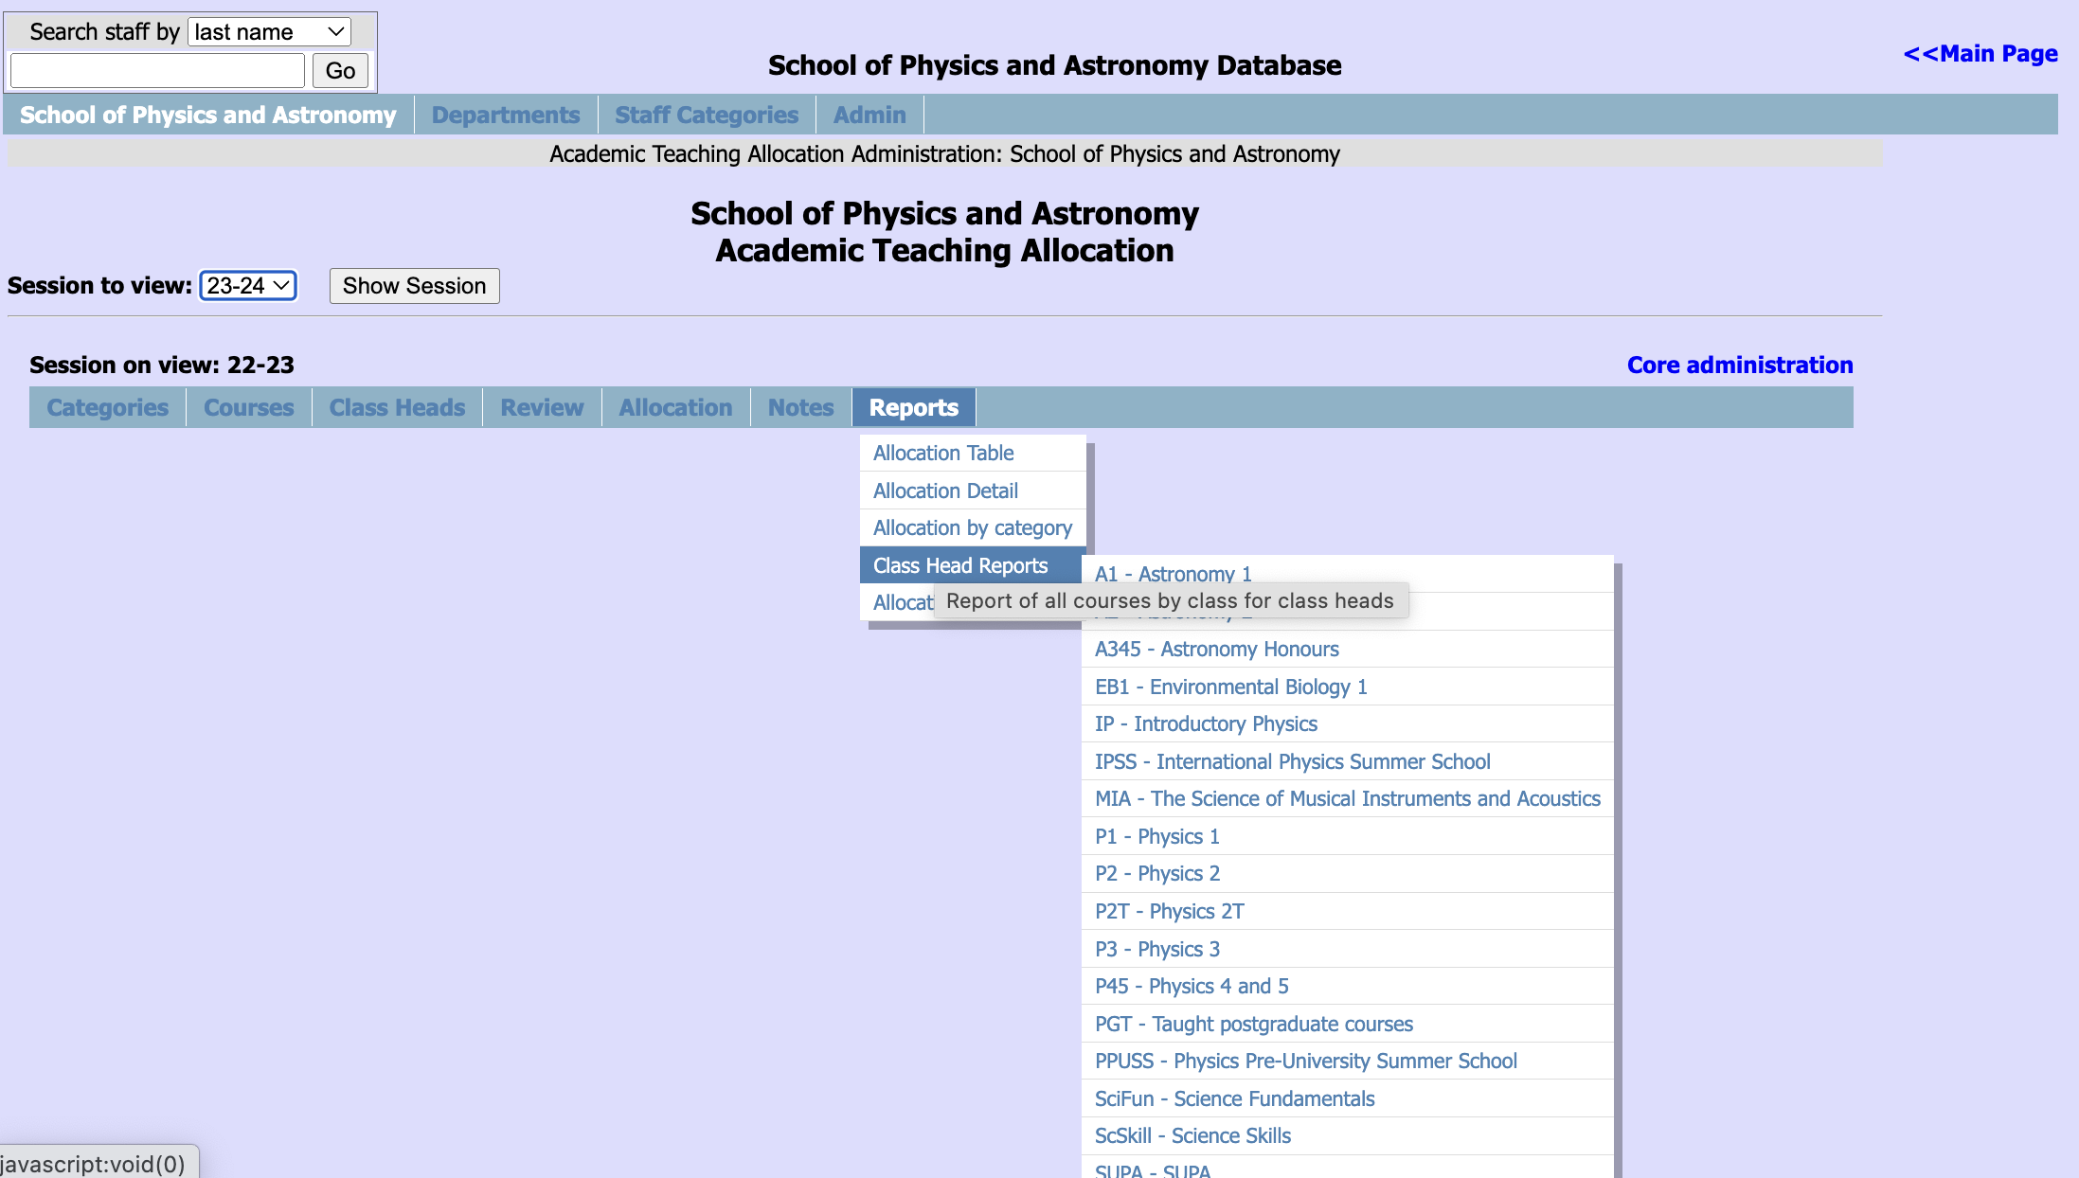
August: Staff database

Slide 8
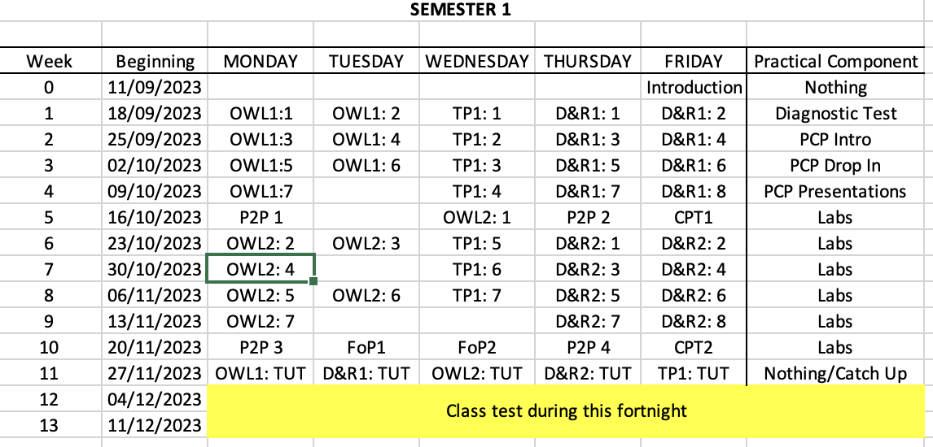
August: Scheduling lectures
Honours years (levels 3, 4, 5): lecture times are set centrally, so there is nothing to do.
Non-Honours years (levels 1, 2): your course will contain a series of modules, and you need to sort who precisely who will be lecturing each day.
E.g. …

Slide 9
August: Meet your team
Arrange a pre-semester meeting with your lecturing team and support staff
  Allows you to set out your expectations on staff such as
    Deadline for assessments
    Any changes to staffing
    Any changes to delivery
  Allows your staff to ask any questions they might have

Slide 10
September: Set up course Moodle(s)
The TST archives all Moodles each year, cloning the previous years to create the next year.
You need to make sure that anything you want hidden from students at the start of the year is hidden.
As soon as students enrol on your course they will have access to the Moodle site (or from the date the site is set to open, depending on when they enrol)
Make sure to remind your lecturers that it is their responsibility to maintain the part of the Moodle relating to their course/module.

Slide 11
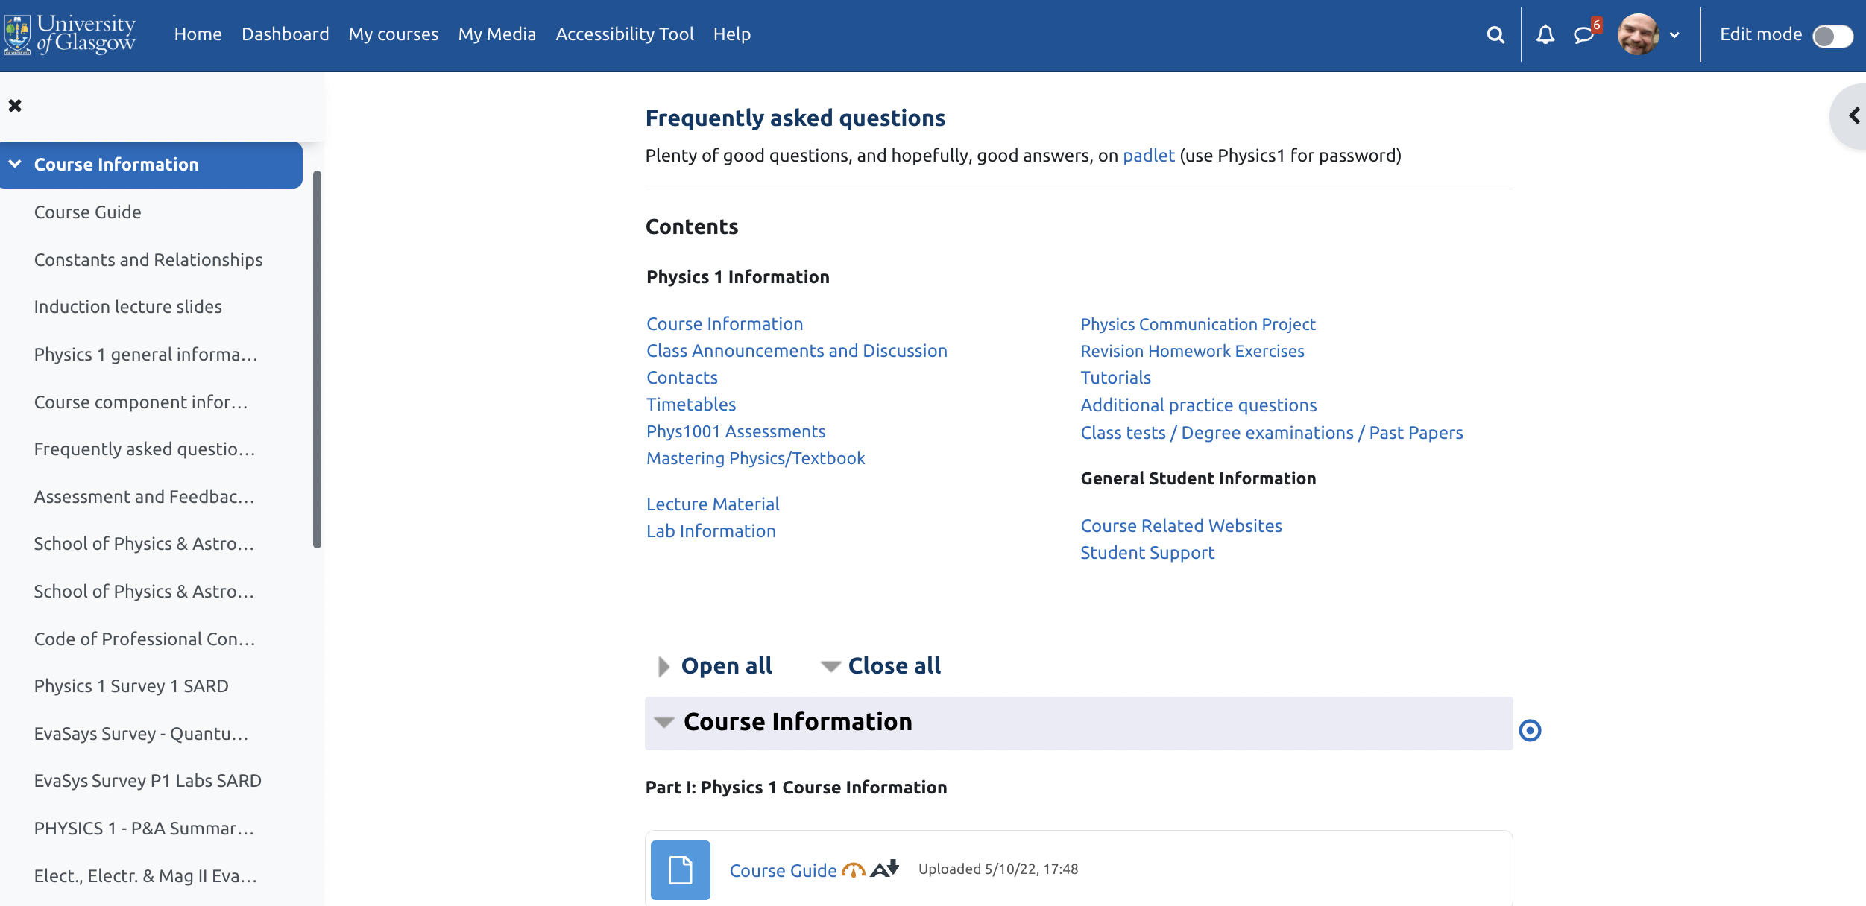
September: Example Moodle

Slide 12
September: Moodle for communication
Moodle is our main point of contact for students
  Messages sent to the Class News Forum automatically get forwarded to student emails, so they have no excuse for missing messages.
  All examinable material must be made electronically via Moodle by the time assessments of that material come round.
  Uploaded documents should be as accessible as possible.
  The Teaching Support Team and/or the Technician Team can help you get everything set up.

Slide 13
September: Timetables and Moodle
We are not meant to keep pdf timetables on Moodle.
Students should be told to either …
Download “UofG Life” app for their mobile device which they can then log in to with their GUID – this should show them all of their classes and where they are; OR
Log in to the University’s website and go to “Timetables and Room Booking” link, select the “Timetable Viewer” tab and then enter their course.
We ARE allowed to keep local timetables with details of which module is on which day, but these should not include the venues.
Minimises risk of students going to the wrong places.

Slide 14
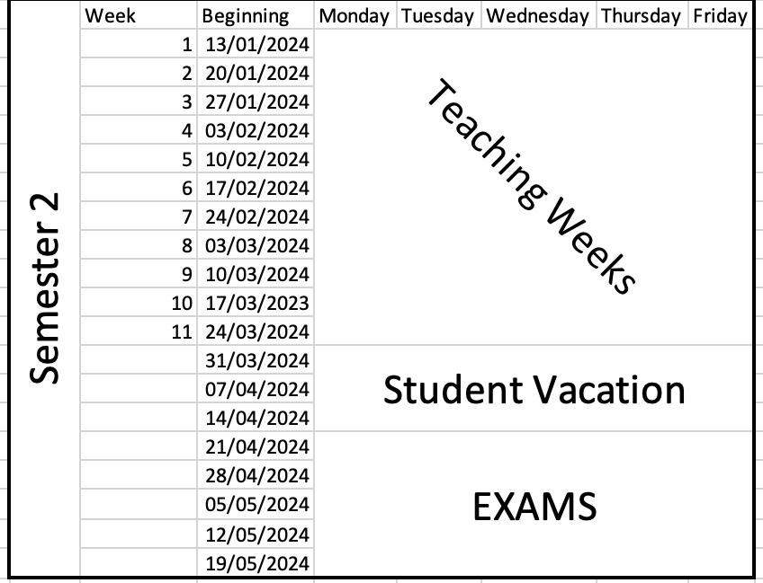
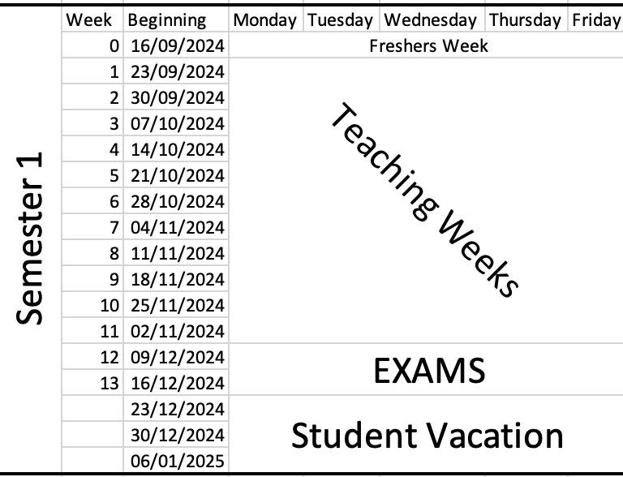
September: The academic year
Teaching runs for 22 weeks, split into two semesters.

Slide 15
September: Course begins
Courses begin with an Induction session, either at the end of Freshers week, or the beginning of week 1.
Purpose of Induction:
  Say hello
  Explain what the course is and who it is for
  Set out clearly what you expect the students to do
  Set out clearly what the students can expect from you
  Highlight how they can contact you if they need to
  Explain what to do if they are absent from the course – Good Cause Claims
  Summarise content – both in terms of subject matter and skills that they’ll develop/improve

Slide 16
September: Class representatives
All classes have student representatives who act as the liaison between their classmates and the School.
  How many your class has depends on the class size
    Up to 50 – 1 or 2
    51 – 150 – 2
    150 or more – 3 or 4
  They – and you – are part of the Staff-Student Liaison Committees.
  The School has 2 – one for levels 1 and 2, and one for Honours years

Slide 17
September: Class rep elections
You need to run an election early in Semester 1 (or 2 if your course only runs then)
Format is up to you
  In person
  On moodle
Good practice is to ask for people to volunteer and then get those candidates to put together a short – 200-300 words – “Why me” message for the class
Once you have your reps, pass details to the School’s TST
(Students then get offered training from the SRC.)

Slide 18
September: SSLCs
The SSLCs meet once per semester
Good practice to meet with your own class reps ahead of those meetings so there is a chance to discuss solutions to problems at the meetings
You can learn more at
  Staff Tool Kit
  https://www.gla.ac.uk/myglasgow/students/studentrepresentationtoolkit/stafftoolkit/
  Code of Practice
  https://www.gla.ac.uk/myglasgow/apg/qea/studentrepresentationmyclassreps/codeofpractice/

Slide 19
September: Class sub-groups
Supervisions
  If your class has Supervisions you will need to decide how to divide the class up
  You will be assigned a team of staff to run these as they see fit
  Supervisors may need encouraging/reminding to sort out their students into groups and arrange meetings
Lab Groups
  Students will have selected a specific lab day or group in MyCampus when the enrolled on the course
  If you then need them to choose experiments or put themselves into sub-groups you’ll need to work out how.
  Moodle Choice can help
  Speak to the Technicians.

Slide 20
September: Students with special needs
Students with additional need can register with the Student Disability Service
https://www.gla.ac.uk/myglasgow/disability/
This can entitle them to additional provisions for classes and assessments which can include
    Permission to record lectures
    Flexibility with deadlines
    Extra time in examinations
    Separate rooms for examinations
School’s Disability Coordinator will contact you with details for your course.
Best to then discuss with individual students

Slide 21
September: Who are these students?
You can identify such students on your course in MyCampus using the following query:
    Main Menu – Reporting Tools – Query – Query Viewer
    Search for query: UOG_DISABILITY_BY_CLASS_ENR
    Set “Institution” to “GLSGW”
    Set “Subject” to “PHYS” or “ASTRO”
    Set “Catalog” to the 4 digit code for your course.
    E.g Physics 1 = “PHYS” and “1001”
    Set “Term” to current academic.
    E.g. 2024-25 = “2024”

Slide 22
September: Good Cause Claims
If students miss an assessment, or a course component that contributes to their course grade, they should log a Good Cause Claim. They can also do this if they take part in assessment but feel their performance was adversely affected by something.
Details on how to do this should be contained within the Course Guide.
The claim is made through their MyCampus account, via their “Student Centre”
Once the claim is submitted three people (set within MyCampus) will receive an email notification and be able to access the details:
  “Course Coordinator” – usually set as Class Head
  “Good Cause Coordinator” – usually set as Lab Head or Class Deputy Head
  “Course Administrator” – usually set as a member of the TST
https://www.gla.ac.uk/myglasgow/apg/policies/assessment/goodcausefaqs/

Slide 23
September: Handling GCCs
They are designed to be used for unexpected events – illness, accident
Should not be used for chronic conditions – issues that run on for weeks/months
Decisions on whether to accept/decline GCCs for continuous assessment (CA) should be made by the class/lab head within 1-2 weeks at most
Decisions on whether to accept/decline GCCs for examinations are made by the School’s Good Cause Claim Committee, which meets January, June and August.
Chair of GCC Committee happy to offer advice on any claims
We do not usually insist on supporting evidence for one-off CA absences/affected performances
We DO insist on supporting evidence for claims relating to examinations.

Slide 24
September: Lab demonstrators
If you are a lab head, now is the time to bring your team up to speed.
Let them know what their duties are.
Let them know what behaviour expected from them.
Train them in the experiments they will be carrying out.
Make sure they understand how marking will be carried out.

Slide 25
October/November: Up and running …
Once the course is up and running, your role is basically supervisor …
  Keep an eye on attendance
  Keep an eye on performance/engagement in any assessments
  Respond to any student queries
  Make sure lecturers are uploading notes, responding to queries, etc
  Post regular messages to class if there are important events coming.
  Making decisions on any GCCs
If you are seeing students who are missing a lot of the course, make sure to pro-actively try to engage with them. An email is usually sufficient to get things going.
If you struggle to make contact, though, you should get in touch with the student’s Adviser of Studies and/or the School’s Student Support Officer.

Slide 26
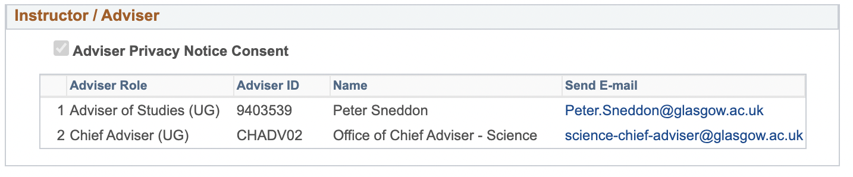
October/November: Contacts
People you can contact if you are concerned about a student …
Their Adviser of Studies - details can be found on
MyCampus – Main Menu – Records and Enrollment – Student Summary.
The School’s Senior Adviser of Studies – Prof Jörg Götte on
phas-senioradviser@glasgow.ac.uk
The School’s Student Support Officer – Mara Dougall on
phas-studentsupport@glasgow.ac.uk
The College Chief Adviser of Studies – Dr Colette Mair on
science-chief-adviser@glasgow.ac.uk

Slide 27
November/December: Exam prep
The majority of our degree examinations are held in the May exam diet, though a small number run in the December diet.
Preparation of exam papers for Honours years is led by the School’s Honours Exam Committee, with initial calls for questions usually going out early in Semester 1.
Preparation of exam papers for non-Honours years is led by the Class Heads.

Slide 28
November/December: Exam prep non-Hons
There are multiple stages in preparing the exam papers for level 1 and 2 courses
The precise dates vary from year to year, but the approximate pattern is as follows:
Deadline (all Semester 2) | Detail
End of Week 3 | 1st complete draft of exam paper(s) sent to School’s non-Honours exam chair for relaying to the School’s Internal Checker
Beginning Week 7 | Feedback from Internal Checker returned to Class Heads
End of Week 7 | Revised papers returned to non-Honours exam chair for relaying to the External Checker
Beginning Week 10 | Feedback from External Checker returned to Class Heads
End of Week 11 | Final version of papers returned to non-Honours exam chair
Strongly encourage you ask lecturers for questions as early as possible.

Slide 29
November/December: Resit examinations
It is possible to re-use previous resit examination papers at non-Honours.
Alternatively, you can ask your lecturers to create new ones each year
Re-use is permitted provided you are 100 % certain that the papers have never been released electronically. If they have, they are considered “public” and cannot be re-used.
If you do wish new resits created, they should be created at the same time as the main diet papers so they can go through the same checking process.
Re-used papers usually only need to be checked by the lecturers to make sure they are still appropriate.

Slide 30
Useful contacts
Learning & Teaching Committee: Convenor Sarah Croke sarah.croke@glasgow.ac.uk
Teaching Support Team: Lead by Lynne Stewart phas-teachingsupport@glasgow.ac.uk
Technician Team: Led by Tom Queen phas-teaching-techs@glasgow.ac.uk
Student Support Officer: Mara Dougall phas-studentsupport@glasgow.ac.uk
Senior Adviser of Studies for School: Jörg Götte phas-senioradviser@glasgow.ac.uk
Good Cause queries: Me peter.sneddon@glasgow.ac.uk
General queries: Also me peter.sneddon@glasgow.ac.uk

