Slide 1
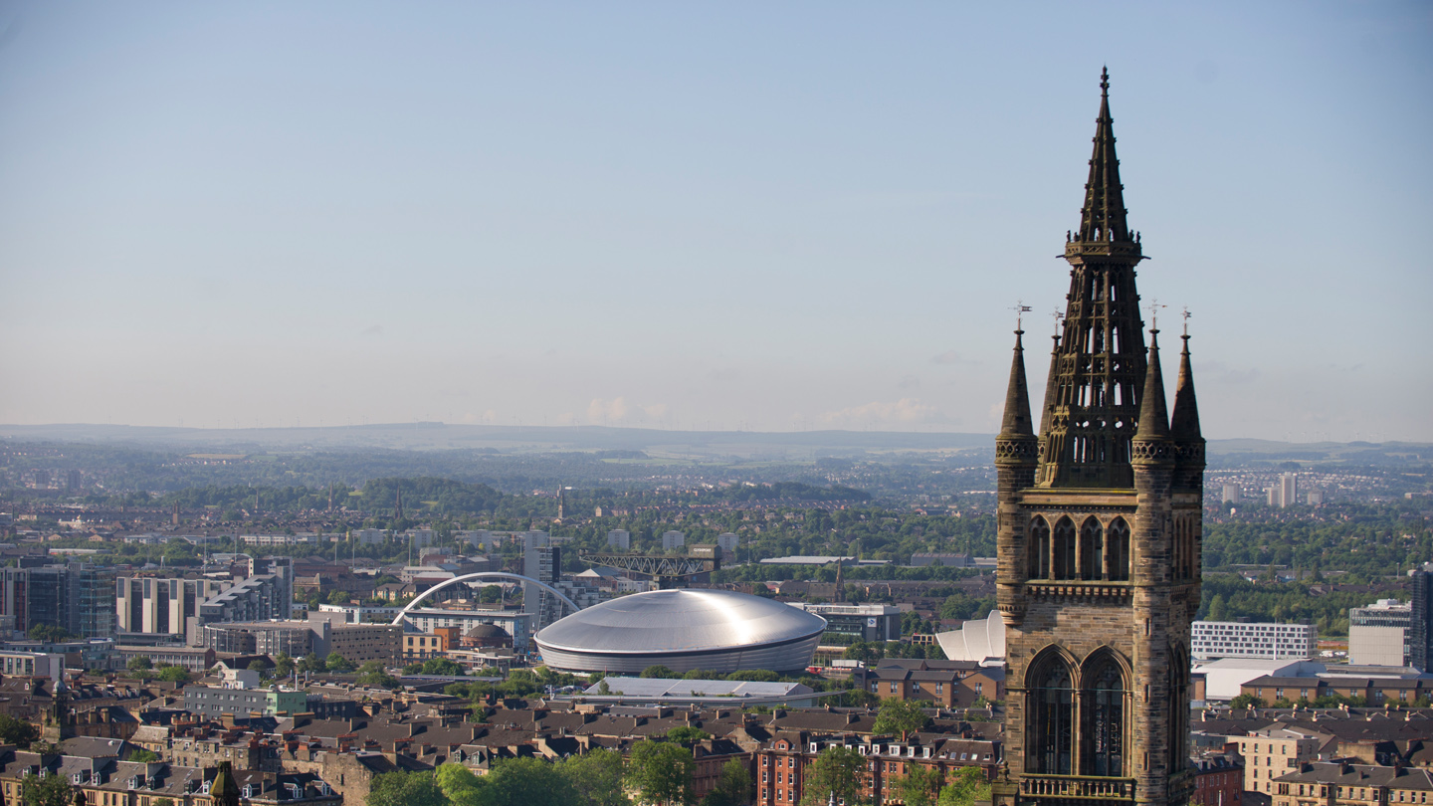
Research Support Office - Overview
Project Coordinator - College of Science & Engineering

Slide 2
Research Support Manager Interim Structure
Helen Harkness
Head of College Research Support
Sarah MacPhail
Research Support Manager
Hub 1
Hub Lead: Derek Motherwell
Hub 2
Hub Lead: Jacqueline Heuchan
Hub 3
Hub Lead: Jeanne Dayton
Lesley McGown Senior Research Support Administrator
Derek Motherwell,, Anca Quinn, Tom Staves, Shannon Llewelyn, Craig Mannion Project Coordinators
Jacqueline Heuchan, Nikki Sloan
1 PC Vacancy
Project Coordinators
Jeanne Dayton, Ana Carneiro, Karen Docherty, Maria Alguero- Muniz (Mat Leave) Project Coordinators
Emma Cheasty, Andrew Bruce
Asst Project Coordinators
Sandra James, Linda French,
Amina Choudary(on Mat Leave),
Jaime Cross, Iona Davidson,
Fatma Ashraf,Olga Getsaeva
Research Support Administrators

Slide 3
Research Support Organisation Structure
Helen Harkness Head of College Research Support
David Pollock Senior Industry Engagement Manager
Lynne McCorriston Research and Business Development Manager
Sarah MacPhail
Research Support Manager
Keith Dingwall Impact & Innovation Manager
Ana Carneiro, Derek Motherwell, Jacqueline Heuchan, Anca Quinn, Tom Staves, Maria Alguero- Muniz (Mat Leave), Jeanne Dayton, Nikki Sloan, Karen Docherty, Shannon Llewelyn Catriona MacCallum (Mat Leave), Craig Mannion Project Coordinators
Emma Cheasty, Andrew Bruce
Assistant PC (Mat Cover)
Richard Mosses
Photonics & Quantum Accelerator
(PBIAA EPSRC Funded)
Anne-Mari Gillespie Industry Engagement Manager
David Nisbet, Linsey Robertson, Neil Findlay / Suzannah Turner
Research Development Managers
Gennaro Strazzullo
Industry Engagement Manager
Calum Kirk
Research Impact Officer
Maryam Morel Research Administrator
Marina Santana Vega
Industry Engagement Manager
Lesley McGown Senior Research Support Administrator
Ali Jamshed, Steffan Gwyn, Caroline Hogarth, David Hughes
KE Associate (EPSRC IAA Funded)
Sandra James, Linda French,
Amina Choudary(on Mat Leave),
Jaime Cross, Iona Davidson,
Fatma Ashraf, Olga Getsaeva
Research Support Administrators
Maaike Siegerist IAA Digital Communications (EPSRC IAA Funded)
Notes:
FTE:
HoCRS: 1 FTE Headcount 1
Snr IE Mgr: 1 FTE Headcount 1
IE Mgrs 3 FTE Headcount 3
Research Admin 1 FTE Headcount 1
Research & Biz Dev Mgr: 1 FTE Headcount 1
RDMs 2.8FTE Headcount 4
RSM: 1 FTE Headount 1
PCs: 12.2 FTE Headcount 13
I&I Mgr 1 FTE Headcount 1 (funded from EPSRC IAA Project)
Impact Officer 1 FTE Headcount 1
KE Associates 3.9FTE Headcount 4 (funded from EPSRC IAA Project)
IAA Digital Comms 0.6FTE Headcount 1 (funded from EPSRC IAA Project)

Slide 4
Submitting an application*
* This process applies where the University of Glasgow is the lead organisation on applications over £100K (cost to funder) for funding calls that have been well publicised or have no deadlines.
Owned by Project Coordinator
Core proposal idea and partners agreed?
PI notifies PC of intention to submit
(3months ahead of submission deadline)
PI provides PC with fully -developed Costing Request Form
(4-6 weeks ahead of submission deadline)
Budget creation and adjustment with support from Research Office. PI advised on CAPEX and EXPORT
Budget finalised
PC submits budget through workflow
(allow 48 hours)
Workflow sign off process complete?
PC can confirm all compliance requirements met?
Application submitted
(48 hours before deadline)
Why such long lead-times …
Improves lead time for Head of School to consider and prepare letter of support
More strategic approach to the submission of applications. Involvement of Business Development Manager/Industry Engagement if required.
More dedicated time from PC to coordinate application development and costing support
Allow more time for Research Development to work with PI to strengthen application
If multi-partner project, allows more time to collate partner’s costing and prepare funder portals.

Slide 5
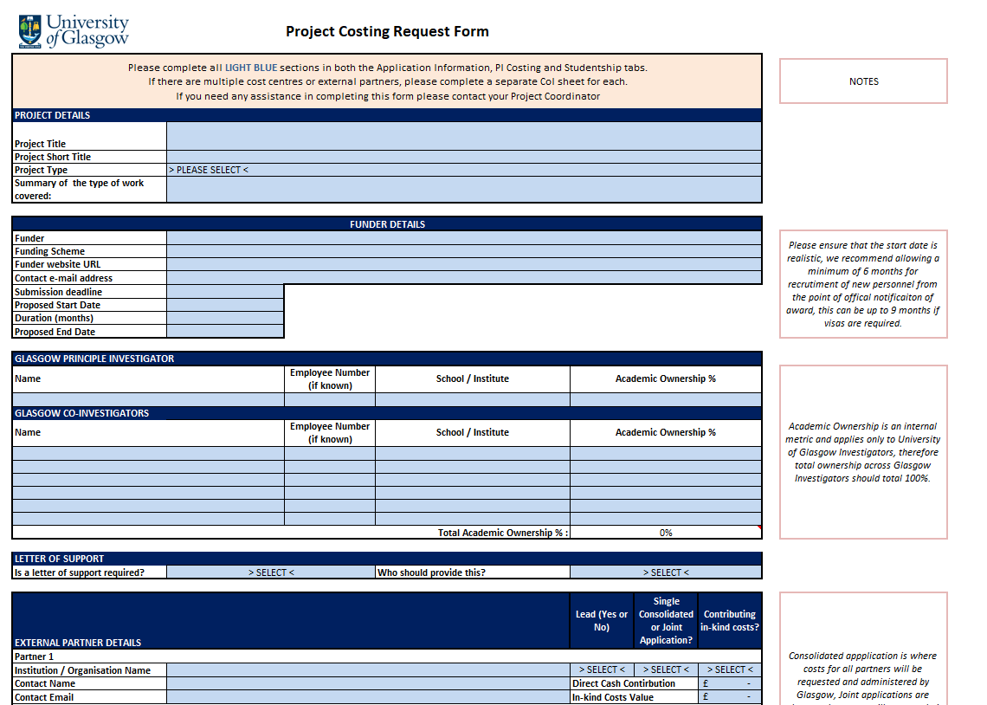
Costing Request Form The project and who is involved
Costing Request Form

Slide 6
Costing Request Form What are the risks

Slide 7
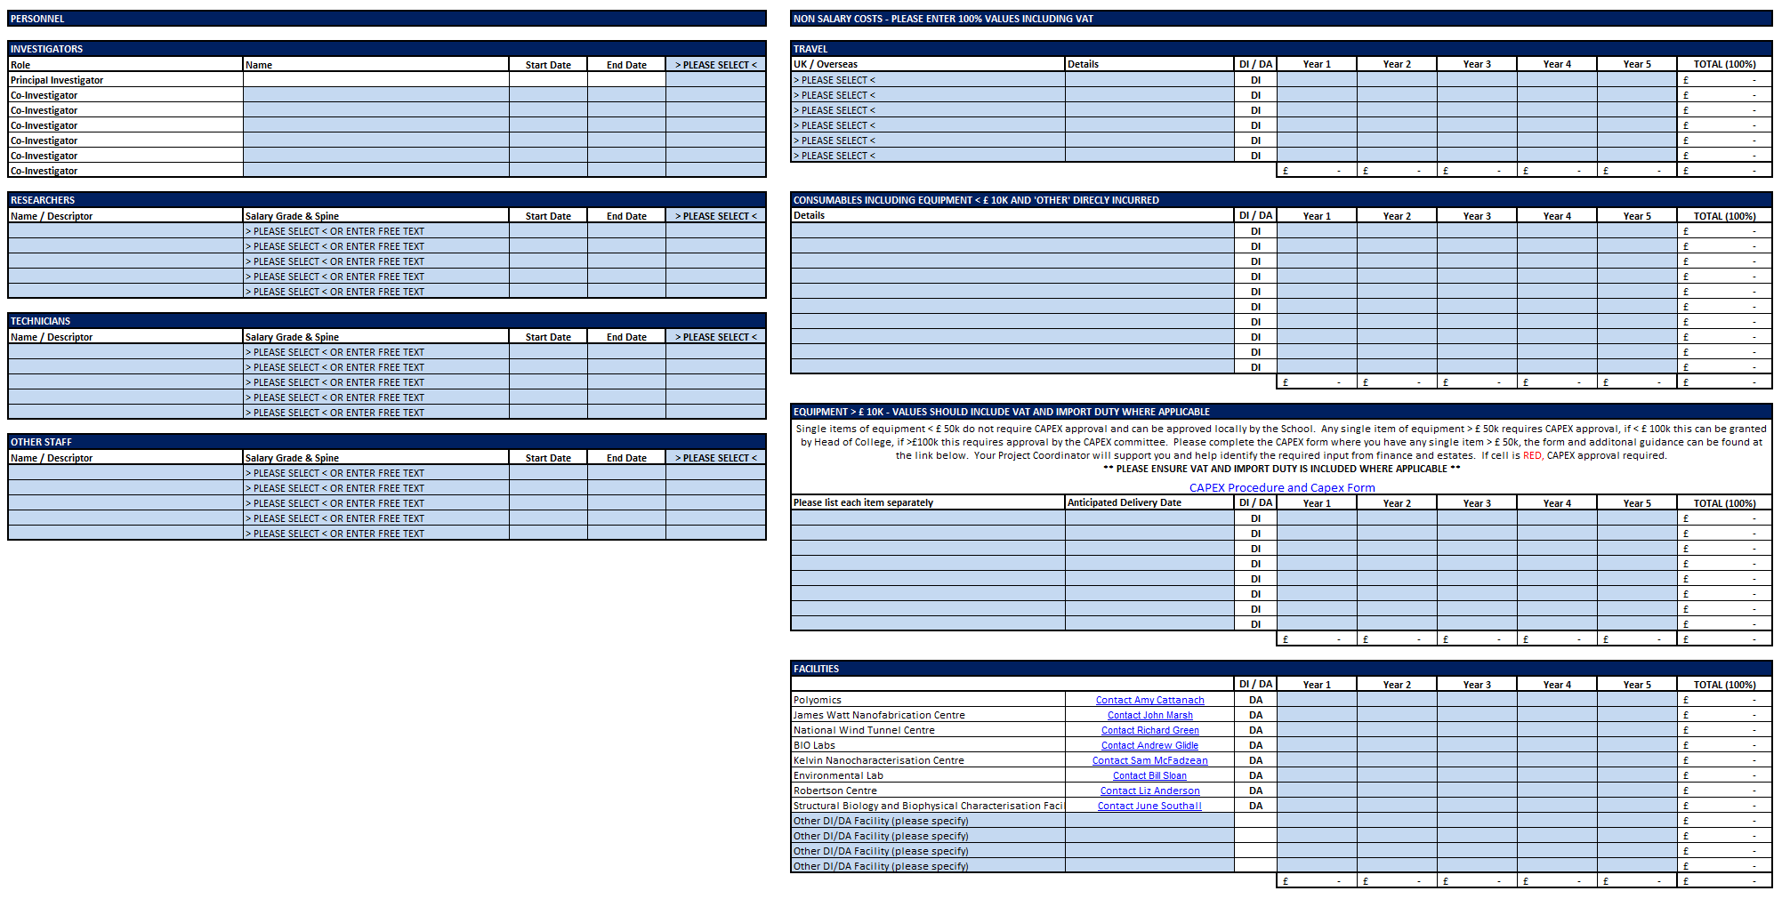
Costing Request Form £££££

Slide 8
What you can do for your PC and BDM
Communicate – early, often, be responsive to queries, ask questions and don’t just assume. We are always one TEAMs call away!
Read, understand and comply with the scheme guidelines
Complete the costing request form as fully developed as possible incl. research partners details.
Flag anything you think might be a risk or is unusual in any way – does your research rely on your going to a war zone, or are there living things involved, export etc.
Provide early drafts of your JoR in an editable format
Stay up to date on guidance and best practices for example Trusted Research training, Procurement rules etc.

Slide 9
What your PC will do for you
Log your project on the Research System (ARCP), generate a reference number and provide a draft summary.
Ensure your application complys with the funder terms and conditions
Advise on school /college policies e.g PI / Tech recoups, Facilities, Export etc
Work with you to produce a final budget and assist input it on the application form – e.g on the JeS/ TFS we will do the staff and all finance sections.
Ensure the internal authorization of the budget for your project
Check and comment on your Justification of Resources
Check other attachments comply
Advise on the CapEx process if required

Slide 10
Award set up
After confirmation of funding , the PI should forward this correspondence to their PC. The PC will monitor the funder portal for Award letter etc. Once received, your PC will initiate the acceptance and award approval process.
Led by Project Coordinator
Review award letter (figures and conditions) and agree start date with
Formal award acceptance on funder system
Award workflow approval on ARCP
Finance set up and activation
Recruitment starts
Start certificate submission
Final finance Report and award closure
Review award letter (figures and conditions) and agree start date with PI
The process varies depending on funder and scheme
The award set up process will usually involve PC, PI, Finance and HR (in some cases contracts)
Once award is active, PI will receive automatically generated financial reports monthly. Any questions regarding expenditure can be sent to Project Coordinator
Project reporting (regarding deliverables etc) is a responsibility of the PI

Slide 11
Post Award Support
Recruitment/HR
Liaise with RSA regarding the recruitment to progress externally funded posts on research projects, both directly and advertised appointments
Processing of managers requests to amend contracts and staff that are paid via externally funded research grants
Work with Schools and local HR to ensure monthly tenure reports are completed and contracts are amended before payroll deadlines
Reporting and Financial Management
Monitoring post award expenditure against budget and providing advice on project and financial queries
Ensuring expenditure is eligible as determined by funder terms and conditions
Financial reporting on spend to funders on a quarterly/annual and also review and submission of final expenditure statements
Liaising with University Services
Liaising with Contracts Office to ensure Collaboration agreements are prepared and fully executed when required where a grant has an external partner
Working with Central Research Support Team to resolve any issues relating to award documentation, invoicing & Income, and to support funder audits.
Point of contact for other University services including, Local Finance, Central Finance (including Payroll & Accounts Payable), Research Assurance Office & Agresso Support Team

Slide 12
Some useful jargon definitions…
PC | Project Coordinator
RSA | Research Support Assistant
BDM | Business Development Manager
ARCP | Glasgow's internal research costing system
CRF | Costing request form. Should be completed for all applications. Used by PC to draft all costings.
Workflow | Process to receive full institutional approval
FEC | Full Economic Cost. Costing and pricing methodology derived from TRAC. Cost of all resources needed to undertake all activies associated with project, irrespective of what funder will pay. Internally referred to as UofG FEC, which is higher than funder FEC (internally referred to as FAC) as it includes inflation. Amount PI will have to spend.
FAC | Funder Accepted Costing (Funder FEC). As above, less inflation. Funder may apply their own inflation at award.
Price | The value the funder will actually cover (i.e. UKRI = 80% FAC). Income to University.
JoR | Justification of Resources
DI | Directly incurred costs, arise from conduct of project. Items with an audit trail, directly charged as cash value actually spent.
DA | Directly allocated costs - cost of shared resources e.g. core staff time, estates, DA consumables
Indirects | Non-specific costs charged across all projects based on estimates that are not already included under DA, eg. Library, HR.
Overheads | Estates, Technical Infrastructure, Indirects.
CAPEX | Procedure that must be followed for equipment >£50K

