Slide 1
04
Dec
2024
University of Glasgow User Training
Professional
Services

Slide 2
Agenda
Introduction to Amazon Business
Registration Process
How to Purchase at Amazon Business & Punchout Purchasing
Business Customer Service
Q&A
Professional
Services

Slide 3
Why Amazon Business ?
Services professionnels

Slide 4
Product
Variety
Good
Prices
Purchase
Comfort
>100 m. Products with Business Billing
the largest business selection worldwide
Business Prices
Special prices for corporate customers
Fast Delivery
within 1-2 days
Simple shopping experience integrated with business tools
Reconciliation is facilitated with accounting department
Volume Discounts
Corporate customers get discounts with increasing order volume
Marketplace
Products from suppliers around the world
Consolidated VAT calculation for business customers
Business Customer Service
At your disposal via real-time chat / telephone / e-mail in a few seconds
Professional
Services

Slide 5
Registration Process
Professional
Services

Slide 6
There are 3 different registration scenarios …depending on how a user has used his work e-mail address in the past
1
2
3
user had no amazon account before
user had a an amazon consumer account before
user had an amazon business account before
start purchasing immediately
option 2a:
merge account to business
option 2b:
keep account & move to private e-mail
if admin:
accept consolidation request
if requisitioner:
user will be merged automatically to central business account
Professional
Services

Slide 7
1 | user had no Amazon account before with the work email address
punchout from eProc system
start
purchasing
1
2
3
Professional
Services

Slide 8
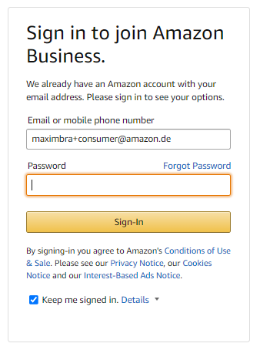
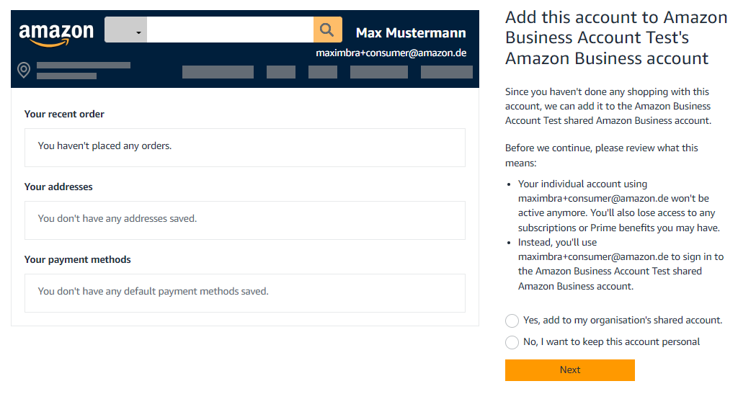
2 | user with amazon consumer account
punchout from eProc system
2a
2b
enter password for existing consumer account or click ‘forgot password’
If you want to merge your previous amazon account to central business account select ‘yes’ (2a) or select ‘no’ (2b) if you want to move your previous account to a private e-mail-address
1
2
3
Professional
Services

Slide 9
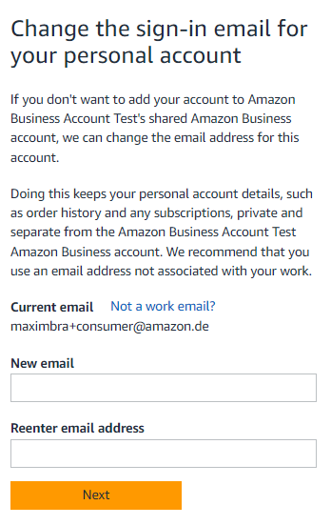
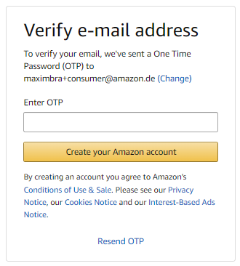
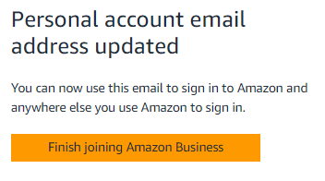
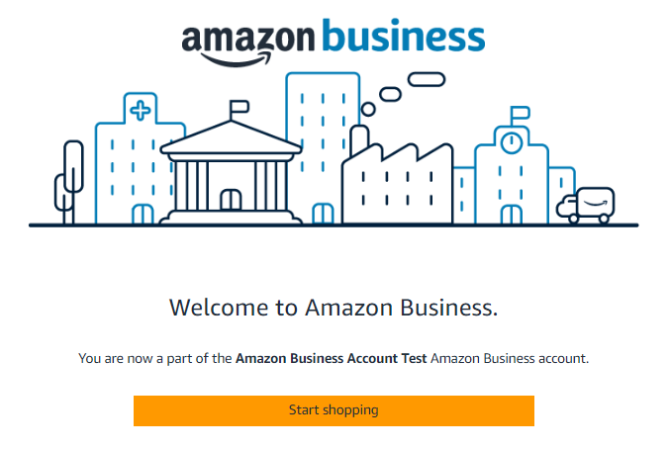
2 | user with amazon consumer account
2a
2b
consumer account was moved successfully
to private
e-mail-address
enter code sent to
new e-mail-address
enter new e-mail-address
for consumer account
1
2
3
Professional
Services

Slide 10
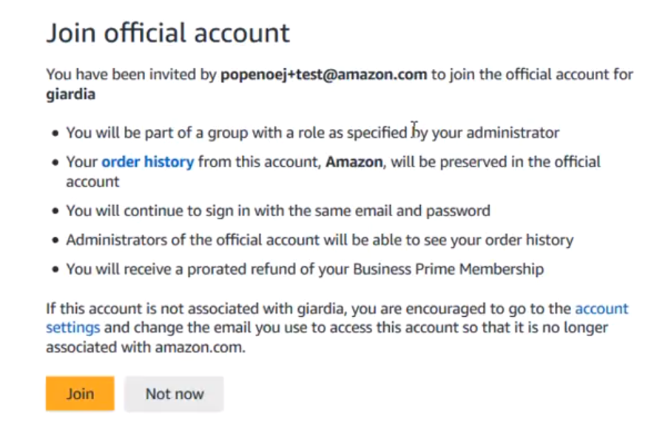
3 | user with amazon business account
admin@workemail.com
click button / link from invitation e-mail
with consolidation invitation
fulfill requirements & accept request
admin of central account will receive a notification and can assign the users
1
2
3
Professional
Services

Slide 11
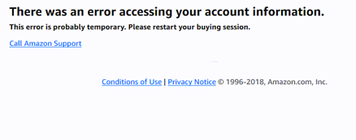
Error messages during a Punchout session
user’s e-mail address is connected to another business account
→ reach out to the Amazon Business admin and ask him to remove the user / deregister the account
user tries to place an order outside punchout environment
→ go to eProc system and start a punchout
application error
→ user might require support by your Ariba admin or AB customer service outside
Professional
Services

Slide 12
Purchasing at Amazon Business
Professional
Services

Slide 13
Punchout Order Journey
How to purchase on Amazon Business with a punchout integration
Procurement System
Amazon Business Website
click on Amazon Business catalogue
and punchout
add items to the
shopping cart
complete checkout process and submit for approval
shopping cart passes approval workflows
order confirmation
will be issued
purchase order will be submitted automatically
invoice will be created and send automatically when the delivery was shipped
Professional
Services

Slide 14
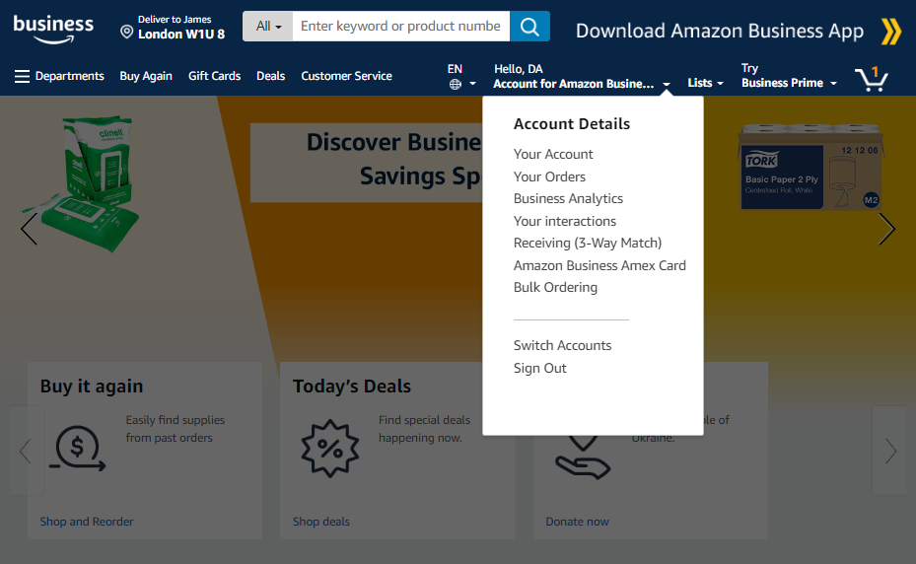
Account Navigation
Hover over your name and navigate through your account
Basic information on account (orders, addresses, payments etc.)
View & track own orders. Admins can view all orders.
Create & filter custom reports on orders.
View your open & resolved customer support cases.
Professional
Services

Slide 15
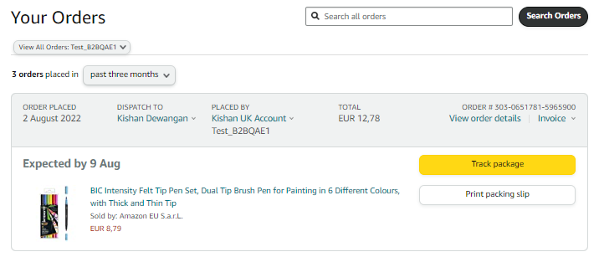
Your Orders – Overview & Tracking
… gives you an overview of all orders with filter & search options, order details and order status including tracking of the delivery.
Professional
Services

Slide 16
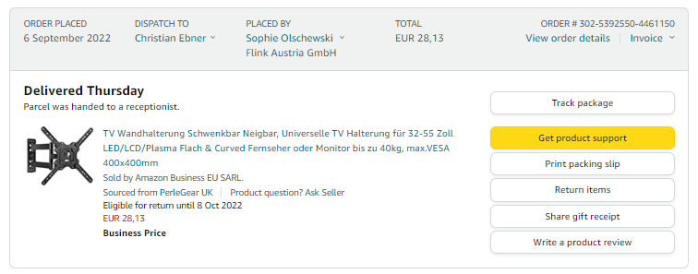
Your Orders - Returns
Items shipped and sold by Amazon can be returned within 30 days of receipt of shipment. Return policies, and timeframes, can vary if purchase was made from a 3rd party seller.
1 | Select item
2 | Choose a reason
3 | Print label
4 | Return parcel
303-6485155-645874
Andy Jassy
Andy Jassy
Test GmbH
Professional
Services

Slide 17
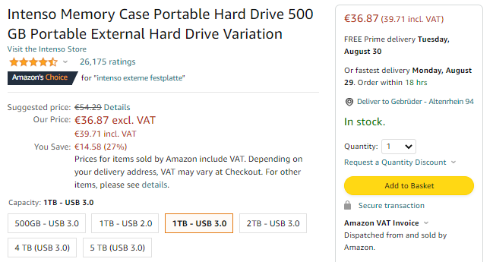
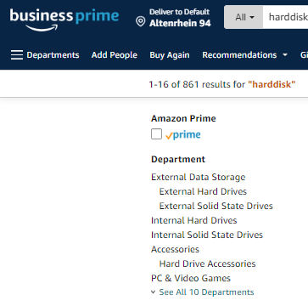
Shipping Benefits
Free delivery
Fast delivery
Always shipped by Amazon
Product guidance
Search results can be filtered based one Business Prime eligibility
Depending on the Business Prime plan, items might be highlighted for buyer’s guidance
preferred
restricted
blocked
Professional
Services

Slide 18
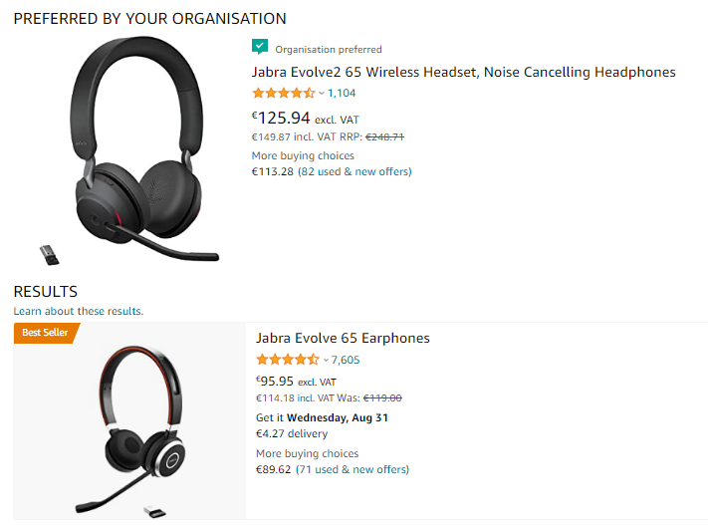
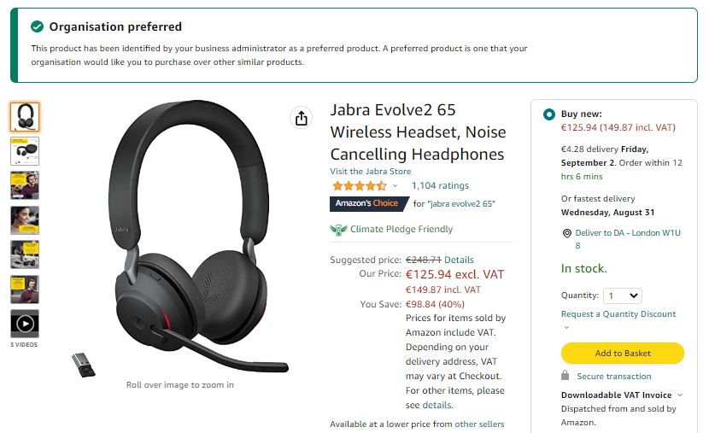
Preferred Items
… marked by your administrator to purchase these items preferred to others.
Professional
Services

Slide 19
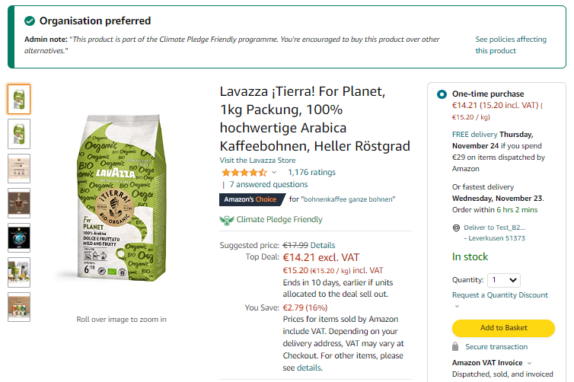
Preferred Items – Climate Pledge Friendly
… marked by your administrator to purchase these items preferred to others.
Professional
Services

Slide 20
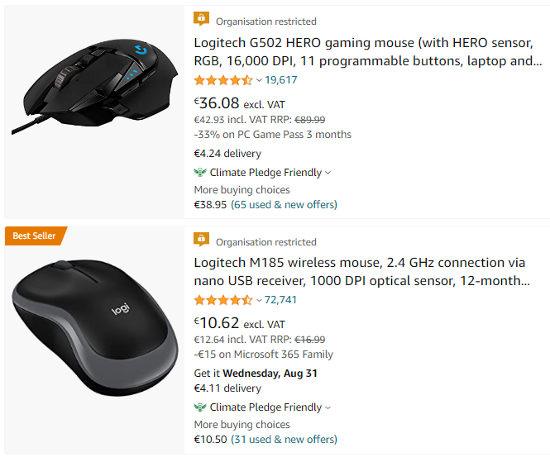
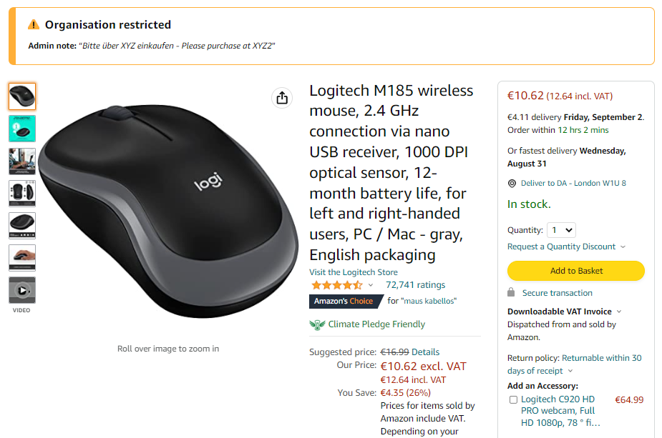
Restricted Items
… marked by your administrator to remark to purchase these items only in
special / exceptional cases. Restricted items may require additional approval.
Professional
Services

Slide 21
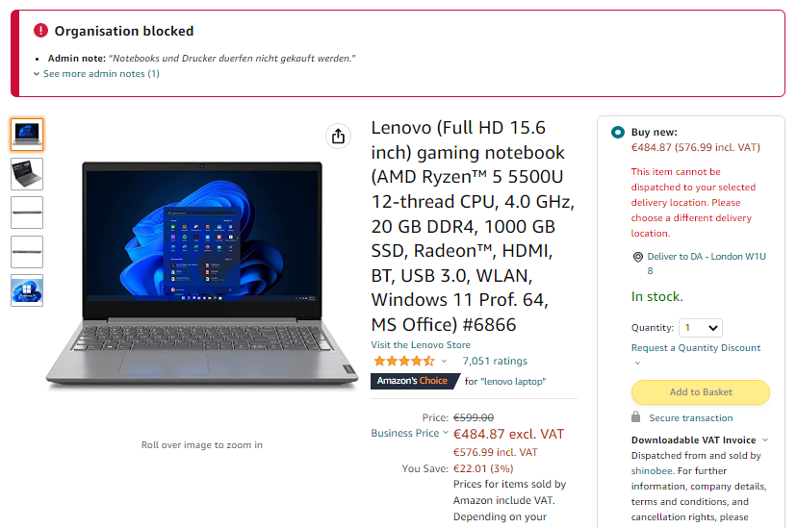
Blocked Items
… marked by your administrator to prohibit purchasing these items.
Blocked items can’t be added to the basket.
Professional
Services

Slide 22
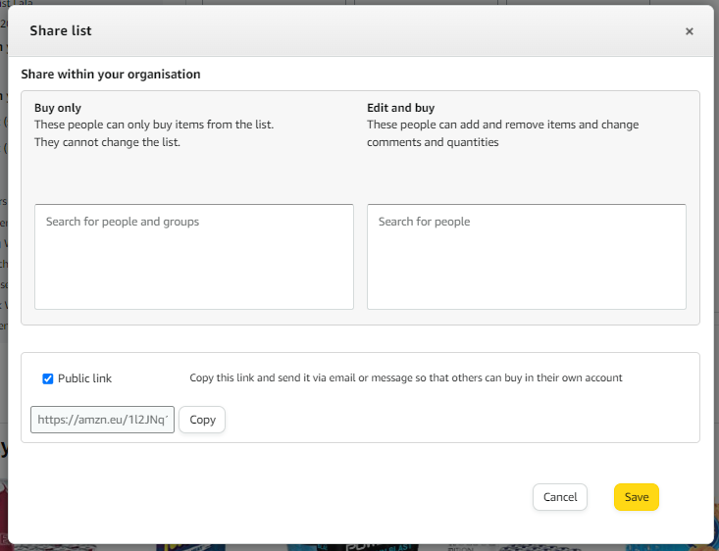
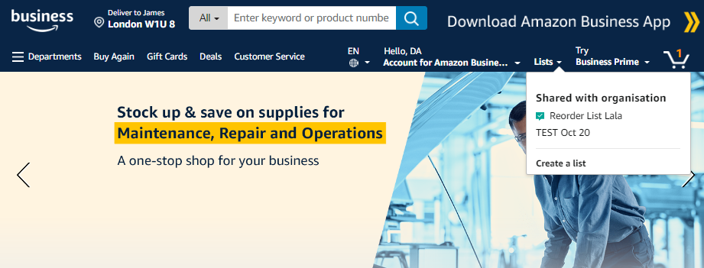
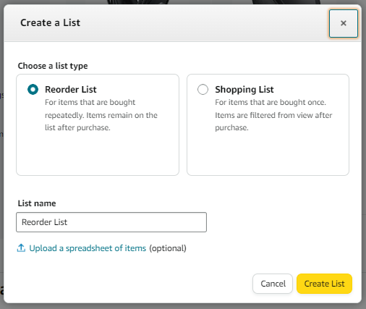
Reorder lists
… for frequently purchased items
4
1
2
Benefits of Reorder lists
Put several products with a predefined quantity in just 1 click into the product basket
create item or use case related lists
Share lists with single colleagues or the whole organization
3
Professional
Services

Slide 23
FAQs & Business Customer Service
Professional
Services

Slide 24
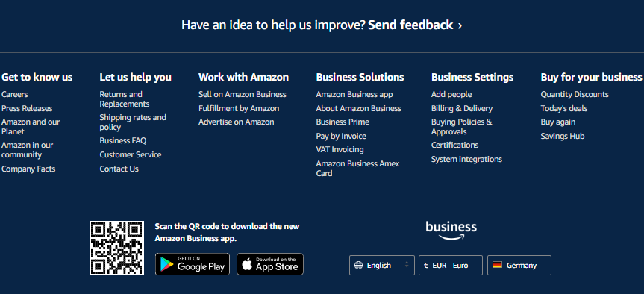
FAQs
… will help you with a quick self-service support if you have questions regarding the usage of AB.
Professional
Services

Slide 25
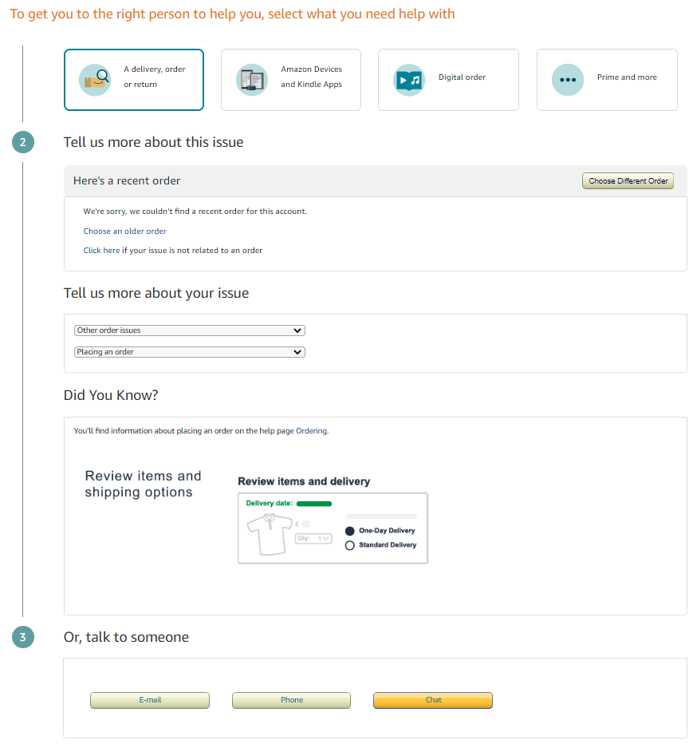
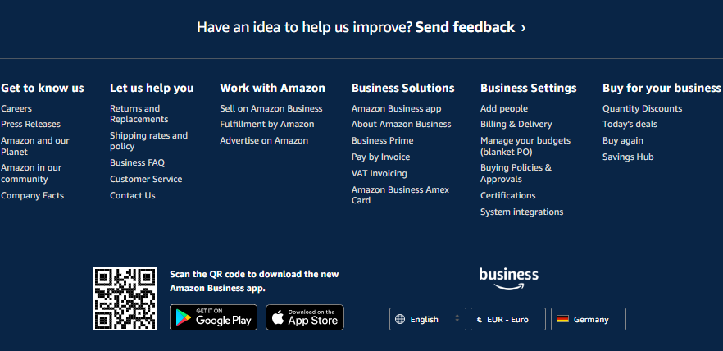
Business Customer Service Reach out to our dedicated customer service for business customers via Live-Chat, immediate Recall or E-Mail
Potential issues to clarify:
Delivery problems
Payment / invoicing issues
Warranty-related topics
Change / cancel / return an order
…
Professional
Services

Slide 26
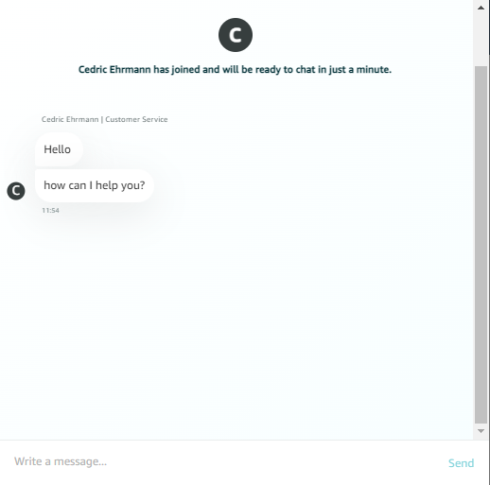
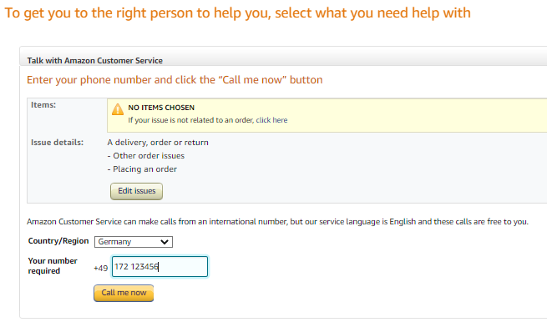
Business Customer Service
Live-Chat
Immediate Recall
Professional
Services

Slide 27
Training Videos
… a portfolio tailored for building the capabilities customers need to create a successful, data-driven procurement program
Click Here
Professional
Services

Slide 28
Q&A
Professional
Services

Slide 29
Thank You!
Professional
Services

