Slide 1


Large scale data donation on WhatsApp
Kiran Garimella
Rutgers University
Joint work with Simon Chauchard, UC3M
Notes:
Talk about data collection more. Less about research.

Slide 2
WhatsApp
The biggest end to end encrypted social network
Over 2 billion monthly active users
500 million Indians are on WhatsApp
100% of Brazil internet population is on WhatsApp.
29% of US population is on WhatsApp (more than Twitter).
Not much focus due to difficulty of access
We have no idea how bad things are on WhatsApp!
Notes:
Truly global super app

Slide 3
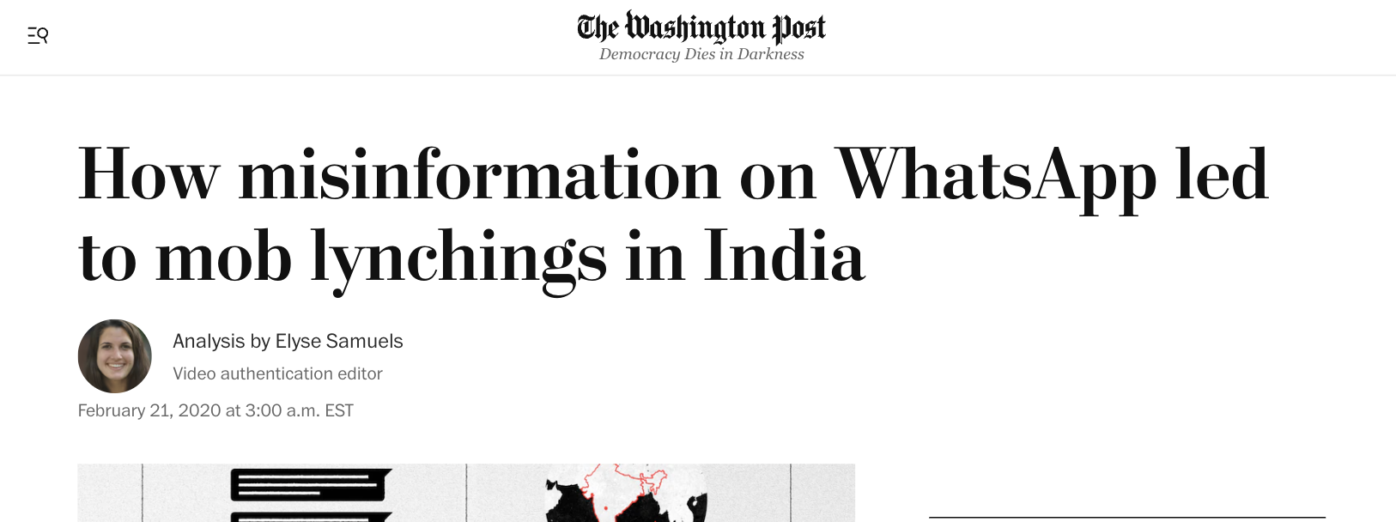
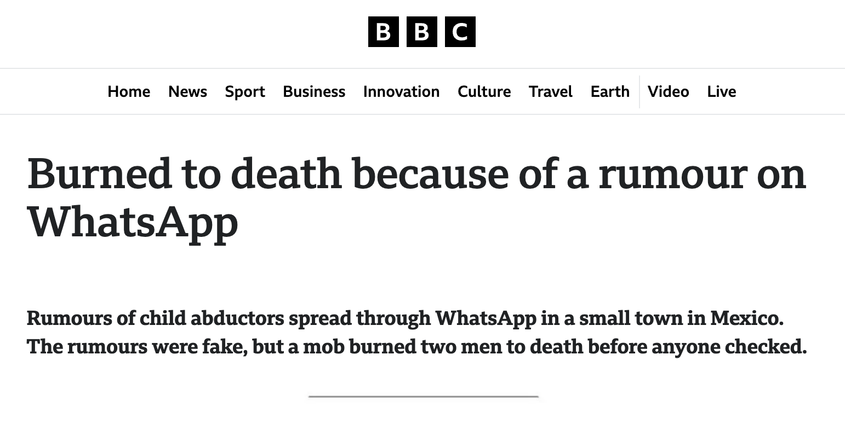
Misinformation on WhatsApp
Important offline consequences.
  Dozens killed due to misinformation.
Political trolling and propaganda.

Slide 4
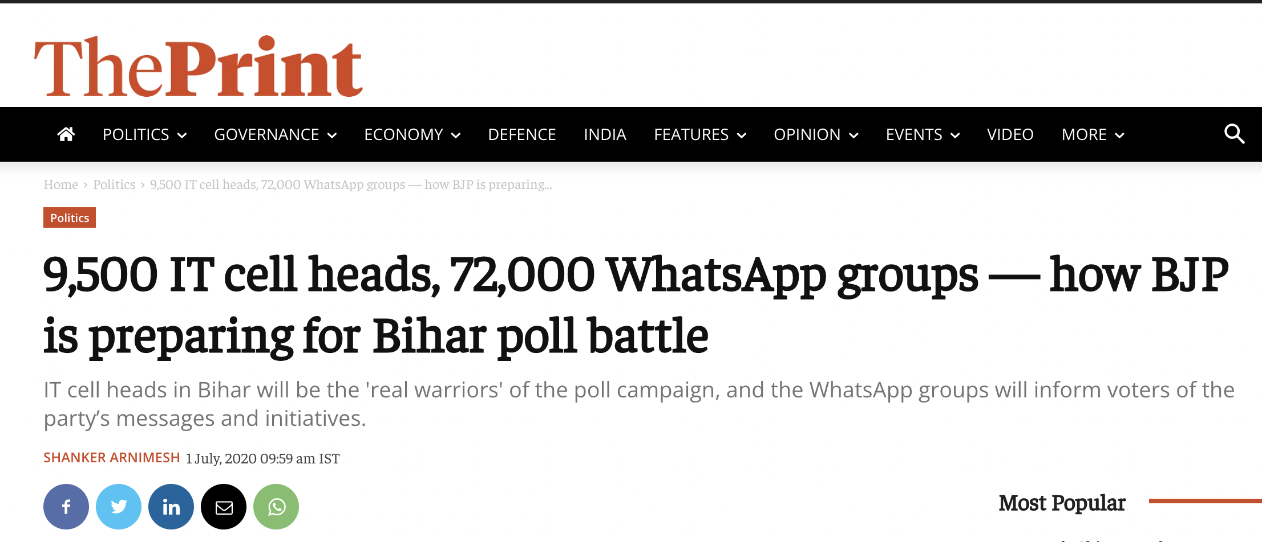
Political Misinformation on WhatsApp

Slide 5
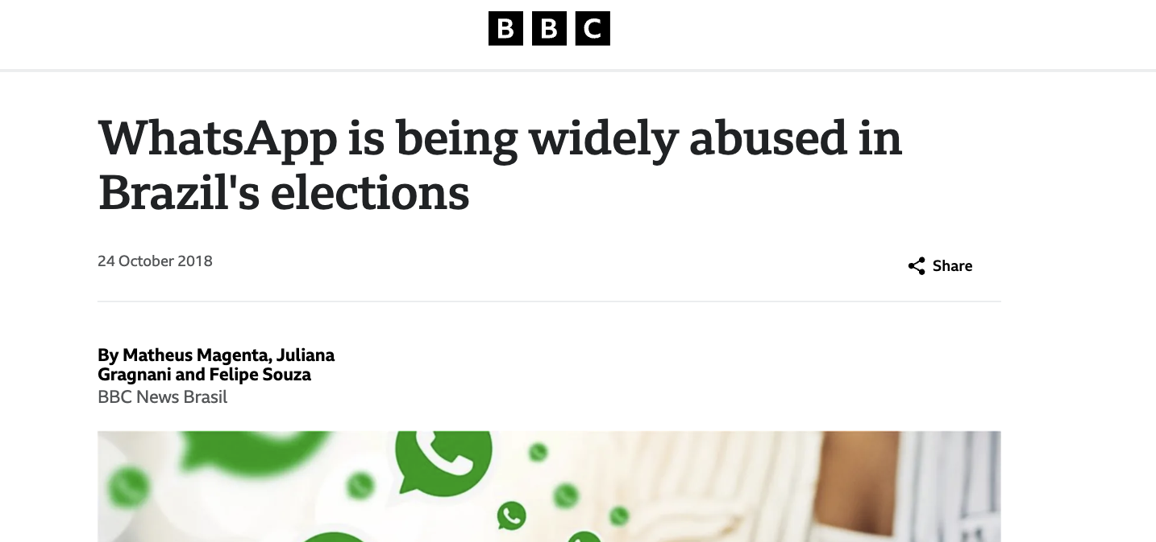
Political Misinformation on WhatsApp

Slide 6
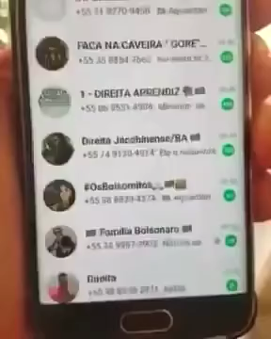
Political Misinformation on WhatsApp

Slide 7
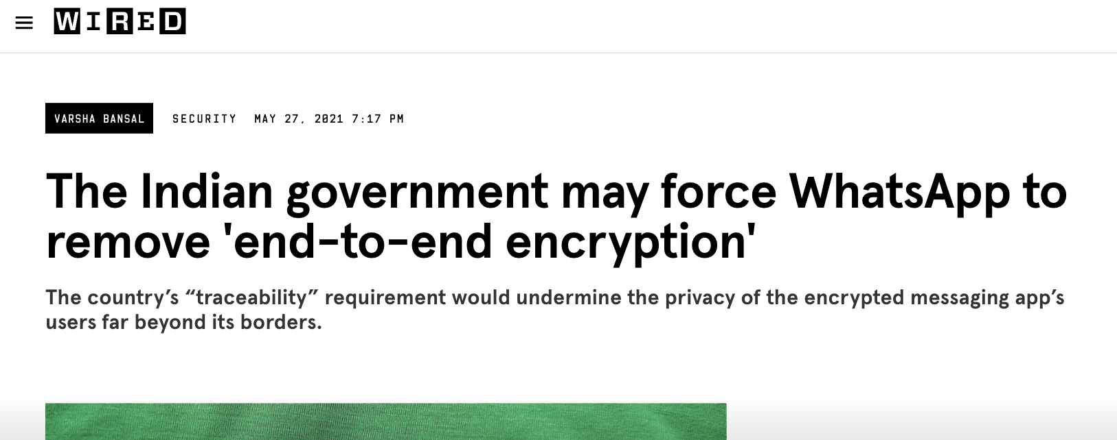
What can be done?
WhatsApp: We can’t do much due to encryption.
Governments: Break encryption to enable moderation.

Slide 8
Gap: Evidence based discussion
Is misinformation a problem on WhatsApp?
What is the prevalence of misinformation on WhatsApp?
What can be done to prevent misinformation?
… etc.
Notes:
2-3 examples
Rumors, politics, hate speech
No moderation

Slide 9
Data collection on WhatsApp
Data collection is hard. Even the platform does not have the data.
  No API.
  Private data.
  End to end encryption.
Data donation.

Slide 10
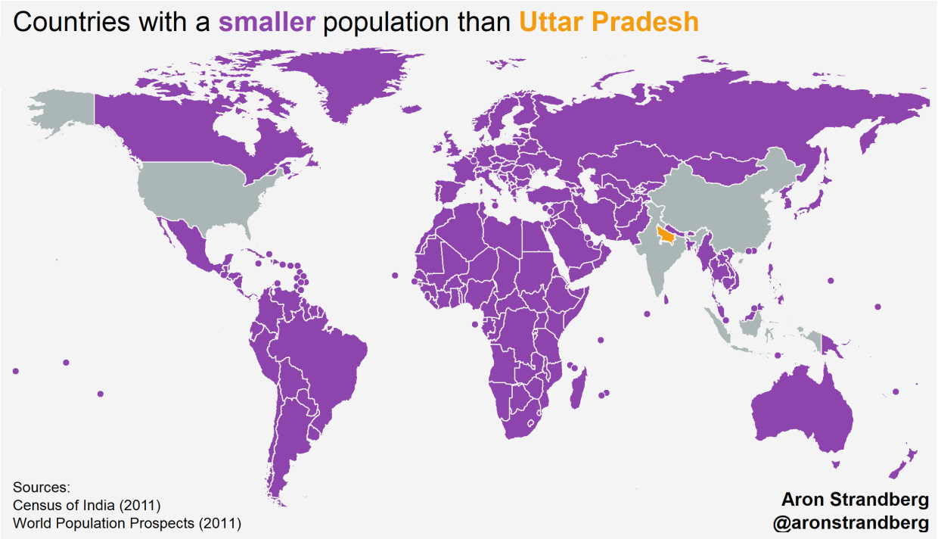
Data donation model
Privacy preserving, opt-in model for data collection.
Users give us access to their WhatsApp groups.
On ground survey in various parts of India and Brazil.

Slide 11
WhatsApp Explorer
A tool to collect private WhatsApp data in a legal, ethical and practical way
A clone of Web WhatsApp where users have the choice to donate data
https://whatsapp.whats-viral.me/ (available for public access for now!)
Notes:
Technical: need to devise practical, rapid, reliable data donation strategy. Which works on mobile
Ethics approval/GDPR compliance. Several thorny issues

Slide 12
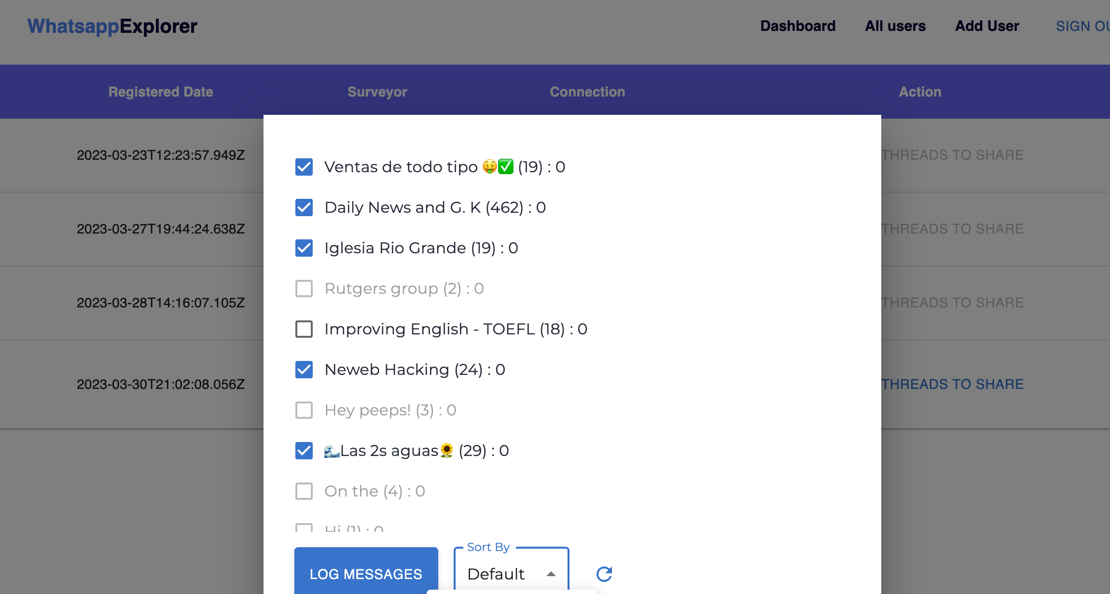
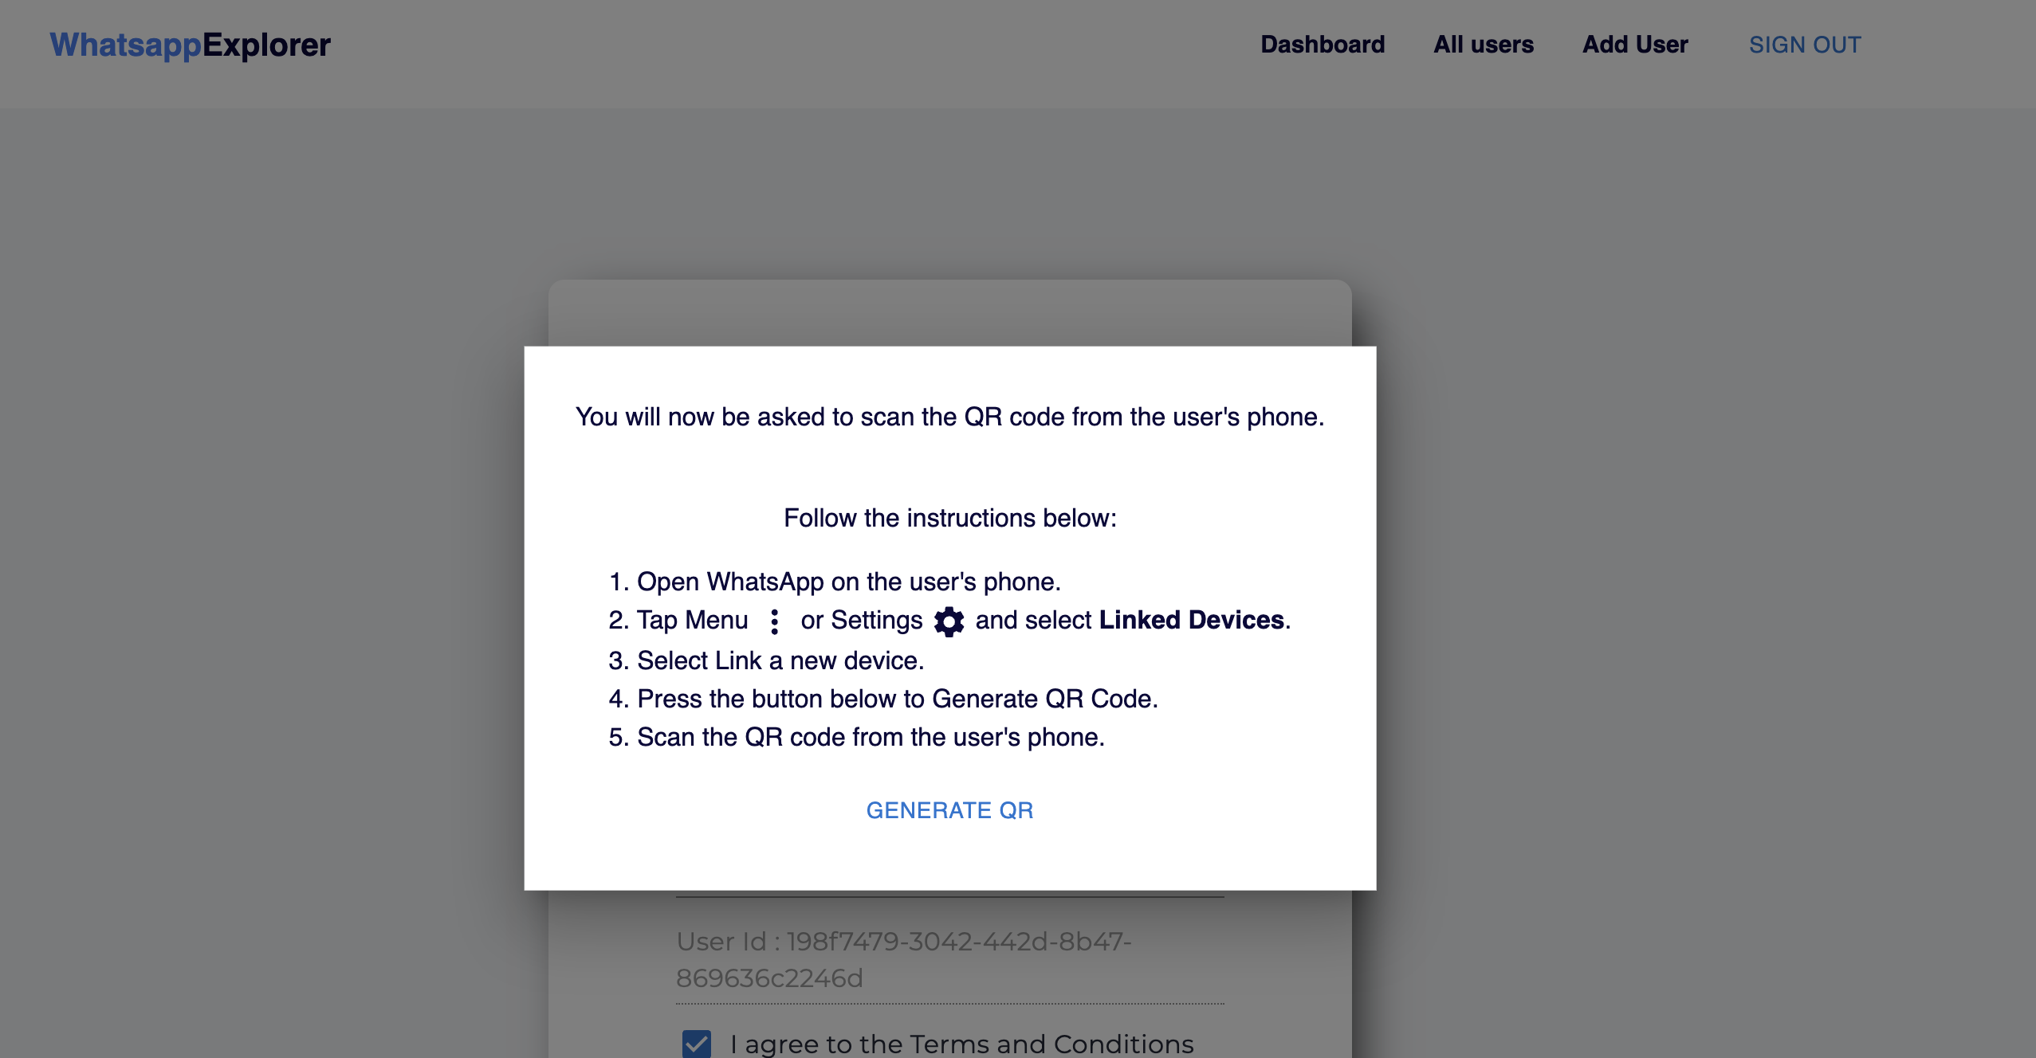
WhatsApp Explorer steps
Say you consent after we thoroughly explain and detail incentives:
  We generate a QR code that we ask you to scan from within WhatsApp (as for linking your computer).
  You see a screen with a subset of your WhatsApp groups.
We concentrate on groups >= 5 members, and with sufficient activity. Importantly, you are able to exclude groups.

Slide 13
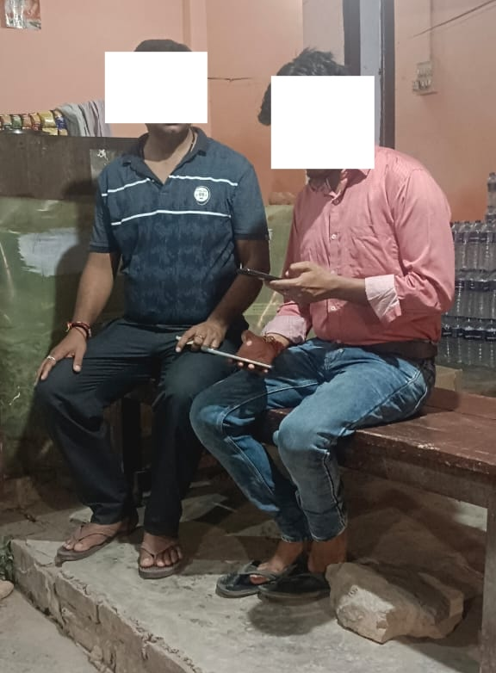
WhatsApp Explorer steps
3. Log the following data:
  Previous 2 months of data on each of the groups.
  Next two months of data (or until you choose to kick us out).
  Network (contacts, chat list).
  Anonymization starts immediately.
4. You respond to 3-4 questions about each of groups we have and do not have.
5. You receive money ($10).

Slide 14
Ethics concerns
Not everyone provides consent in a group.
Our solution: Only analyze viral content.
  Content ‘forwarded many times’, potentially seen by many users.
Anonymization before any content is stored on our servers.
Notes:
The objective of this was to get a truly random sample of whatsapp users and show prevalence etc.

Slide 15
Sampling issues
Tried random sampling.
  Not many people use WhatsApp, actively.
Sample through influencers.
  Identify popular users in a village.
  Sample quotas through them.
  Quotas for age, gender, caste and religion, etc.
Notes:
The objective of this was to get a truly random sample of whatsapp users and show prevalence etc.

Slide 16
Data donation model
Important: generalizability of this model.
  Data collected in US, Sierra Leone, Colombia, and Indonesia.
This could potentially ‘solve’ the problem of data collection on WhatsApp.

Slide 17
Sample details
 | India | Brazil | Colombia | Indonesia | Sierra Leone | US
Users | 3,547 | 201 | 65 | 78 | 1,823 | 135
Groups | 8,655 | 792 | 633 | 902 | 5,201 | 568
Messages | 5.5 million | 1.6 million | 589k | 1.3 million | 2.8 million | 700k
Notes:
Talk about what these groups are!!!

Slide 18
India sample details
Link to the India sample
 | India
Users | 3,547
Groups | 8,655
Messages | ~5.5 million
Notes:
Talk about what these groups are!!!

Slide 19
Number of groups donated

Slide 20
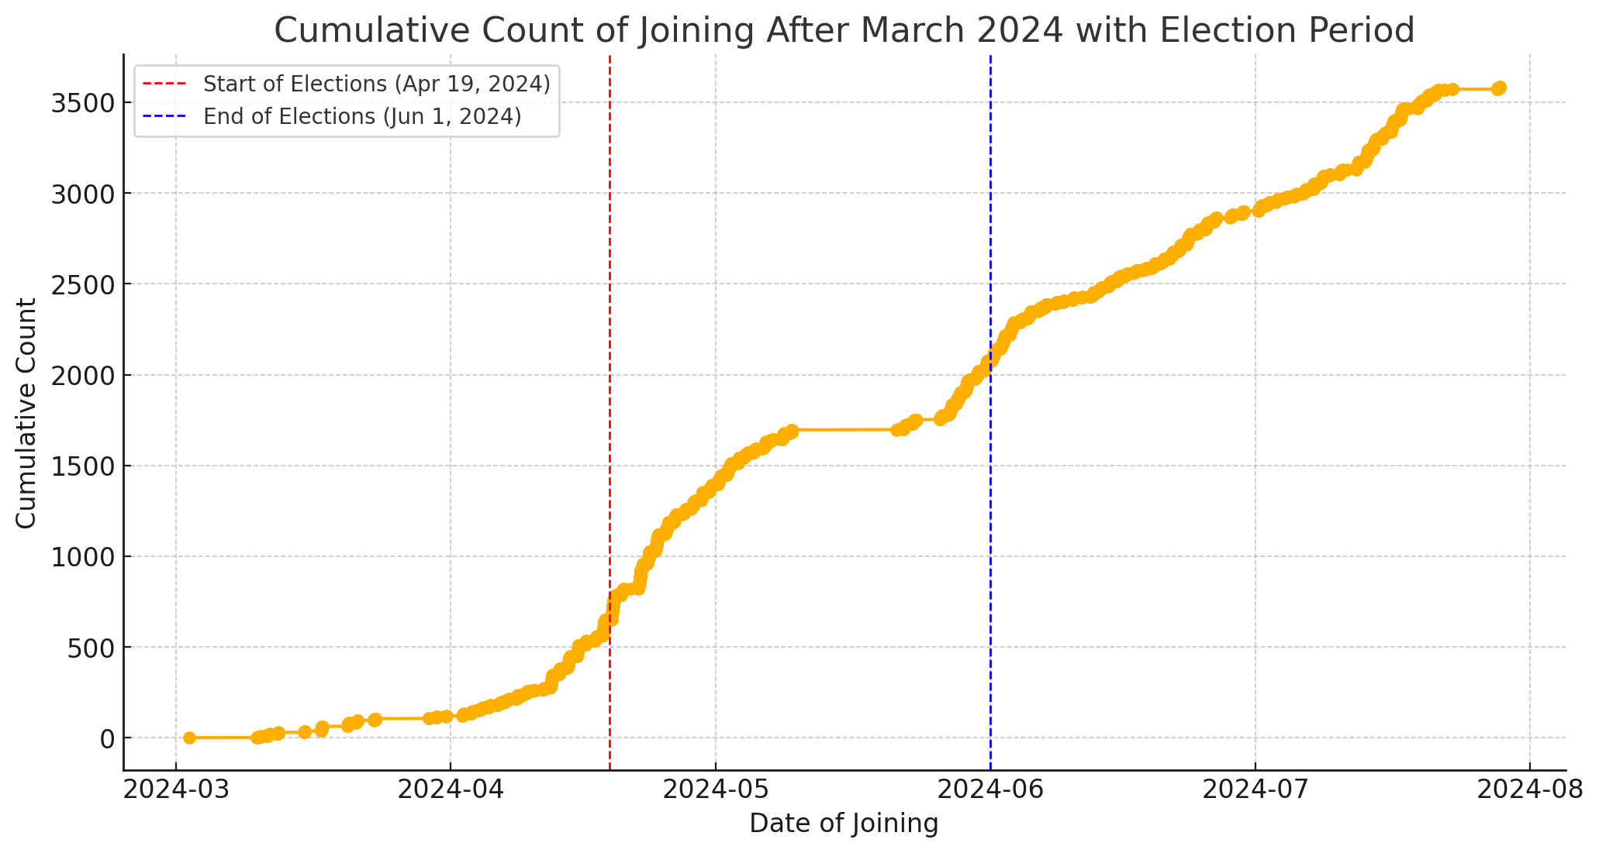
Cumulative users over time

Slide 21
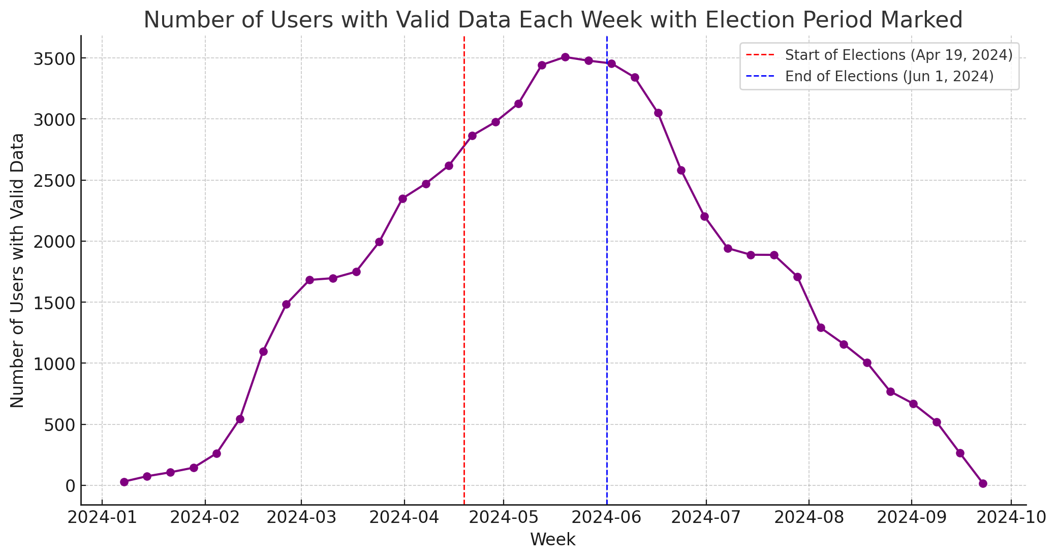
Users with valid data

Slide 22
Coverage: Age

Slide 23
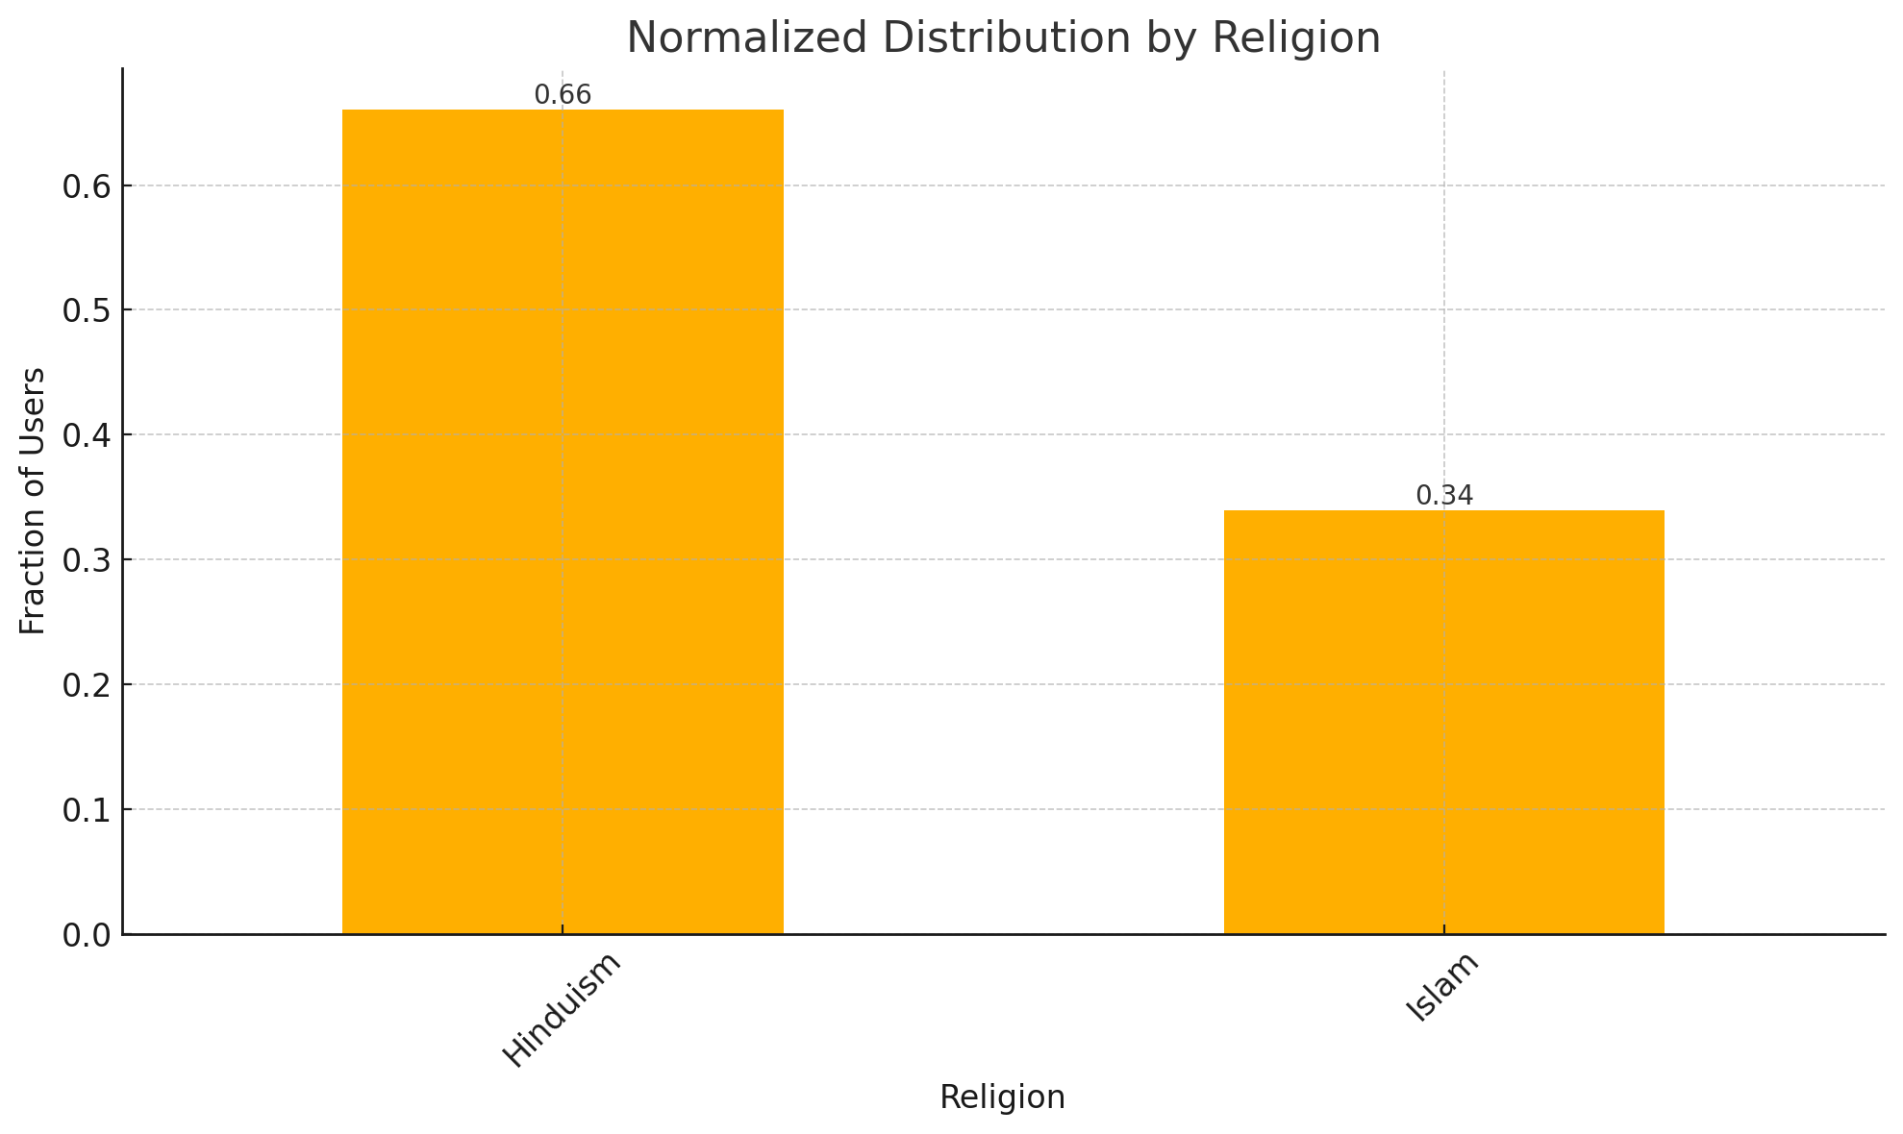
Coverage: Religion

Slide 24
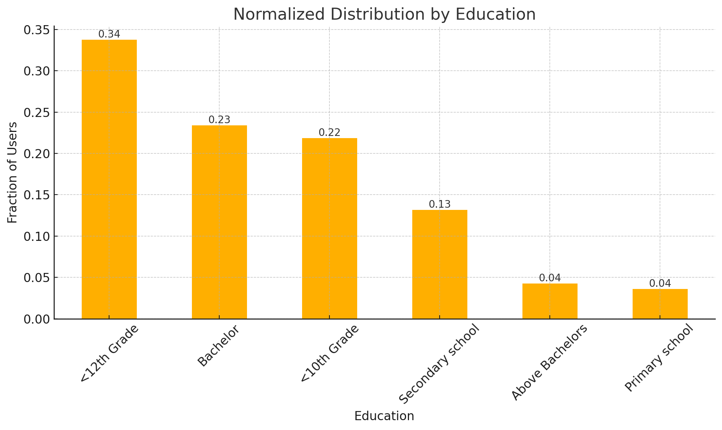
Coverage: Education

Slide 25
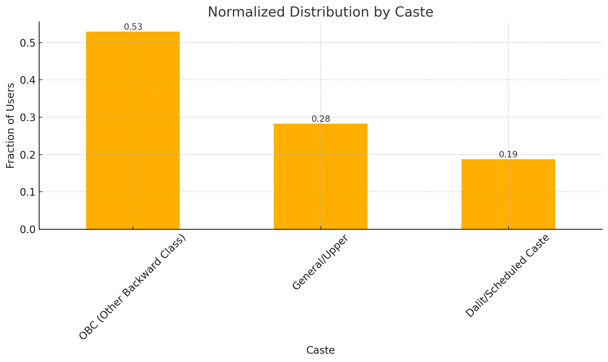
Coverage: Caste

Slide 26
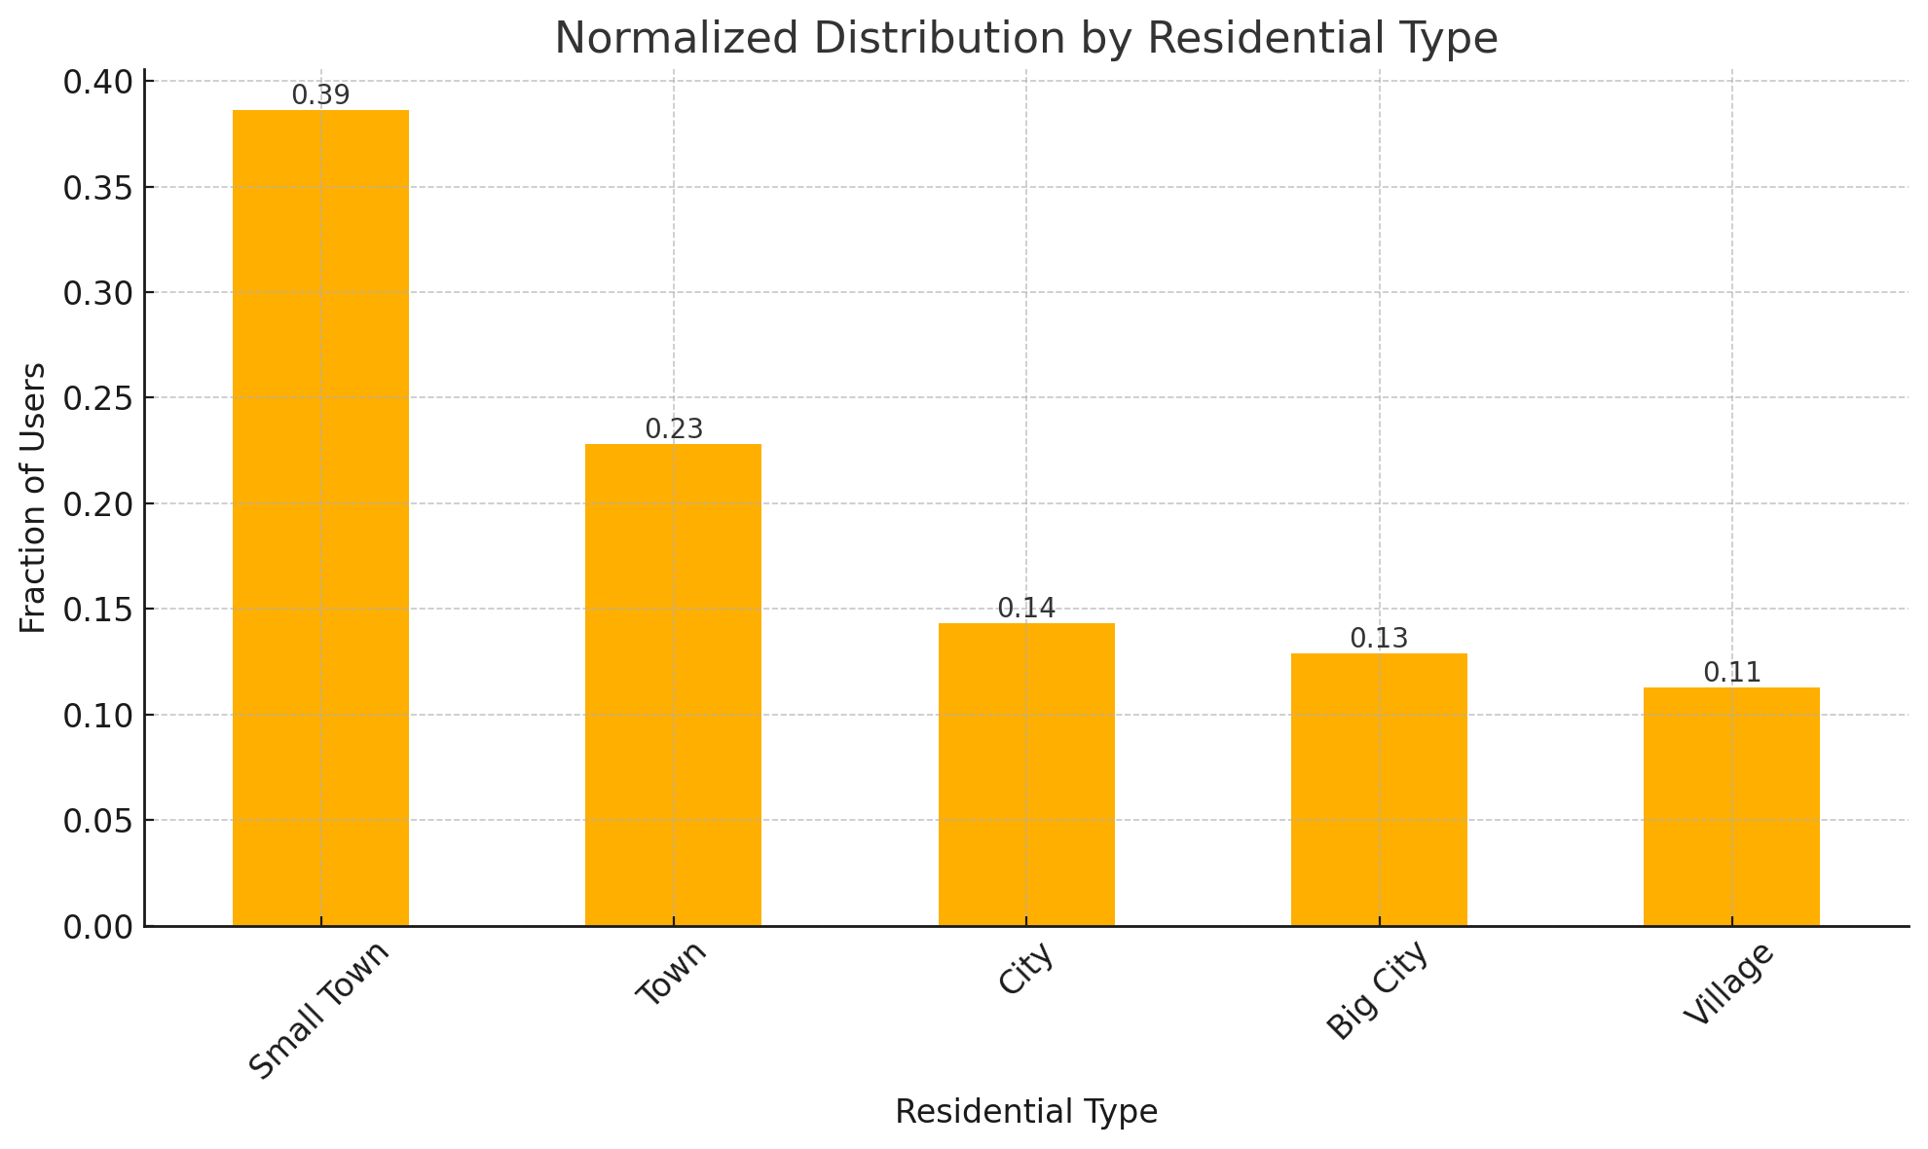
Coverage: Residential type

Slide 27
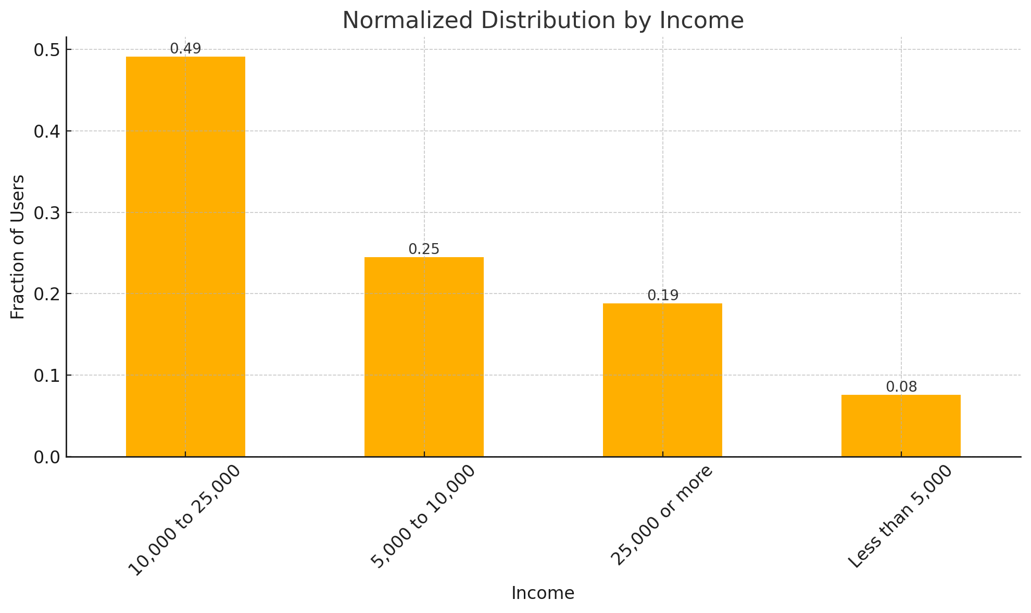
Coverage: Income

Slide 28
Types of content
Around 50% is non textual!

Slide 29
Virality of content

Slide 30
Results: Prevalence of Misinformation, etc.
Analysis on the full data is on going.
I’ll show you some results on older pilot data (Sept/Oct 2023).

Slide 31
Related work
Prevalence of misinformation
  Grinberg et al (2020), Gentzkow et al. (2018).
  Around 2 – 5% misinformation.
Prevalence of hate speech
  Meta (2023), Mathew et al. (2022).
  0.01% on Facebook, 2% on Gab.
Prevalence of political news/propaganda
  Allen et al. (2023).
  14% adults consume ‘news’.
Caveats

Slide 32
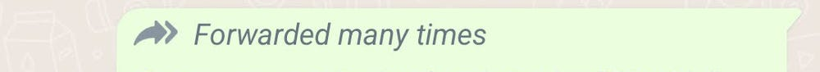
Misinformation annotation
Manually coded ~2,000 pieces of content.
Duration: September – October 2023.
“Viral” content (“Forwarded many times”)
~1% of the total content.
Trained fact checker coding the content.
Notes:
Brazil ongoing

Slide 33
Overall prevalence: Misinformation
22% of the viral content is misinformation!

Slide 34
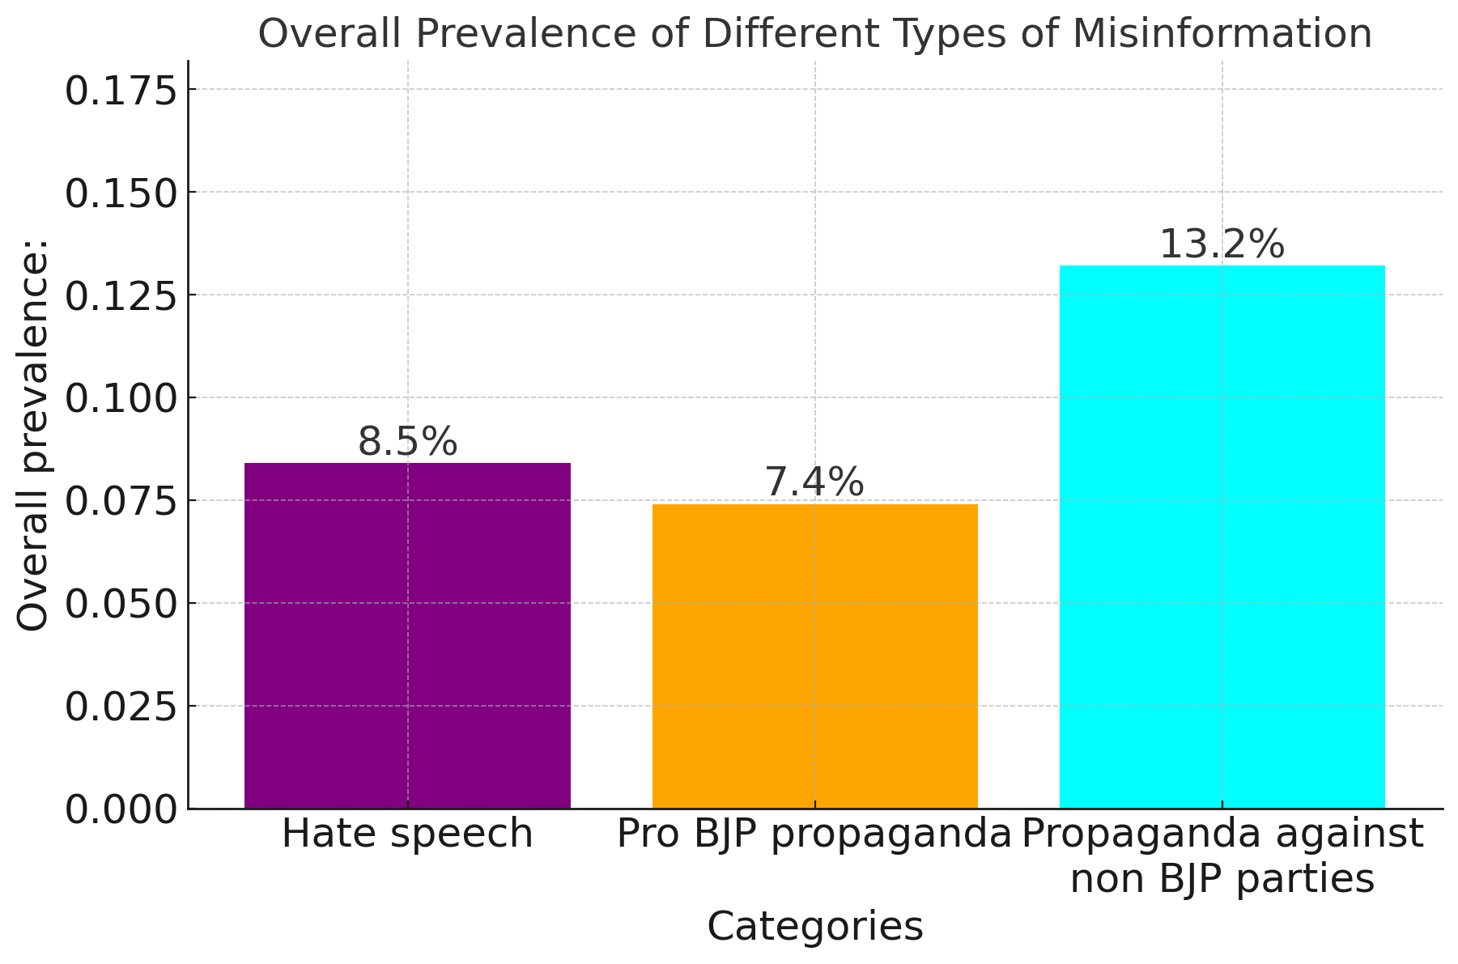
Overall prevalence: Hate speech and Propaganda

Slide 35
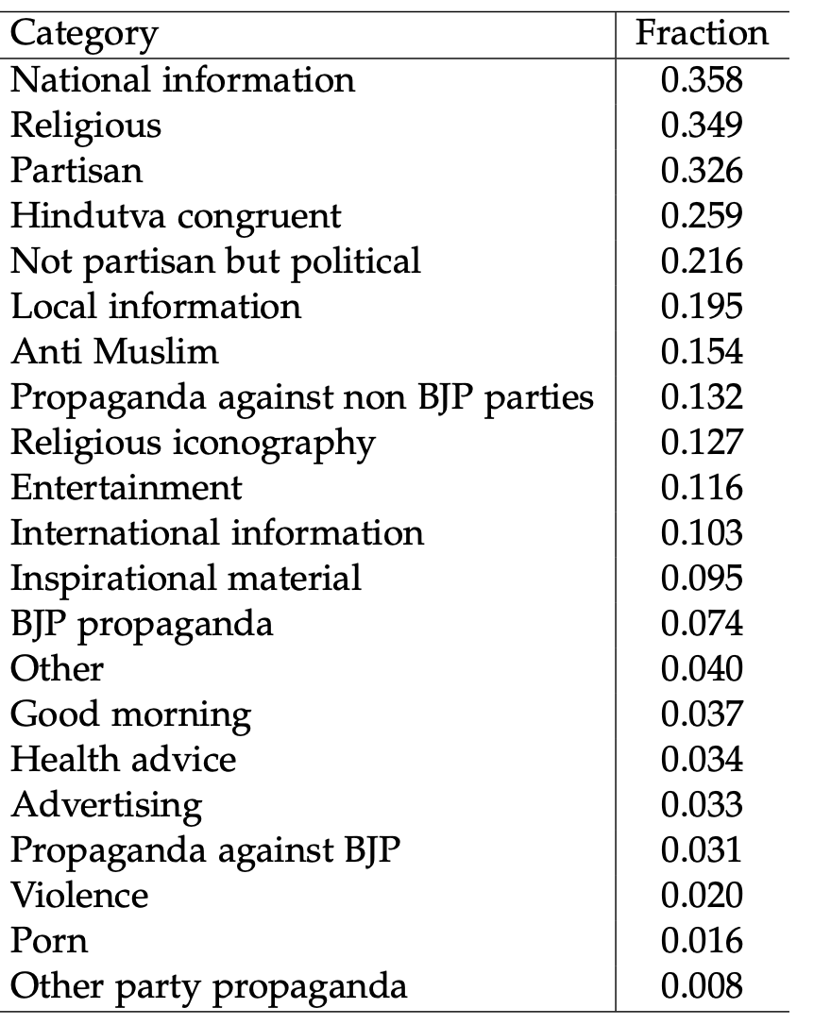
Overall prevalence

Slide 36
Prevalence of Misinformation, etc.
Overall, misinformation maybe rare but it is disproportionately viral.
Extremely high prevalence of hate speech and propaganda.
Organically viral.
Notes:
Not showing the content because of lack of context

Slide 37
Next steps
Large scale manual annotation
4 goals:
  All `viral` content shared during the election (~7,000 pieces of content)
  All content shared widely within our dataset (x,000 pieces of content)
  Random sample of groups (x0,000 pieces of content)
  Random sample of users (x0,000 pieces of content)

Slide 38
Next steps: Beyond description
Datasets for the community.
  Large, multi-modal, multi-lingual, conversational data.
  Annotated for a wide range of items.
Estimating the reach of misinformation.

Slide 39
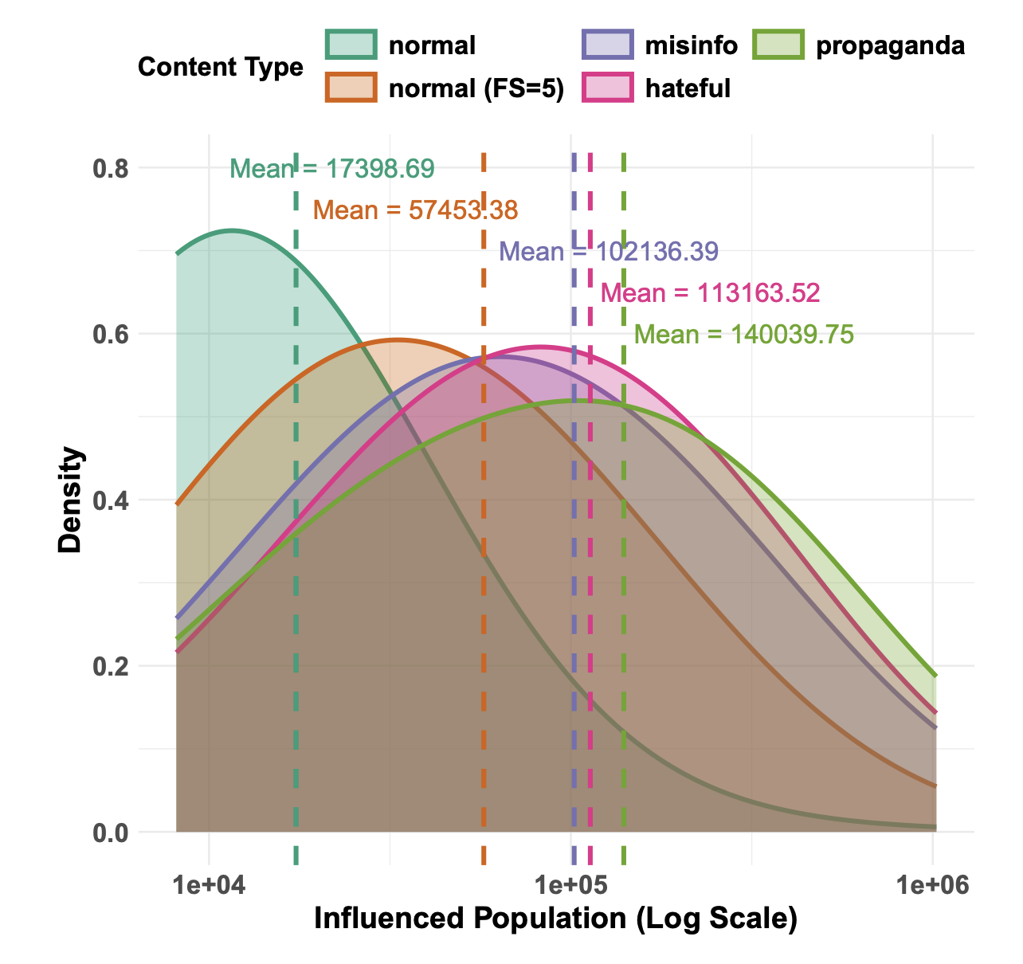
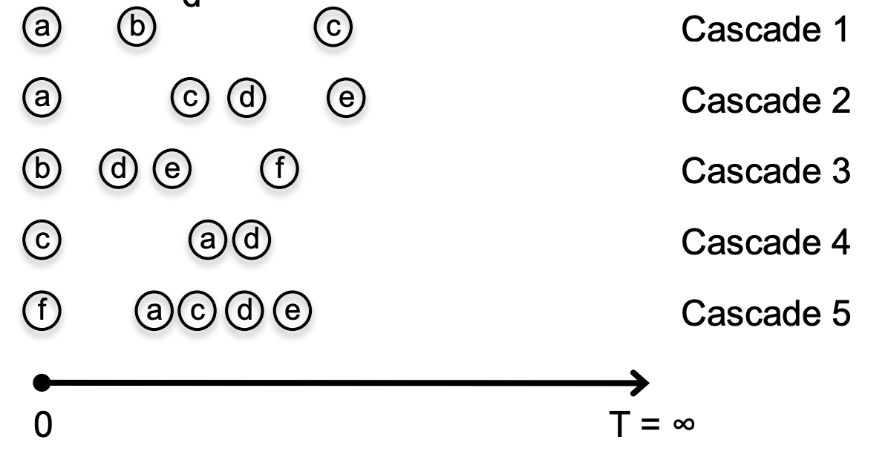
Next steps: Estimating reach of misinformation
We have the partial network and traces of content spread
We reconstructed the cascades
Estimated potential reach of various types of harmful content

Slide 40
Next steps: Beyond description
Datasets for the community.
  Large, multi-modal, multi-lingual, conversational data.
  Annotated for a wide range of items.
Estimating the reach of misinformation.
Study the impact of elections on misinformation.

Slide 41
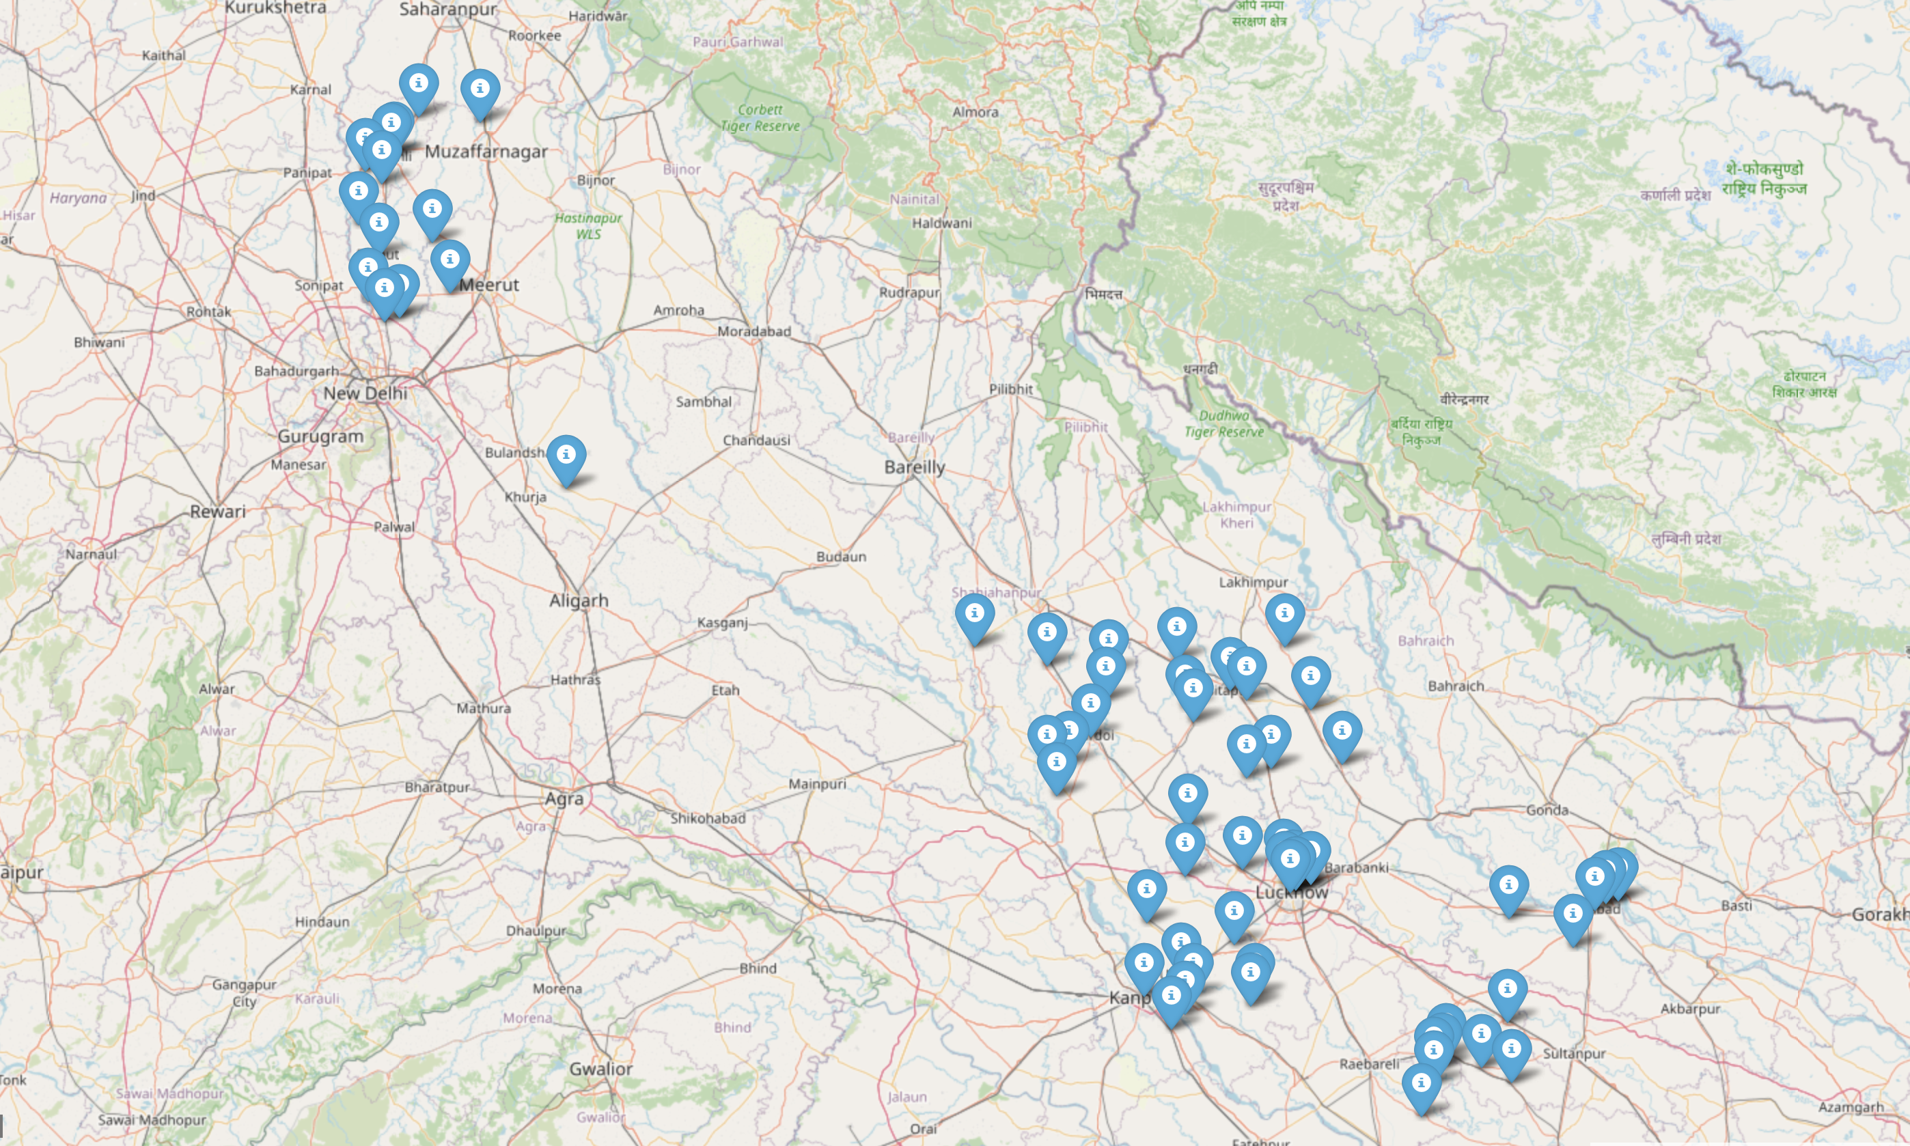
Next steps: Impact of elections on misinformation
Is more misinformation/hate speech spread during elections?
Election took place in 6 phases.
We have data before and after each phase.
Election date: May 7
Election date: April 26

Slide 42
Next steps: Interventions
Using the data donation approach to get real time data.
Deliver fact checking intervention.
  Study whether receiving information from friends is better.

Slide 43
Next steps: Beyond description
Datasets for the community.
  Large, multi-modal, multi-lingual, conversational data.
  Annotated for a wide range of items.
Estimating the reach of misinformation.
Study the impact of elections on misinformation.
Beyond WhatsApp: Data donation on other platforms.
  Facebook, YouTube, Telegram

Slide 44
Data donation on tools and datasets
Just released: https://bit.ly/data-donation-paper
Data donation tools for WhatsApp, Facebook, YouTube, Telegram and Instagram.
Datasets from these platforms.
  Browsing histories from YouTube.
  Viral content from WhatsApp from 3 countries.
  Page/group/channels subscribed by users.
  Demographics of users.
  etc.

Slide 45
Summary
Encrypted platforms like WhatsApp are important.
A novel data donation technique to enable data collection.
A novel sampling strategy to collect representative data.
Large scale manual effort to categorize content consumption.
Broader implications beyond misinformation
Wide adoption of social media but no baseline on what and how social media is being used.

Slide 46

Thank you!
kiran.garimella@rutgers.edu
Joint work with Simon Chauchard at UC3M
Supported by the ERC POLARCHATS project, NSF and Knight Foundation.

