Slide 1
The Senegal Demographic Survey- Insights from a Facebook recruited survey in Senegal
Jessica Donzowa^{1,2}
¹ Max Planck Institute for Demographic Research, Germany
² Bielefeld University, Germany
Social Media as a Research Tool Webinar Series
DEMED project at the University of Glasgow
20.05.2025

Slide 2
structure
Motivation: Data availability and & challenges in data collection
Project overview: The Senegal Demographic Survey
Project 1: Assessing Data Quality in Online Surveys: A Case Study of Facebook Recruitment in Senegal Joint work with: Björn Rohr & Steffen Pötzschke
Project 2: Estimating Fertility Indicators in Low- and Middle-Income Countries: Evidence from a Network Reporting Online Survey in Senegal Joint work with: Daniela Perrotta, Dennis Feehan & Emilio Zagheni

Slide 3
Data Availability Challenges for Vital Statistics in Sub-Saharan Africa
Lack of civil registration systems: Only 44% of births in Africa are registered compared to 98% in Europe (Civil Registration and Vital Statistics, 2024)
Slow progress in vital registration expansion: Between 1980 and 2015, global vital registration coverage increased by only 2.4% (Mikkelsen et al., 2015)
Reliance on large-scale surveys: Countries without registration systems depend on large-scale surveys, which are costly & infrequent (Jerven, 2014; Cori et al., 2020)
Digital solutions for data collection: Social media-based surveys offer a potential alternative for faster and cost-effective data collection but face coverage challenges (Zindel, 2023; Kühne & Zindel, 2020)

Slide 4
Challenges for Facebook Surveys in Sub-Saharan Africa
Digital gender gap: Higher Facebook user rates for men (Fatehkia et al., 2018)
Representativeness: Overrepresentation of men, younger, urban, and highly educated users compared to offline surveys (Rosenzweig et al., 2020; Rosenzweig et al., 2021; Pham et al., 2019; McGeer & Stremlau, 2024)
Regional coverage: Urban users show higher participation and completion rates than rural user (Pham et al., 2019; Soehl et al., 2024)

Slide 5
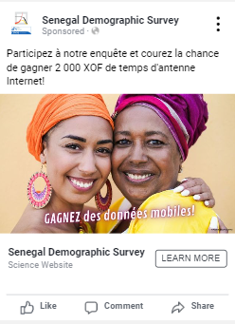
Project overview: Senegal demographic survey
Recruitment through paid advertisements on Facebook
Target population: 18+ Facebook population in Senegal
Online survey on number of children of respondents and network members
Goal: Estimate fertility indicator
Comparison data: Population representative data from the 2023 Demographic Health Survey (DHS)

Slide 6
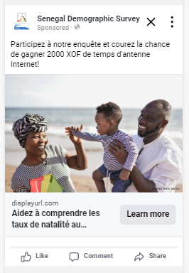
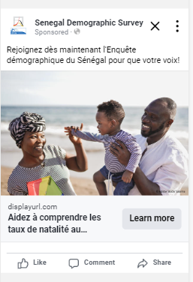
Incentive pretest in the capital Dakar
Online survey recruited through advertisements placed on Facebook
Displayed to men and women above 18 years in Dakar, Senegal
Advertisement goal: link clicks
15-02.-18.02.24 (4 days)
358€ spent per campaign
Incentive: Lottery for mobile phone credit
Two identical campaigns
With incentive
Without incentive

Slide 7
Incentive pretest in the capital Dakar
 | Incentive Campaign | No Incentive Campaign
Impressions | 1.156.453 | 1.239.029
Reach | 595.913 | 603.380
Link clicks | 10.179 | 10.497
Unique link clicks | 9.288 | 9.696
Started interviews | 170 | 32
Start rate | 1.83% | 0.21%
Completed interviews | 137 | 20
Completion rate | 80.59% | 62.5%
Cost per completed interview | 2.62 | 17.93

Slide 8
Final Data collection
Recruited through Facebook advertisements in Senegal in October 2024
Campaign goal: Traffic/ Link clicks
Targeting by region, gender, age (where possible)
Budget: 4.584 €
Incentive: Lottery for mobile phone credit
5.52 € per started interview (n_{Respondents}= 830)

Slide 9
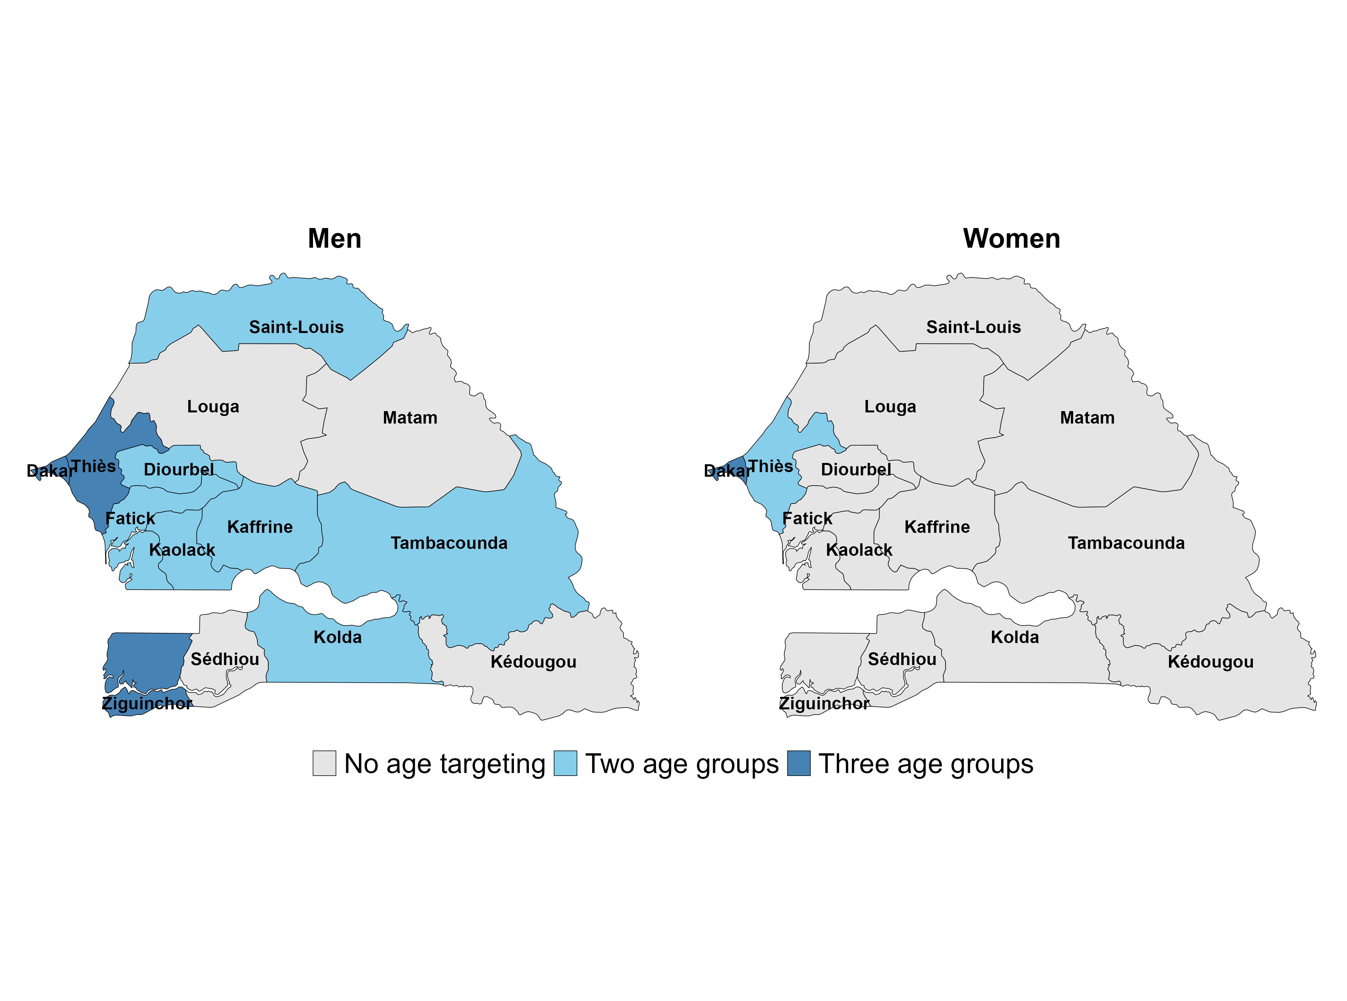
Facebook Campaign ad set targeting
Two age groups | 18-33; 34-49 (women) 18-36; 37-54 (men)
Three age groups | 18-29; 31-41; 42-49 (54)

Slide 10
Campaign performance and survey recruitment
Performance metric | Value
Estimated audience size | 3.192.700-3.762.300
Reach | 1.109.356
Impressions | 7.068.868
Unique Link Clicks | 71.424
Unique Outbound clicks | 68.494
Budget spend (before taxes) | 4.584€
Click through rate | 6.4%
Cost per link click | 0.05€
The cheapest ad set | Dakar (0.02€)
The most expensive ad set | Kaffrine and Kolda (0.14€)
Cost per started survey | 5.52€
Hits on the survey landing page | 122.812
Hits probably by human internet users | 70.755
Beyond welcome page | 2.167
At least one valid response before compulsory question on page 4 | 830

Slide 11
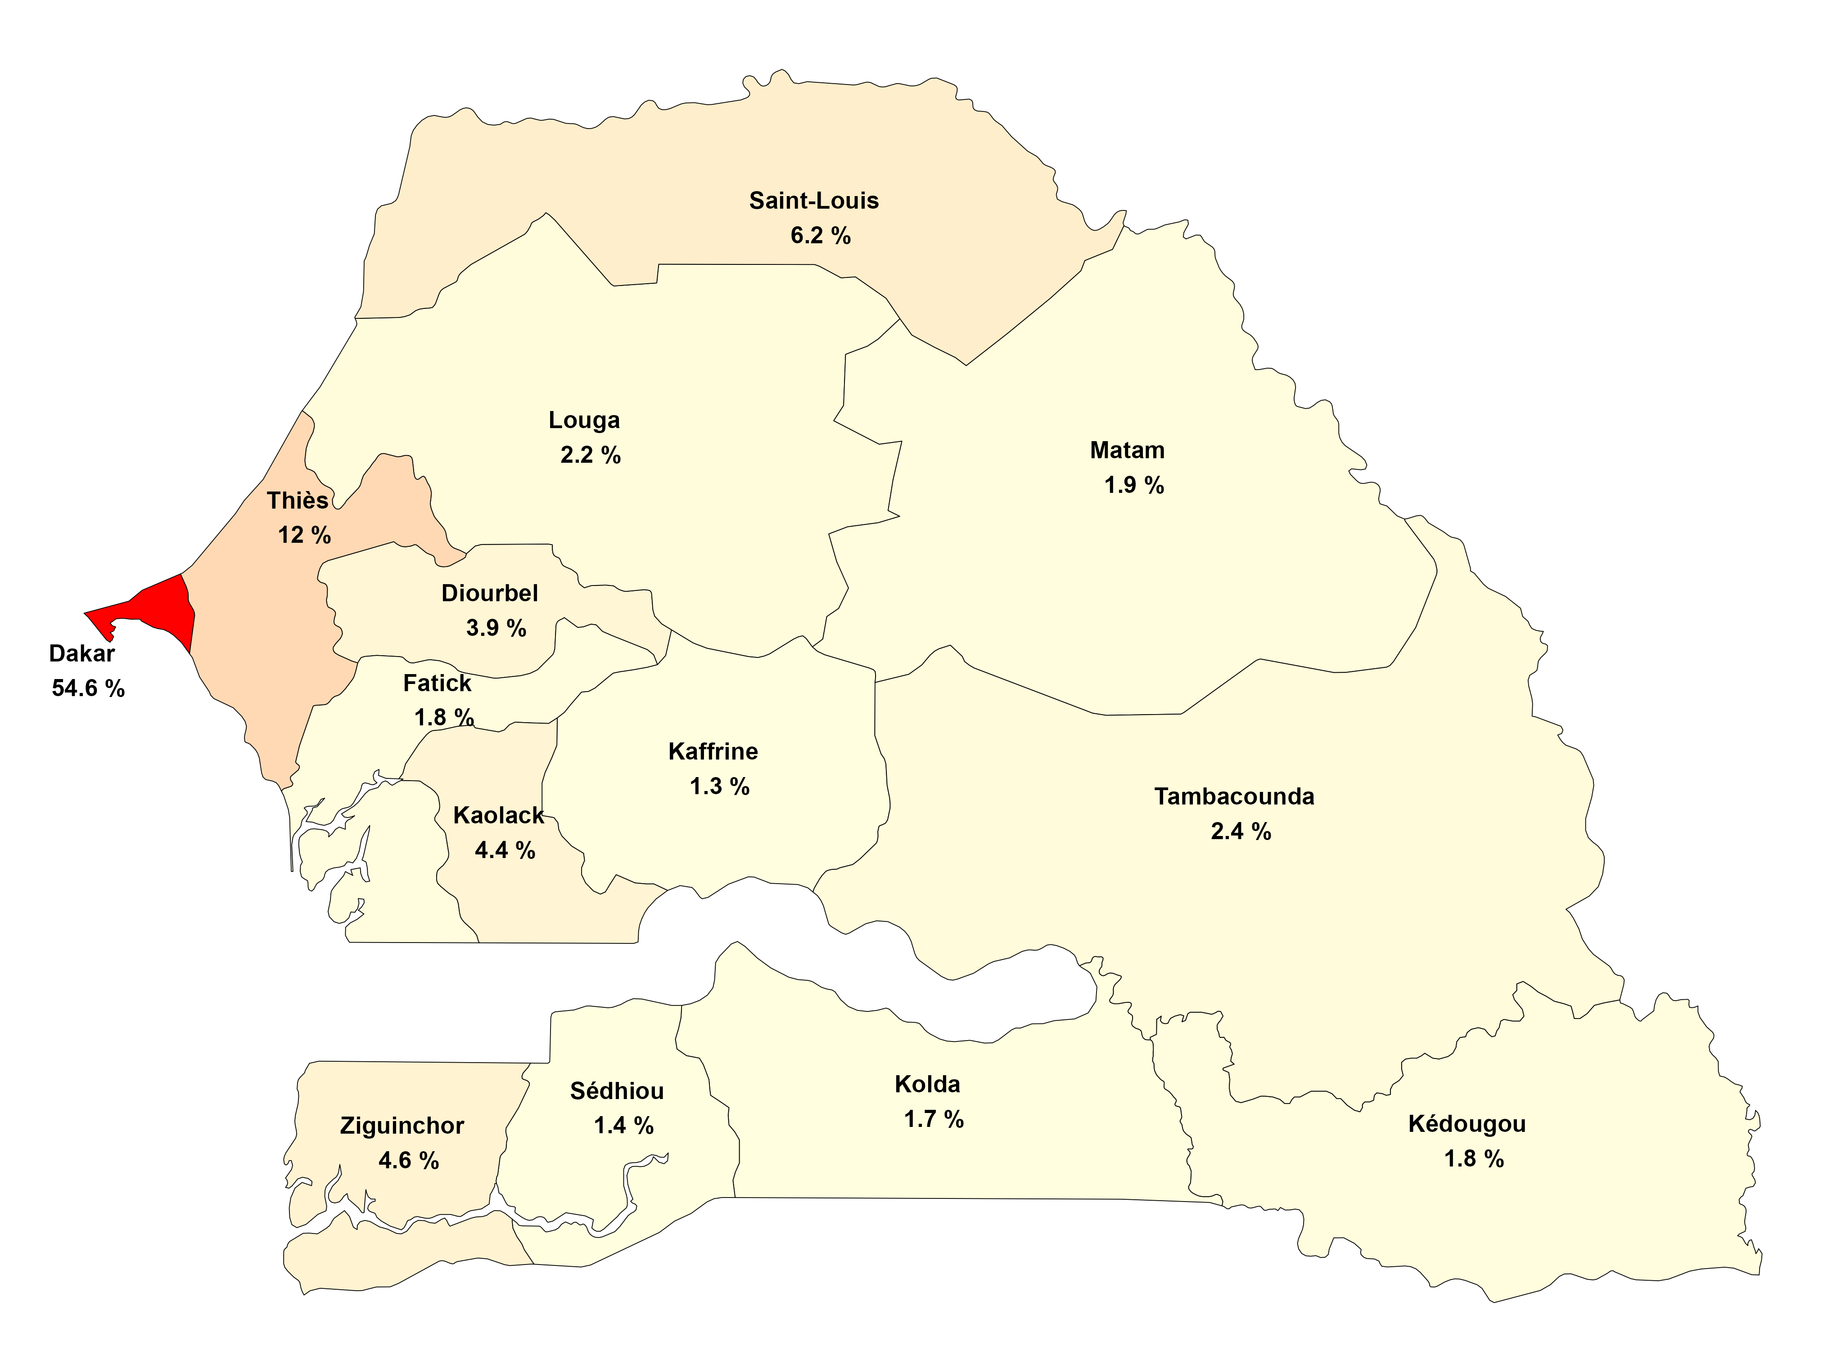
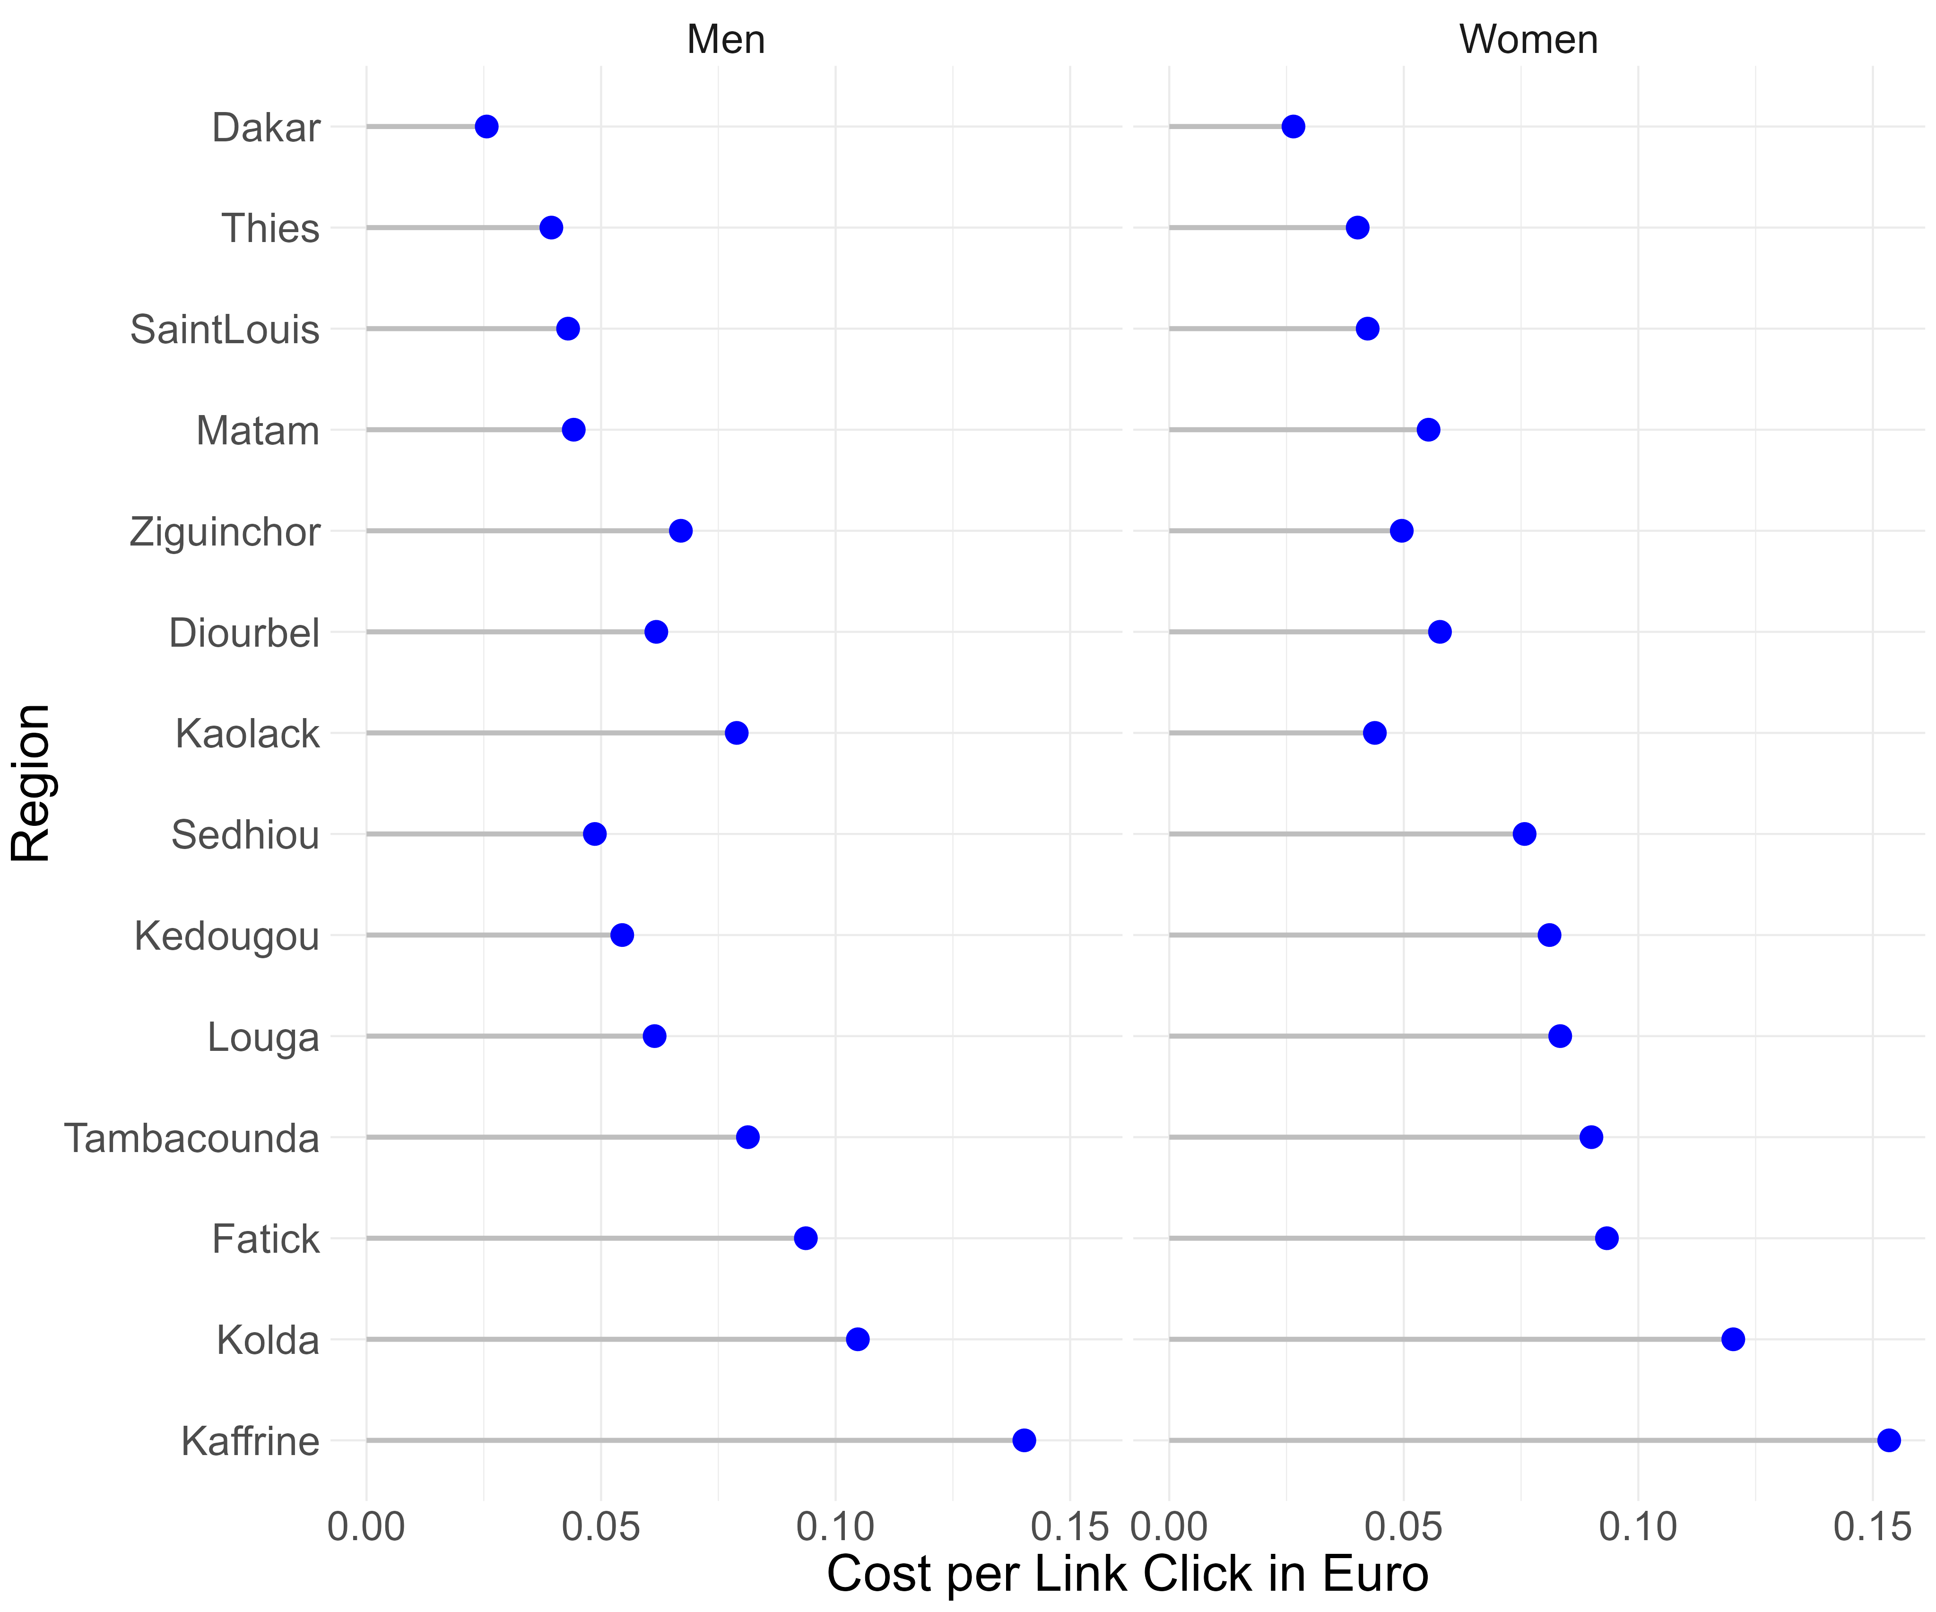
Meta data- Campaign performance by region
Distribution of Facebook users in Senegal at the time of the data collection (October 2024)
Cost per link click by targeting region

Slide 12
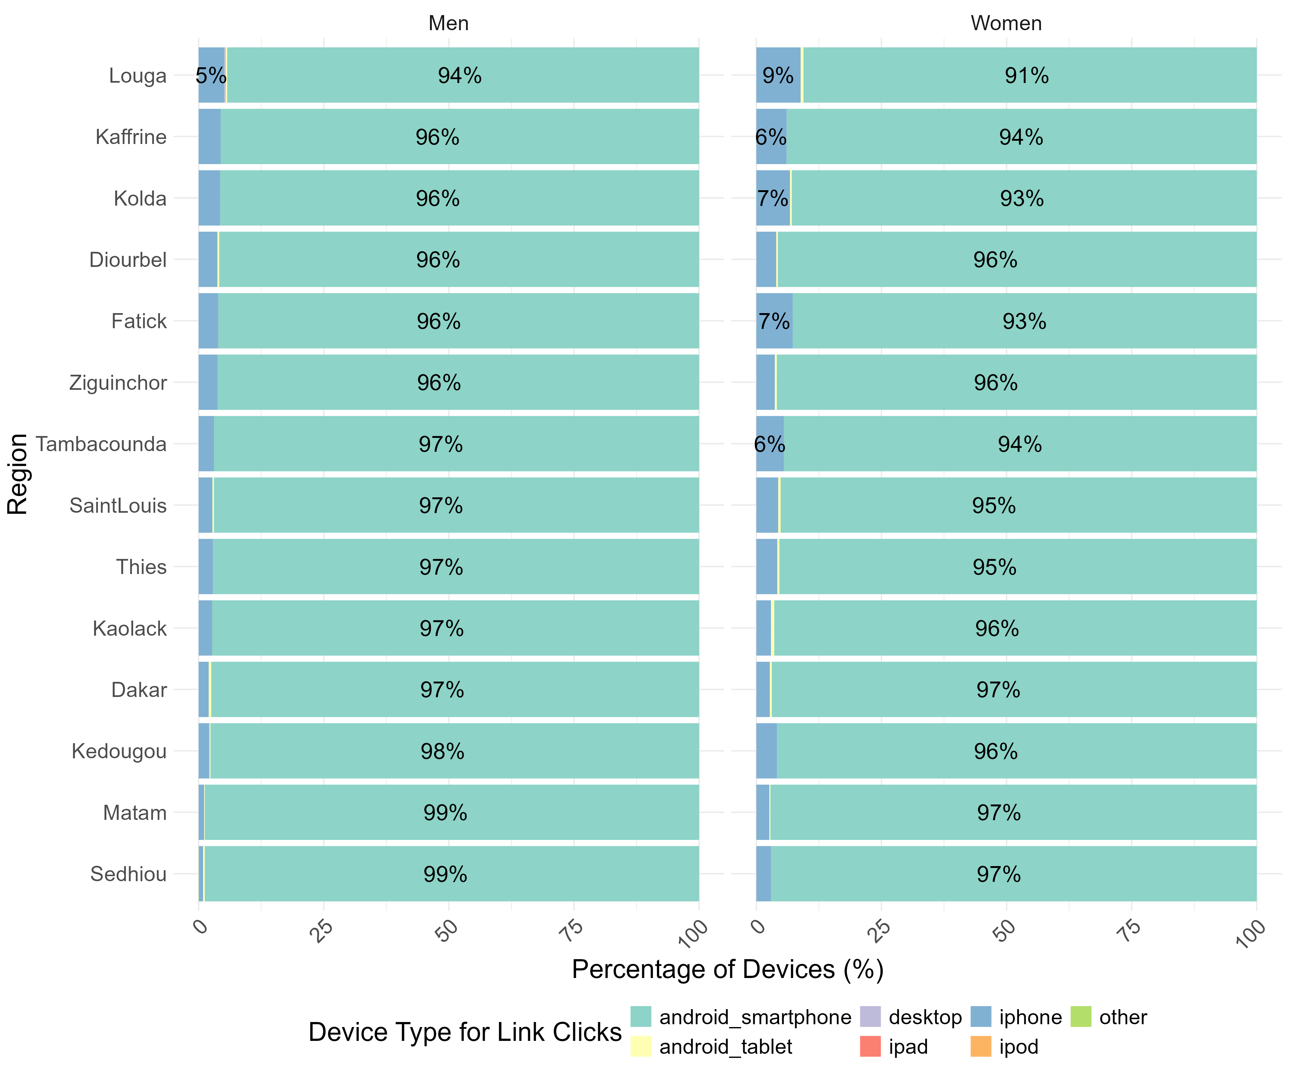
Meta data- Device for link click by region
Distribution of Facebook users in Senegal at the time of the data collection (October 2024)
Device used for link clicks by region

Slide 13
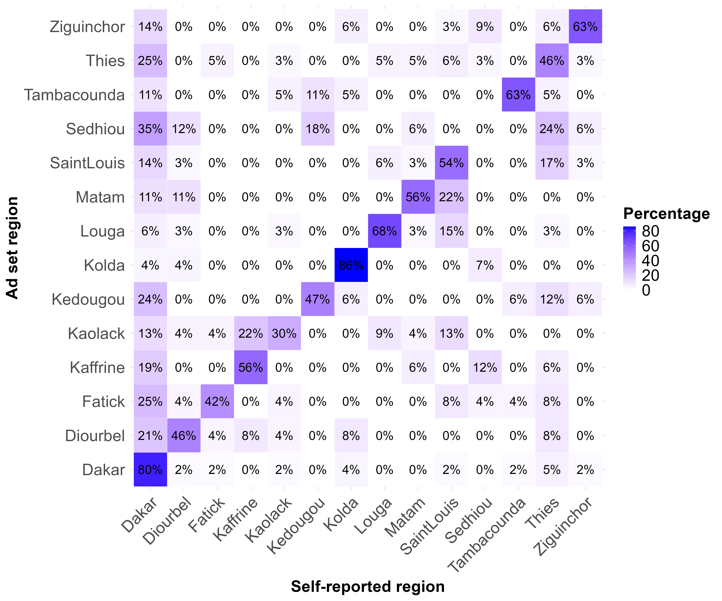
Campaign performance: Targeting accuracy
Distribution of Facebook users in Senegal at the time of the data collection (October 2024)
Correspondence between ad set and self-reported region

Slide 14
Demographic composition of the sample
Variable | Category | N | Percentage (%) | Total
Sex | Female | 268 | 40.6 | 660
 | Male | 392 | 59.4
Age | 18-29 | 238 | 49.7 | 479
 | 30-39 | 126 | 26.3
 | 40+ | 115 | 24.0
Education | Primary | 114 | 20.8 | 547
 | Secondary | 259 | 47.3
 | Tertiary | 174 | 31.8
Region | Rural | 185 | 43.6 | 424
 | Urban | 239 | 56.4
Religion | Muslim | 435 | 87.2 | 499
 | Other/No Religion | 64 | 12.8

Slide 15
Research questions: Regional variation
Starting error: The survey starting rate will be higher for men and for the capital region, compared to women and non-capital regions.
Unit Dropout Error: The bias in the demographic composition increases over the course of the survey pages more strongly for non-capital regions than the capital region.
Item non-response error: The mean item nonresponse is higher for participants targeted at the non-capital region than for the capital region.
Joint work with Björn Rohr & Steffen Pötzschke

Slide 16
Starting ERROR: Gender
Ad set gender | Impression (%) | Clickers (%) | Respondents (%) | Resp.- Clickers
Men | 64.0 | 60.00 | 61.2 | 1.20
Women | 36.0 | 40.00 | 38.8 | -1.20
Total | 100 | 100 | 100 | 100
No difference in the ad set gender composition between clickers and respondents.

Slide 17
Starting ERROR: Region
Ad set region | Impression (%) | Clickers (%) | Respondents (%) | Resp.- Clickers
Dakar | 21.0 | 29.4 | 15.2 | -14.2
Diourbel | 6.2 | 5.8 | 7.8 | 2.1
Fatick | 5.2 | 3.6 | 5.7 | 2.1
Kaffrine | 3.7 | 2.2 | 4.5 | 2.2
Kaolack | 5.8 | 5.7 | 6.4 | 0.7
Kedougou | 3.8 | 3.2 | 3.9 | 0.7
Kolda | 4.6 | 2.9 | 6.9 | 3.9
Louga | 4.3 | 3.3 | 5.8 | 2.4
Matam | 4.4 | 4.4 | 4.2 | -0.2
Saint Louis | 8.8 | 8.3 | 8.1 | -0.2
Sedhiou | 3.7 | 3.9 | 3.9 | -0.1
Tambacounda | 5.5 | 4.2 | 5.3 | 1.1
Thies | 13.9 | 15.3 | 14.5 | -0.9
Ziguinchor | 9.2 | 7.8 | 8.1 | 0.3
Total | 100 | 100 | 100

Slide 18
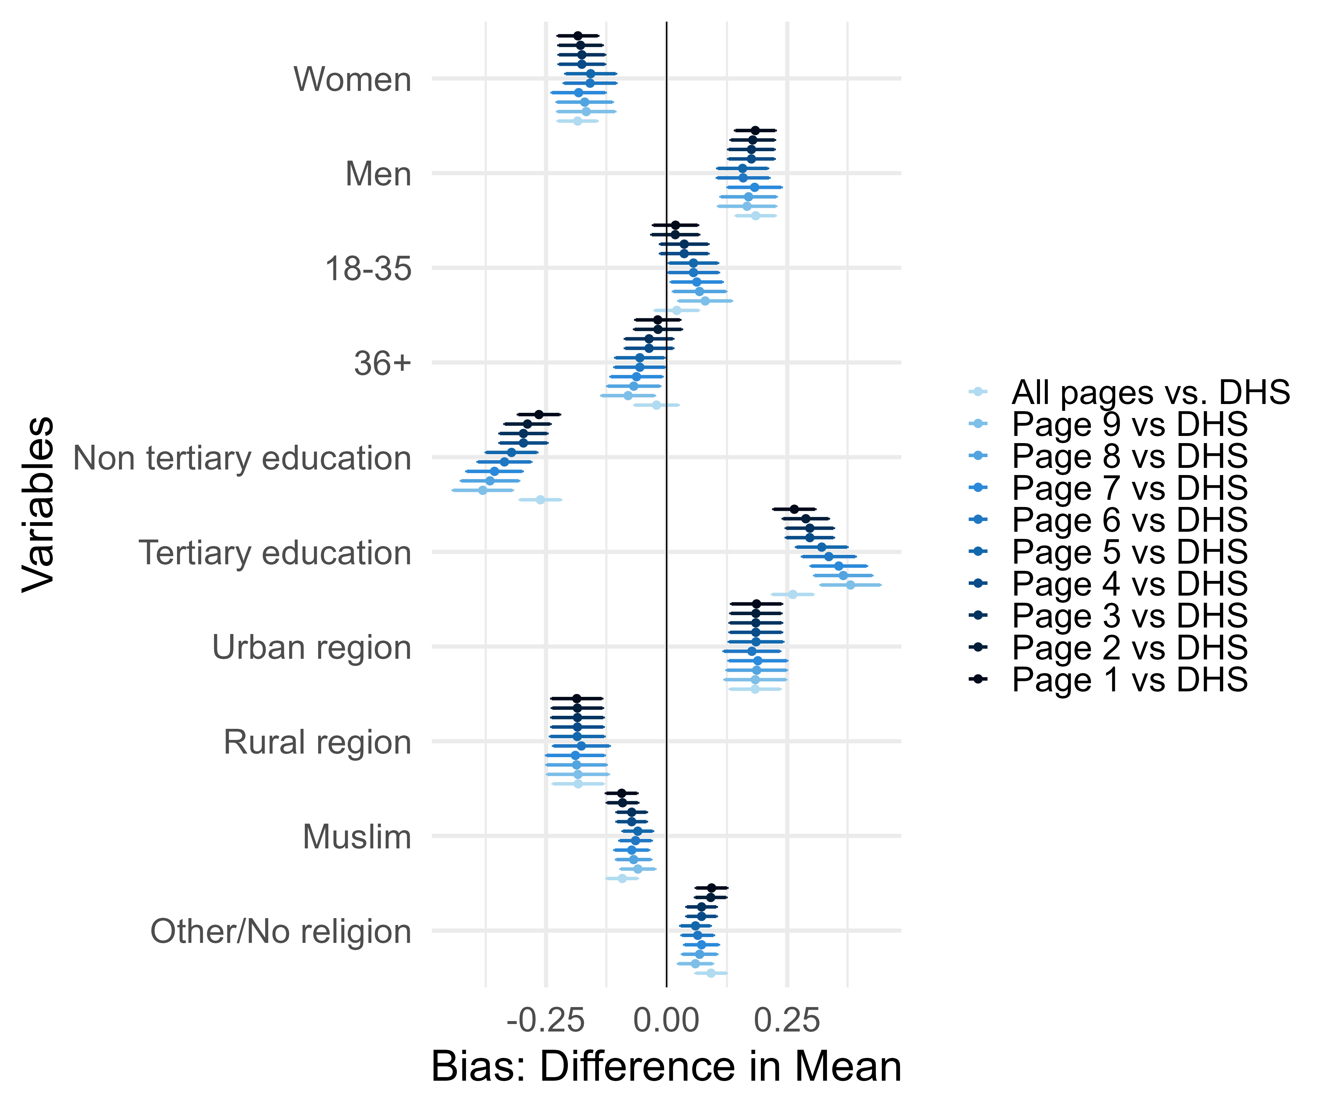
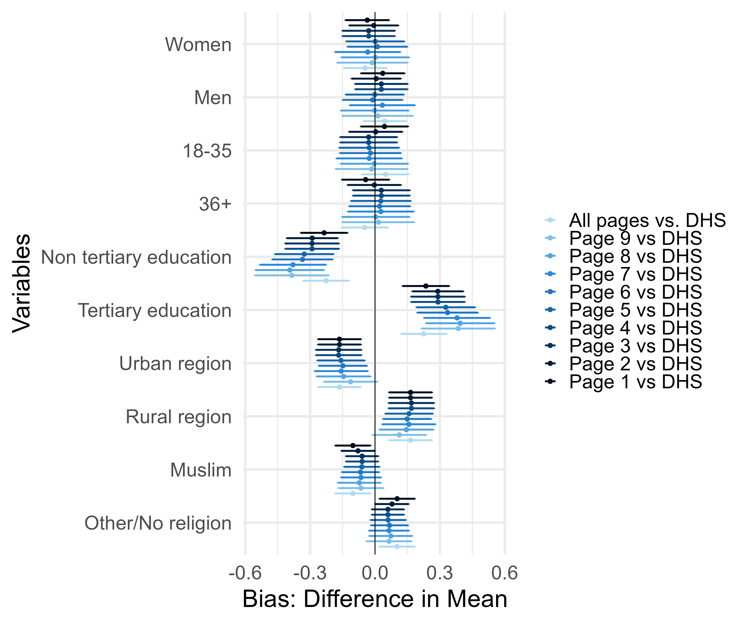
Unit Dropout error
Ad set region: Non-capital
Ad set region: Capital (Dakar)

Slide 19
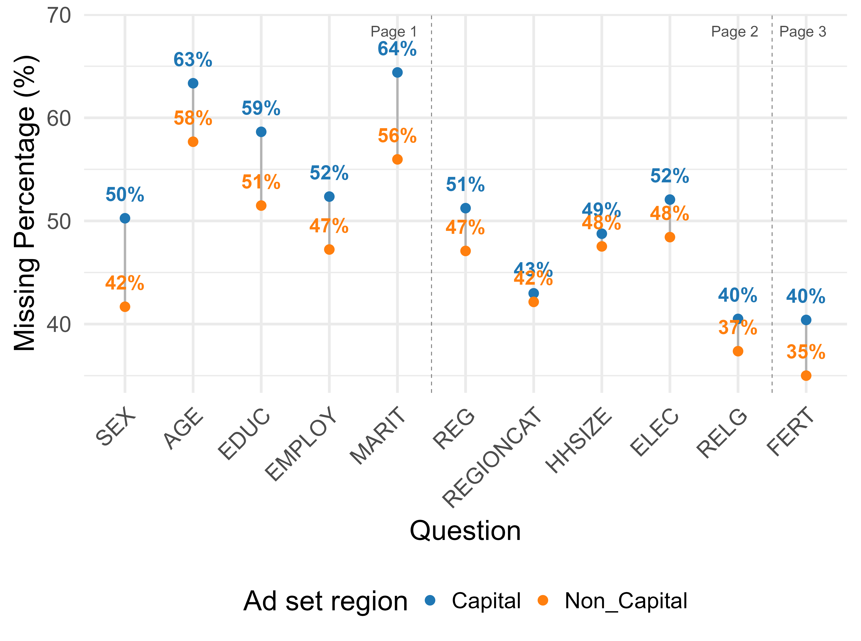
Item non-response error
Item non-response seems to be higher in ad set capital regions.
Next steps: Investigate age and gender pattern.

Slide 20
Extending social media Survey Coverage: Network Reporting
Network reporting for hard-to-survey populations:
Used to estimate sizes of hard-to-survey populations, e.g. those at risk of HIV/AIDS or the homeless (Bernard et al., 2010; Killworth et al., 1998)
In demographic research, used for estimating mortality rates in settings lacking vital registration systems (Rwanda) (Feehan & Umubyeyi, et al., 2016)
Used with Facebook survey recruitment to estimate Internet adoption rates across countries (U.S., U.K., Brazil) (Feehan & Cobb, 2019)
Joint work with Daniela Perrotta, Dennis Feehan & Emilio Zagheni

Slide 21
Extending social media Survey Coverage: Network Reporting
Network reporting for hard-to-survey populations:
Used to estimate sizes of hard-to-survey populations, e.g. those at risk of HIV/AIDS or the homeless (Bernard et al., 2010; Killworth et al., 1998)
In demographic research, used for estimating mortality rates in settings lacking vital registration systems (Rwanda) (Feehan & Umubyeyi, et al., 2016)
Used with Facebook survey recruitment to estimate Internet adoption rates across countries (U.S., U.K., Brazil) (Feehan & Cobb (2019)
Can a network reporting approach help mitigate biases in Facebook-recruited samples, leading to more representative survey results?

Slide 22
Network reporting in our survey
Network definition:
People with whom respondents had a conversation the previous day
People with whom respondents shared a meal the previous day
First contact
Conversation
network
Socio-demographic information
Mean number
of children
Second contact
Attention check
Meal
network
Third contact

Slide 23
Network structure of dataset
Respondents N=244
Network member N=482
Reported children N=883

Slide 24
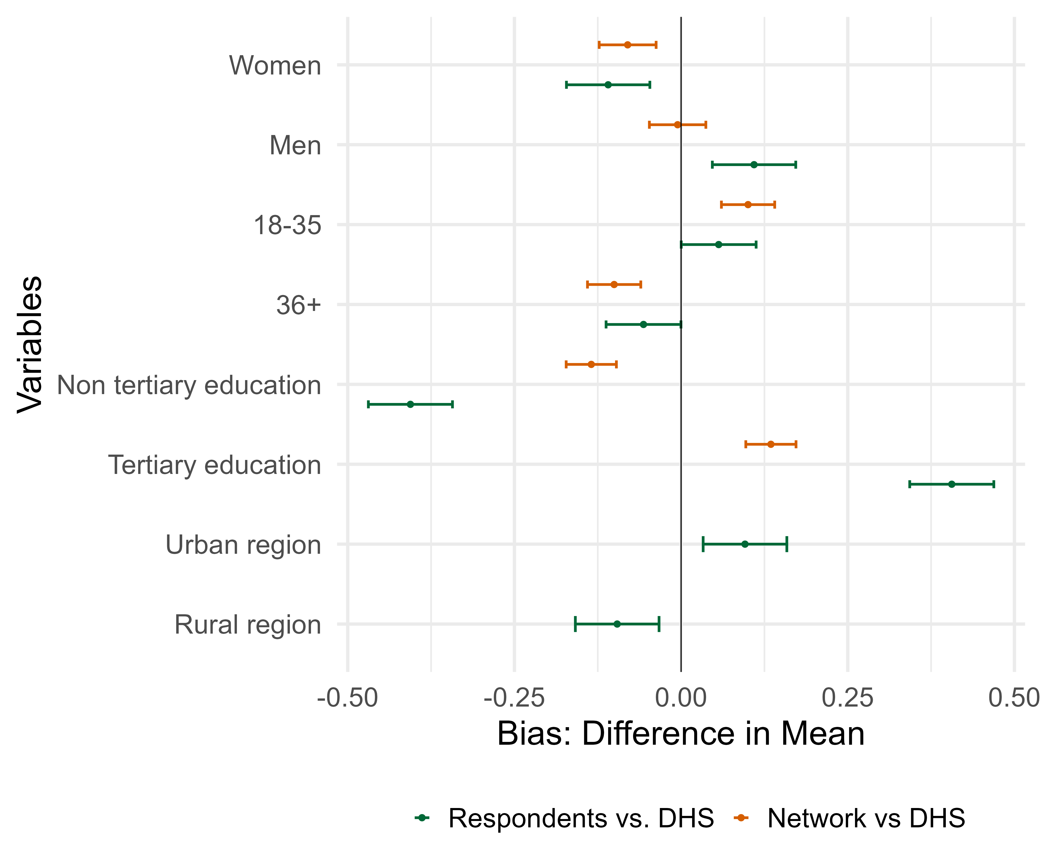
Comparison of the composition of our sample to the Demographic Health survey
Do we find a similar representativeness issues as previous research?
Our sample is also more likely to be male, tertiary-educated, and urban compared to probability-based survey data (Demographic Health Survey 2023)
Smaller gender or educational bias for network members

Slide 25
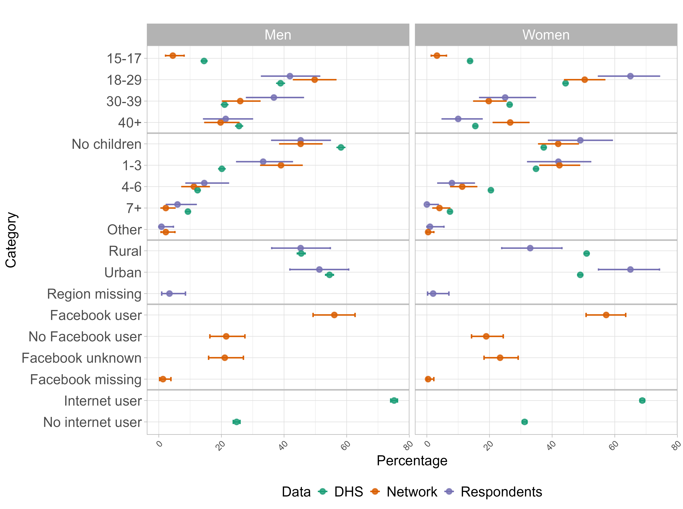
Comparison of the composition of our sample to the Demographic Health survey
Oversample young women (18-29)
Female respondents & network member are more childless than the DHS sample

Slide 26
Comparison of the composition of our sample to the Demographic Health survey
More urban population for women and no difference for men
21% of male and 18% of female network members do not use Facebook

Slide 27
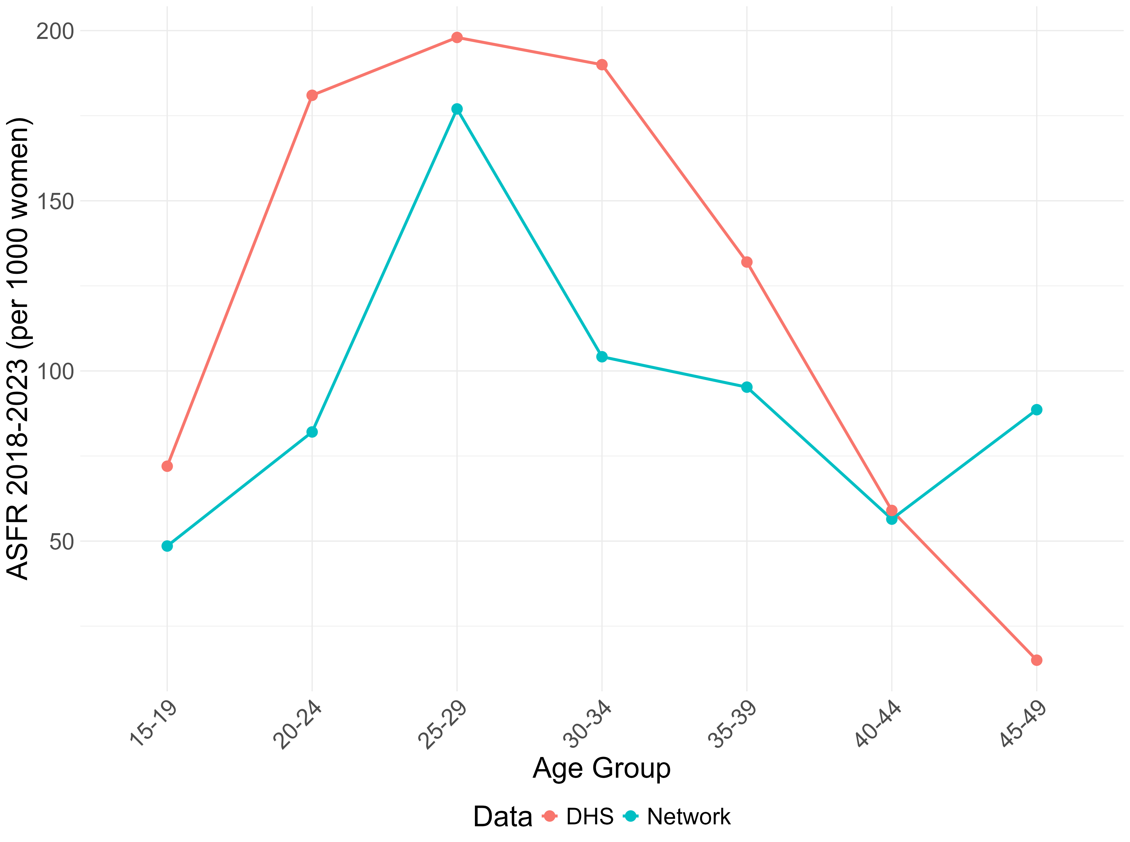
Age specific fertility rates for women compared to the Demographic Health survey
Unweighted pooled estimates for the years 2018-2023
General underestimation of fertility in key reproductive age groups (20–34)
Substantial overestimation at ages 45–49
Next steps: Explore reporting structure & weighting

Slide 28
Take aways
Incentives: Improve participation in contexts where internet access is expensive
Algorithmic bias: Targeting accuracy varies substantively by subnational region
Response quality: More starting and item nonresponse error for capital region, but smaller for drop out error.
Sample composition: Over-representation of men, tertiary educated, and urban population & Network samples appear less biased for gender and education
Fertility estimation: General underestimation of fertility with unweighted rates → Weighting

Slide 29
Thank you for your attention!
Jessica Donzowa
Doctoral Researcher
Department of Digital and Computational Demography | Max Planck Institute for Demographic Research
Faculty of Sociology | Bielefeld University
donzowa@demogr.mpg.de
@jdonzowa.bsky.social

Slide 30
References
Bernard, H. R. et al. (Dec. 2010). “Counting Hard-to-Count Populations: The Network Scale-up Method for Public Health”. In: Sexually Transmitted Infections 86.Suppl 2, pp. ii11–ii15. issn: 1368-4973. doi: 10.1136/sti.2010.044446.
Civil registration and vital statistics (2024). en. url: https://www.who.int/news-room/fact- sheets/detail/civil- registration- and- vital- statistics.
Cori, Liliana et al. (Jan. 2020). “Risk Perception and COVID-19”. In: International Journal of Environmental Research and Public Health 17.9, p. 3114. issn: 1660-4601. doi: 10.3390/ijerph17093114.
Fatehkia, Masoomali, Ridhi Kashyap, and Ingmar Weber (July 2018). “Using Face-book Ad Data to Track the Global Digital Gender Gap”. In: World Development107, pp. 189–209. issn: 0305750X. doi: 10.1016/j.worlddev.2018.03.007.
Feehan, Dennis M. and Curtiss Cobb (Dec. 2019a). “Using an Online Sample to Estimate the Size of an Offline Population”. In: Demography 56.6, pp. 2377–2392. issn: 0070-3370, 1533-7790. doi: 10.1007/s13524-019-00840-z.
Feehan, Dennis M., Aline Umubyeyi, et al. (Apr. 2016). “Quantity Versus Quality: A Survey Experiment to Improve the Network Scale-up Method”. In: Am. J.Epidemiol. 183.8, pp. 747–757. issn: 0002-9262, 1476-6256. doi: 10.1093/aje/kwv287.
Jerven, Morten (2014). “Poor Numbers and What to Do about Them”. In: p. 2.
Killworth, Peter D. et al. (Apr. 1998). “Estimation of Seroprevalence, Rape, and Homelessness in the United States Using a Social Network Approach”. In: EvalRev 22.2, pp. 289–308. issn: 0193-841X, 1552-3926. doi: 10.1177/0193841X9802200205.
Kühne, Simon and Zaza Zindel (Dec. 2020). “Using Facebook and Instagram to Recruit Web Survey Participants: A Step-by-Step Guide and Application”. In: Survey Methods: Insights from the Field (SMIF). issn: 2296-4754. doi: 10.13094/SMIF-2020-00017.

Slide 31
references
McGeer, Caitlyn and Nicole Stremlau (2024). “Researching hate speech online: Exploring the potential and limitations of Facebook as a survey tool in Africa”. en. In: Methodological Innovations 17.3, pp. 172–186. doi: 10.1177/20597991241264838.
Mikkelsen, Lene et al. (Oct. 2015). “A global assessment of civil registration and vital statistics systems: monitoring data quality and progress”. en. In: The Lancet386.10001, pp. 1395–1406. issn: 01406736. doi: 10 . 1016 / S0140 - 6736(15 )60171-4.
Pham, Katherine Hoffmann, Francesco Rampazzo, and Leah R. Rosenzweig (Oct.2019). “Online Surveys and Digital Demography in the Developing World: Face-book Users in Kenya”. In: arXiv:1910.03448 [cs].
Rosenzweig, Leah R et al. (Oct. 2020). Survey Sampling in the Global South Using Facebook Advertisements. Preprint. SocArXiv. doi: 10.31235/osf.io/dka8f.
Rosenzweig, Leah R. and Yang-Yang Zhou (Mar. 2021). “Team and Nation: Sports, Nationalism, and Attitudes Toward Refugees:” in: Comparative Political Studies. doi: 10.1177/0010414021997498.
Soehl, Thomas, Zhenxiang Chen, and Aaron Erlich (July 2024). “Promises and Limits of Using Targeted Social Media Advertising to Sample Global Migrant Populations: Nigerians at Home and Abroad”. en. In: Sociological Methods &Research. Publisher: SAGE Publications Sage CA: Los Angeles, CA. doi: 10 .1177/00491241241266634. url:
Zindel, Zaza (2023). “Social Media Recruitment in Online Survey Research: A Systematic Literature Review”. en. In: methods, data, analyses 17.2. Artwork Size:42 Pages Publisher: methods, data, analyses, 42 Pages. doi: 10.12758/MDA.2022. 15.

