Slide 1


Survey Research Beyond the Checkbox: Methods, Pitfalls, and Practice
Utkun Aydin, PhD
Lecturer in Mathematics Education
Open Lectures in Educational Research Methods

Slide 2

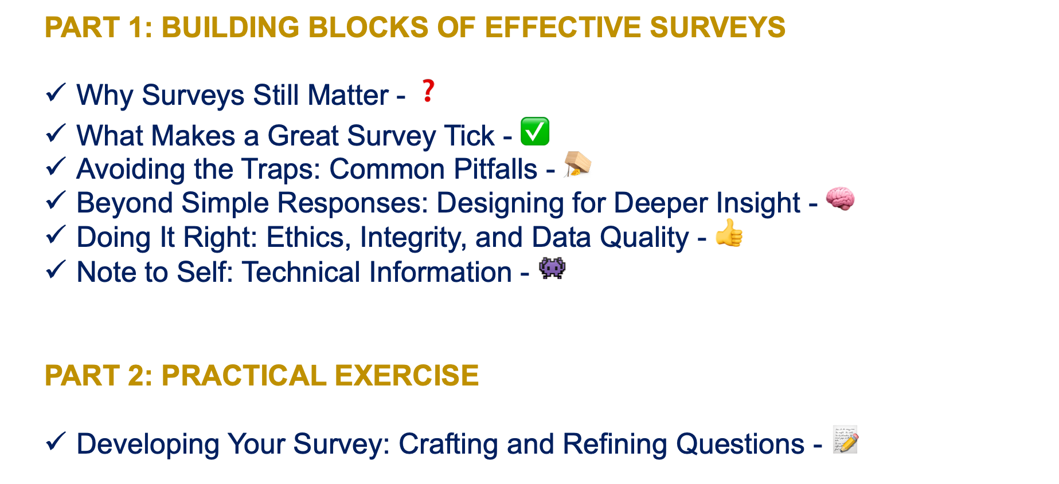
OUTLINE
PART 1: BUILDING BLOCKS OF EFFECTIVE SURVEYS
Why Surveys Still Matter - ❓
What Makes a Great Survey Tick - $✅$
Avoiding the Traps: Common Pitfalls - 🪤
Beyond Simple Responses: Designing for Deeper Insight - 🧠
Doing It Right: Ethics, Integrity, and Data Quality - 👍
Note to Self: Technical Information - 👾
PART 2: PRACTICAL EXERCISE
Developing Your Survey: Crafting and Refining Questions - 📝

Slide 3

Why Surveys Still Matter - ❓
Although we encounter them constantly in our daily lives, surveys remain one of the most powerful data collection tools. But what makes them so widely used?
Academia (Researchers)
Organizations (Companies)
across a wide spectrum, from social sciences to health research, education, and psychology
to measure attitudes, behaviors, and demographic characteristics
to understand employee satisfaction, customer experience, and market trends
indispensable for human resources, marketing, and strategic planning
Public Institutions (Governments)
UX Research (User experience professionals)
conduct regular surveys to gather public opinion, identify needs, and evaluate policy effectiveness
to collect real user feedback on product design and usability

Slide 4
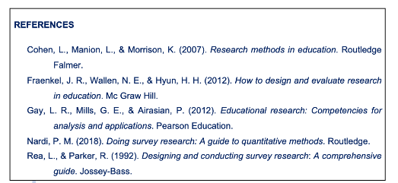
Why Surveys Still Matter - ❓
Survey research is a systematic method for collecting information to describe, compare, or explain knowledge, attitudes, and behaviors in a defined population (Cohen et al., 2007; Fraenkel et al., 2012).
Surveys are most powerful when they allow researchers to identify patterns and predictors across contexts (Gay et al., 2012).
A sound survey design depends on clarity of purpose; operational definitions; reliability and validity; and pilot testing (Cohen et al., 2007).
The greatest threat to survey validity is poor question design (Rae & Parker, 1992).
Surveys are framed as social interactions — each question is part of a conversation between researcher and respondent (Nardi, 2018).
In educational contexts, ethics also include accessibility and inclusivity — ensuring that language, examples, and platforms are appropriate for diverse respondents (Fraenkel et al., 2012; Gay et al., 2012).

Slide 5







Why Surveys Still Matter - ❓
The Power of Surveys in the Digital Age
Scalability
Standardization
You can reach hundreds, even thousands, of people at a low cost. Unlike qualitative methods, it can be applied to large audiences and allows for statistical analysis.
Every participant sees the same questions in the same order. This ensures that responses are comparable and allows for systematic analysis.
Quantifiability
Anonymity
It converts subjective opinions and attitudes into numerical data. Statistical tests, trends, and correlations become researchable.
Participants may give more honest answers compared to face-to-face interviews. The chance of receiving open feedback on sensitive topics increases.
Flexibility
Time Efficiency
Various question formats can be used, from closed-ended to in-depth open-ended questions, from Likert scales to ranking.
It saves time for both the researcher and the participant. Online surveys can be completed asynchronously, allowing participants to proceed at their own pace.

Slide 6

Why Surveys Still Matter - ❓
Thanks to platforms like Google Forms, SurveyMonkey, Microsoft Forms, and Qualtrics, anyone can create a survey in minutes.
However, this ease creates a paradox: As access to tools becomes easier, the number of poorly designed surveys also increases! ☹
produce bad data,
waste participants' time,
reduce reliability,
lead to incorrect decisions.
Survey design = Science + Art
Anyone can create a survey, but not everyone can create a good survey.

Slide 7

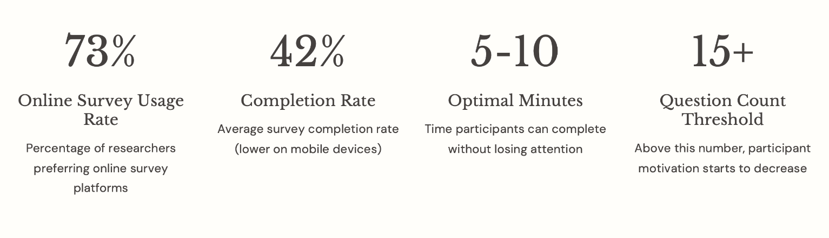
What Makes a Great Survey Tick - ✅

Slide 8

What Makes a Great Survey Tick - ✅
The Core Principle:
A good survey maximizes clarity and participation while minimizing measurement error and response bias.
Clear objectives
Operationalization
Question design
Response formats

Slide 9



What Makes a Great Survey Tick - ✅
1. Clear Objectives
Target Sample
Decision Point
Research Question(s)
What do you actually want to investigate?
"I'm curious" is not enough.
Who are you collecting data from?
Why them?
What will you do with this data?
Taking actions!
Before you start creating your survey, answer these three questions in writing.
If you don't have clear answers, you are not ready to conduct a survey yet.

Slide 10
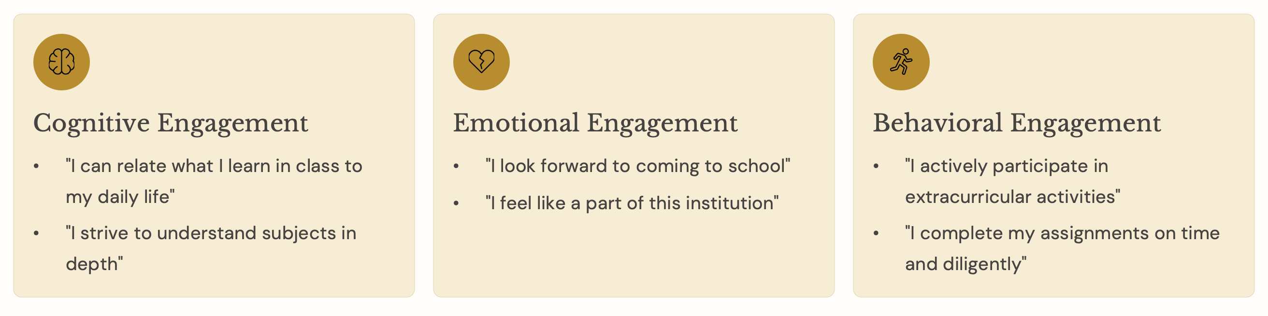
What Makes a Great Survey Tick - ✅
2. Operationalization
Operationalization is the art of transforming abstract concepts into measurable variables.
Let's say you want to measure “student engagement.”
How would you make this concept measurable?
A broad concept is broken down into multiple dimensions (e.g., cognitive, emotional and behavioral),
and specific, observable indicators (e.g., questions/items) are defined for each dimension.

Slide 11

What Makes a Great Survey Tick - ✅
3. Question Design
How questions are asked dramatically affects the answers you receive.
Common mistakes to avoid in developing questions/items:
❌ Ambiguous
❌ Double-Barreled
❌ Leading
❌ Jargon and Complex Language

Slide 12
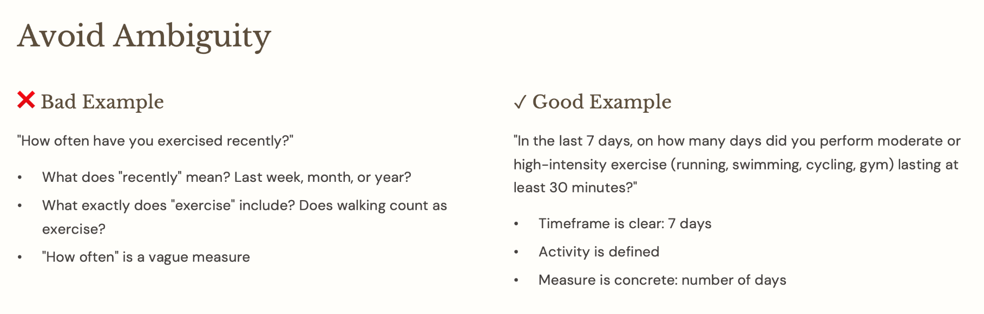
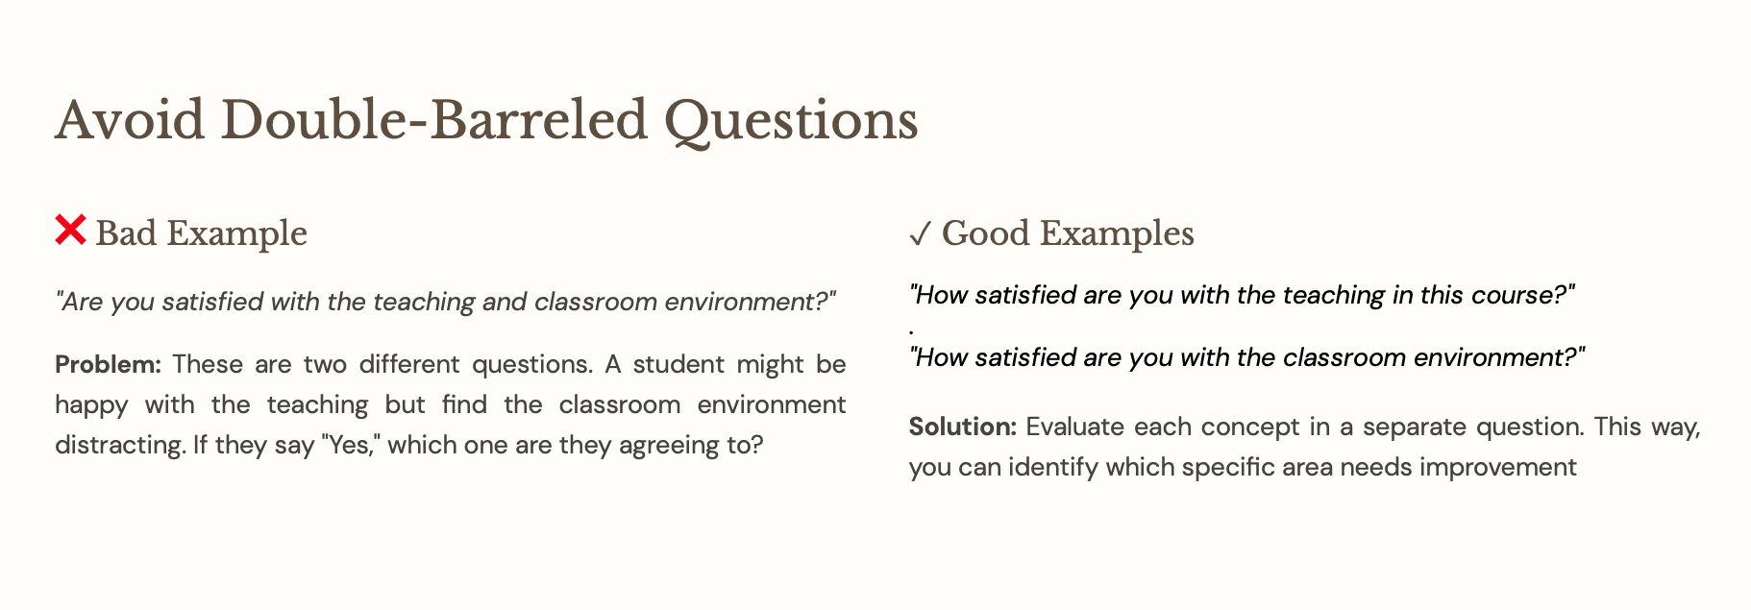
What Makes a Great Survey Tick - ✅

Slide 13
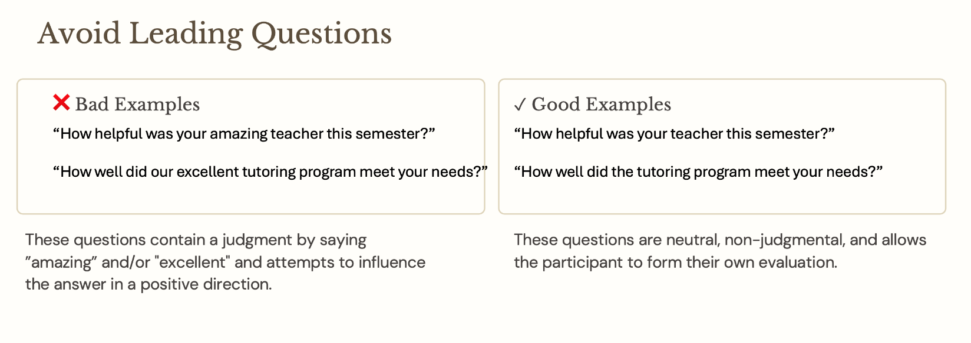
What Makes a Great Survey Tick - ✅
Tip: After reading your question, ask yourself,
"Does this question encourage me to answer in a particular direction?"
If the answer is YES, rephrase the question.

Slide 14
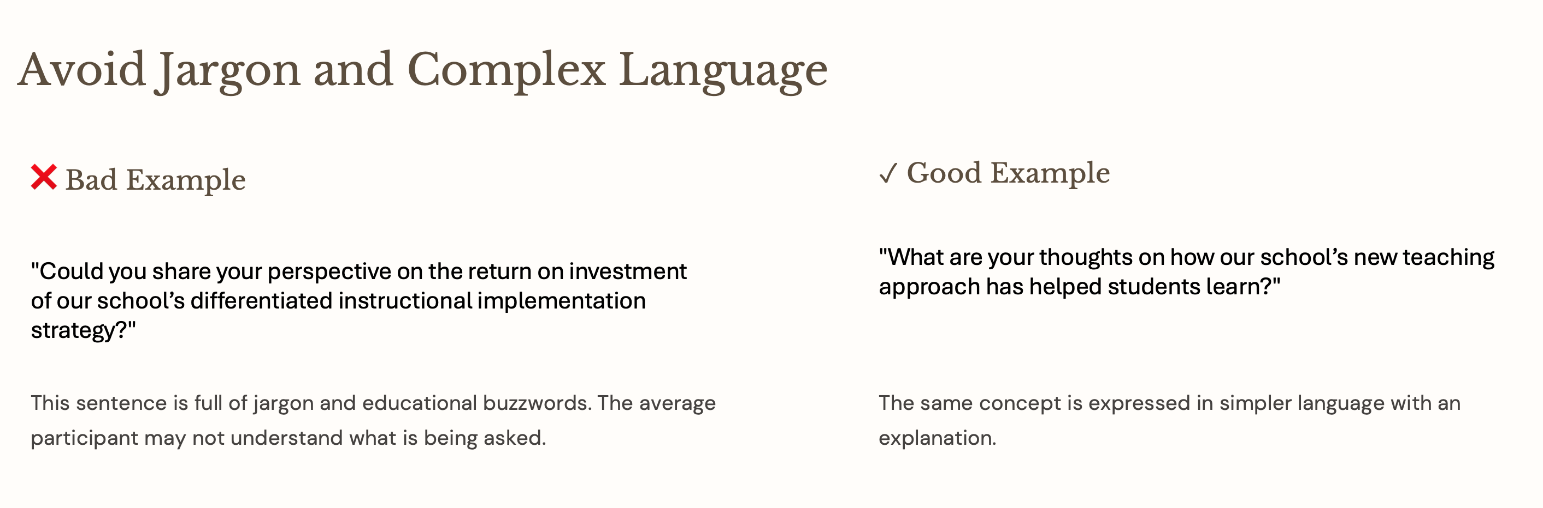
What Makes a Great Survey Tick - ✅

Slide 15
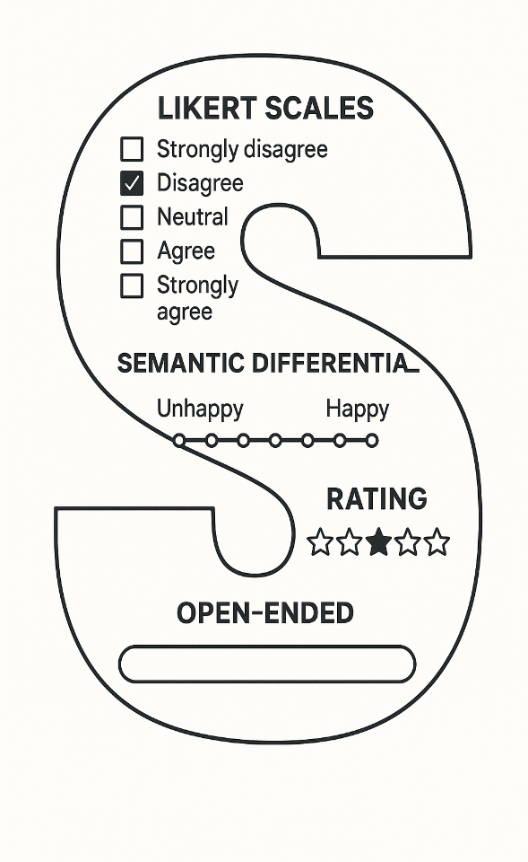
What Makes a Great Survey Tick - ✅
4. Response Formats
The question format determines the type and quality of the data you collect.

Slide 16
Likert Scales
The most popular format. A 5 or 7-point scale from "Strongly Disagree" to "Strongly Agree".
Ideal for measuring affective variables (e.g., attitudes, motivation, metacognition, etc.)
“I feel confident using technology in my classroom.” (Strongly Disagree – Disagree – Neutral – Agree – Strongly Agree)
Semantic Differential
A scale between two opposing adjectives.
Useful in perception and image studies.
“How would you rate your school’s learning environment?” (Unfriendly 1–2–3–4–5 Friendly)

Slide 17
Ranking Questions
Participants arrange options by priority.
Effective for understanding preferences and priorities, but cognitive load is high.
“Please rank the following study resources from most to least helpful: 1️⃣ 2️⃣ 3️⃣ 4️⃣"
”
Textbooks Online videos Teacher feedback Group discussions

Slide 18

Open-ended Questions
Free-text responses.
Provides in-depth insights but challenging to analyze.
Blend qualitative data with quantitative surveys.
“What changes would you suggest to make classroom lessons more engaging? Please explain.”
“PLEASE EXPLAIN.” …….. in other words,
You can use the survey tool settings to adjust the word limit and indicate this in the question/item stem, if necessary (no more than 100 words). This helps make your expectations clear to participants—for instance, that you are asking for suggestions rather than full letters; no need to send them by pigeon s……..u……..g……..g…..e……..s……t…..i…..o…..n

Slide 19

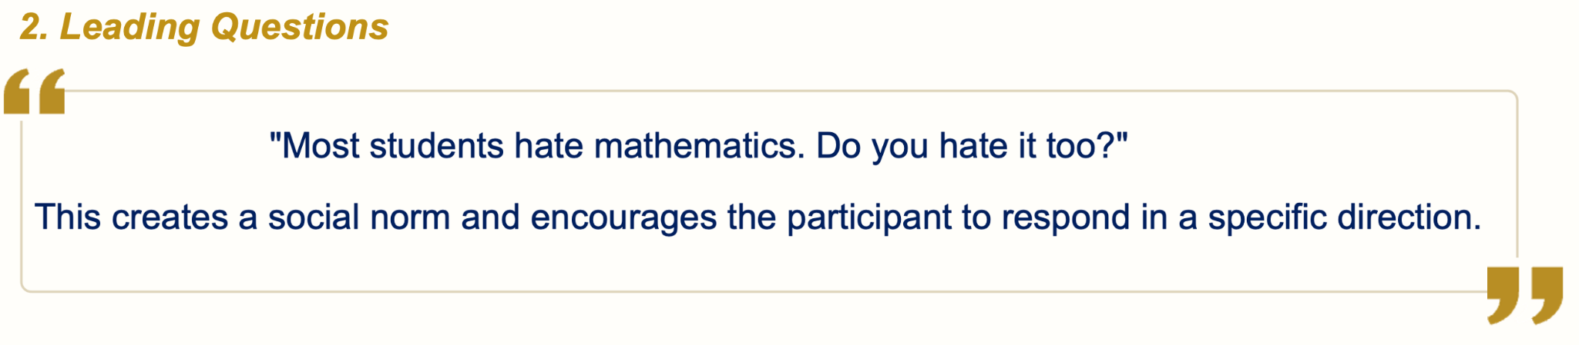
Avoiding the Traps: Common Pitfalls - 🪤
Sampling Bias “We surveyed 10 people from our group chat.” ≠ representative sample.
Homogeneity: Everyone in your group chat likely thinks similarly to you.
Small Sample Size: 10 people do not yield statistically significant results.
Generalization Issue: The opinions of these 10 people do not represent your entire target audience.
Useful Strategies: Random, stratified, convenience, and snowball strategies.

Slide 20

Avoiding the Traps: Common Pitfalls - 🪤
3. Question Order Effects
Primacy Effect
In a student survey about school satisfaction, if you FIRST ask:
“How fair do you think your teachers are when grading assignments?” and THEN ask:
“How satisfied are you with your overall school experience?”
The 1st question primes students to think about fairness and grading, which might make them more critical in their overall satisfaction rating.
Conversely, if you START with: “How much do you enjoy participating in school activities and social events?” and THEN ask about satisfaction, students may answer more positively because they’re thinking about enjoyable aspects of school life.
Notes:
The primacy effect means the questions you ask first influence the answers to subsequent questions.

Slide 21

Avoiding the Traps: Common Pitfalls - 🪤
3. Question Order Effects
Context Effect
In a student survey about teaching quality, if the FIRST questions focus on:
“How often do your teachers assign challenging work?” and “How strict are your teachers with deadlines?”
These items create a context emphaisizing difficulty and strictness. When a LATER item asks,
“How satisfied are you with your teachers overall? ” students may answer more critically because their minds are already focused on demanding aspects of teaching.
If instead the EARLIER questions asked about teacher support or encouragement, the same satisfaction question might receive more positive answers.
Notes:
The context effect means earlier questions shape how later ones are interpreted — not by changing the facts, but by steering participants’ attention and mindset.

Slide 22
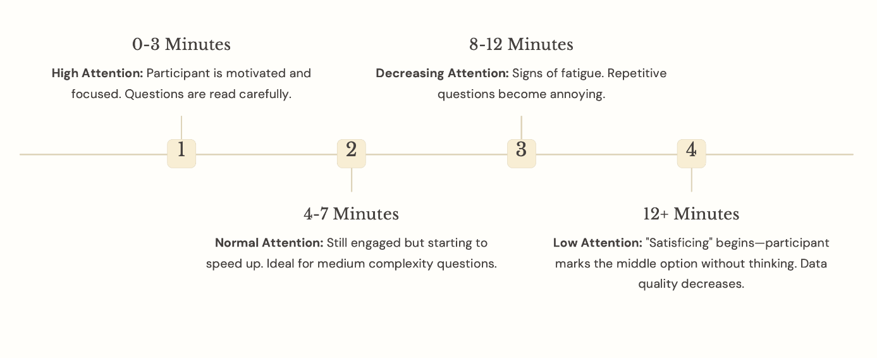
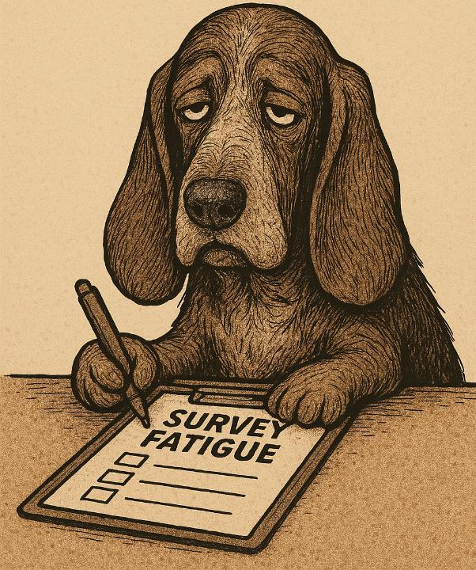
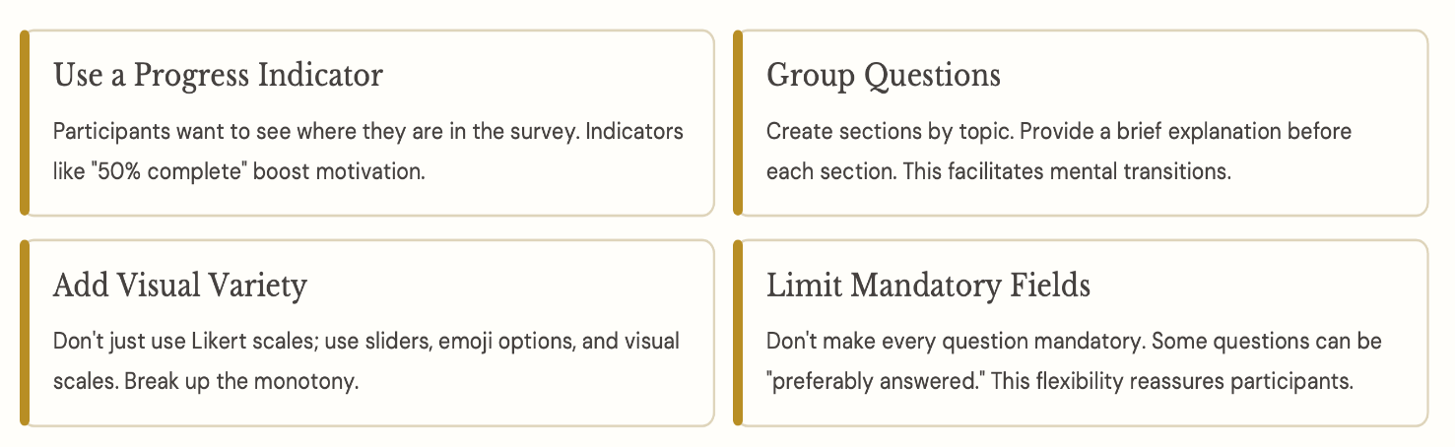
Avoiding the Traps: Common Pitfalls - 🪤
4. Survey Fatigue
Strategies to prevent:

Slide 23

Avoiding the Traps: Common Pitfalls - 🪤
5. Social Desirability Bias
People want to present themselves as better than they are, especially when it comes to social norms, moral values, or sensitive topics.
Student Survey: “How often do you complete your homework on time?”
Bias: Students may say “always” to appear diligent, even if they sometimes miss deadlines.
Teacher Survey: “How often do you differentiate instruction to meet individual student needs?
Bias: Teachers may report doing this more frequently to align with professional expectations/standards.
Parent Survey: “How often do you read with your child at home?”
Bias: Parents might overreport their involvement to appear supportive/engaged in their child’s
education.

Slide 24
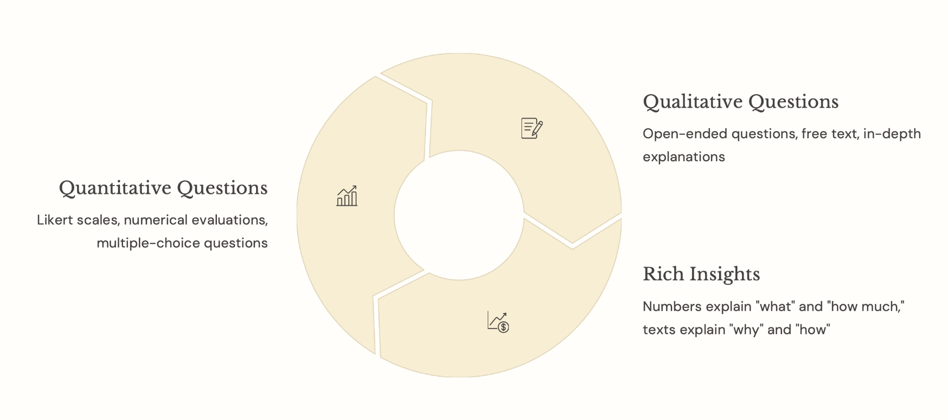
Beyond Simple Responses: Designing for Deeper Insight - 🧠
1. Mixed Methods
You can add an optional "Why?" question after each quantitative question.
Notes:
Classic surveys are effective but one-dimensional. They can only ask predetermined questions, are static, and do not interact with the participant.
However, as technology and methodology evolve, we can make surveys more dynamic, richer, and more engaging.

Slide 25

Beyond Simple Responses: Designing for Deeper Insight - 🧠
2. Adaptive Surveys
“Are you currently enrolled in any online courses?”
If Yes: Next question → “Which online learning platform, do you use most often?”
If No: Next question → “Do you prefer in-person or blended (in-person + online) classes?”
“Do you teach at the elementary, secondary, or post-secondary level?”
If Elementary: Next question → “How often do you integrate play-based learning in your classroom?”
If Secondary: Next question → “How do you assess student engagement in project-based learning?”
If Post-secondary: Next question → “What digital tools do you use to support student collaboration?”
Notes:
Adaptive surveys display different questions based on the participant's previous answers. This personalizes the survey and improves the experience by skipping irrelevant questions. Caution: Excessive branching can complicate the survey flow. Caution! Limit branching to a maximum of 2-3 levels.

Slide 26
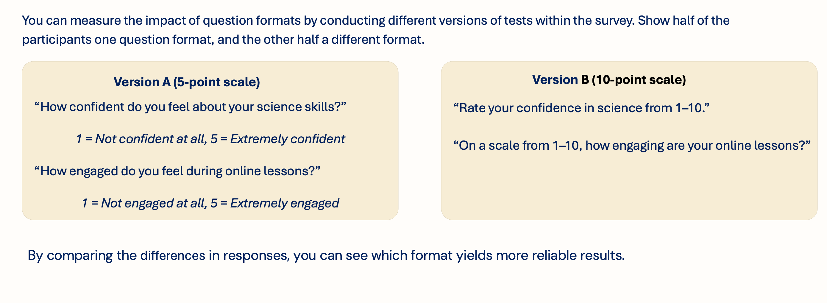


Beyond Simple Responses: Designing for Deeper Insight - 🧠
3. Embedded Experiments

Slide 27
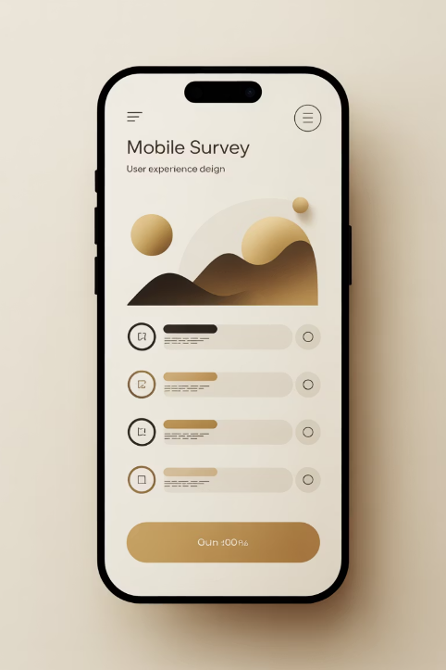
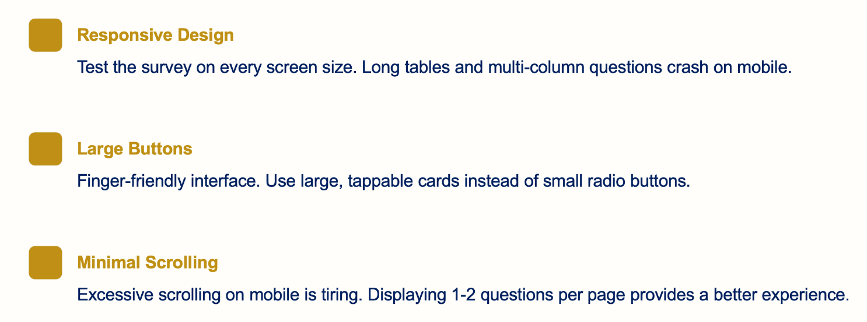
Beyond Simple Responses: Designing for Deeper Insight - 🧠
4. Visual and Mobile Design
More than 60% of surveys are now completed on mobile devices. Therefore, a mobile-friendly design is critical for interactive options.
sliders vs. buttons
emojies vs. bullets
visuals vs. texts
Keep in mind!....

Slide 28




Beyond Simple Responses: Designing for Deeper Insight - 🧠
5. Gamification
Quiz Format: Questions like "Which type of X are you?".
Provide the participant with a profile at the end.
Time Pressure: Use a timer for some questions (use carefully—it can increase stress).
Progress Badges: Earning badges as sections of the survey are completed.
☺ Game psychology ☺
Comparison: At the end, provide feedback like "Compared to other participants..."

Slide 29
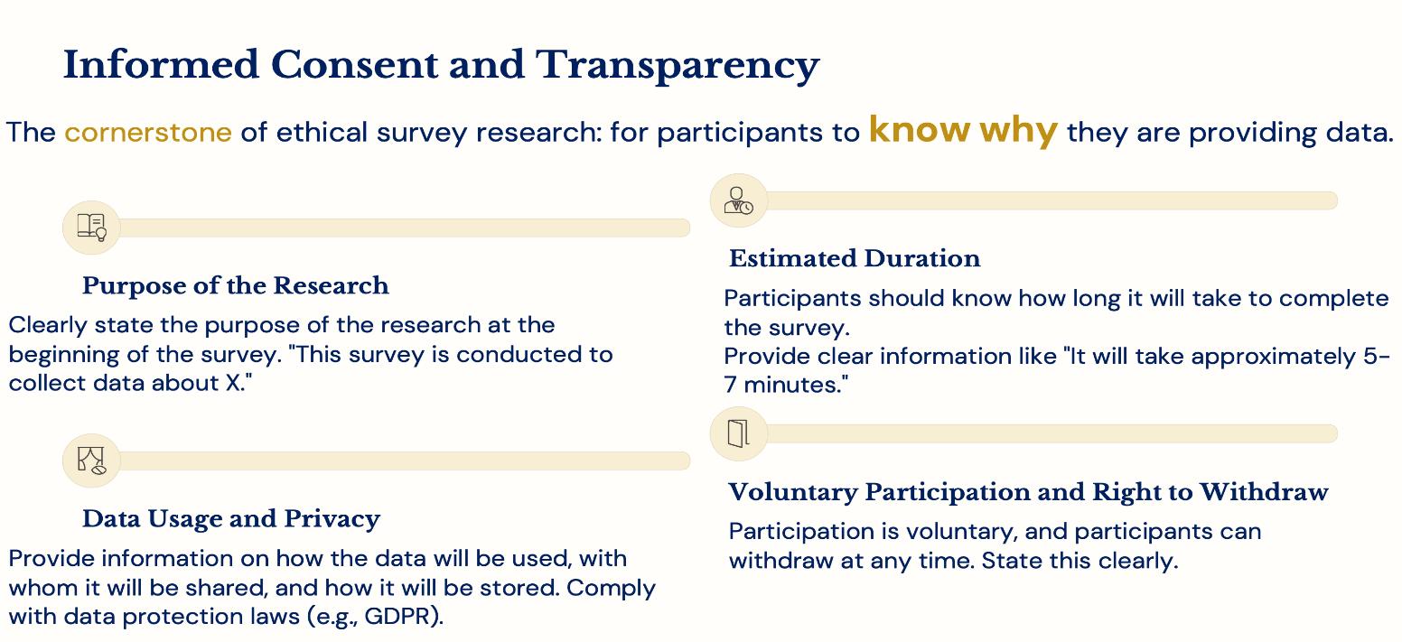

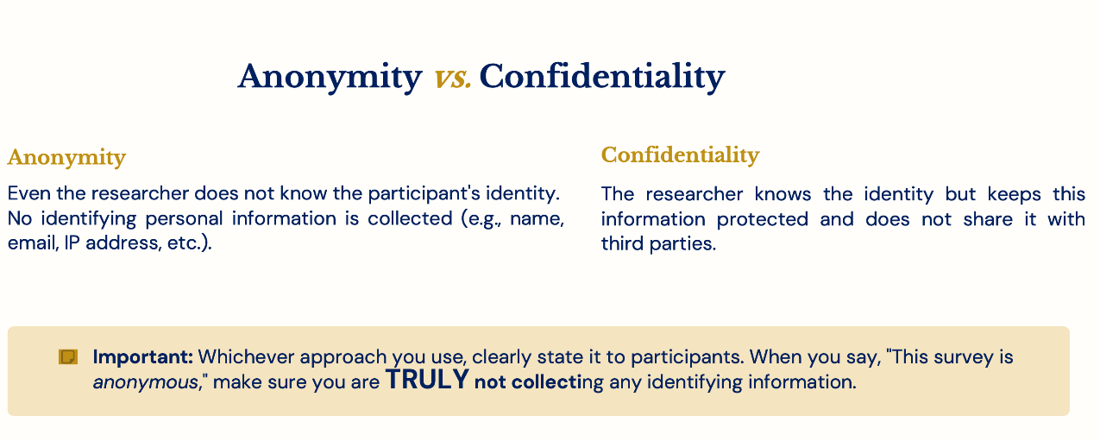
Doing It Right: Ethics, Integrity, and Data Quality - 👍

Slide 30

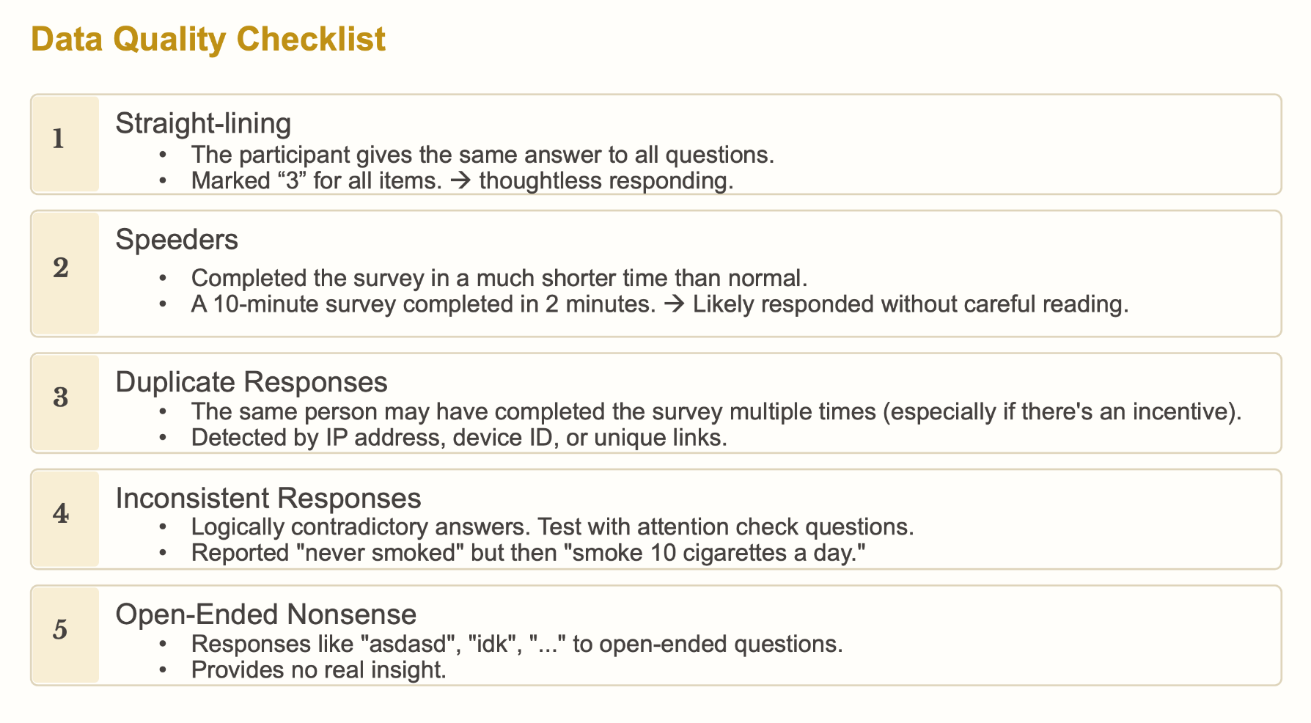
Doing It Right: Ethics, Integrity, and Data Quality - 👍
Notes:
Data Cleaning: Tracing Bad Data
After the survey is collected, the work isn't over—you need to check the quality of the data.

Slide 31
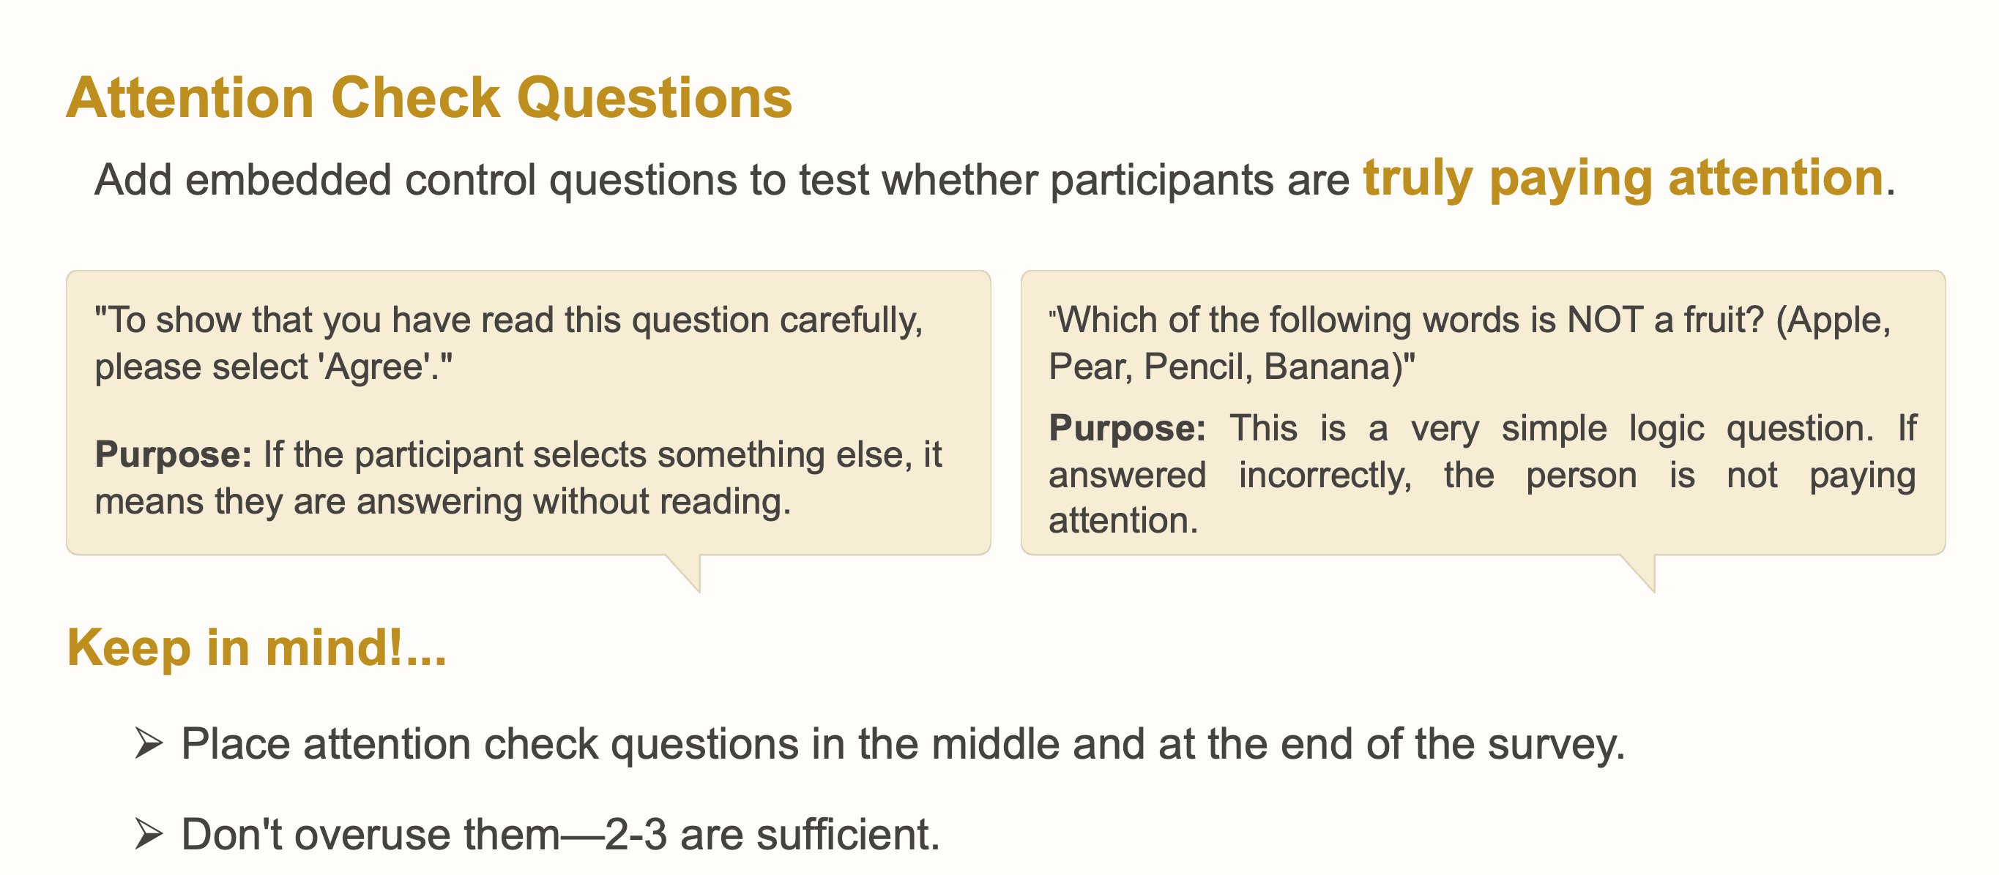
Doing It Right: Ethics, Integrity, and Data Quality - 👍

Slide 32
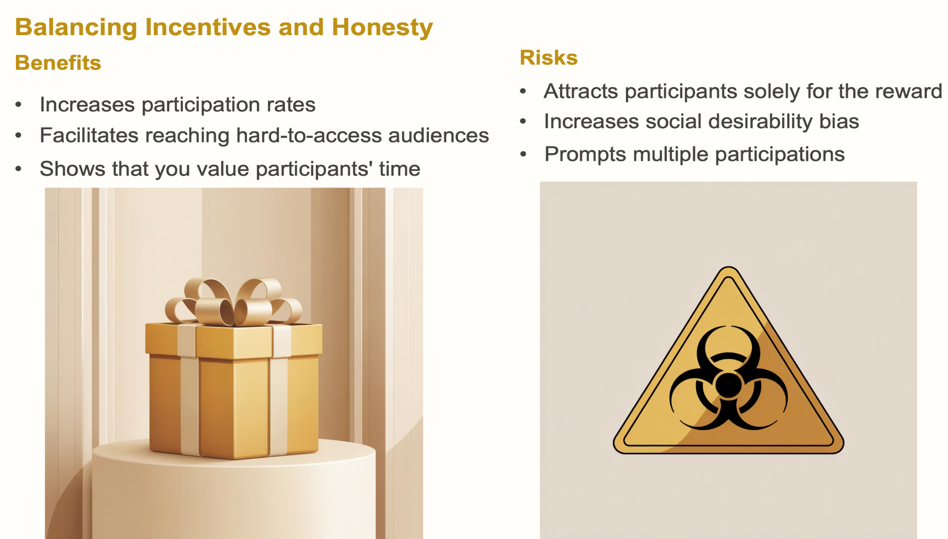
Doing It Right: Ethics, Integrity, and Data Quality - 👍

Slide 33
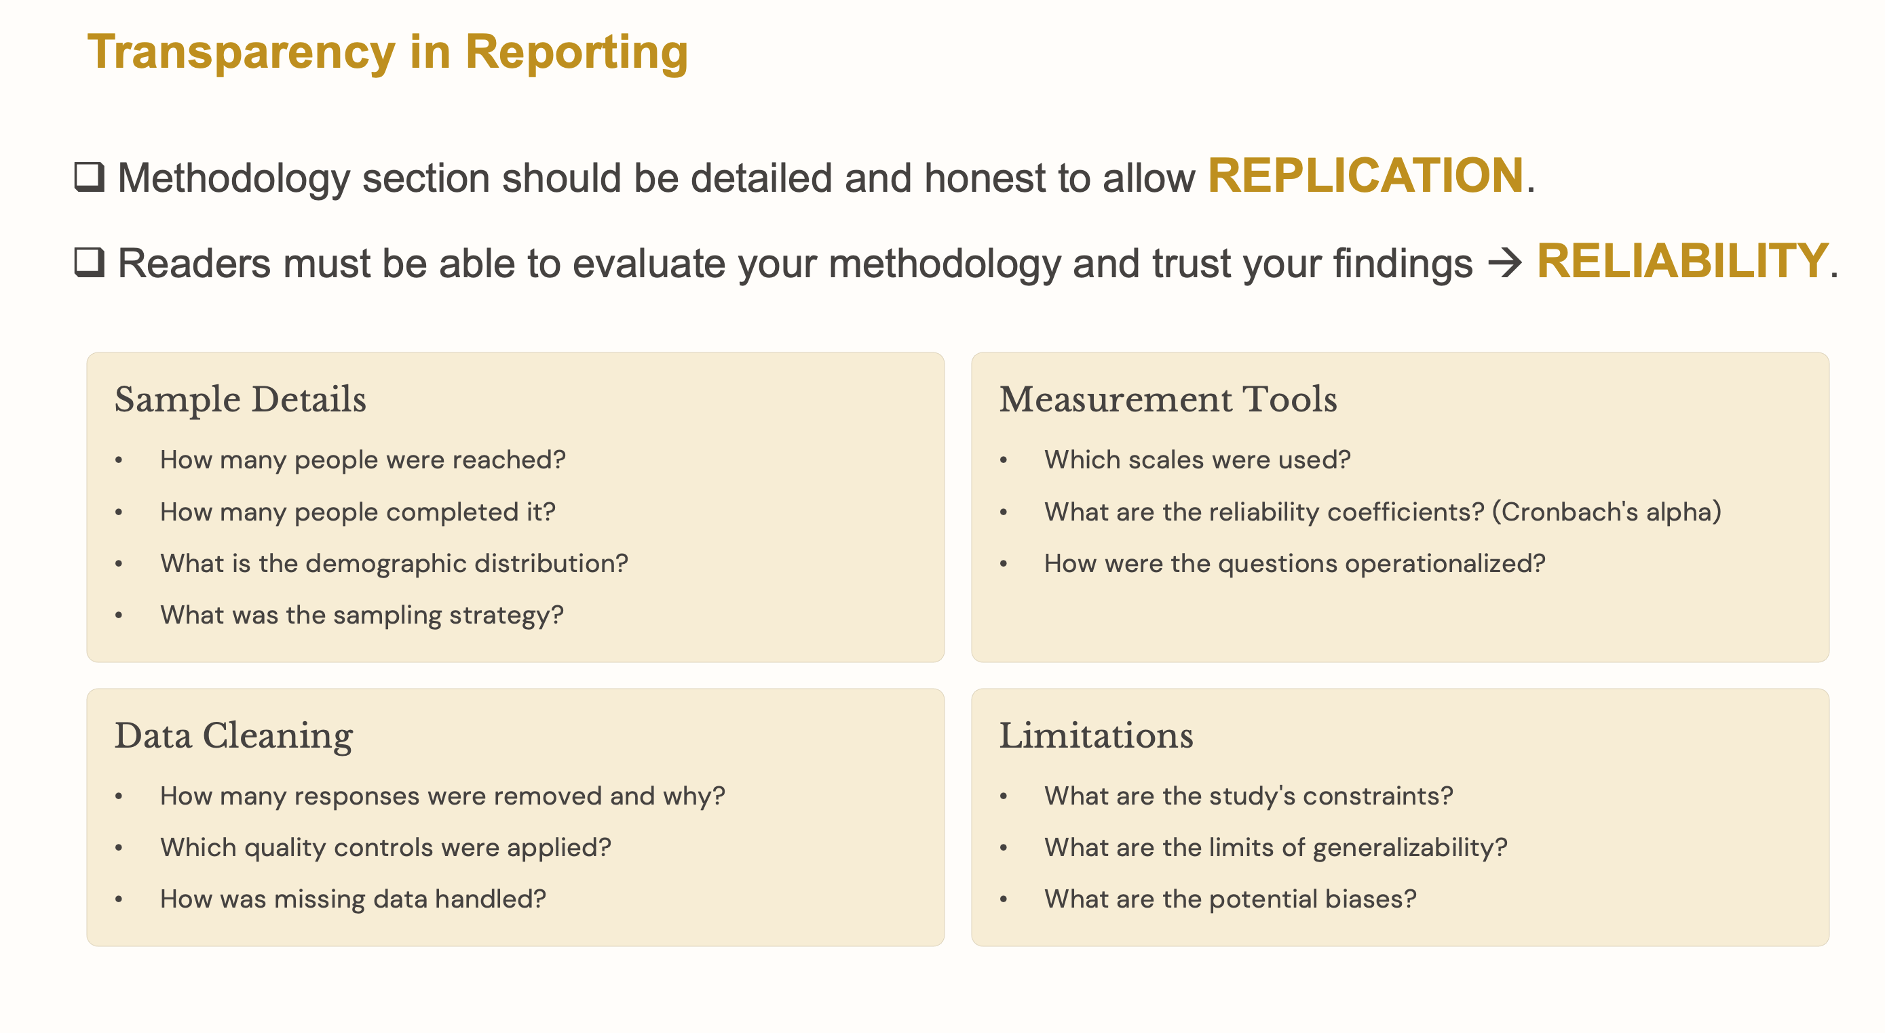
Doing It Right: Ethics, Integrity, and Data Quality - 👍

Slide 34
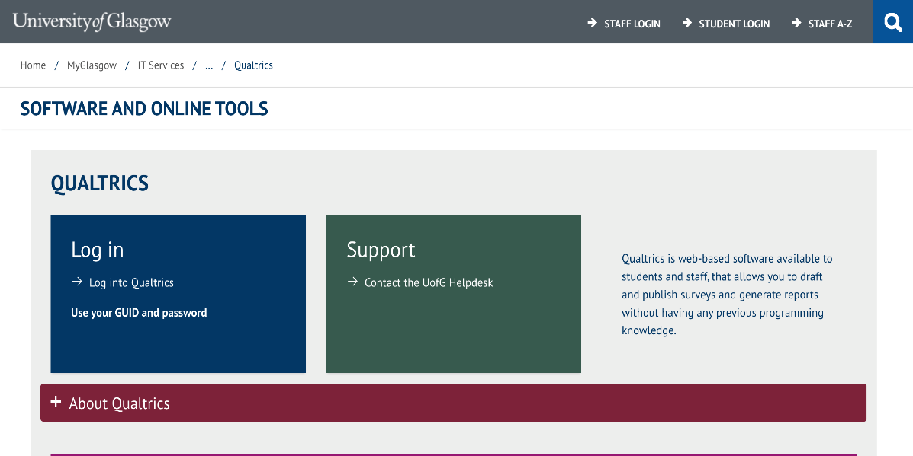
Data Collection and Analysis: Technical Information - 👾
Data Collection: QUALTRICS
Create, distribute, and view questionnaire/survey/test results.
https://www.gla.ac.uk/myglasgow/it/softwareandonlinetools/qualtrics/

Slide 35
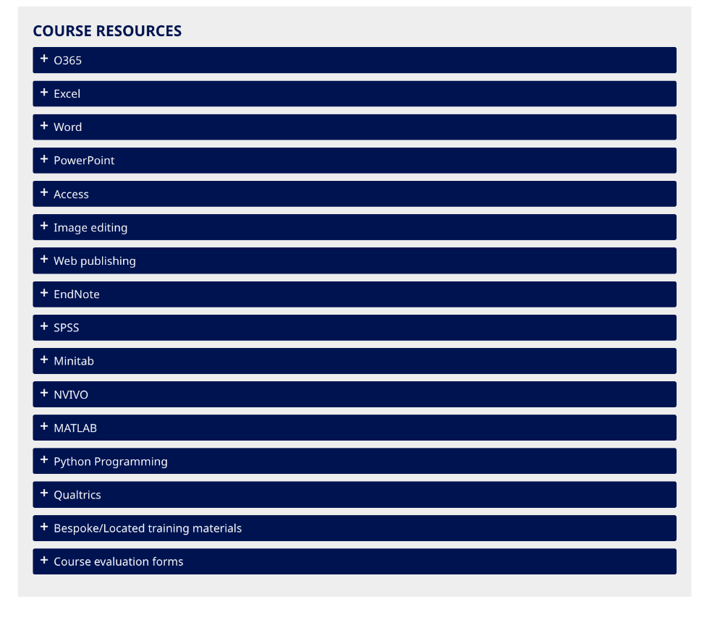
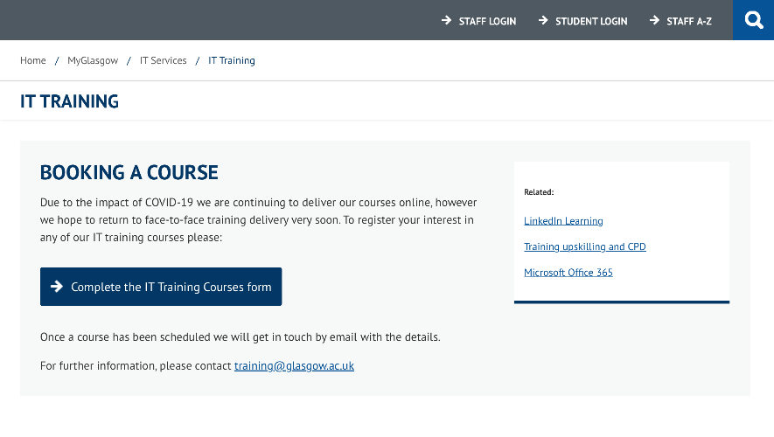
IT Training Team offers introductory courses about how to navigate the platform, design and format different types of questions, and use the features of data analysis.
https://www.gla.ac.uk/myglasgow/it/training/index.html
https://www.gla.ac.uk/myglasgow/it/training/courseresources/
Data Collection and Analysis: Technical Information - 👾
Data Collection: QUALTRICS

Slide 36

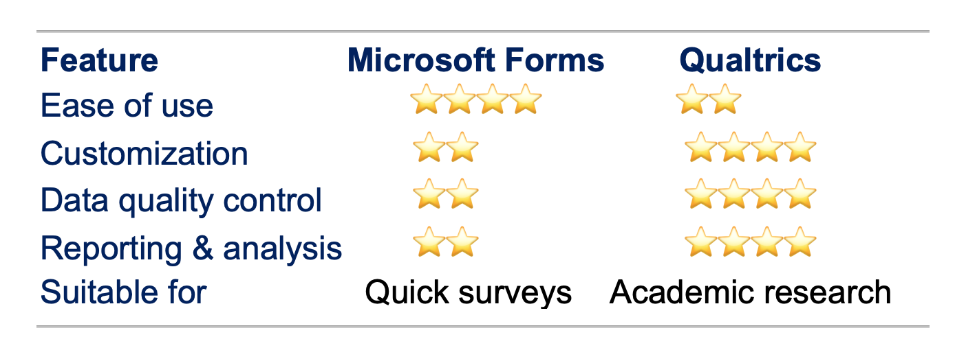
Data Collection and Analysis: Technical Information - 👾
Keep in mind!....

Slide 37
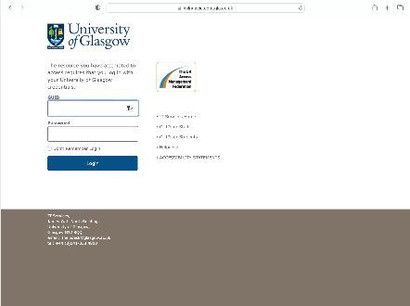
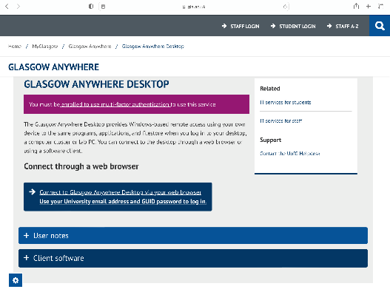
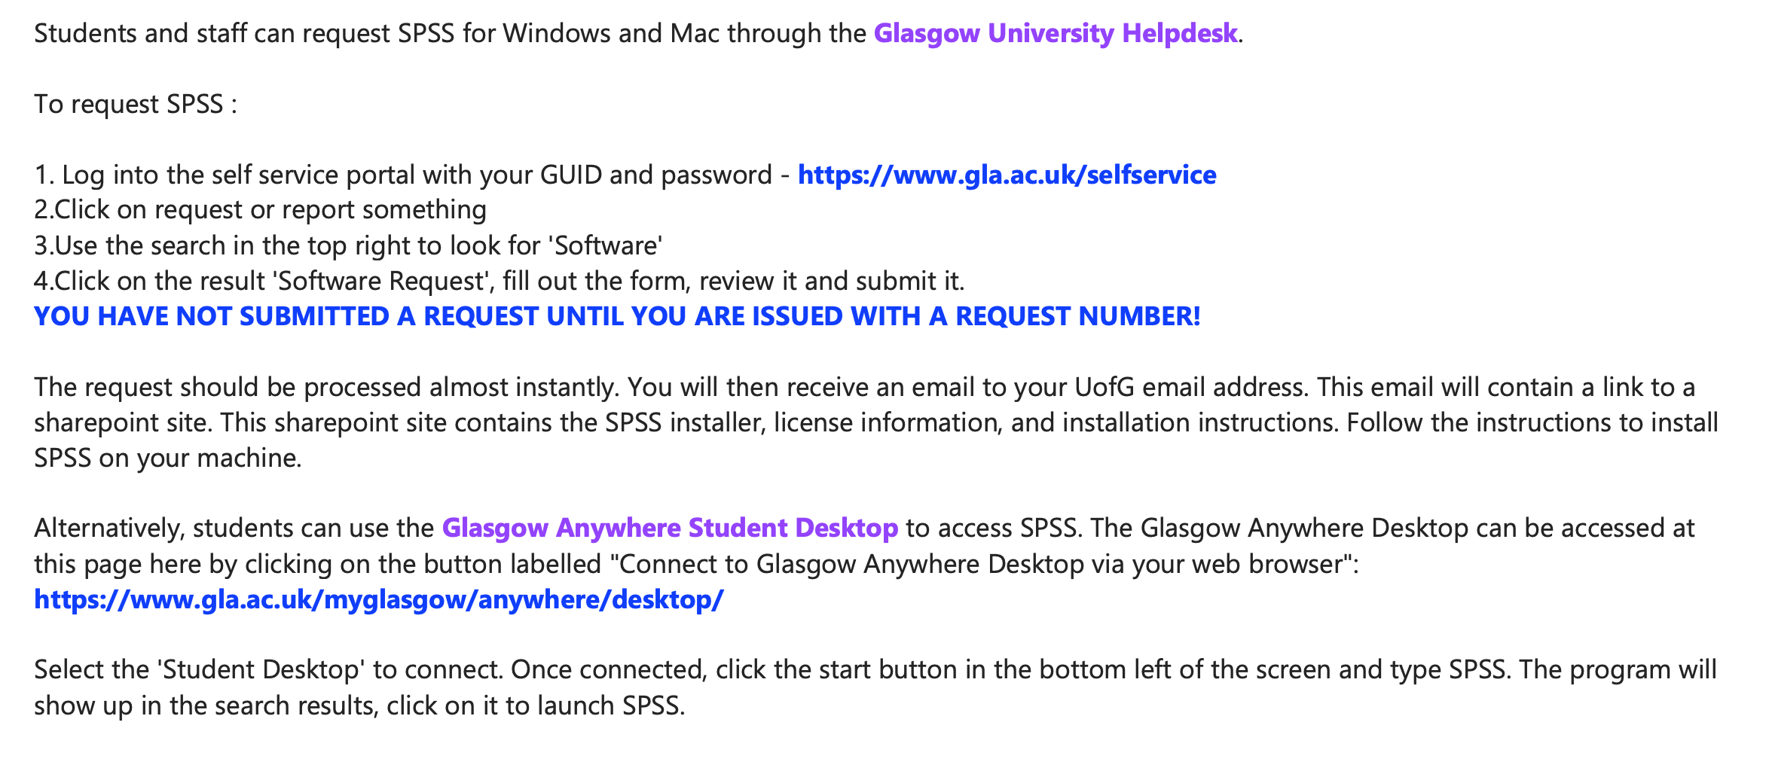
Downloading the Software
Glasgow University Helpdesk
Glasgow Anywhere Student Desktop
Data Collection and Analysis: Technical Information - 👾
Data Analysis: Statistical Package for the Social Sciences (SPSS)

Slide 38
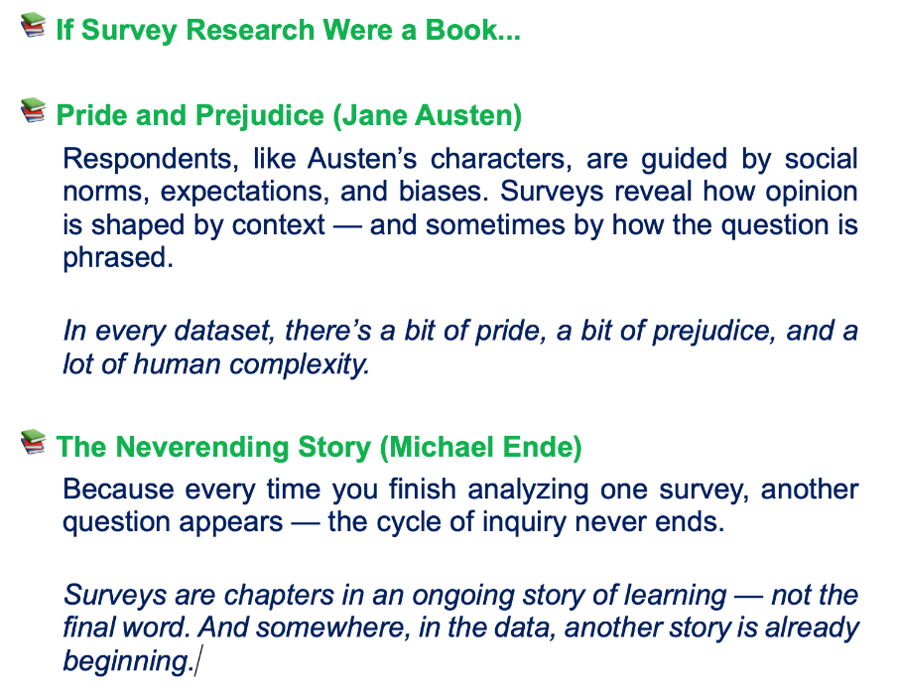

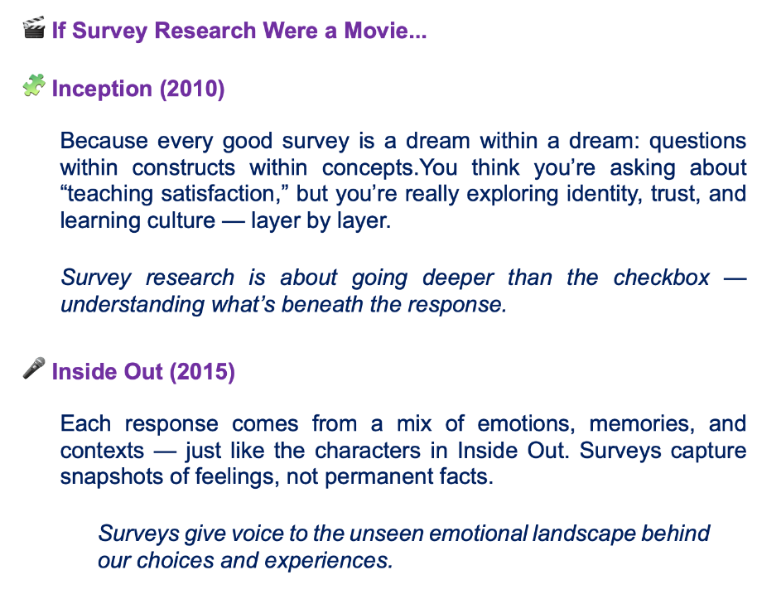
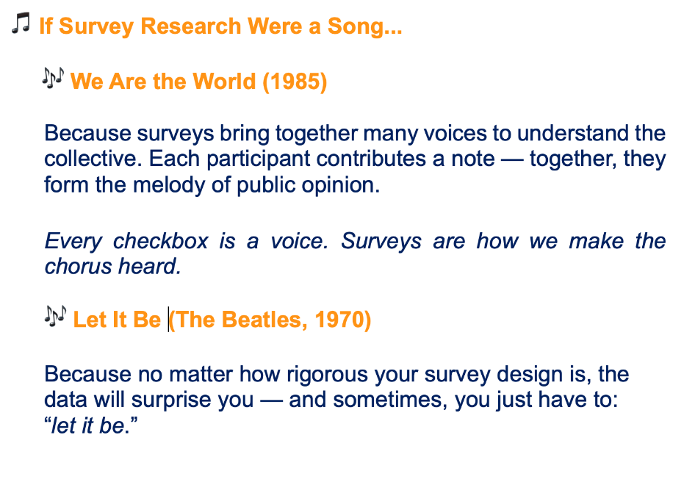


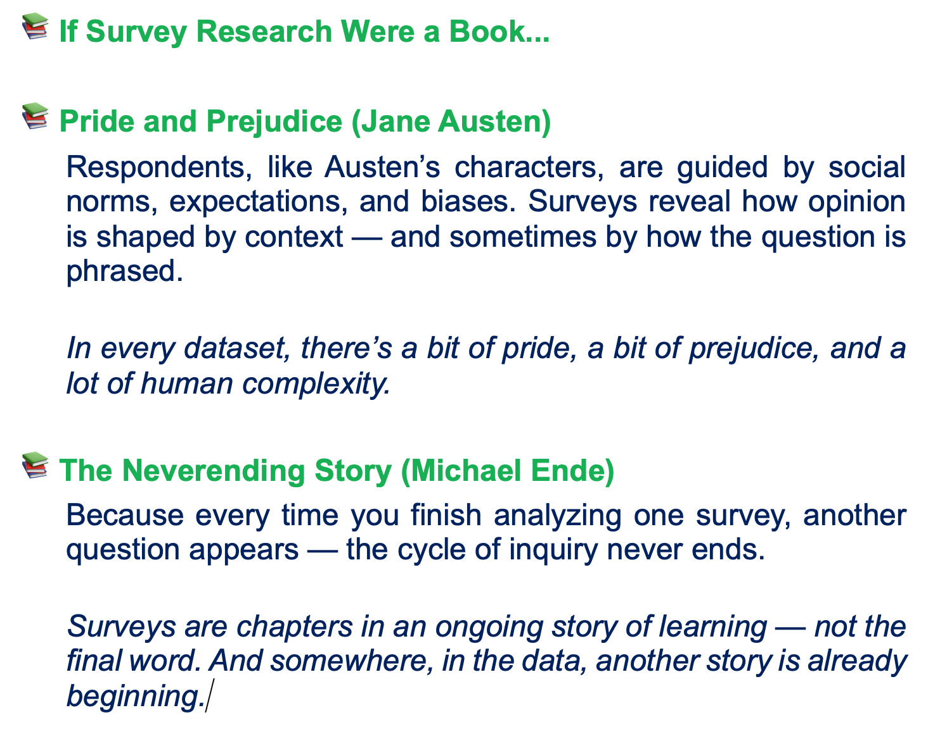
The Last but…
This Photo by Unknown Author is licensed under CC BY-NC-ND
This Photo by Unknown Author is licensed under CC BY-SA
…Not the Least
This Photo by Unknown Author is licensed under CC BY

Slide 39

Developing Your Survey: Crafting and Refining Questions - 📝
♟♘ Step 1: Form Groups
🧵 🧶 Step 2: Design Your Mini-Survey
✅ 📝 Step 3: Exchange and Test
🗣 📢 Step 4: Discuss and Conclude
🤔 🧐 Step 5: Reflect

Slide 40


♟♘ Step 1: Form Groups
Groups of 3-4 People
Choose a Quick Topic
Form small groups with the people around you. The ideal group size is 3-4 people.
Choose something fun but measurable. It doesn't have to be complicated—keep it simple and interesting.
Example Topics:
Coffee drinking habits on campus
Perspectives on AI use in education
Student stress and sleep quality
Motivations for social media use
Favorite procrastination methods
Sustainability behaviors
Remote work preferences
Campus gym satisfaction

Slide 41

🧵 🧶 Step 2: Design Your Mini-Survey
Each group will complete the following tasks:
Choose Response Formats
Write 5 Questions
Select the appropriate response format for each question. Likert scale? Rating? Open-ended?
Make your design decisions consciously.
Define the Goal
At least 3 closed-ended questions (Likert, rating, etc.) and 1-2 open-ended questions.
Apply the principles you learned today:
clear, unbiased, single-dimension questions.
What do you truly want to explore?
Write your research question.
Example: Is there a relationship between students' coffee consumption frequency and their academic performance?
Tip: You can write your survey on paper. The important thing is to experience the design process.

Slide 42

✅ 📝 Step 3: Exchange and Test
Groups will exchange their surveys with each other. Fill out another group's survey.
While Filling Out, Pay Attention To:
Are the questions clear? Did you have difficulty understanding any question?
Is there bias? Did the questions push you to answer in a certain way?
Is it tedious? Did the survey feel boring or long?
Are the answer options sufficient? Were the answer options you wanted not available?
How was the overall experience? Was filling out the survey enjoyable or cumbersome?
Take notes! This feedback is very valuable.

Slide 43
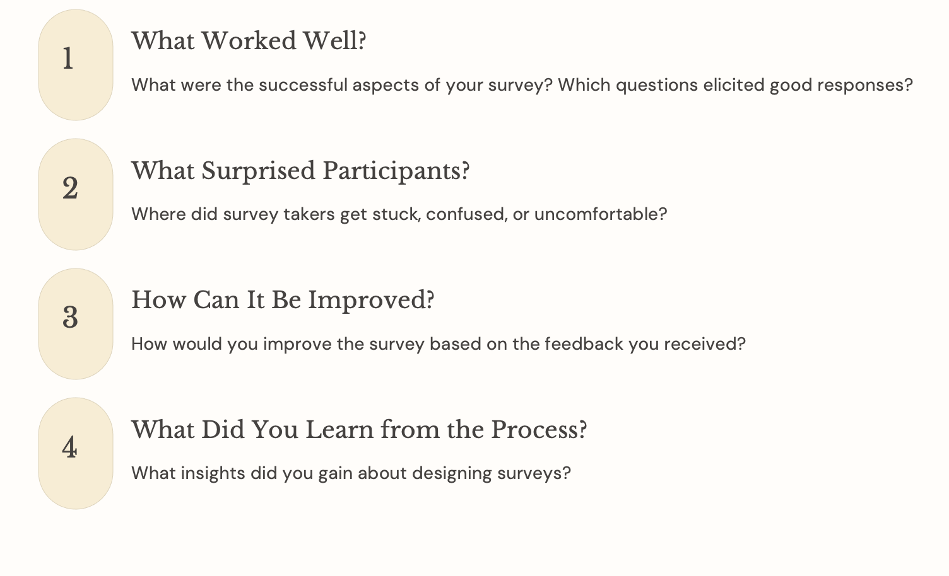
🗣 📢 Step 4: Discuss and Conclude
Groups will come together and share their experiences. Each group will briefly present:

Slide 44
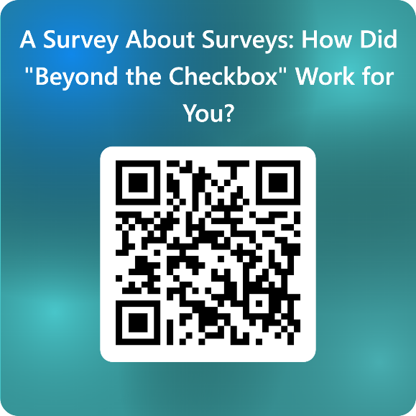
🤔 🧐 Step 5: Reflect
Survey research isn't about checking boxes — understanding people through structured curiosity.
Every survey teaches you two things about:
your topic, and
how humans interpret questions.
The real skill isn’t just collecting data—it’s designing empathy into measurement.
TAKE AWAY! A good survey isn't one that GETS responses, but one that EARNS responses.
https://forms.office.com/e/ndd7QgbWDg

Slide 45


THANK YOU!... ☺
Q & A ?
📩 Utkun.Aydin@glasgow.ac.uk
@Utkun79
www.linkedin.com/in/utkun-aydın

