Slide 1
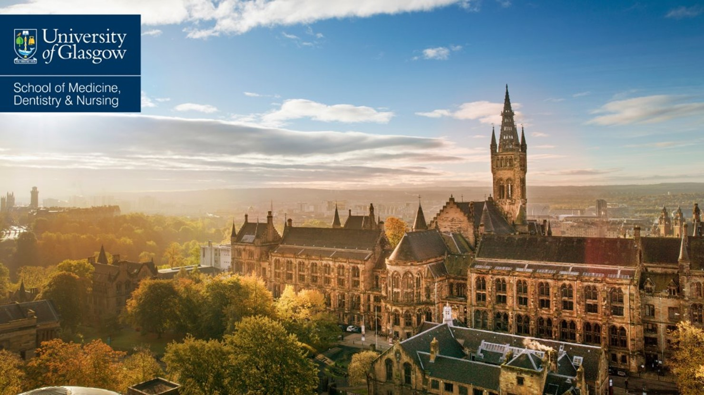
BDS Interviews 2026

Slide 2
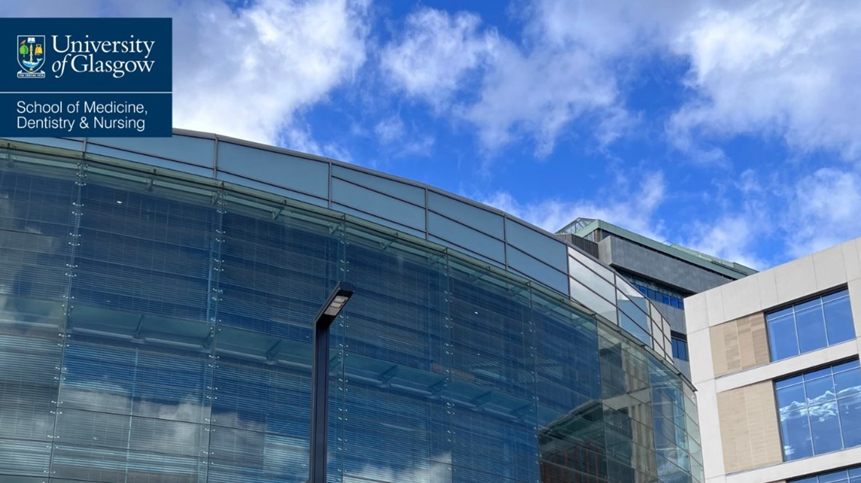
For 2026 entry, interviews will take the form of online Multiple Mini Interviews (MMIs). Interviews will take place 23, 25 & 27 February 2026.
The Interview
All necessary instructions and guidance will be given to applicants prior to their interview.
Interview questions/scenarios will be based on role-play and discussion around pertinent topics around becoming a member of the dental profession.
The interview process will last approximately 30 minutes in total, and applicants will be assigned to online breakout rooms, and will progress through 5 different questions/scenarios.
Applicants will be interviewed by one member of staff in each question/scenario.
The interviews are conversational, with no writing required at any stage of the process. Each question/scenario will be 6 minutes in total, which includes 1-minute reading time.
Interview Preparation
Refer to the BDS curriculum - https://www.gla.ac.uk/undergraduate/degrees/dentistry/
Refer to our Person Specification - https://www.gla.ac.uk/media/Media_1170595_smxx.docx
Revisit your personal statement (interviewers have no knowledge of you other than your full name).
Think of examples of your achievements and skills.
Consider your personal characteristics and how these align with the attributes expected of a dentist.
Reflect on previous interactions or experiences so that you can draw on them in the various scenarios.
Be aware of current issues/challenges within the NHS/Dentistry.

Slide 3
Interview Confidentiality
Your online interview will be subject to similar expectation regarding confidentiality as a face-to-face interview. You should not:
discuss questions you were asked or scenarios in your interview with others, either online or in person, following your interview and that includes your school.
use any smartphone, electronic device, AI, or written resource during your interview.
record your interview in any way.
The University does not record interviews, and we do not give permission for any part of your interview to be electronically recorded. We will hold no record of your interview performance other than interviewers’ score sheets.
Remember that integrity is an important aspect of good dental practice. We would view any failure to respond to the guidance in this section as an issue of fitness to practise which could jeopardise any offer you are made.

Slide 4
Important Interview Information
An interview is not guaranteed.
If an applicant is invited to interview, they will be notified by email only. Applicants will be informed if they have been successful in being offered an interview mid-December. Invites will be sent to the email address provided on your UCAS application. Please remember to check your spam or junk folder just in case.
An applicant must advise the BDS Admissions Team directly if they will not be attending a scheduled interview. Applicants who do not attend their interview will not be considered further. Please contact med-sch-dental-ug@glasgow.ac.uk
Applicants to the BDS programme are encouraged to disclose any current or previous health conditions and/or disabilities, so that advice and support can be offered where necessary. Applicants who declare any health issues are considered on the same criteria and principles as all other applicants. Regarding arrangements for interview, should you have a visual or hearing impairment, mental health difficulty, physical, mobility or other disability that we need to know about prior to your interview, please email med-sch-dental-ug@glasgow.ac.uk as soon as possible so that any necessary modifications/support can be arranged.
The Dental School aims to process interview decisions on UCAS Track by the 31st of March at the latest.
Detailed interview feedback will not be provided.
Please note that your application will be considered and administered based on the information given on the UCAS application form and you must notify us immediately of any changes.

Slide 5
Full Admissions Process document can be found in the link below:
https://www.gla.ac.uk/media/Media_1105179_smxx.docx
If you have any further queries, please contact the Admissions team – med-sch-dental-ug@glasgow.ac.uk

