Slide 1
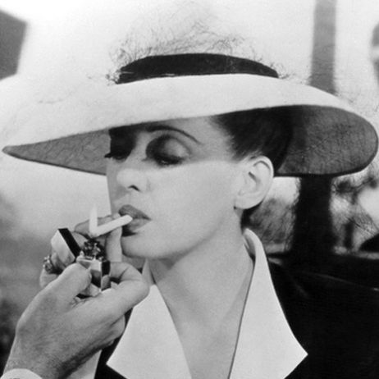
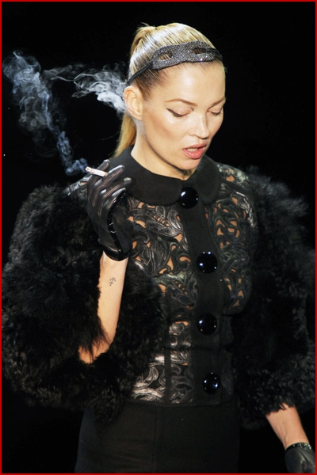


‘Risking enchantment’
How are we to view the smoking person?
_{Jane Macnaughton}
(Susana Carro-Ripalda, Andrew Russell
Paper forthcoming in Critical Public Health)
,
Notes:
http://www.google.co.uk/imgres?imgurl=http://content9.flixster.com/photo/99/12/37/9912371_gal.jpg&imgrefurl=http://www.flixster.com/photos/bette-david-now-voyager-9912371&usg=__lAFp4olIhLqxATRjZ97riL-Oeh4=&h=462&w=462&sz=26&hl=en&start=12&zoom=1&tbnid=kB-BQTm_AaEoQM:&tbnh=151&tbnw=139&ei=Pnv-TaGTF4e3hQfile2aCw&prev=/search%3Fq%3Dnow%2Bvoyager%2Bbette%2Bdavis%26um%3D1%26hl%3Den%26biw%3D1071%26bih%3D633%26tbm%3Disch&um=1&itbs=1&iact=hc&vpx=807&vpy=303&dur=178&hovh=225&hovw=225&tx=167&ty=197&page=2&ndsp=13&ved=1t:429,r:12,s:12&biw=1071&bih=633
http://www.google.co.uk/imgres?imgurl=http://www.fadedyouthblog.com/wp-content/uploads/2011/03/kate-moss-smoking-louis-vuitton6.jpg&imgrefurl=http://www.fadedyouthblog.com/221133/kate-moss-smoking-on-the-runway/kate-moss-smoking-louis-vuitton6&usg=__X98Qg9YnpsELqqSyS0DJPCFoTTU=&h=600&w=400&sz=124&hl=en&start=0&zoom=1&tbnid=dJz_E2tkgaVgTM:&tbnh=183&tbnw=133&ei=kXv-TcbGFYOxhQfdvrCcCw&prev=/search%3Fq%3Dkate%2Bmoss%2Bsmoking%26um%3D1%26hl%3Den%26biw%3D1071%26bih%3D633%26tbm%3Disch&um=1&itbs=1&iact=hc&vpx=433&vpy=69&dur=139&hovh=275&hovw=183&tx=107&ty=169&page=1&ndsp=15&ved=1t:429,r:2,s:0&biw=1071&bih=633

Slide 2
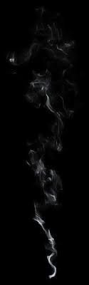
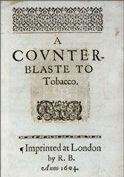

..a custom loathsome to the eye, hateful to the nose, harmful to the brain, dangerous to the lungs, and in the black stinking fume thereof nearest resembling the horrible stygian smoke of the pit that is bottomless.
James VI and I, 1604

Slide 3
GP: If it’s an ulcer in your stomach, if it’s gastritis then smoking isn’t helping it (both laugh) but that’s something we go on about all the time.
Pt: (laughing a lot) I just asked that chap in there why have a questionnaire about smoking?
GP: I had to get it in somewhere.
Pt: I think you’re directing that at me weren’t yer?
….
GP: Oh I don’t know. It’s a bit of both…
Pt: I’ll give up smoking when you get me better.
GP:… I’m saying that it’s the smoking that’s doing it…
Pilnick and Coleman, 2003

Slide 4
GP: But it’s a serious time for the smoking for both of you, isn’t it?
Pt: We all want this magic cure, you know that makes you give up smoking. You know when you’ve got this little voice in your head saying “you enjoy those” and they are your sanity it’s very hard to give up smoking….
The patches to a degree work but you can’t sleep at night; I don’t sleep if I have those patches on.
GP: Well take them off. Take the patches off when you go to bed.
Pt: Yes but when I wake up I try to smoke..
GP: …. The patches take away the dependence on nicotine. They sort out that side..
Pt: But the habit.
GP: But the habit of just having something to do with your fingers. If you want to. It’s actually that wanting to. You say you actually enjoy it; I can accept that comment.
Pt: Only a few though don’t you. You don’t enjoy all of them…
GP: No some of them you are just smoking for the sake of smoking them but it comes down to the fact that you have a bloody great pain in the chest and here you are worried to death that you’ve got something nasty in your chest. Knowing in fact that smoking gives you lung cancer. I mean Christ what more do you want?
Pilnick and Coleman, 2003

Slide 5
.So everytime you get stressed about something, or, you know.. I’ve got an essay to do and I’ve got this or I’ve got that. I’ll have a cigarette. It’s always a way out, so I see that as like a partner.
Hargreaves, Amos et al, 2010
I was conscious of the fact that I could show her I could really smoke so I was full draw-back, coming out of my nose, the whole thing…
Thompson, L, Pearce, J, Barnett R, 2009.
It [smoking] is the best and worst friend you can have. .. he is the best because he is with you when you are sad, when you’re happy, when you have insomnia, when you’re busy, when you’re quiet, he’s there beside you, at your fingertips… It is worse because it kills you, but it causes great pleasure..
Trotta Borges, Simoes-Barbosa, 2008

Slide 6
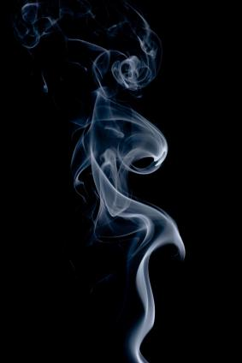
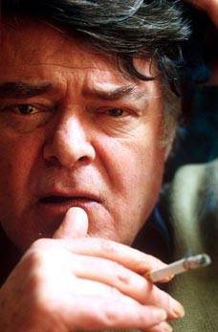
‘..our smoking was exhilaratingly furtive, the deep, dark, swirling pleasures of the smoke being sucked into fresh, pink, welcoming lungs, it took me just three or four cigarettes to acquire the habit and you know there are still moments now when I catch more than a memory of the first suckings-in, the slow leakings-out when the smoke seems to fill the nostril with far more than the experience of itself, and I regret the hundreds or thousands of cigarettes that I never experienced, inhaled and exhaled without noticing…’
Simon Gray, The Smoking Diaries, 2004.

Slide 7
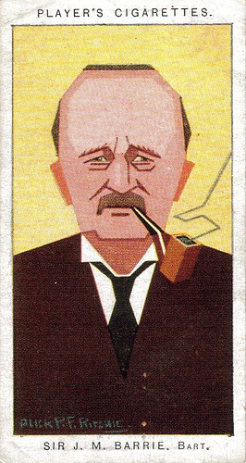
Darkness comes, and with it the porter to light our stair gas…The men on my stair emerge from their holes…Soon we are in the old room again, Jimmy on the hearthrug, Marriot in the cane-chair; the curtains are pinned together with a pen-nib, and the five of us are smoking the Arcadia Mixture.
The very smell of tobacco is abominable, for one cannot get it out of the curtains. And there is little pleasure in existence unless the curtains are all right.
J. M. Barrie, My Lady Nicotine, 1890.

Slide 8
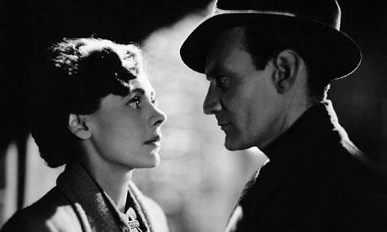
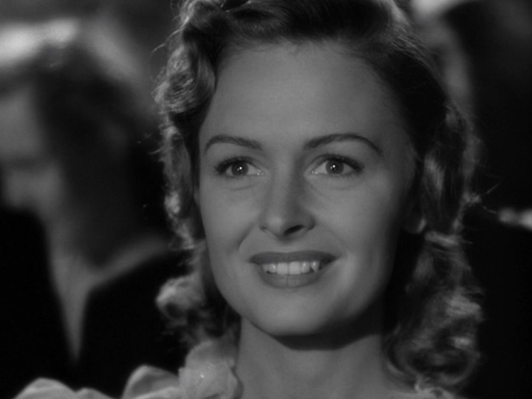

GOODY
VAMP
Notes:
http://ann-lauren.blogspot.com/2009/12/20th-cent-marlene-dietrich.html
http://www.guardian.co.uk/lifeandstyle/poll/2011/jan/20/relationships-my-love-life-your-hands
http://www.dvdbeaver.com/film/dvdcompare/wonderfullife.htm

Slide 9
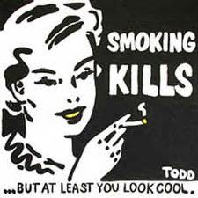
‘I was conscious of the fact that I could show her [companion] I could really smoke….There must be an element of wanting to belong to that crowd…it’s that naughty girl thing – we’re the coolies because we know how to do it.’
Thompson, Pearce & Barnett, 2009.

Slide 10
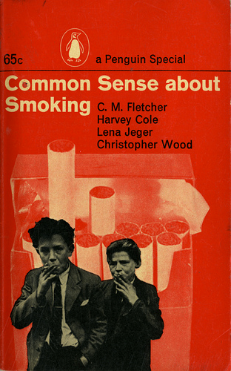

Slide 11
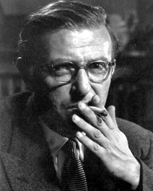
Some years ago I brought myself to the decision not to smoke any more. The struggle was hard, and in truth, I did not care so much for the taste of the tobacco which I was going to lose, as for the meaning of the act of smoking. A complete crystallization had been formed. I used to smoke at the movies, in the morning while working, in the evening after dinner, and it seemed to me that in giving up smoking I was going to strip the film of its interest, the evening meal of its savour, the morning work of its fresh animation. Whatever unexpected happening was going to meet my eye, it seemed to me that it was fundamentally impoverished from the moment that I could not welcome it while smoking. To-be-capable-of-being-met-by-me-smoking: such was the concrete quality which had been spread over everything. It seemed to me that I was going to snatch it away from everything and that in the midst of this universal impoverishment, life was not so worth living.
J. P. Sartre, Being and Nothingness, 1958

