Slide 1
Psychiatry beyond the current paradigm: The role of narrative psychiatry
Philip Thomas
Honorary Visiting Professor
Social Science and Humanities
University of Bradford

Slide 2
‘The balance between science/technology and art has shifted so far towards the former that the latter is a pale shadow, a fragile remnant of what had for centuries been crucial to the work of the doctor’
(Kleinman, 2008:22)

Slide 3
Outline of Talk
Define the technological paradigm.
Examine recent evidence from within the paradigm shows that the non-technological components of therapeutic interventions are effective in psychiatry.
Set out the main features of narrative psychiatry
Illustrate narrative psychiatry through a short story

Slide 4
What is the technological paradigm?
1. Madness arises from faulty mechanisms or processes involving abnormal physiological or psychological events occurring within the individual.
2. These mechanisms or processes can be modelled in causal terms. They are not context-dependent.
3. Technological interventions are instrumental and can be designed and studied independently of relationships and values.

Slide 5
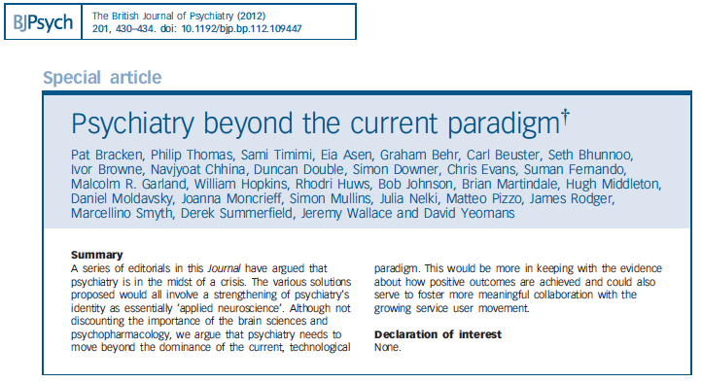

Slide 7
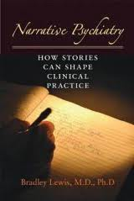
Narrative Psychiatry Lewis, B. (2011) Narrative Psychiatry: How Stories Can Shape Clinical Practice Baltimore, The Johns Hopkins University Press.

Slide 8
Narrative theory in narrative psychiatry
Plot - draws different elements together in a meaningful way.
Metaphor – juxtaposition of words to create new meaning.
Narrative identities

Slide 10
Selected References
Bolton, D. & Hill J. (1996 ) Mind, meaning and mental disorder. Oxford: Oxford University Press.
Bracken, P., Thomas, P., Timimi, S. et al (2012) Psychiatry beyond the current paradigm. British Journal of Psychiatry, 201:430-434.
Frank, A. (1995) The Wounded Storyteller: Body, Illness and Ethics. Chicago, University of Chicago Press.
Heidegger, M. (1962) Being and Time. (trans. J. Macquarrie & E. Robinson). Oxford, Basil Blackwell.
Holmes, J. (2000) Narrative in psychiatry and psychotherapy: the evidence? Journal of Medical Ethics: Medical Humanities. 26, 92 - 96.
Laing, R. (1960) The Divided Self. London, Tavistock.
Lewis, B. (2011) Narrative Psychiatry: How Stories Can Shape Clinical Practice Baltimore, The Johns Hopkins University Press.
MacIntyre, A. (1981) After Virtue. Notre Dame, University of Notre Dame Press.

Slide 11
20. Andrews G. Placebo response in depression: bane of research, boon to therapy. Br J Psychiatry 2001; 178: 192-94.
21. Kirsch I, Sapirstein G. Listening to prozac but hearing placebo: a meta-analysis of antidepressant medication 1998. Prevention and Treatment, 1, Article 0002a. http://journals.apa.org/prevention/volume1/pre0010002a.html
22. JC, DeRubeis RJ, Hollon SD, et al. Antidepressant drug effects and depression severity: a patient-level meta-analysis. JAMA 2010; 303: 47-53.
24. Kirsch I, Deacon BJ, Huedo-Medina TB, Scoboria A, Moore TJ, Johnson BT. Initial severity and antidepressant benefits: a meta-analysis of data submitted to the Food and Drug Administration. Public Library of Science: Medicine 2008 ; 5, e45.
34. Jacobson NS, Dobson KS, Truax PA, Addis M, Koerner K, Gollan JK, Gortner E, Prince SE. A component analysis of cognitive-behavioural treatment for depression. Journal of Consulting and Clinical Psychology 1996; 64: 295-304.
35. Longmore RJ, Worrell M. Do we need to challenge thoughts in cognitive behaviour therapy? Clinical Psychology Review 2007; 27: 173-87.
36. Budd R, Hughes I. The Dodo Bird verdict – controversial, inevitable and important: a commentary on 30 years of meta-analyses. Clinical Psychology and Psychotherapy 2009; 16: 510-522.
37. Cooper M. Essential Research Findings in Counselling and Psychotherapy: The Facts are Friendly. Sage Publications, 2008.
38. Castonguay LG, Beutler LE. Common and unique principles of therapeutic change: What do we know and what do we need to know? In LG Castonguay, LE Beutler (Editors), Principles of Therapeutic Change that Work. Oxford University Press, 2005.
39. Stiles WB, Barkham M, Mellor-Car J. Effectiveness of cognitive-behavioural, person-centred, and psychodynamic therapies in UK primary-care routine practice: replication in a larger sample. Psychological Medicine 2008; 38,: 677-688.

