Slide 1
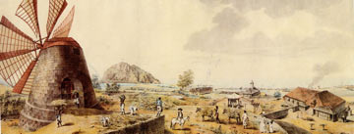
Slavery and the sugar plantation

Slide 2
Learning Intentions
Today I will learn about sugar plantations and what the slaves in them did.
I will know I’ve been if I can:
Gather information on sugar plantations from both written and visual sources.
Discuss the relationship between slaves and masters.
successful

Slide 3
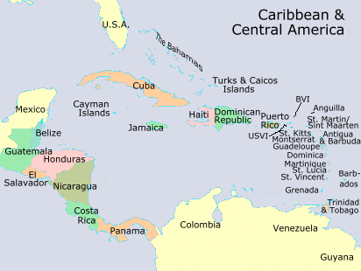
There were many different types of plantations in the Caribbean during the slave trade.
Slaves (owned by the French and English) produced different products on each plantation – like cotton, coffee and rice.
BUT, what was the main crop produced on plantations throughout the 18th, 19th and 20th centuries?
HINT: it goes in your tea........

Slide 4
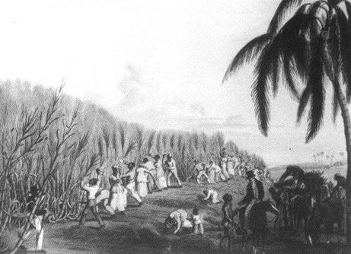
Why would the Europeans want sugar?
What would they use it for?

Slide 5
TASK
In your group, look at the three images in front of you......
What is going on in the pictures?
What do the conditions look like?
What are the slaves doing?
How do you think the slaves feel?
Could you think of a modern day headline
to go on a newspaper about the image?
Remember to write your answers down.
15 MINUTES

Slide 6
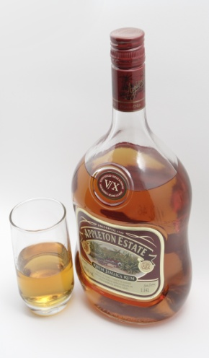
How was sugar produced?
Planting
Cutting
Crushing
Boiling
Curing
Molasses
Rum
SUGAR

Slide 7
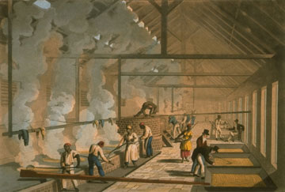
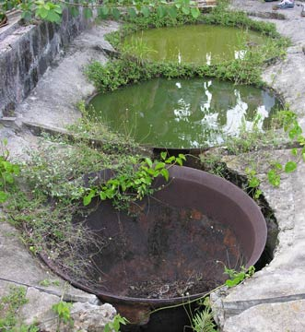
How dangerous do you think it was to produce sugar?
"The story of sugar was not all sweetness.”
“If a Boyler gets any part into the scalding Sugar, it sticks like Glew, or Birdlime, and 'tis hard to save either Limb or Life."

Slide 8
TASK
Think about what we have already discussed about how sugar was made, what the conditions were like for slaves and what slaves were made to do.
Think now about how these conditions affected the
relationship between slaves and their owners
Look at the primary quotes and secondary historians
quotes on your worksheet.
Answer the questions in your textbook.
20 MINUTES

Slide 9
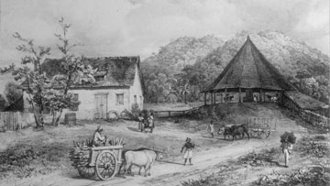

Slide 10

http://www.youtube.com/watch?v=IOZ0kmgU39U

Slide 11

You’re on £125,000 with all life lines still left to use.........Ready for your next question?

Slide 12
Question 13:
How was sugar made?

Slide 13
How was sugar made?
^{A}
Boiling -> Cutting -> Crushing -> Planting -> Molasses -> Curing -> Rum -> SUGAR
^{B}
Planting -> Crushing-> Cutting -> Boiling -> Curing -> Rum -> Molasses -> SUGAR
^{C}
Planting -> Cutting -> Crushing -> Boiling -> Molasses -> Rum -> Curing -> SUGAR
^{D}
Planting -> Cutting -> Crushing -> Molasses -> Boiling -> Rum -> Curing -> SUGAR

Slide 14
Congratulations. You’re now on £250,000. Here’s your next question.....

Slide 15
Question 14
What did the slaves use to cut down the sugar cane?

Slide 16
What did the slaves use to cut down the sugar cane?
^{A}
Tom
^{B}
Harry
^{C}
Sill
^{D}
Bill

Slide 17
That’s £500,000.....Can you answer the final question to win yourselves £1 million??

Slide 18
Question 15
What was Act 82?

Slide 19
What was Act 82?
^{A}
A master “may imprison his slave for stealing Molasses……”
^{B}
A master “may flog a negro of his own for drinking rum…..”
^{C}
A master “may wilfully kill a negro of his own……”
^{D}
A master “present their slaves with a bottle of rum at the end of
every month…..”

Slide 20
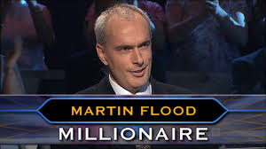
CLASS …….
S

