Slide 1
The Middle Passage
Living Conditions of the enslaved aboard Trans-Atlantic Slave Ships

Slide 2
Slave Ship Conditions
Today we will learn about the conditions which slaves faced in the journey from Africa to the New World.
We will get an understanding of the horrors of the Middle-Passage from the perspective of those who suffered its worst extremes.
I know I will be successful if I can:
  Imagine how it felt to be a captive slave
  Describe the conditions of the middle passage slave ships
  Explain why conditions were so bad aboard these ships

Slide 3

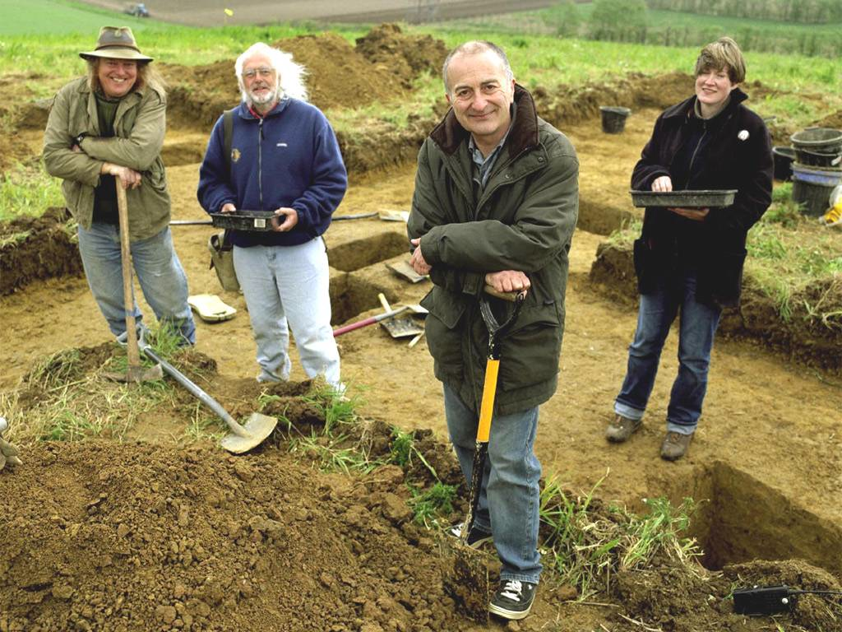
Learning Intenions
Today I will learn …
How to analyse and evaluate sources. (Like this man here!)
How to work in groups and use teamwork to reach a conclusion.

Slide 4
When Slaves were sold into new world-slavery on the West-African coast, they would face a terrible journey across the Atlantic Ocean
They would spend the majority of the journey in chains and awful conditions of filth and bad nutrition, leading to disease and death.
In fact, of the 10-15 million slaves who were to be forced across the Atlantic, at least 2 million died. (between 15-20%)

Slide 5
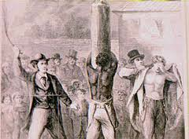
Slaves would be routinely punished with whipping and beating amongst other forms of punishment.
They would be held in captivity and below the deck of the ship all night with no access to any essentials such as bathrooms.

Slide 6
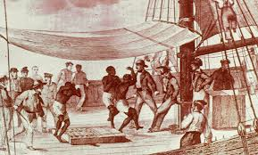
When they were allowed on the upper deck for brief period during the daytime, slaves were forced to ‘exercise’.
Often this took the form of being forced to dance for their master’s amusement.

Slide 7
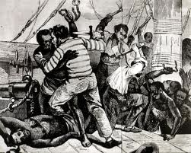
In such unbelievably terrible conditions, slaves sometimes tried to rebel to overthrow the rule of the ship’s crew.

Slide 8
Furthermore, in such conditions suicide by jumping into the sea became very common.
This was a problem for ship captains as slaves were very valuable.
The methods used to combat suicide therefore, were very severe.
For example, captains used the sharks that followed the ships as a means to terrify slaves. One ship captain, who had a rash of suicides on his ship, took a woman and lowered her into the water on a rope, and pulled her out as quickly as as possible. When the slaves could see her, it became apparent that the sharks had already killed her—and bitten off the lower half of her body.’

Slide 9
This lesson will outline these conditions which the enslaved suffered and help us to understand the lengths they went to in order to be free from them.

Slide 10
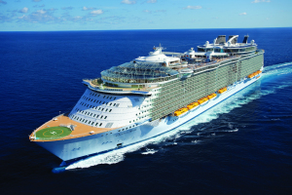
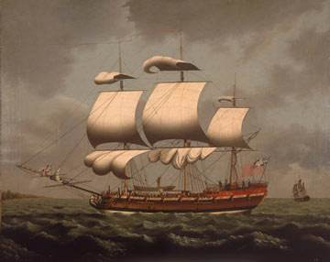
Starter Exercise
Comparing a Middle-Passage slave ship to a modern day cruise ship

Slide 11
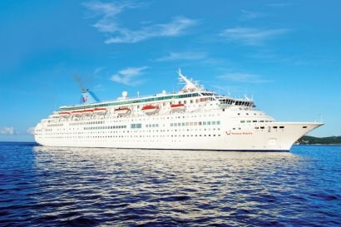
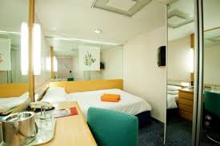
On this ship, the ‘Thomson Majesty’
The size of a regular cabin for two people measures 3 m² (roughly
the size of a small bedroom in an average house).

Slide 12
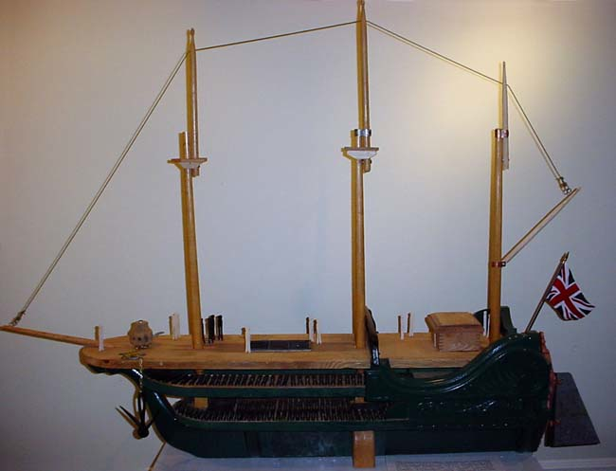
In comparison, aboard this slave ship, ‘The Brookes’
The Sleeping Quarters was 1.4x6ft for men, 1.4x5ft for women, 1x5ft for Boys, and 1.4.6ft for Girls. What did this look like?

Slide 13
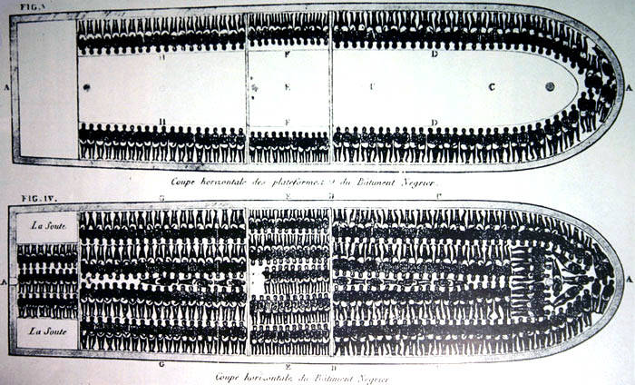
A famous picture of the Ship’s layout.

Slide 14
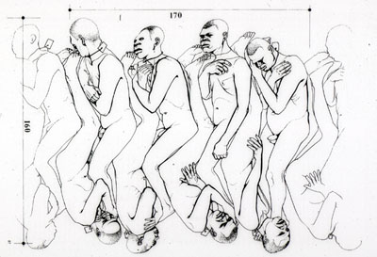
A Drawing of how the enslaved would sleep

Slide 15
Quick Exercise
A Mediterranean cruise on the Thomson Majesty lasts a fortnight. How long do you think a journey on a slave ship would last?
Answer: up to 3 months

Slide 16

Main exercise: conditions on a slave ship
Lets listen to the conditions aboard slave ships described by Mr Norris, who was Pro-Slavery.
(http://gallery.nen.gov.uk/assets/0712/0000/0046/mr_norris.mp3)

Slide 17
Final Thoughts…
Most of today’s sources have been taken from Abstract of the evidence…, (1791) and are from the perspective of abolitionists petitioning parliament to end the slave trade. Eventually their efforts succeeded when the British parliament banned trade was banned in 1807. Given the horrific conditions outlined in this material
Why do you think it took so long for this to happen?
In the late 18th century, abolitionists only sought to end the slave trade, but not the institution of slavery itself. It was only after the trade was ended in 1807 that abolitionists began to campaign against slavery (which was eventually abolished in 1834-8).
Why do you think they did this?

