Slide 1
The Middle Passage
The experiences of slaves/sailors on board the slave ships.

Slide 2
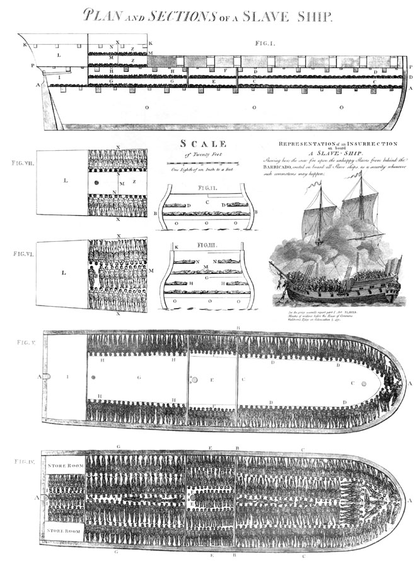
Slave Ship
100ft in length
20ft at its widest part
carried 609 slaves

Slide 3
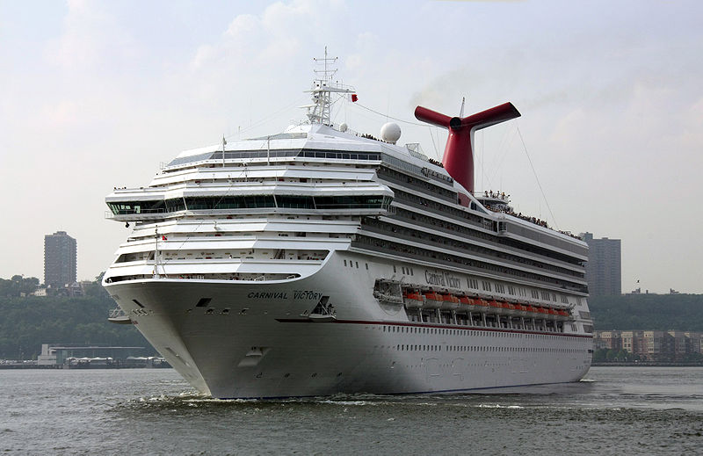
Cruise Ship
893ft long
125ft wide
can carry max 3,470

Slide 4

Scale & Comparison
The Cruise Ship is almost 9x longer and just over 6x wider.
Football pitch is 393ft long.
Slave ship is one quarter of a football pitch.
Cruise ship is roughly the length of 2 and 1/3 football pitches.

Slide 5
Main Activity
Class split into two groups.
One will consider the experiences of the slaves, and the other will consider the experiences of the sailors – using the worksheets
Each group given their selection of sources. In smaller groups, they will be required to read/look at the sources and to use them to write answers to the questions

Slide 6
Source Material Questions
What would you (as a slave/sailor) have feared on the Middle Passage?
What conditions would you have faced on-board?
Who would have controlled you?
How could you have died during the journey?
How do you think you would have felt?

Slide 7
Discussion & Debate
Lead a discussion/debate surrounding the experiences of those on board ships during the Middle Passage.
Explain to the class that they will need to use the sources they have looked at to back up their points.
They will need to listen to both sides of the debate, as they will need to understand the other group’s experience.

Slide 8
Diamond Game
Students will remain in their Slaves/Sailors groups and compete to be the first team to successfully cross the board.
Each diamond requires a student to correctly answer the question associated with it. If they are correct, the team can choose another connecting diamond and attempt another question.

Slide 9
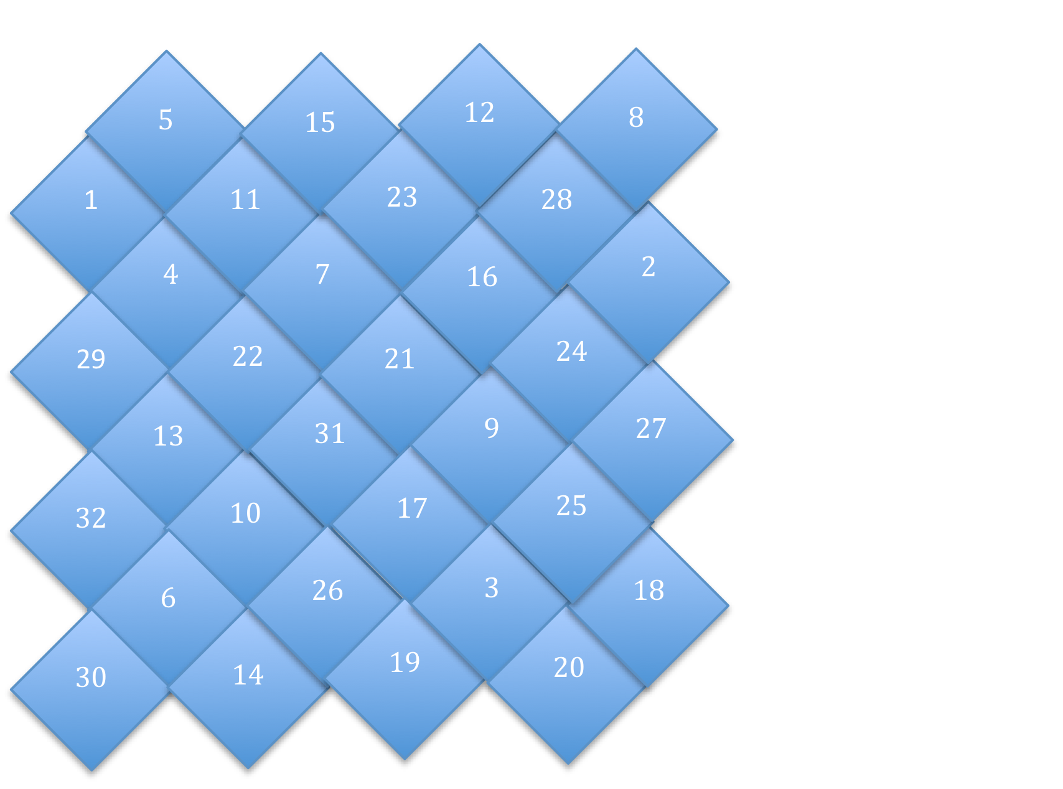
Diamond Game

Slide 10
Example Questions
Who was Alexander Falconbridge?
What were the sailors afraid of?
What weather conditions did the ships face?
How long did the journey take?
How much space did each slave have to live in?
How healthy were those on board?
What were the slaves afraid of?
Name a way in which people on board could die.
Who was on board a ship during the Middle Passage?
Where did the ships sail from, and to?

Slide 11
Example Questions (continued)
Name an illness a slave may have on the ship?
Who was in charge of the ship?
Were the slaves on board the ship all from the same place?
What was a slave guardian?
If a slave, who was in control of you?
Who lived in better conditions: slaves or sailors?
Who was Thomas Phillips?
How could a slave be abused?
Could a slave escape a slave ship? How?
Did many slaves die on board a ship?

