Slide 1
Compact DUAL CHANNEL optical fibre amplifier for space communication applications
Gary Stevens
G&H Systems and Technology Group
& University of Glasgow

Slide 2
Contents
Who we are
The Application
The Technology
Putting it together
The results
Radiation Testing
Future work

Slide 3
G&H Systems and Technology Group
      Company founded in 1948 in Ilminster, Somerset
      9 manufacturing sites, 3 in UK, 6 in USA
      Expertise in Acousto-optics, Electro-optics, Fibre-optics, Precision Optics and RF electronics
      STG based in Torquay - single team offering full system design services (optics, electronics, mechanical, modelling)
      Functional integration of G&H components into high-value products
      Design systems that can be transferred into serial production and ramped to high volumes

Slide 4
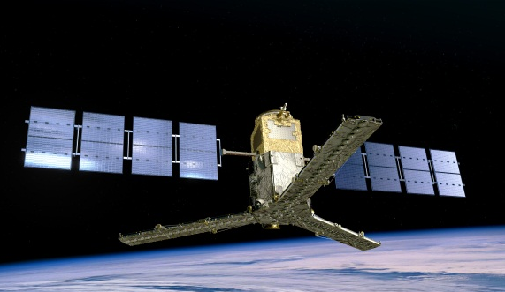
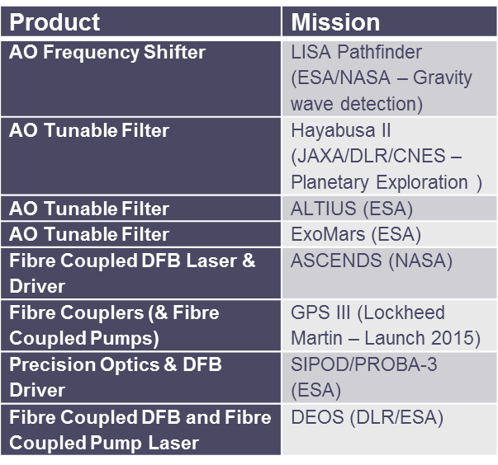
G&H Space Heritage
Missions Launched
Product | Mission
Fibre Couplers and Fibre Modules | SMOS (ESA – Earth Observation)
Fibre Coupled DFB Laser | MISSE (NASA)
Fibre Coupled DFB (& Couplers) | LCRD (NASA)
Precision Optics | Mars Curiosity (NASA)
Precision Optics (superpolished) | Launch Vehicles (Classified)
Fibre Coupled AO | Classified
High Speed Photodetector | Classified
SM & MM Fibre Coupled Pumps | Classified
Missions Planned

Slide 5
STG Space Photonics current projects
  HIPPO High-Power Photonics for Satellite Laser Communications & On-Board Optical Processing
  MERLIN Multi‐gigabit, Energy‐efficient, Ruggedized Lightwave Engines for advanced on‐board digital processors
  BEACON Scalable & Low-Power Microwave Photonics for Flexible, Terabit Telecom Payloads & High-speed Coherent Inter-satellite Links
  MERMIG Modular CMOS Photonic Integrated Micro-Gyroscope
  TESLA-B / TESLA-C Terminal for Small Satellite LEO Application (ESA ARTES 5.2)
  RAD-EDFA Family of Optical Fiber Amplifiers for satellite communication systems and harsh environments (ARTES 5.2)
  ESA ECI 7524 Space validation of Rad‐Hard Erbium Optical Fibre Amplifiers
  ESA ECI 7586 Space Validation of DFB Laser Modules
European Projects
ESA
Projects

Slide 6
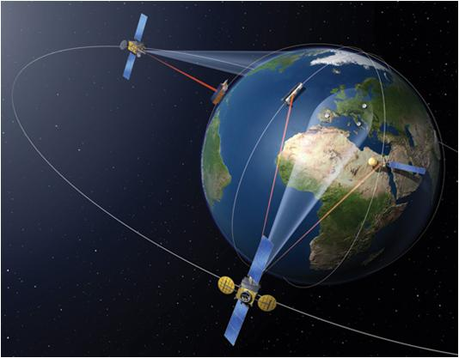
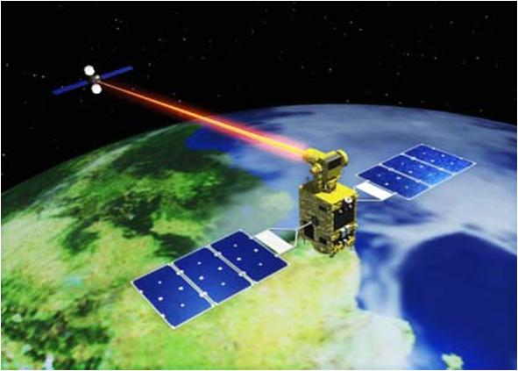




Application
Next generation satellite communication system
  Laser communications replacing radio waves
  Extra security
  Increased data rates
  Lower electrical power, less weight, smaller
TESLA Optel-μ project

Slide 7
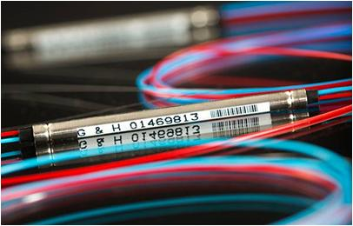
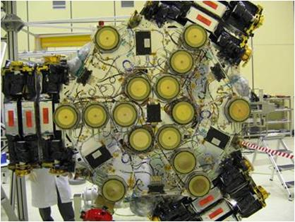
Fibre Amplifier Technology
Telcordia qualified sub-marine grade fused devices (taps, WDMs etc.)
  Space heritage (SMOS, Soil Moisture and Ocean Salinity mission)
Telcordia qualified high-rel isolators
Pump diodes now have space heritage
Biggest challenge is the Erbium Doped Fibre

Slide 8
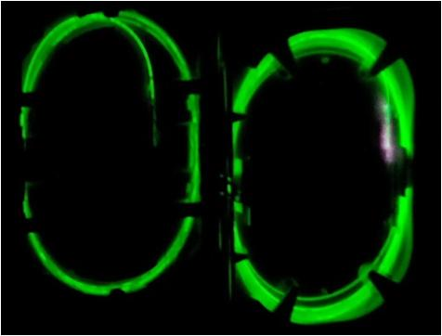
Rad-hard Erbium Fibre
Radiation Induced Attenuation (RIA) decreases transmission, pump absorption and gain
Standard telecoms fibres not suitable
Radiation sensitivity dependent on:
  Doped fiber manufacturing method
  Doped fiber composition
  Doped fiber design / geometry
  Amplifier optical design
Intense R&D on rad-hard erbium-doped fibres

Slide 9
OFA target specifications
Two EDFAs with separate outputs
Outputs can be combined via a switch and wavelength combiner into a single channel
Specification | Value
Input Power | -10 to 10 dBm
Input Wavelength | 1530 to 1565nm
Output power (EOL) | >20dBm
Switch time | 10Hz
Power consumption | <6.5W
Volume | 450cm³
Mass | 550g
Operational Temperature | -10 to 40ºC
Radiation | 30kRad

Slide 10
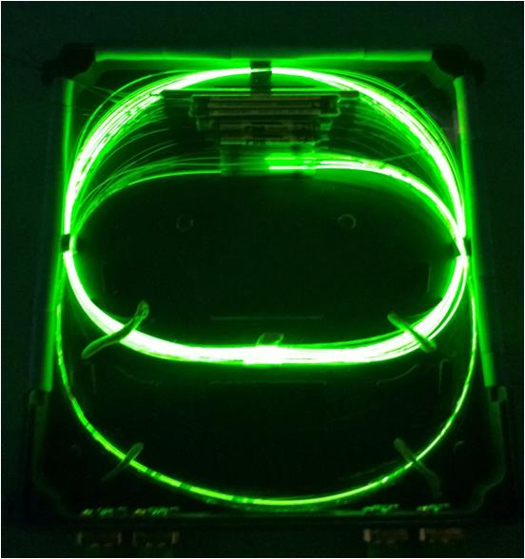
1) Optical design
980nm pumping
Isolated input/output ports
Input and output power monitors
Switch used to combine the EDFAs onto a common output
Built-in redundancy
Up to 40dB gain

Slide 11
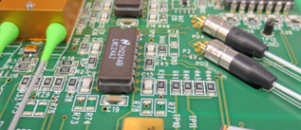
2) Electronics Design
Rad-hard custom design
Current driver and monitors
Telemetry
  Laser current monitor
  Laser power monitor
  Input power monitor
  Output power monitor
  Case temperature monitor
Tele-command
  Remote SET
  Remote ON/OFF
BOL Power consumption: 4.5W

Slide 12
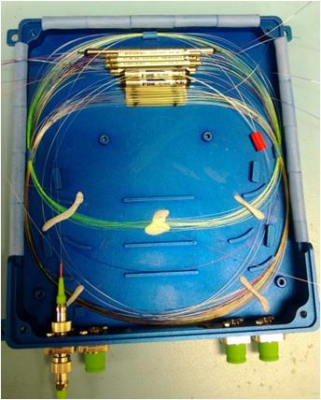
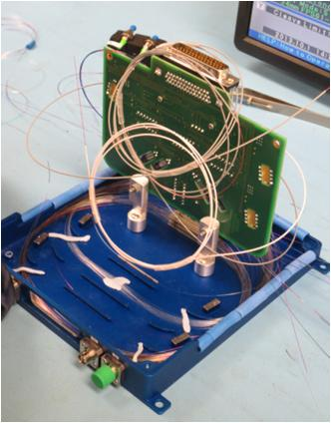
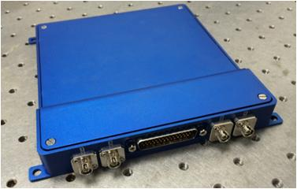
3) Module design & build
Optical network built ‘actively’
Electrical and optical connectors all on a single side
2mm thickness
Volume: 430cm³
Mass: 585g

Slide 13
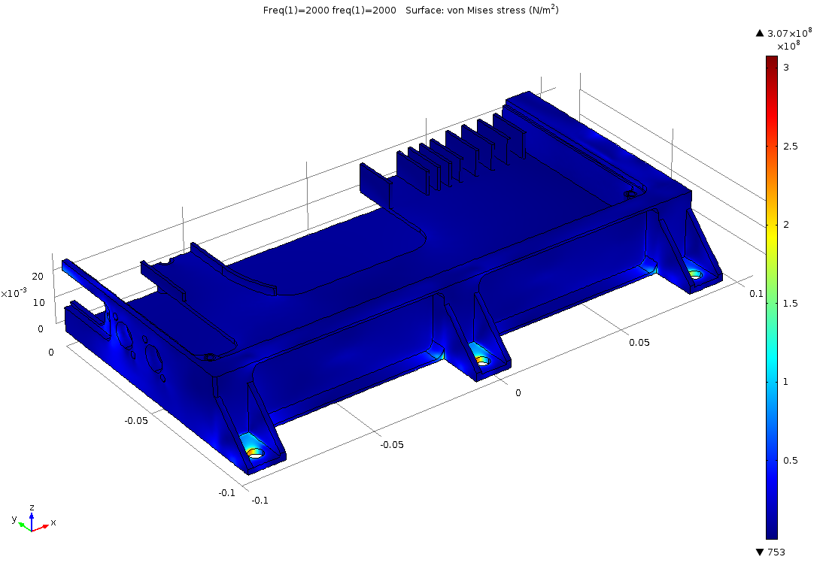
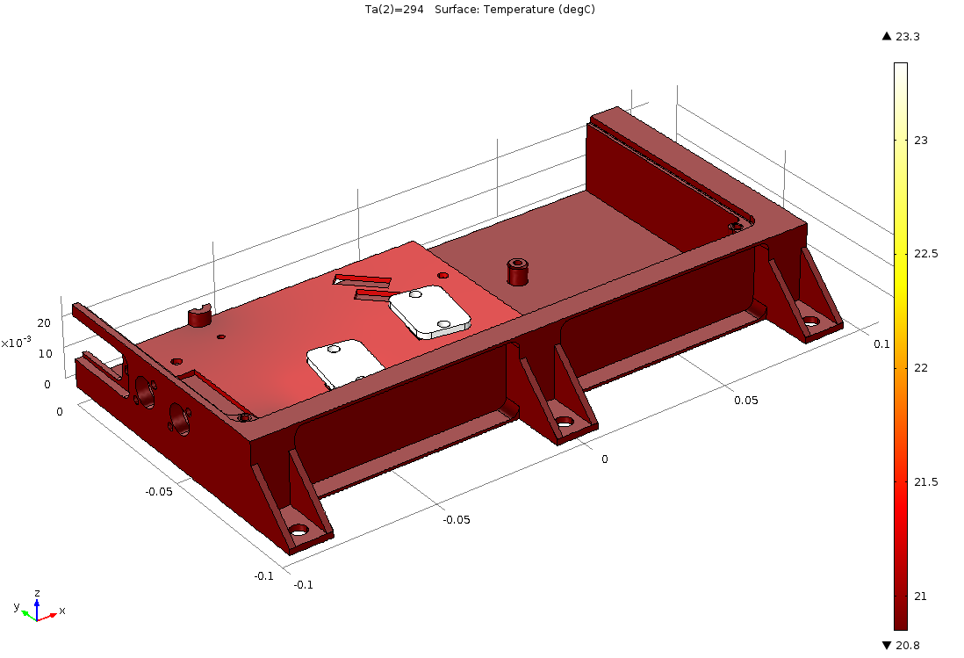
FEA Modelling
Shock and vibration modelling of housing
Modelling in a thermal vacuum
Heat management of pump diodes critical

Slide 14
Amplifier Functional Performance
1545nm results
Input power
Both channels combined
Input power
1565nm results
Input power

Slide 15
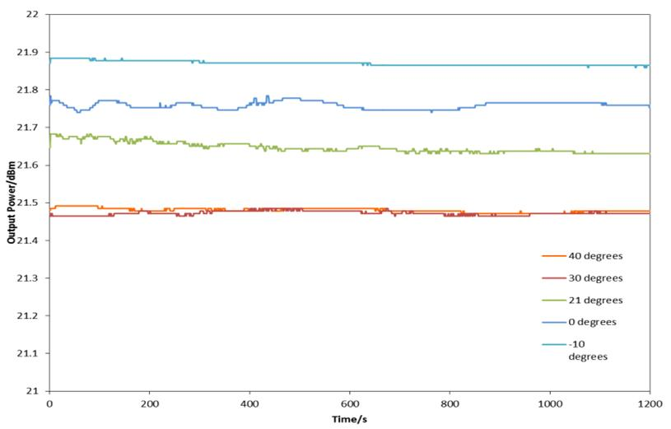
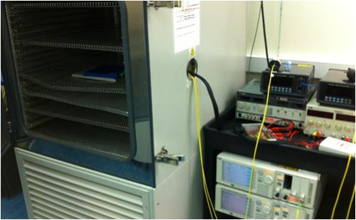
Amplifier Temperature & Stability
Temperature testing -10º to 40ºC.

Slide 16
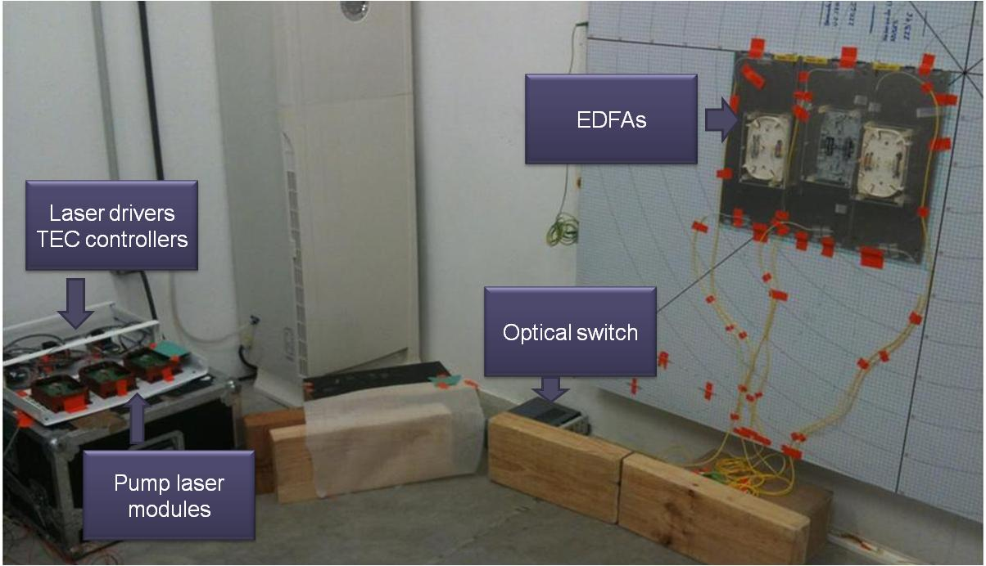
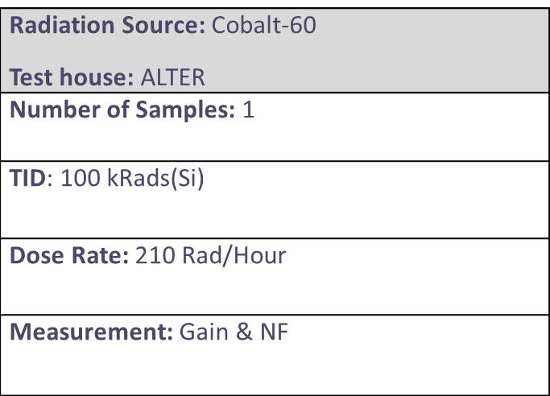
Radiation test setup
Similar amplifier sample built for radiation testing
Testing carried out at ALTER

Slide 17
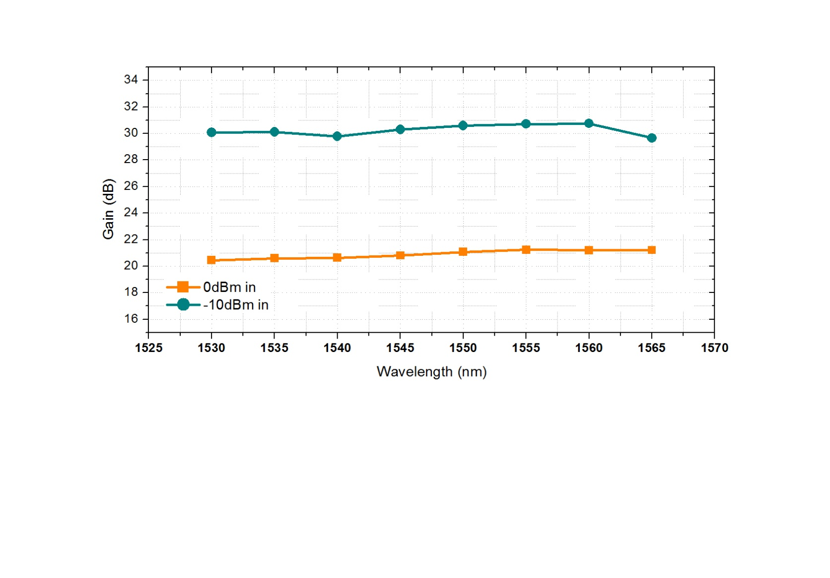
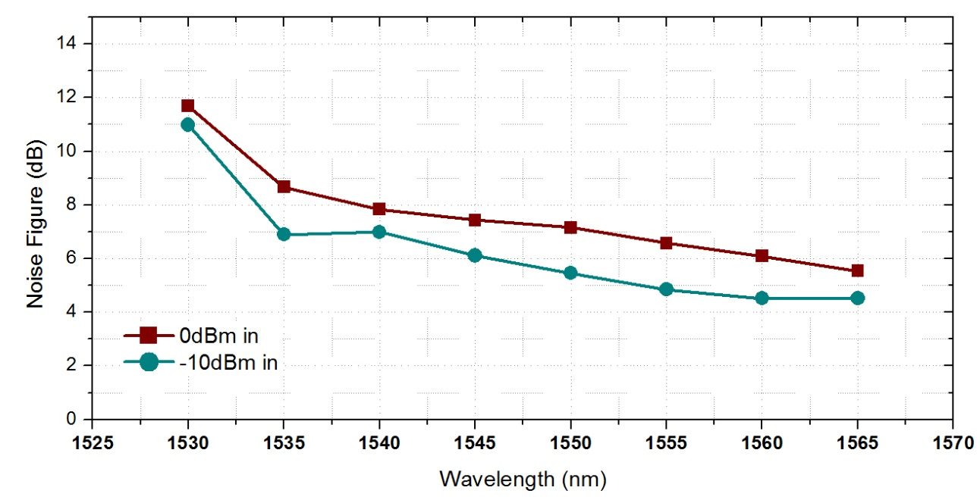
Pre-irradiation
GAIN
>20 dB over C-band
NF
Max 11 dB (1530 nm)
<6 dB (1550 nm)
<5 dB (1565 nm)

Slide 18
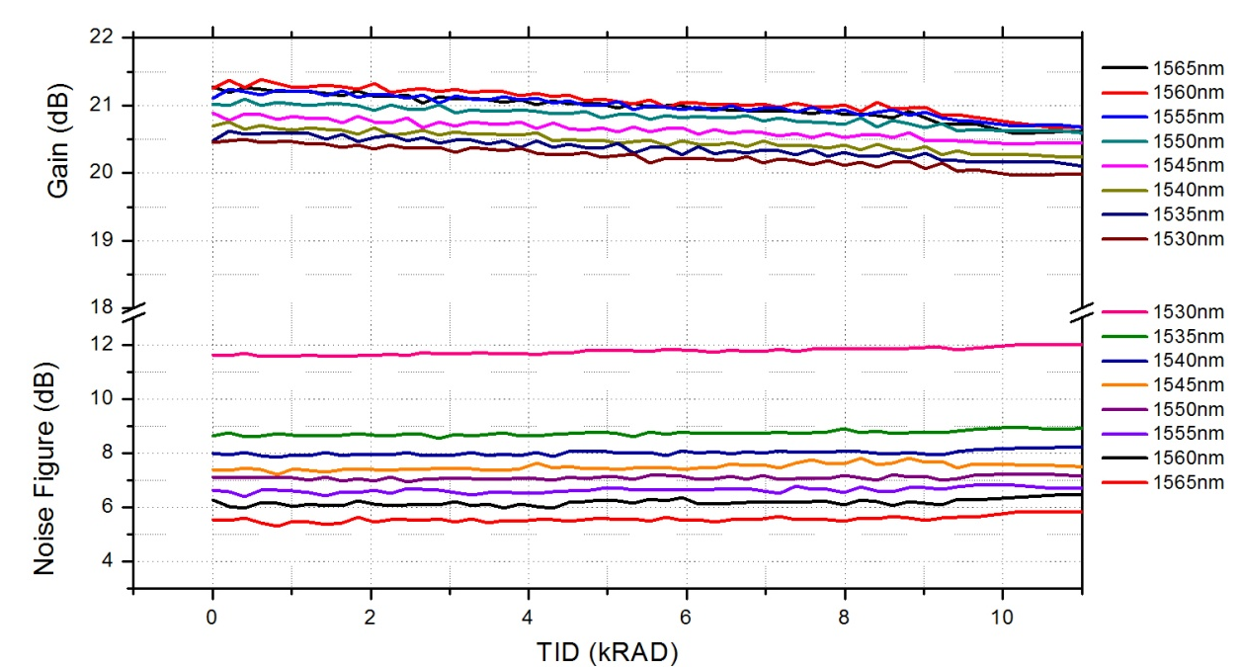
Radiation (LEO scenario): 0 – 10 kRad (0 dBm input)
GAIN
Max gain drop 0.6 dB
>20 dBm over C-band
NF
<0.5 dB increase

Slide 19
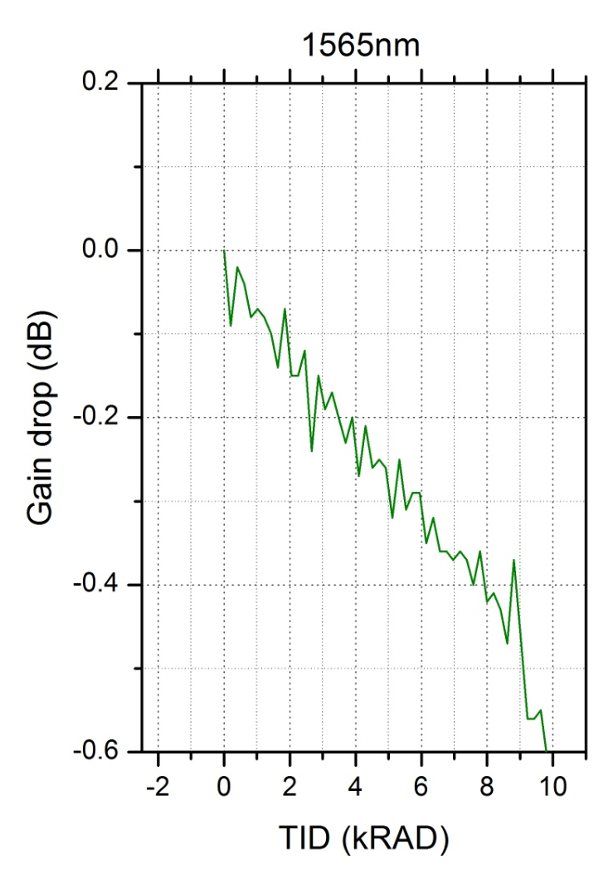
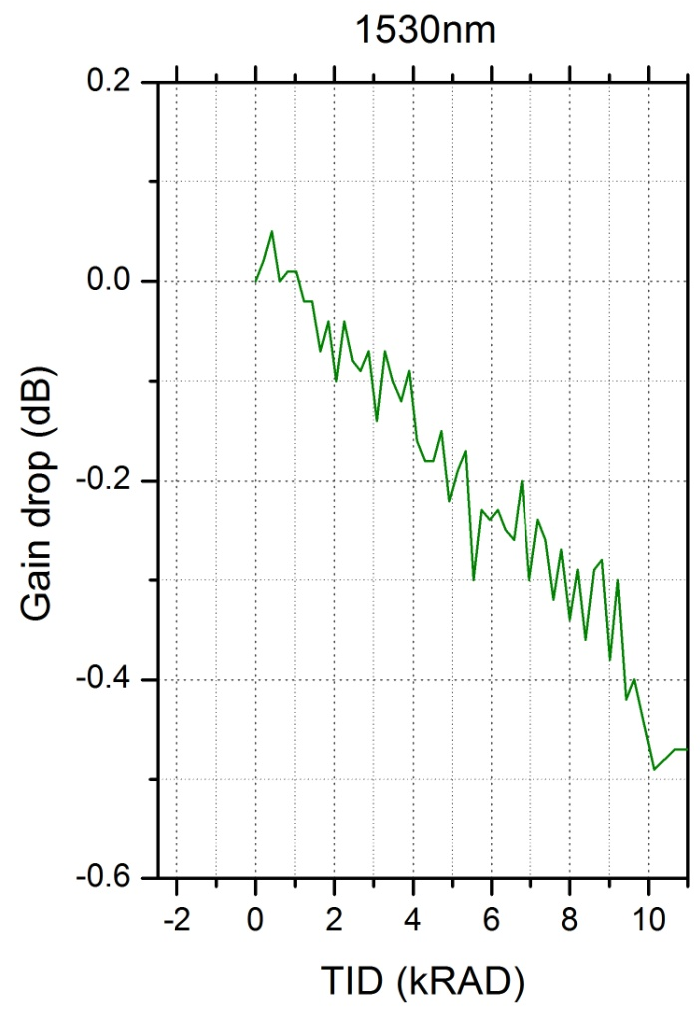
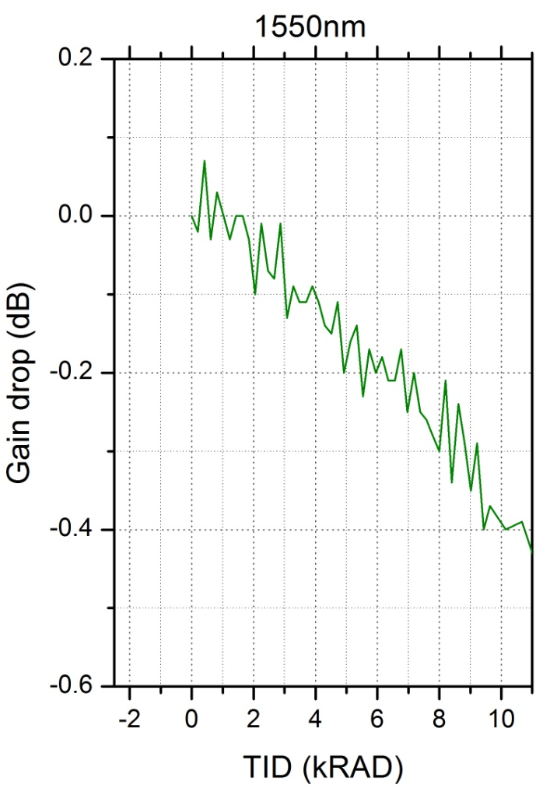
Radiation (LEO scenario): 0 – 10 kRad (0 dBm input)

Slide 20
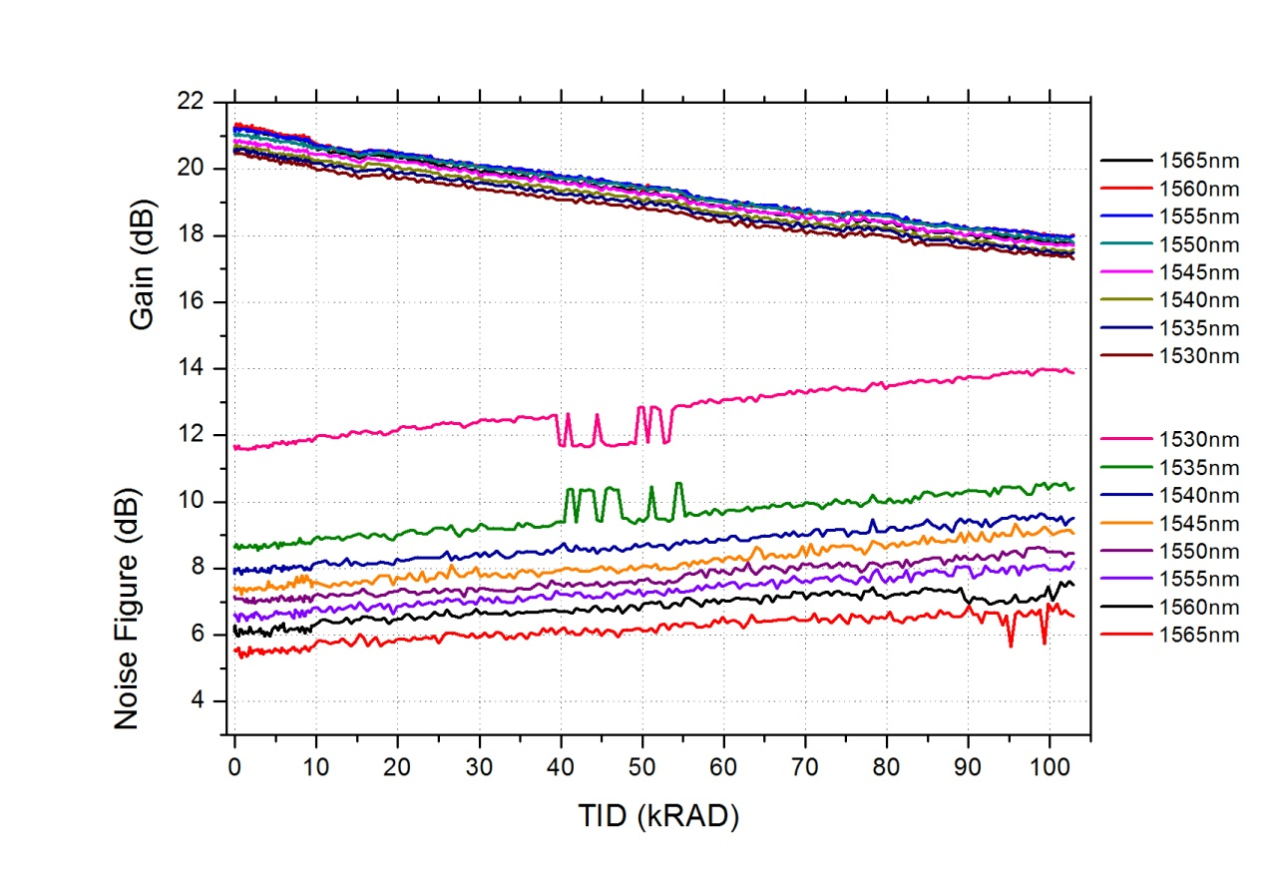
Radiation (GEO scenario): 0 – 100 kRad (0 dBm input)
GAIN
Max gain drop 3.44 dB
>18 dBm @ 60 krad
> 17 dBm @ 100 krad
NF
<2.17 dB increase

Slide 21
Conclusions
Compact Dual Channel EDFA Built
  Provides up to 40dB gain
  Low mass, volume and power consumption
EDFA design validated for LEO / GEO
  >20 dBm over C-band up to 10 krad (even in worst “passive” case)
  Gain drops:
    <0.6 dB up to 10 krad
    <3.44 dB up to 100 krad
  Next Step: Proceed to EQM level development
    Component & Module level tests

