Slide 1

HYBRID PROPULSION FOR IMPROVING FUTURE SPACE MISSIONS
1st Space Glasgow Research Conference, Glasgow, United Kingdom

Slide 2
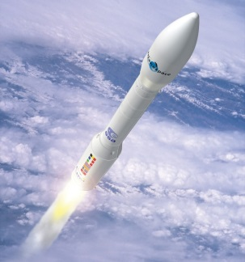
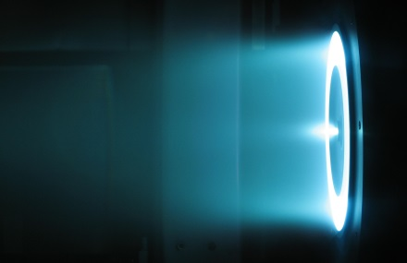
Outline
Introduction of hybrid high-low thrust propulsion
Why ? What benefits are expected ?
How to achieve the desired benefits ?
Explanation of the optimization method developed for hybrid high-low thrust trajectories
Homotopy-continuation method applied for computing fuel-optimal low-thrust trajectory
From low to hybrid thrust fuel-optimal trajectory: a new homotopy-continuation based approach
Preliminary results

Slide 3
Research work goal
Fundamental space mission requirement:
need to reduce the spacecraft mass as much as possible
How ?
optimization of fuel mass consumption
via astrodynamics and trajectory optimization studies, currently focused on:
optimization of trajectories with high-thrust impulsive manoeuvres
optimization of low-continuous-thrust trajectories

Slide 4
Space propulsion frontiers
Variable Specific Impulse Magnetoplasma Rocket (VASIMR)
Electric thruster
Ability to vary the exhaust parameters (thrust and I_{sp})
Capable of lower fuel mass consumption (or higher payload mass for a given fuel load) as well as lowest trip time
New concept: hybrid high-low thrust propulsion
VASIMR pushed to the limit
Dual spacecraft propulsion system: chemical (high-thrust) + electrical (low-thrust)
Is it possible to outperform the fuel mass consumption of only high or low thrust (fuel-optimal) trajectories ? In which cases ?
Recent studies have demonstrated an effectiveness of hybrid high-low thrust propulsion in terms of fuel mass consumption

Slide 5
Hybrid high-low thrust propulsion: work undertaken
The preliminary investigations about hybrid high-low thrust propulsion were applied on specific test cases and lack of full generality
The research work undertaken aims to start to set up a framework for general optimization of hybrid high-low thrust trajectories
The optimization method is fully illustrated and results, even if still preliminary, are presented

Slide 6
Optimization techniques (I)
Trajectory optimization studies are always required in order to make an efficient use of the propulsion systems provided
Different optimization methods are used in literature
The indirect method is the optimization technique mainly used in the current work, because generally:
more precise
faster
cannot require assumptions regarding the structure of the control
However indirect method main drawback is that
it can have a narrow convergence radius for the optimal solution (especially for problems like those regarding the computation of fuel-optimal low-thrust trajectories)

Slide 7
Optimization techniques (II)
Relaxation techniques have been studied and introduced in order to enlarge the search space for the optimal solution, especially for indirect methods
The homotopy-continuation based relaxation has been successfully applied in several study cases for space trajectory optimization:
the homotopy introduction allows to link the optimal control problem to a “relaxed” problem easier to solve with current numerical solvers
the numerical continuation computes the solution of the original optimal control problem starting from the relaxed problem solution and next solving problems progressively closer to the original one
The homotopy-continuation technique makes also possible to obtain an hybrid high-low thrust trajectory

Slide 8
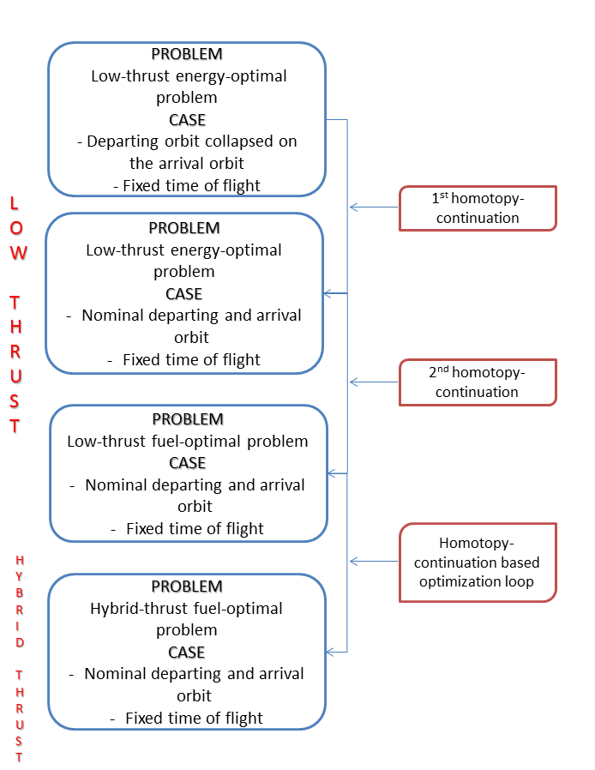
Optimization method outline

Slide 9
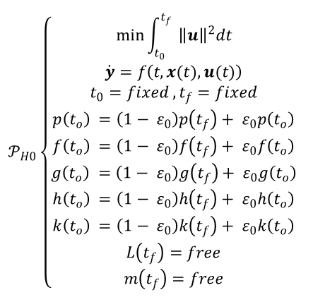

Low-thrust trajectory computation: first homotopy
$ε_{0}$ is the first homotopic-continuation parameter
State represented by means of modified equinoctial elements $x=[p,f,g,h,k,L]$
Homotopic transformation applied on the initial state
final state
initial state

Slide 10
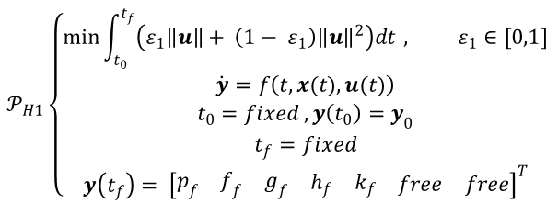

Low-thrust trajectory computation: second homotopy
$ε_{1}$ is the second homotopic-relaxation parameter
The homotopic transformation is here introduced in the Lagrangian of the fuel-optimal problem
fuel
energy

Slide 11
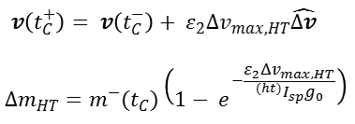
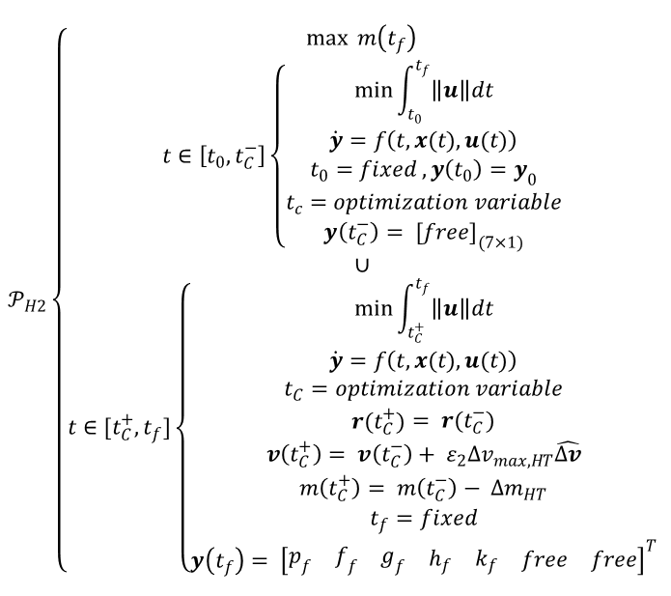

From low to hybrid thrust: a third homotopic approach (I)
increasing
A third homotopic transformation regarding the instantaneous change in velocity and spacecraft mass following the impulsive manoeuvre
$ε_{2}$ is the third homotopic-continuation parameter
The unknowns $\hat{Δv}$ and $t_{C}$ are optimization variables
increasing
updating after impulse

Slide 12
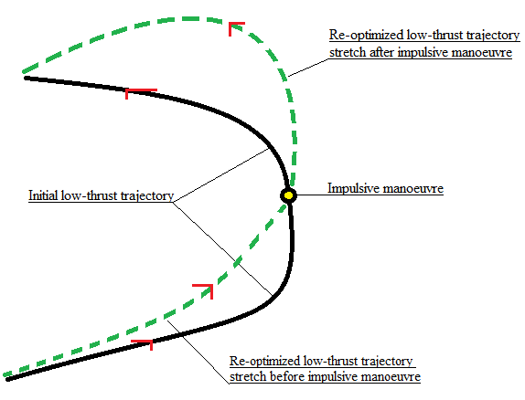
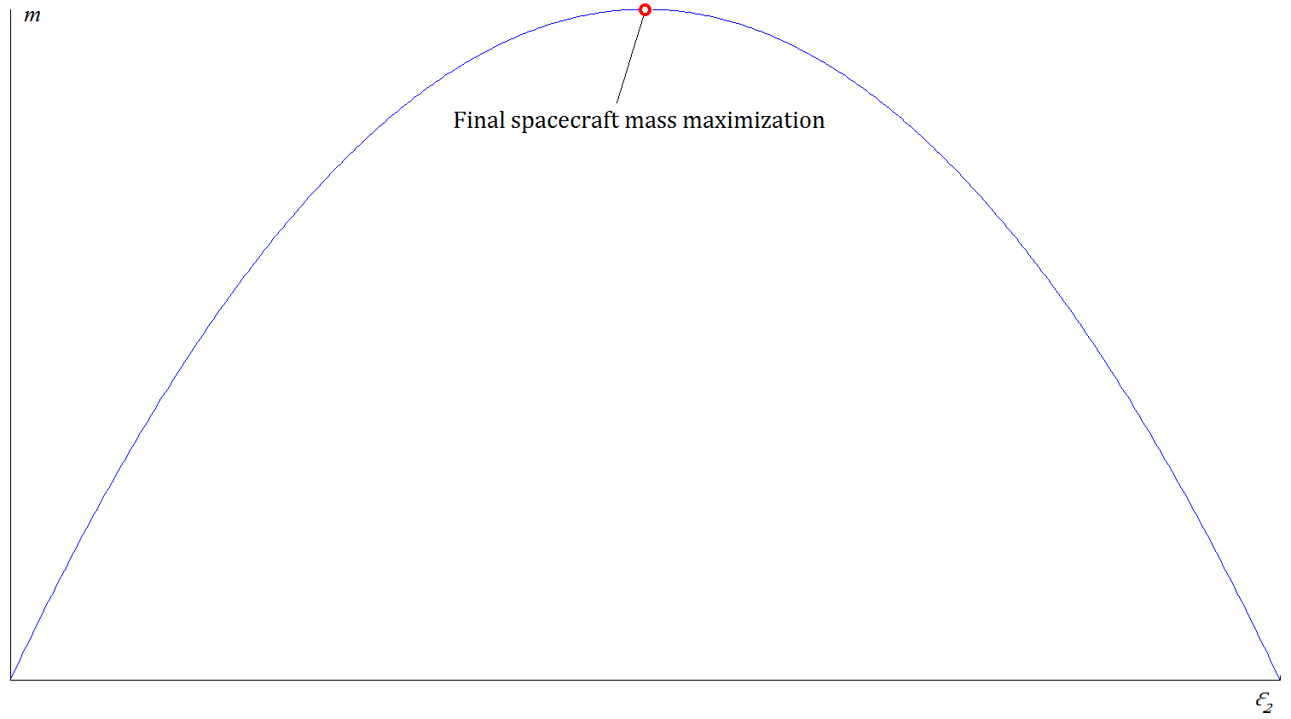

From low to hybrid thrust: a third homotopic approach (II)
Re-optimization of low-thrust trajectory arcs before and after the impulse
The $ε_{2}$ parameter increases in order to find the optimal impulse magnitude that maximizes the final spacecraft mass

Slide 13
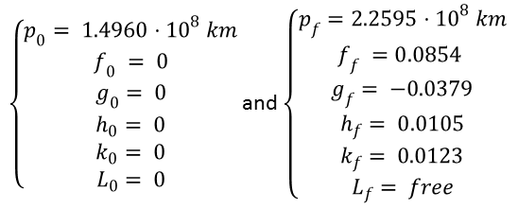
Algorithm validation and preliminary results (I)
Test case presented: interplanetary transfer from Earth to Mars orbit
Problem parameters:
m₀ = 1800 kg, T_{MAX} = 0.5 N, ^{(lt)}I_{sp} = 4300 s, ^{(ht)}I_{sp} = 325 s
Departing and arrival conditions:
Time of flight (ToF) = 500 days

Slide 14
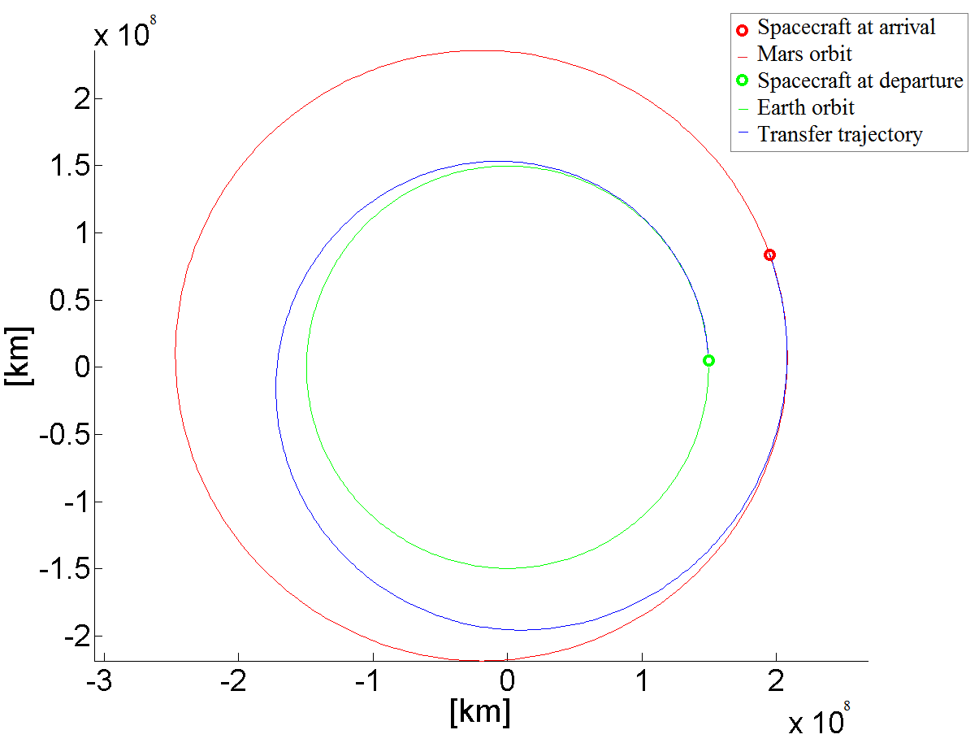
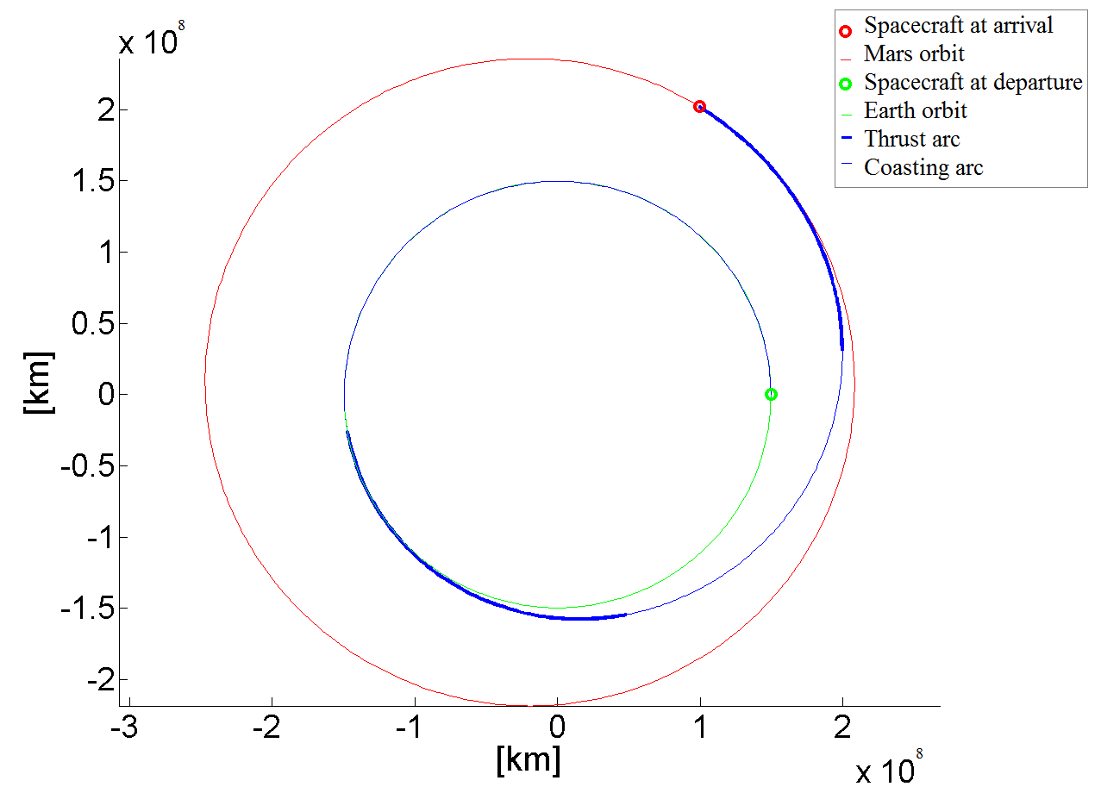
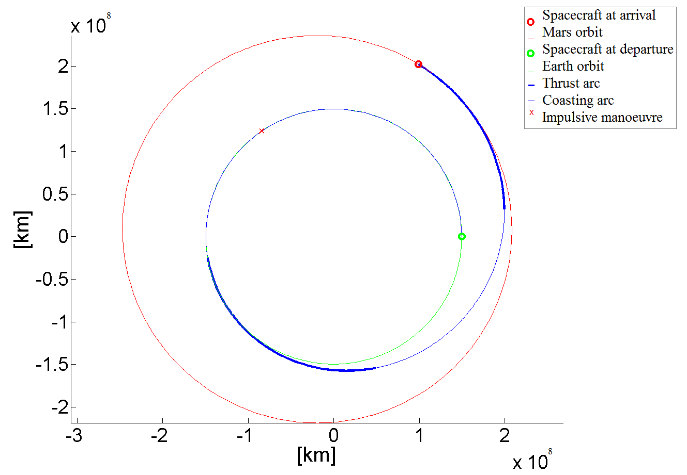
Algorithm validation and preliminary results (II)
1
2
3
1: Energy-optimal transfer
2: Fuel-optimal transfer
3: Hybrid-thrust transfer

Slide 15
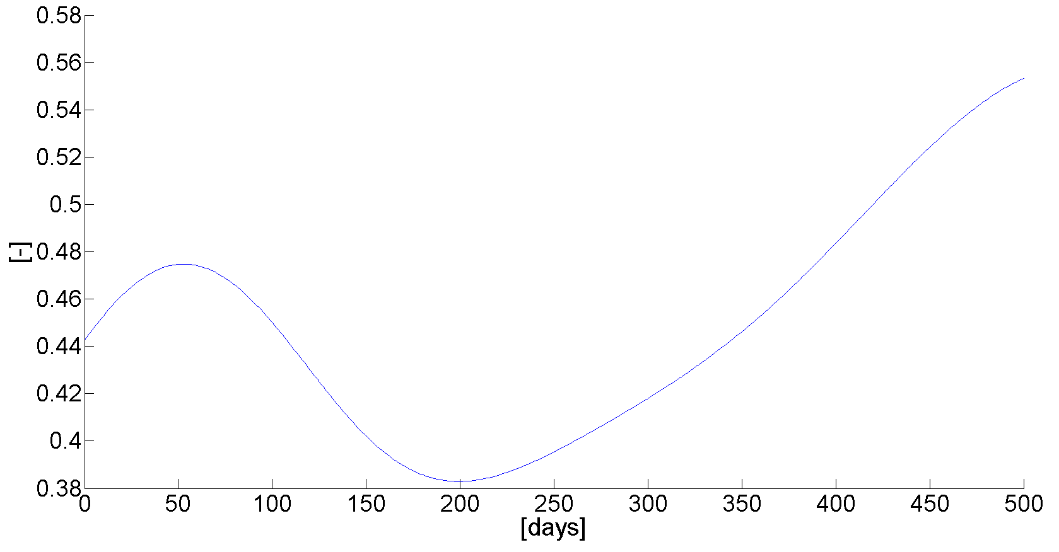
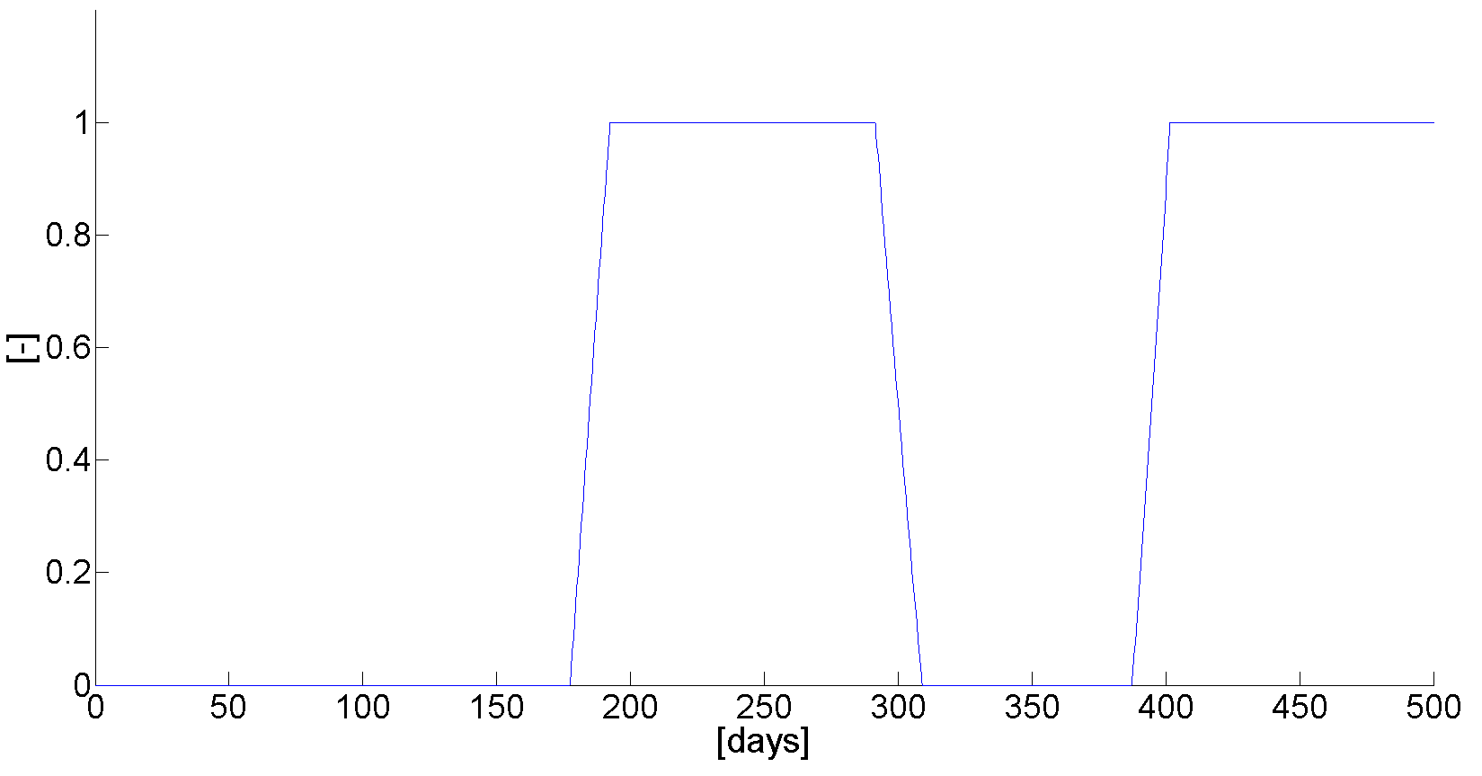
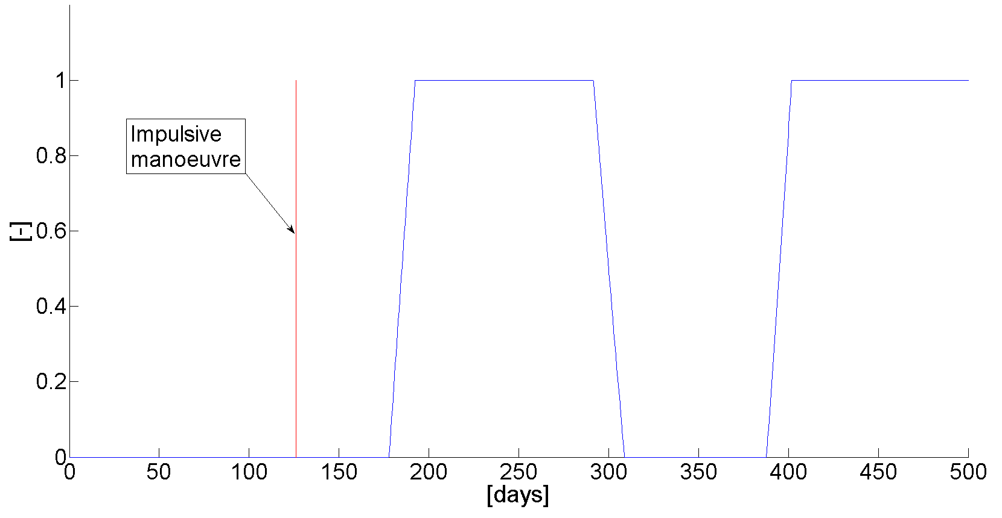
Algorithm validation and preliminary results (III)
1
2
3
1: Energy-optimal control
2: Fuel-optimal control
3: Hybrid-thrust control with impulsive manoeuvre inclusion

Slide 16
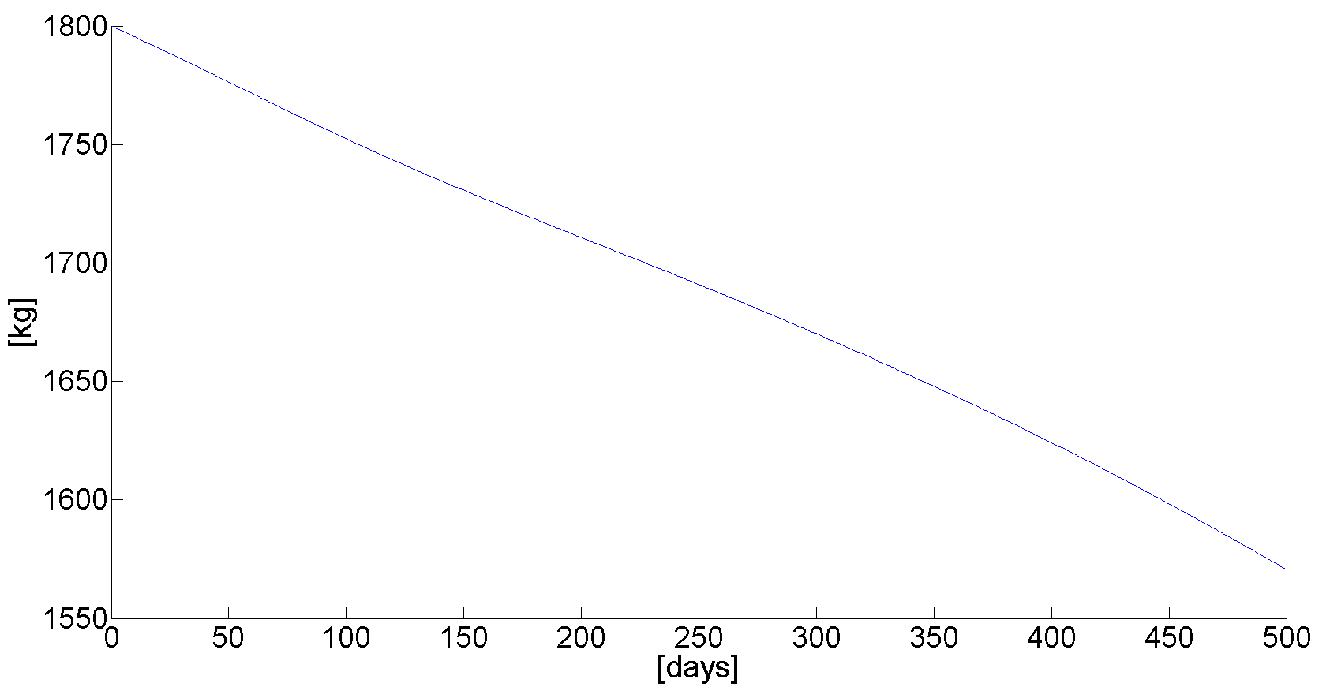
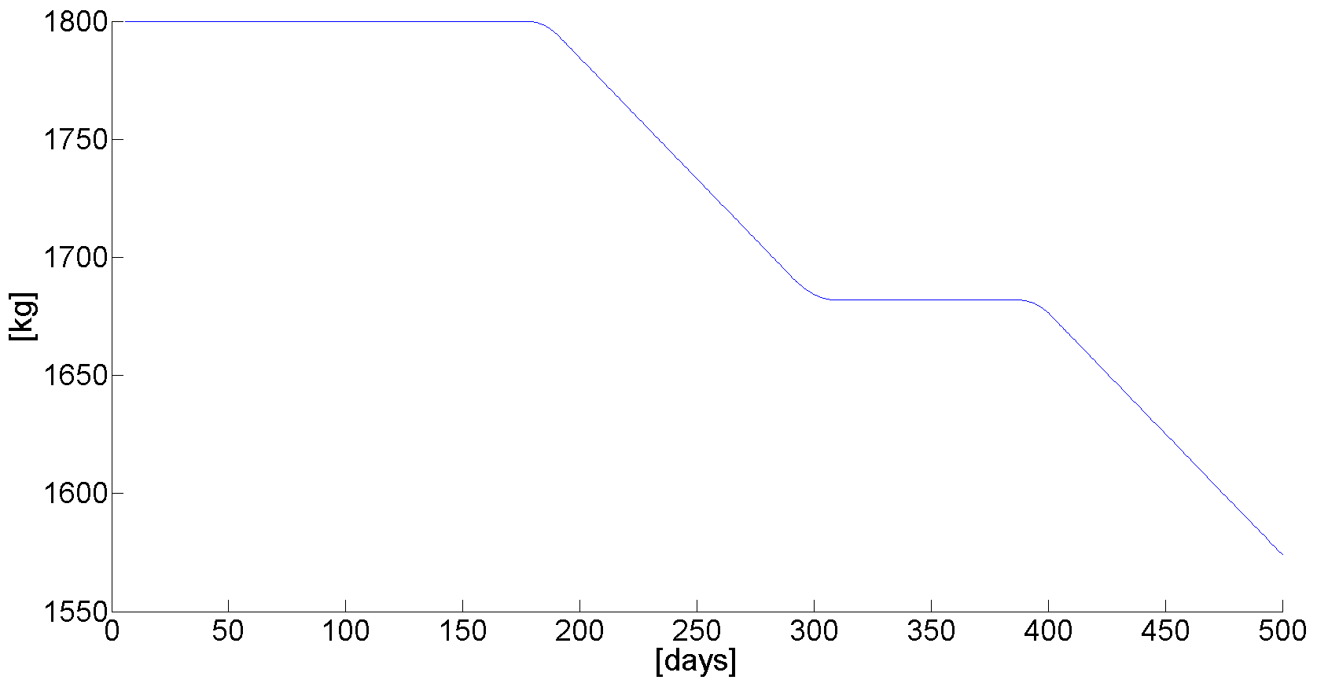
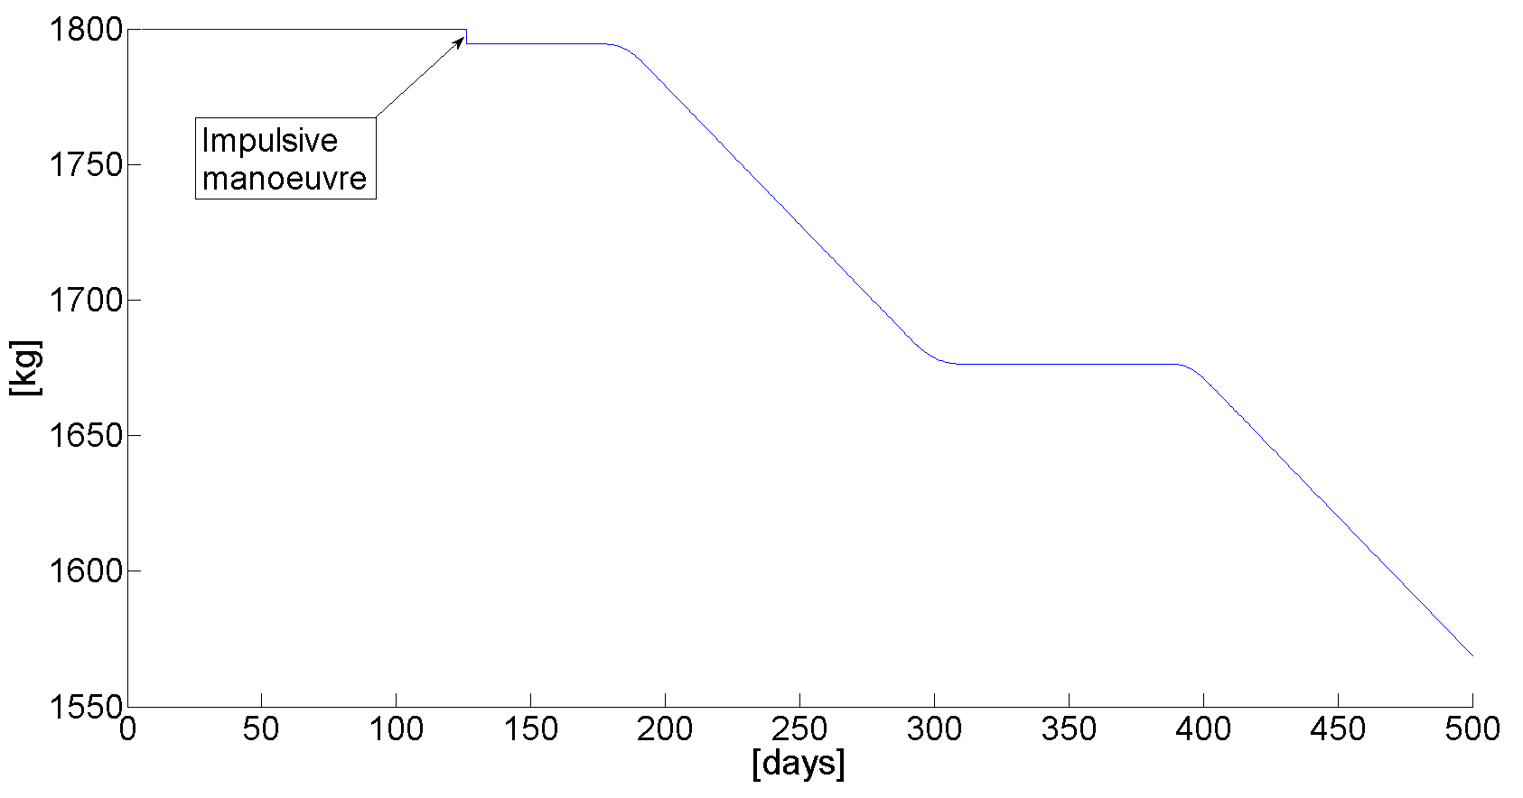
Algorithm validation and preliminary results (IV)
1
2
3
1: Spacecraft mass in the energy-optimal case
2: Spacecraft mass in the fuel-optimal case
3: Spacecraft mass in the hybrid-thrust case

Slide 17
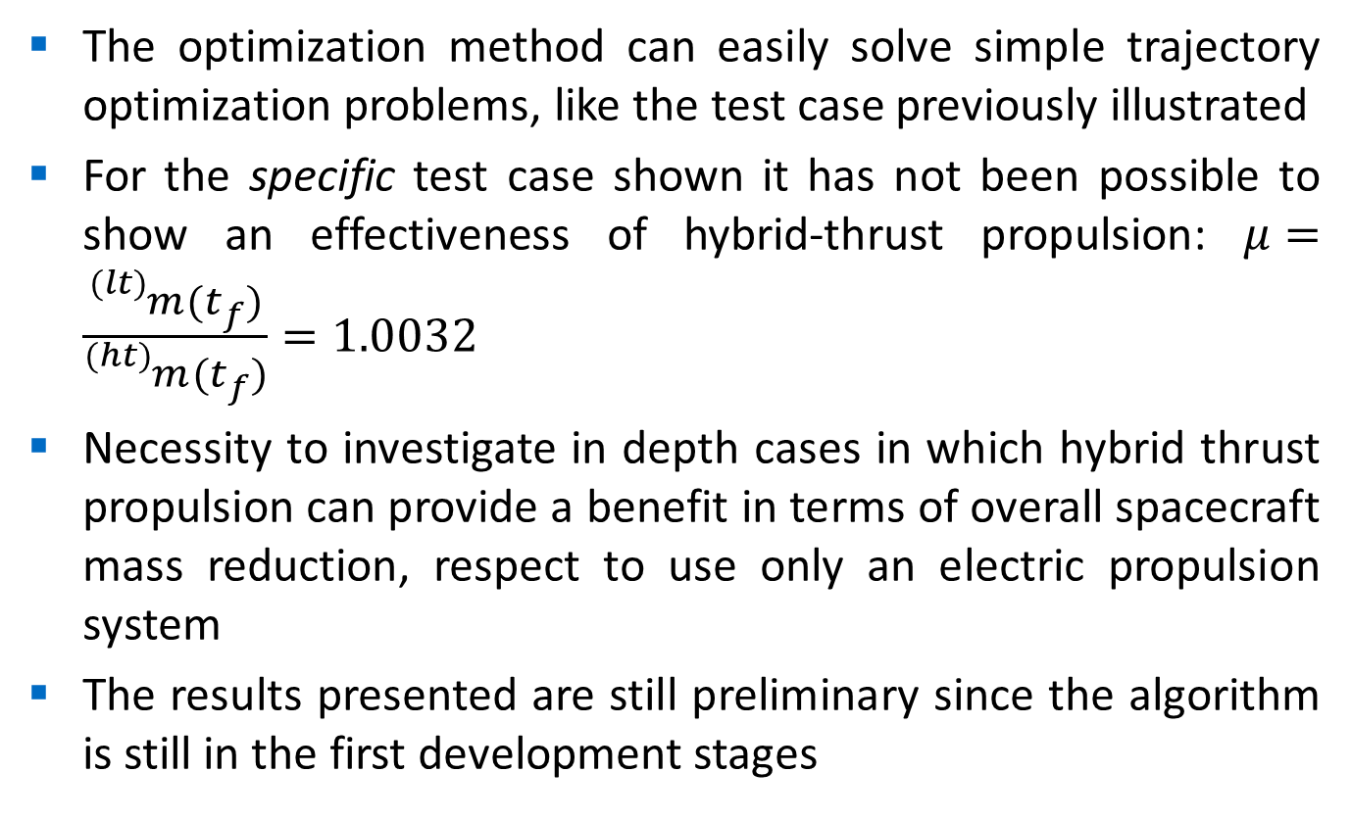
Discussion and conclusions (I)
The optimization method can easily solve simple trajectory optimization problems, like the test case previously illustrated
For the specific test case shown it has not been possible to show an effectiveness of hybrid-thrust propulsion: $μ=\frac{{}_{}^{(lt)}{m(t_{f})}}{{}_{}^{(ht)}{m(t_{f})}}=1.0032$
Necessity to investigate in depth cases in which hybrid thrust propulsion can provide a benefit in terms of overall spacecraft mass reduction, respect to use only an electric propulsion system
The results presented are still preliminary since the algorithm is still in the first development stages

Slide 18
Discussion and conclusions (II)
Several study cases need to be simulated and analysed in order to thoroughly investigate the effectiveness of hybrid high-low thrust propulsion (starting from VASIMR application cases, etc.)
Since the preliminary nature of the software developed, the algorithm still needs improvements that are currently in progress
Finally, an enhancement of the optimization method in terms of generality and in the physical model of motion equations (from 2 to 3 body dynamics, etc.) is also intended to be carried out

Slide 19

n.sullo.1@research.gla.ac.uk
Thank you!

