Slide 1
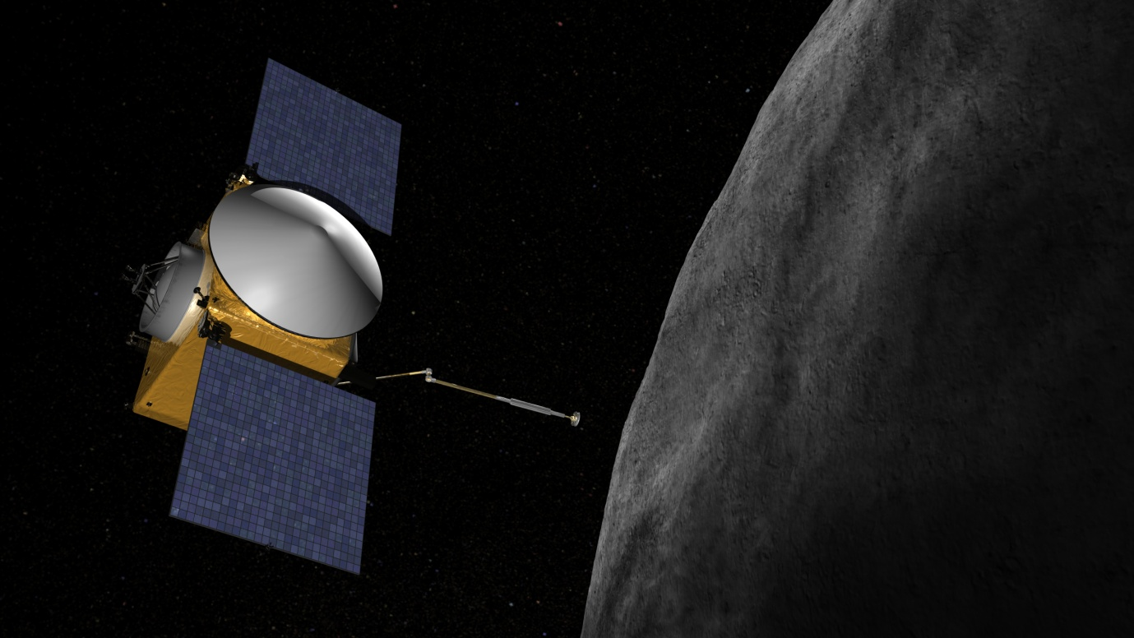
Sample return from C-type asteroids:
What will we bring back?
Paula Lindgren
School of Geographical and Earth Sciences University of Glasgow
SPACE Glasgow Research Conference
University of Glasgow
28th Oct 2014

Slide 2
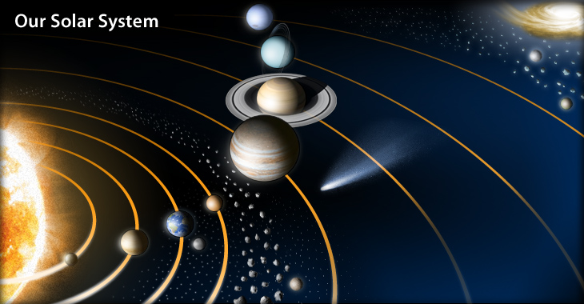
Asteroids
Leftovers from the building blocks of our solar system
A few meters to several hundreds of kilometres wide
The Asteroid belt
The Kuiper belt
Near Earth Objects
Trojans, Hildas, Greeks

Slide 3
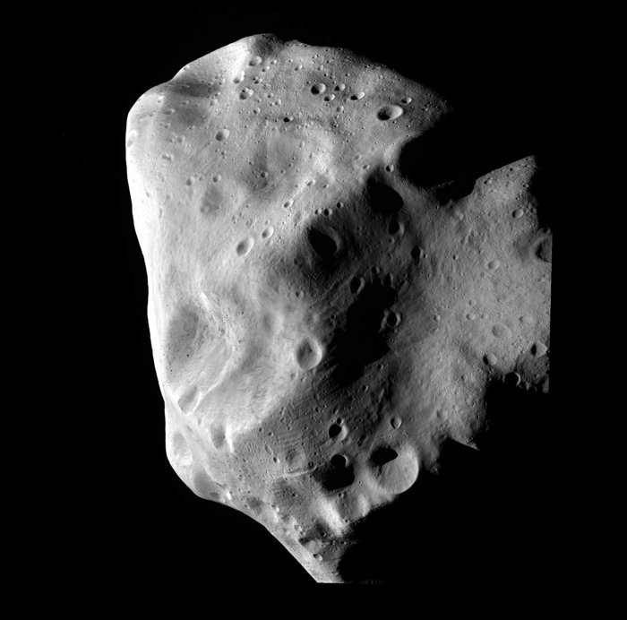
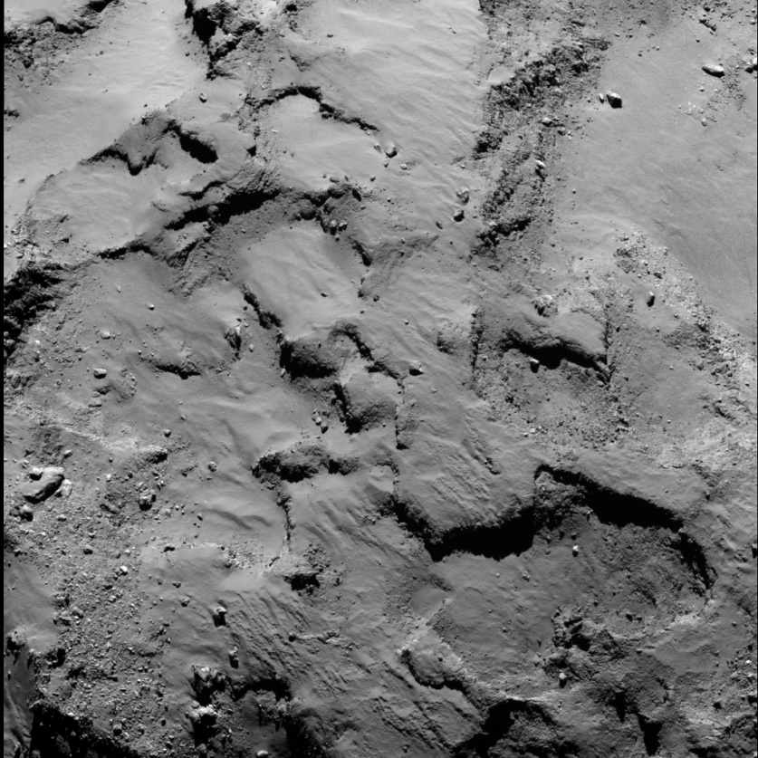
Remote space exploration
Asteroid Lutetia, ESA Rosetta mission
10 July 2010
Ground-based telescopes from Earth
Flyby missions
Spectral data, imaging
Reflects mostly the surface composition
No hands-on samples
Rosetta Mission
COSIMA Cometary Secondary Ion Mass Analyzer
Landing on comet 12th Nov 2014
Comet 67P/Churyumov-Gerasimenko
ESA Rosetta mission, 14 Sep 2014
Notes:
In-situ analyses of dust grains from comet tail

Slide 4
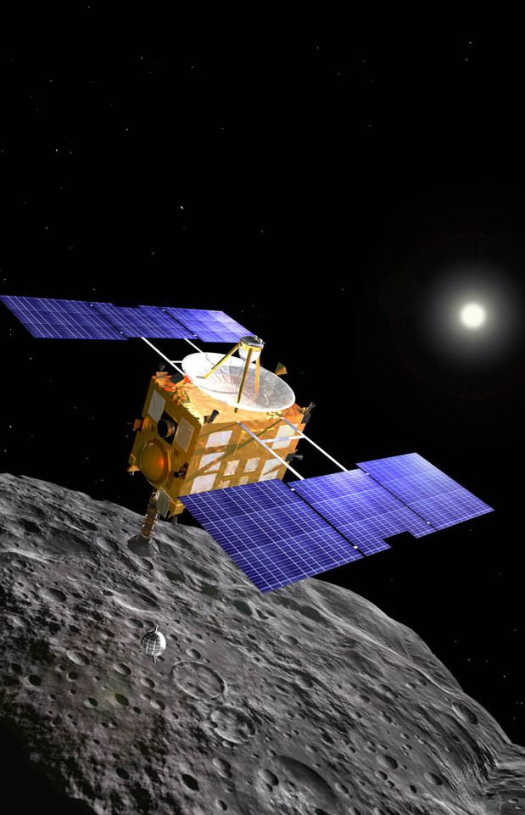
Extraterrestrial sample return
JAXA Hayabusa
Itokawa S-type asteroid
launch 2003 – return 2010
Notes:
Apollo missions – Moon
NASA genesis – solar wind
NASA stardust - comet

Slide 5
Sample return from C-type asteroids
JAXA Hayabusa2
NASA OSIRIS REx
Earliest history of water and organics

Slide 6
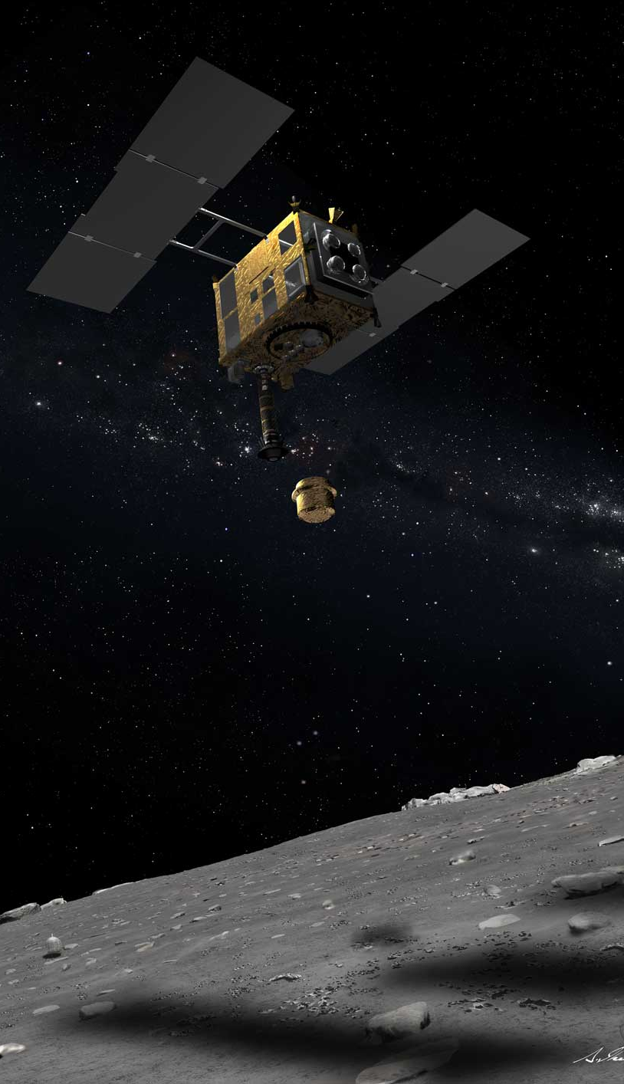
JAXA Hayabusa 2
Asteroid 1999 JU3
Explosive device to dig surface
CM1-CM2 carbonaceous chondrite
Launch December 2014 - return 2020’s?

Slide 7
NASA OSIRIS-REx
Asteroid Bennu
C-type asteroid (sub-type B)
CM1 carbonaceous chondrite
0.055% chance of colliding with Earth in 2082
Launch 2016 - return 2020’s

Slide 8
Sample return from C-type asteroids
The only samples of C-type asteroids currently available are from meteorites
To understand and make scientific use of the samples that will be returned in future missions, we need a good knowledge of the properties of the meteorite samples we have at hand today.

Slide 9
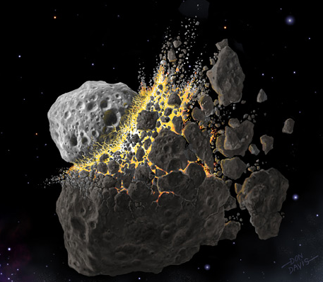
Meteorites
Asteroids, Mars and the Moon
Hands-on samples
Composition and structure of asteroidal interiors
Which asteroid?
Where within the asteroid?
Heating during atmospheric entry
Terrestrial weathering (Antarctica, hot deserts, museums)

Slide 10
Carbonaceous chondrites
Solar nebula
Accretion
Carbonaceous chondrites
PRIMITIVE METEORITES
Ordinary chondrites
Primitive asteroids
Enstatite chondrites
Melting
Differentiation
Stones (achondrites)
Evolved asteroids/planets
EVOLVED METEORITES
Stony irons
Irons

Slide 11
Carbonaceous chondrites
Archives for early solar system processes:
Accretion and compaction
First solids: CAIs and chondrules
Carbon bearing organic molecules: building blocks for life
Traces of first water in Solar System (CM, CI)
20 µm
40 µm

Slide 12
Products formed from alteration by water
Secondary mineralogy
  Phyllosilicates (e.g. serpentine, saponite)
  Hydroxysulphides (e.g. tochilinite)
  Carbonates (aragonite, calcite, dolomite, siderite, breunnerite)
  Sulphates (gypsum, epsomite)
  Iron oxides (magnetite)
  Sulphides (pyrrhotite, pentlandite)
  Halides (halite, sylvite)

Slide 13
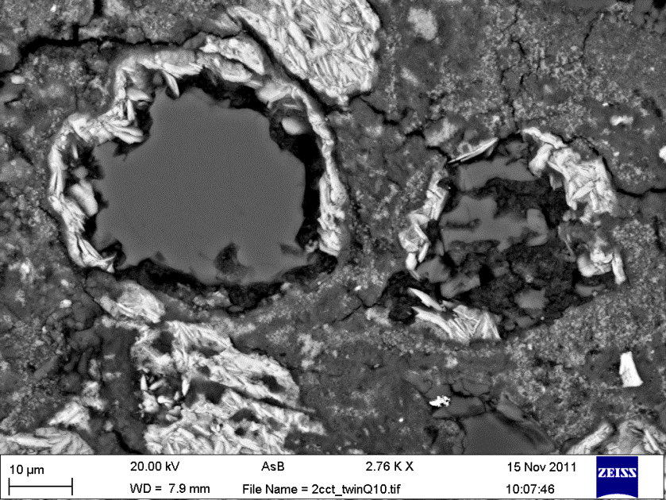
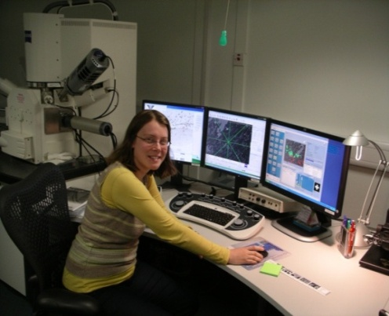
SEM imaging and microanalyses
Calcite grains
60 μm
10 μm

Slide 14

Time scale liquid H₂O
When did liquid H₂O first form?
For how long time was liquid H₂O present?

Slide 15
Time scale liquid H₂O
⁵⁵Mn- ⁵³Cr dating of carbonates
Solar system had an initial ratio of ⁵³Mn/⁵⁵Mn (9.1 ± 1.7 × 10⁻⁶, Nyqvist et al. 2009)
⁵³Mn decays to ⁵³Cr with a very short half-life of 3.7 million years (extinct today)
Measuring excess ⁵³Cr in carbonate → determine the initial ⁵³Mn/⁵⁵Mn of the carbonate → time from accretion 4.568 billion years ago to the precipitation of the carbonate

Slide 16
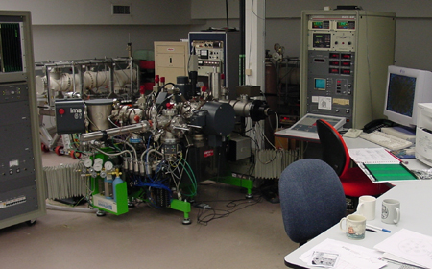
Time scale liquid H₂O
Mn-Cr dating of carbonates
Cameca NanoSIMS 50L; Carnegie Institutions Washington

Slide 17
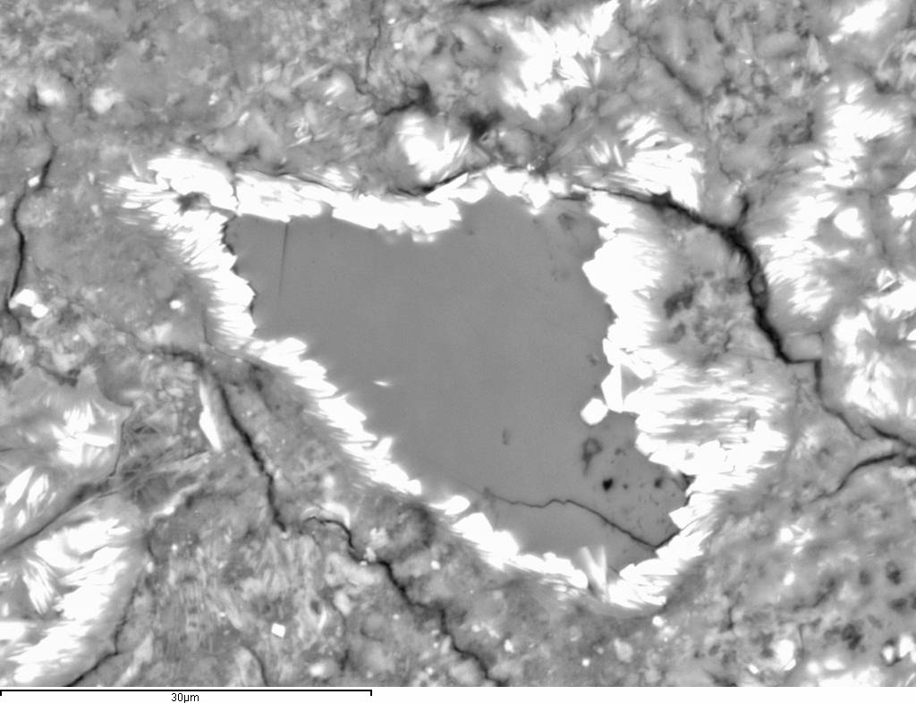
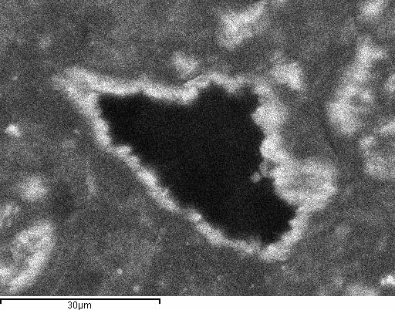
Time scale liquid H₂O
Mn-Cr dating of single-phase carbonates:
a ‘snapshot’ in time of aqueous alteration
Dolomite grain free of inclusions
Si Kα
30 μm

Slide 18
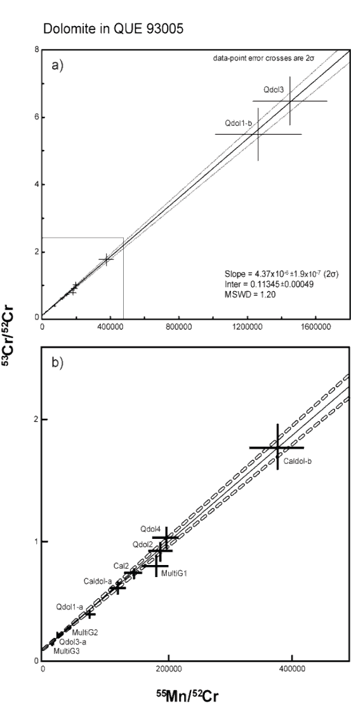
Time scale liquid H₂O
Mn-Cr dating
9 dolomite grains free of inclusions
⁵³Mn/⁵⁵Mn ratio: 4.37x10⁻⁶±1.9x10⁻⁷ (2σ)
Crystallisation age: 3.93 ± 1.7 Ma

Slide 19
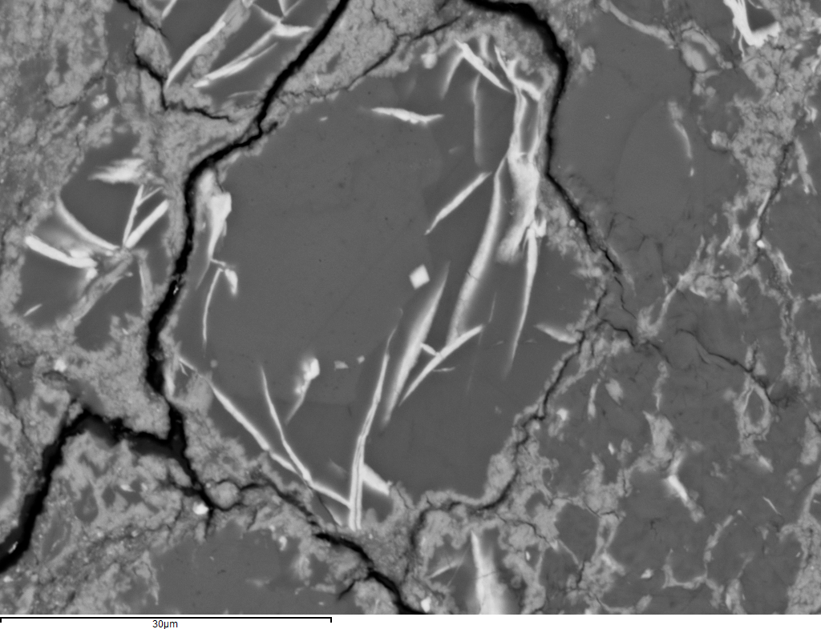
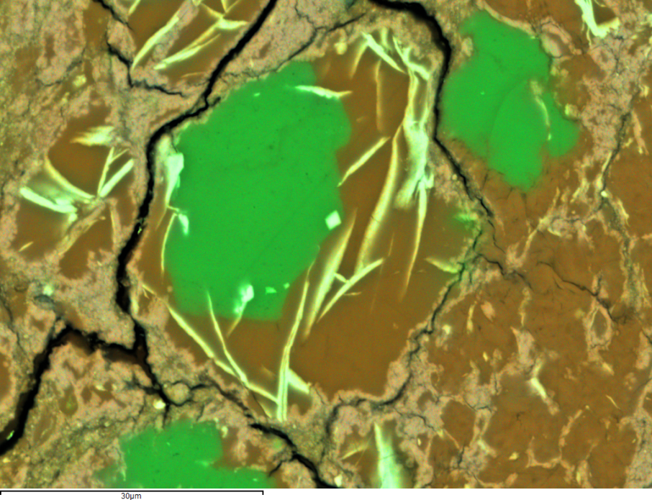
Time scale liquid H₂O
Liquid H₂O present within ~4 Ma after accretion (Mn-Cr dating)
Duration? Dating alteration products replacing carbonates
30 μm
calcite
Phyllosilicate replacing carbonate in LAP 031166 (CM2)

Slide 20
Acknowledgements
Martin Lee and Mahmood Sofe, University of Glasgow
Darren Mark and Ben Cohen, SUERC, Glasgow
Conel Alexander, Carnegie Institutions, Washington DC
UK-STFC for funding
NASA Antarctic meteorite collection for loan of meteorites
Thank you for your attention! ☺

