Slide 1
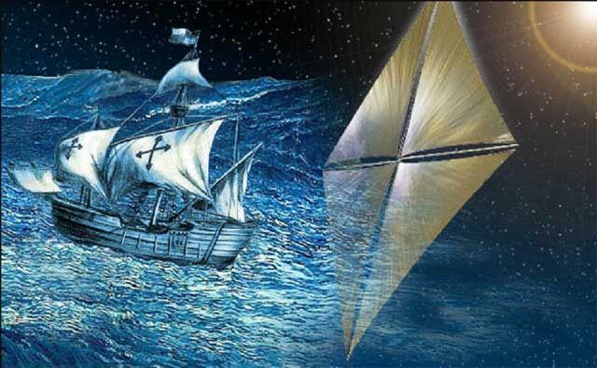
Solar Sailing: How to Travel on a Light Beam
1st Space Glasgow Research Conference,
Glasgow, United Kingdom
Image credits: NASA website

Slide 2
How to travel on a light beam? Solar Radiation Pressure

Slide 3
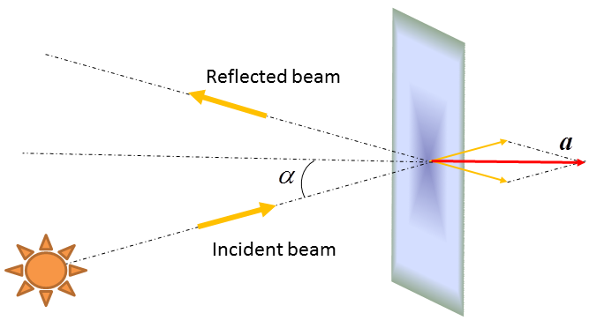
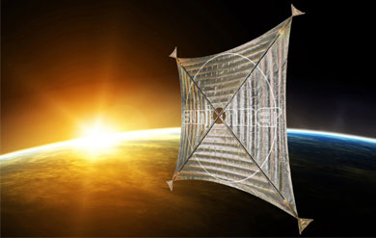
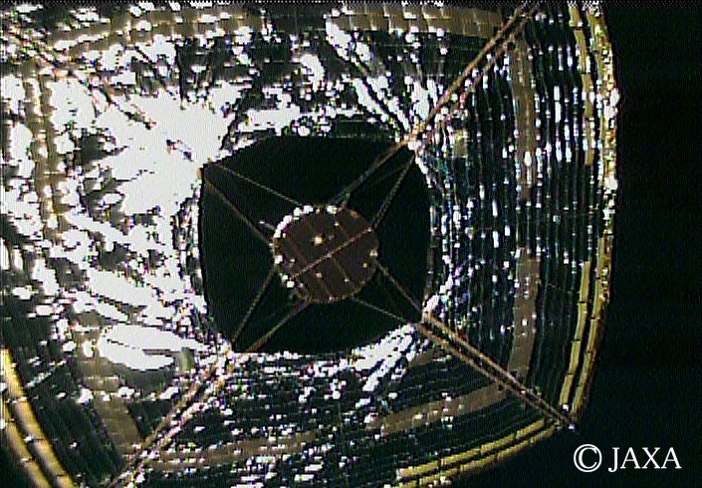
How to travel on a light beam? Solar Sail ideal model
Sunjammer. Image credits:
www.sunjammermission.com
IKAROS. Image credits:
JAXA website

Slide 4
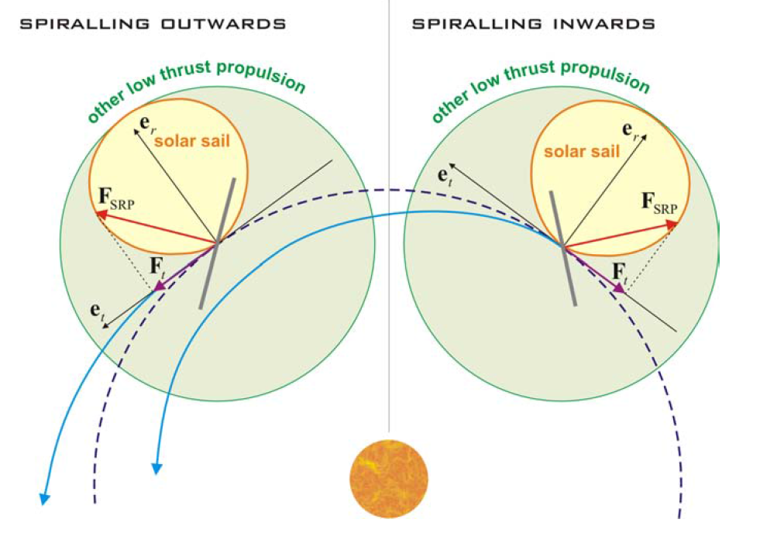
How to travel on a light beam? Solar Sail vs Low-Thrust spacecraft

Slide 5
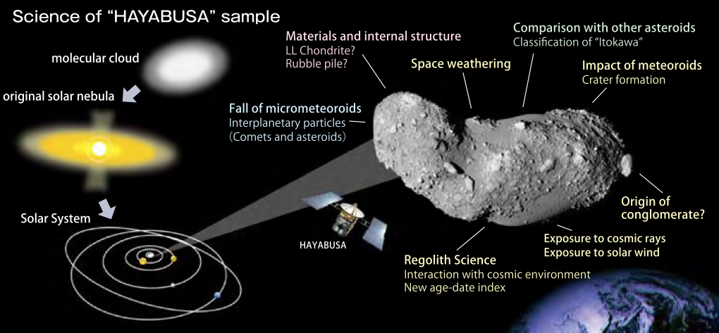
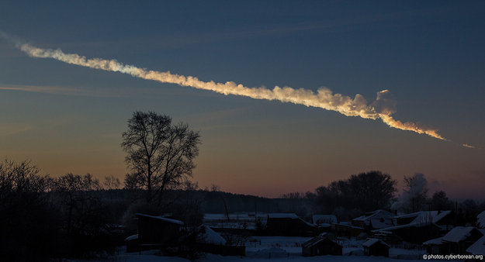
Why NEOs?
15/02/2013
Chelyabinsk impact
Image credits: ESA website
NEO scientific relevance:
Asteroid Itokawa studied by “HAYABUSA”
Image credits: “HAYABUSA” mission overview, ISAS – JAXA website

Slide 6
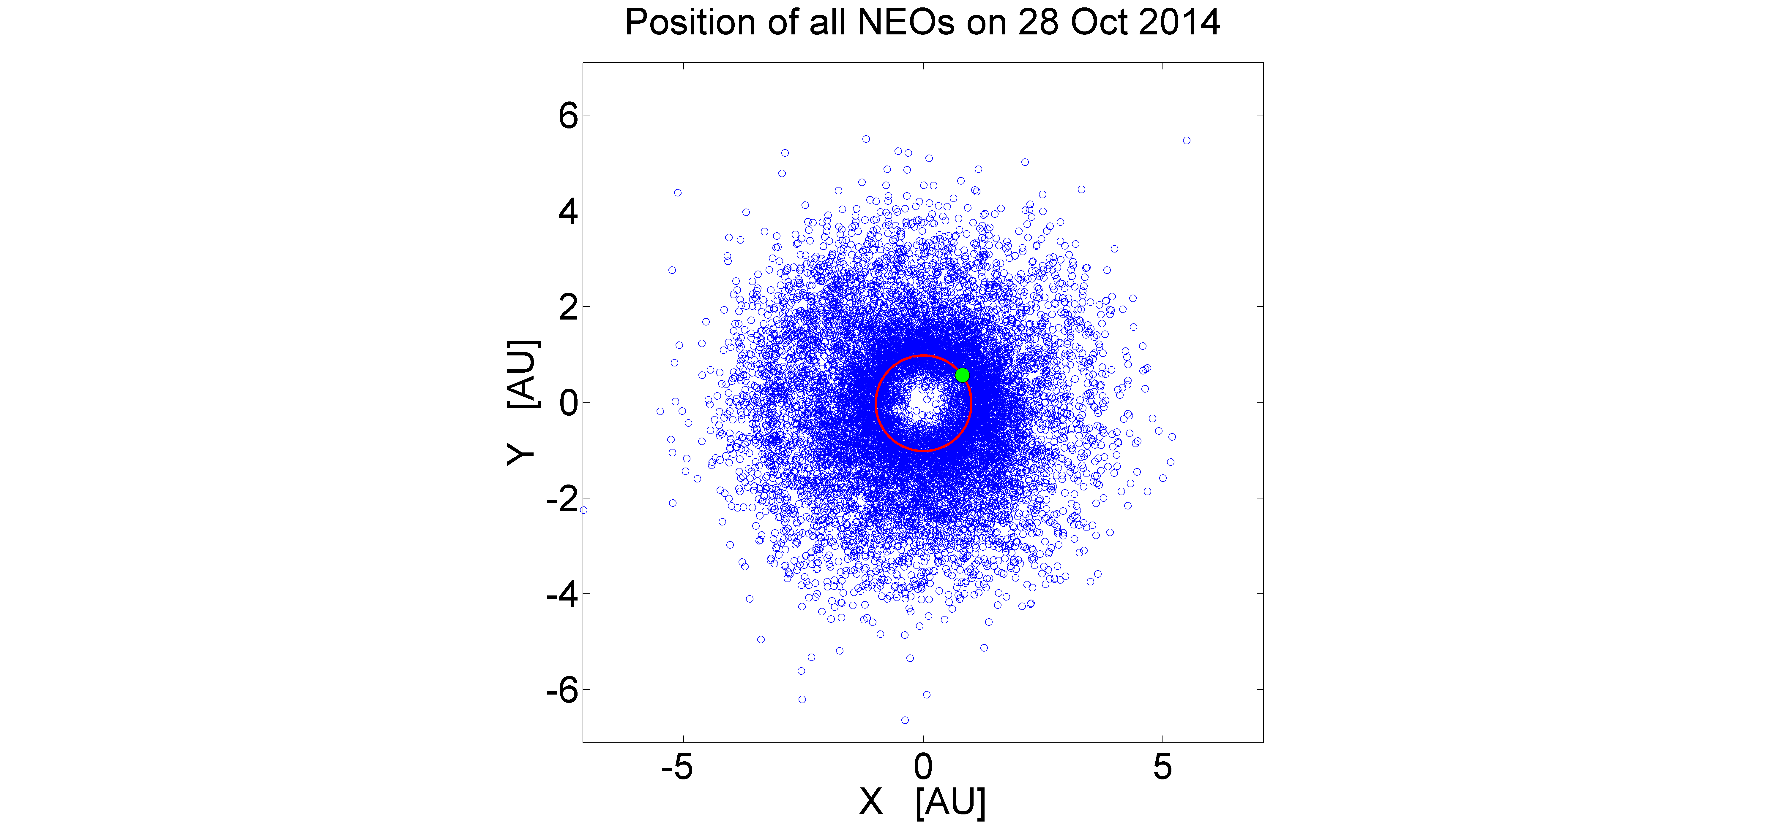
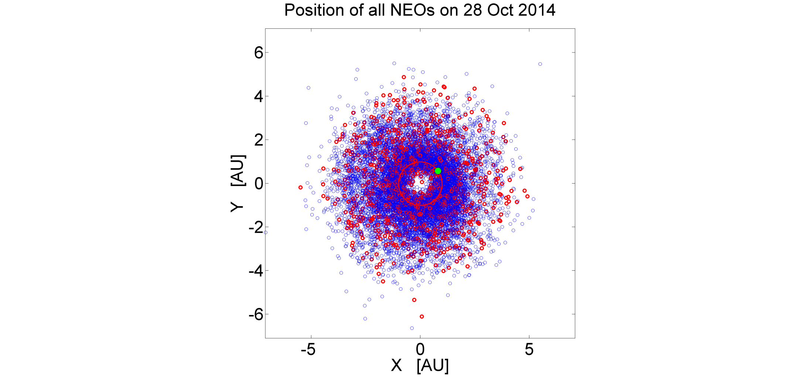
Why NEOs?
You are here

Slide 7
Multiple NEO Rendezvous Mission: Mission Requirements^{[1]}
Mission duration: $≈$10 years
Rendezvous with at least 3 NEOs
Stay time in the order of a few days
At least 1 Potentially Hazardous Object (PHO)
At least 1 Near-Earth Object Human Space Flight Accessible Targets Study (NHATS)^{[2]}
The last should be a very small object (less than 20-50 m in diameter $⟹$ H > 25.5 mag^{[3]})
Characteristic acceleration $a_{c}≤0.3 \frac{mm}{s^{2}} ⟹ \frac{A}{M}≤33 \frac{m^{2}}{kg}$
^{[1]}Dachwald,B. et al., ‘Gossamer Roadmap Technology Reference Study for a Multiple NEO Rendezvous Mission’, Advances in Solar Sailing, edited by M. Macdonald, Springer Praxis Books, Springer Berlin Heidelberg, 2014
^{[2]} http://neo.jpl.nasa.gov/nhats/
^{[3]} http://www.minorplanetcenter.net/iau/lists/Sizes.html

Slide 8
Objective
Mixed combinatorial/optimisation problem
Develop a method to find as many sequences as possible feasible by a solar sail

Slide 9
Approach method
Preliminary sequences found via heuristic rules and simplified trajectory models
Optimal control problem performed on better sequences found, in order to obtain feasible trajectories for solar sails

Slide 10
2D shape-based approach^{[1]}
In-plane Modified
Equinoctial Elements:
^{[1]}De Pascale, P. and Vasile M., “Preliminary design of low-thrust multiple gravity-assist trajectories”, Journal of Spacecraft and Rockets, Vol. 43, No. 5, 2006

Slide 11
Sequence finder
Complete list of NEOs
Pre-pruning on Keplerian parameters
Local pruning on semi-major axis
Shaping function from Earth to all available NEOs
Add a new object
Local pruning on Keplerian parameters
Local pruning on semi-major axis
Shaping functions to all available NEOs
Add stay time at the object
NO
Mission time > 10 years?
YES
Sequence complete

Slide 12
Optimisation
Trajectories and controls of each leg separately through shape-based method
Initial Guess
Pseudospectral transcription (GPOPS-II) used in order to find feasible solutions of the 2D problem for each leg separately
Initial Guess
Pseudospectral transcription (GPOPS-II) used in order to find the global multiphase solution

Slide 13
Optimisation
Objective function:
Derivatives: Automatic differentiation
Endpoint constraints:
Control vector:

Slide 14
Multiple NEO Rendezvous Mission: First Sequence (1/7)
Mission parameters for 5 NEO rendezvous:
Mission Duration: 10.8 years
 | Start | End | Duration [days]
Transfer leg 1: Earth → 2006 RH₁₂₀ | 18 Dec 2019 | 17 Jul 2021 | 578
Transfer leg 2: 2006 RH₁₂₀ → 2000 SG₃₄₄ | 06 Jan 2022 | 23 Nov 2023 | 687
Transfer leg 3: 2000 SG₃₄₄ → 2009 BD | 12 May 2024 | 31 Aug 2026 | 842
Transfer leg 4: 2009 BD → 2006 JY₂₆ | 29 Dec 2026 | 30 Mar 2028 | 457
Transfer leg 5: 2006 JY₂₆ → 2005 QP₈₇ | 26 Sep 2028 | 14 Oct 2030 | 747

Slide 15
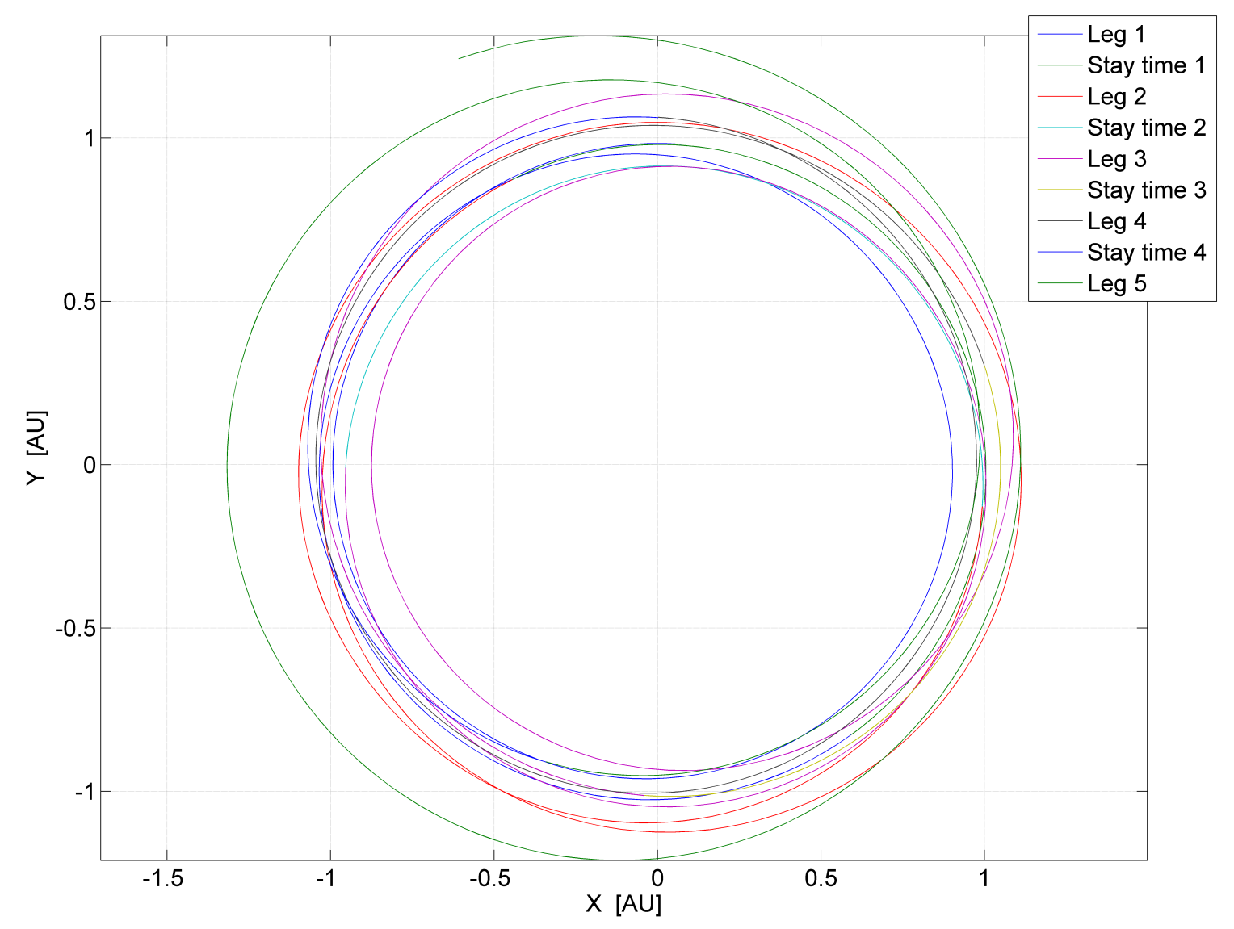
Multiple NEO Rendezvous Mission: First Sequence (2/7)

Slide 16
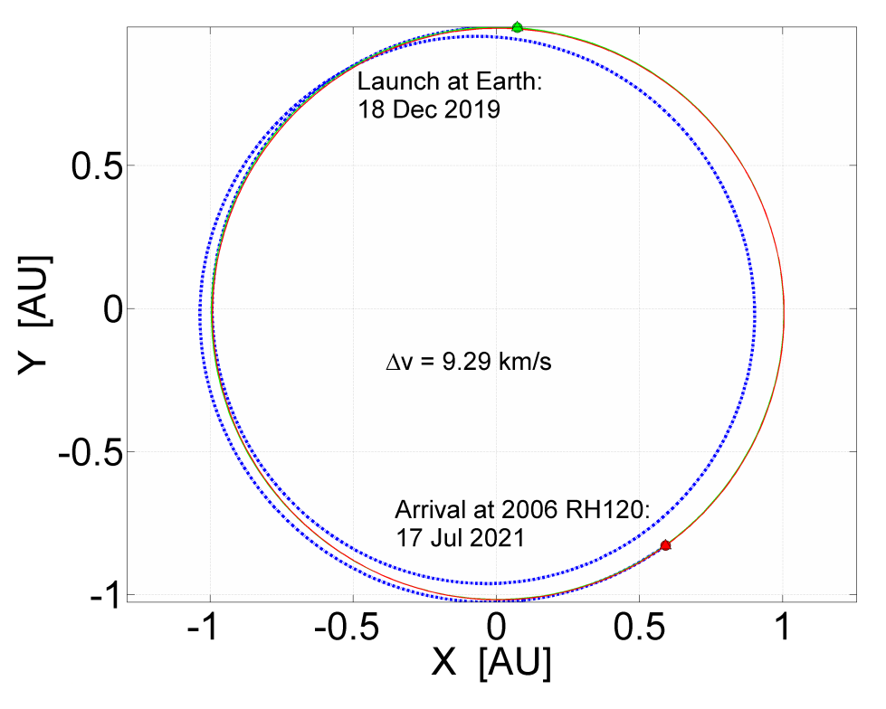
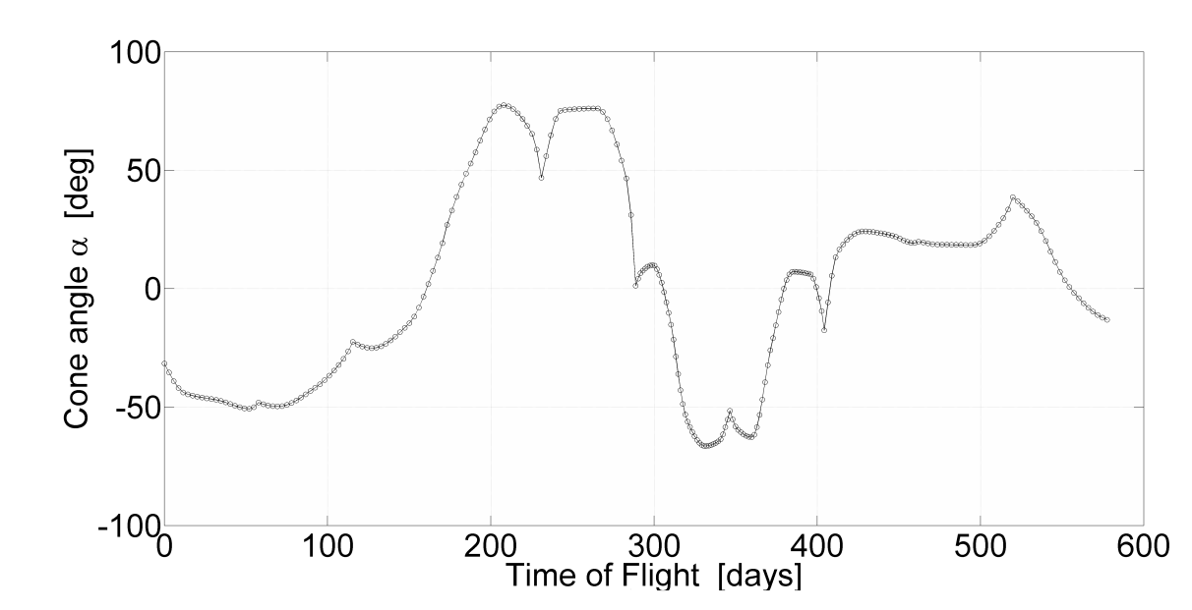
Multiple NEO Rendezvous Mission: First Sequence (3/7)
1st leg of the 5 NEO rendezvous mission
Departing orbit
Arrival orbit
Transfer trajectory

Slide 17
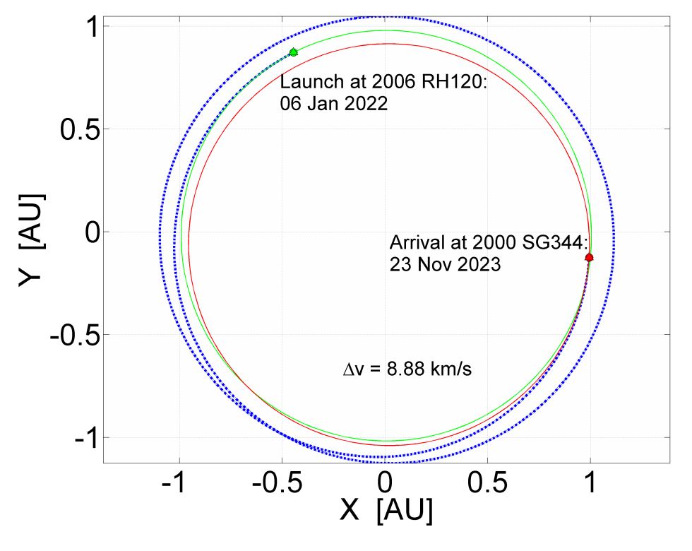
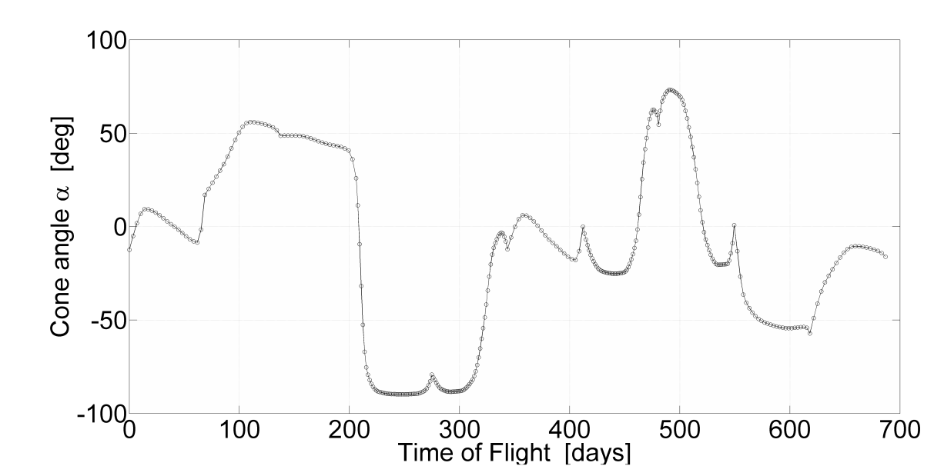
Multiple NEO Rendezvous Mission: First Sequence (4/7)
2nd leg of the 5 NEO rendezvous mission
Departing orbit
Arrival orbit
Transfer trajectory

Slide 18
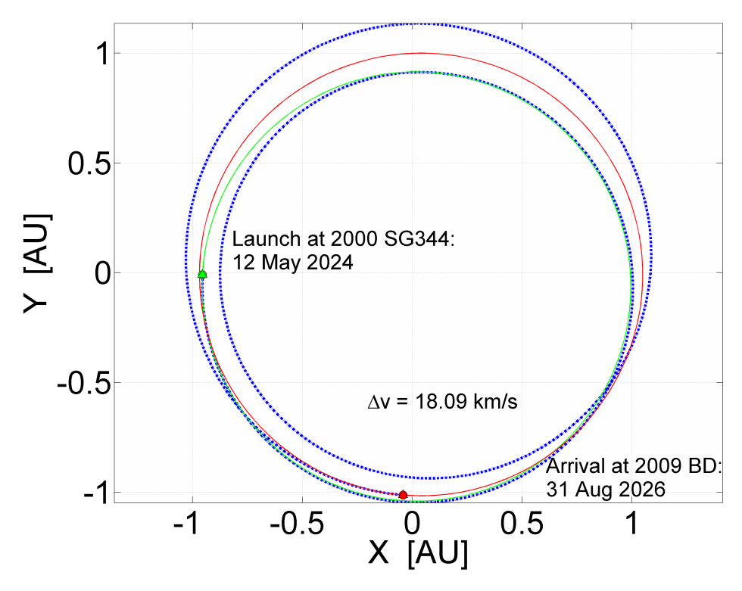
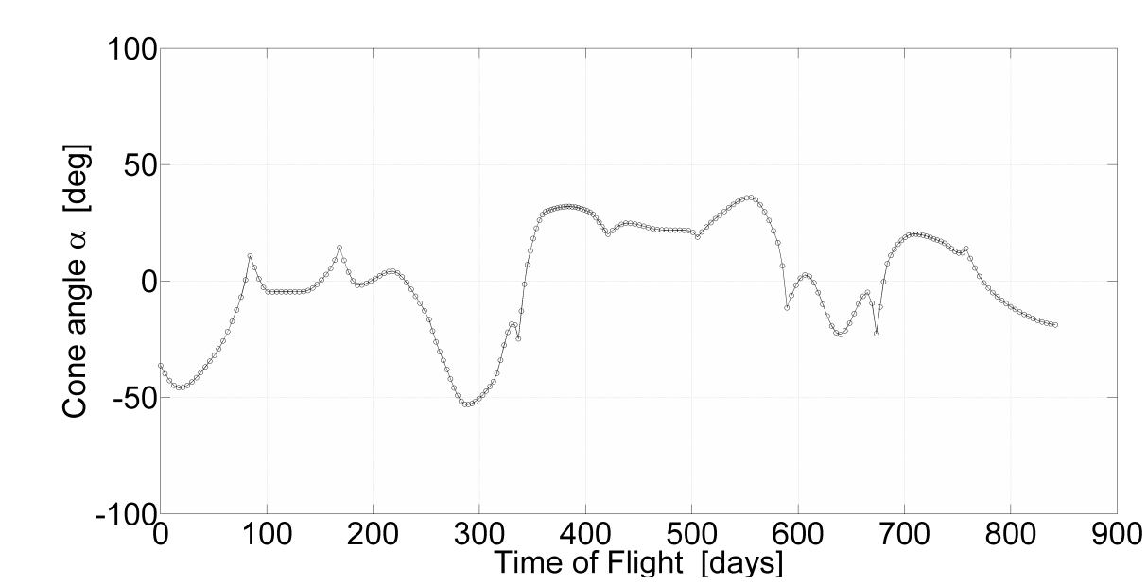
Multiple NEO Rendezvous Mission: First Sequence (5/7)
3rd leg of the 5 NEO rendezvous mission
Departing orbit
Arrival orbit
Transfer trajectory

Slide 19
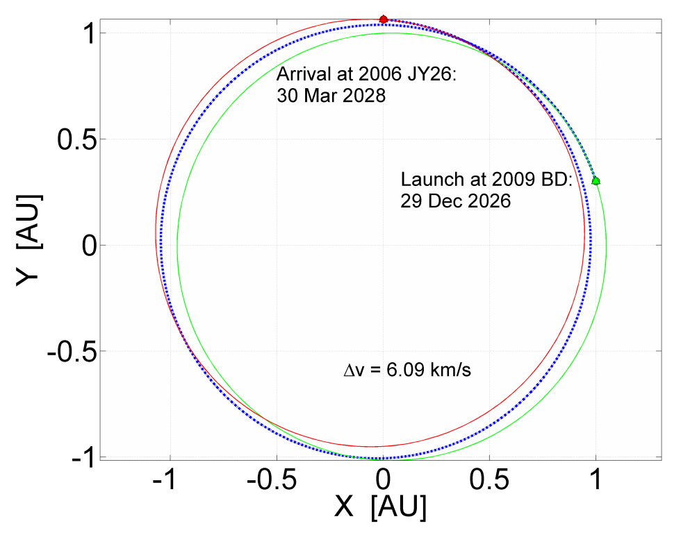
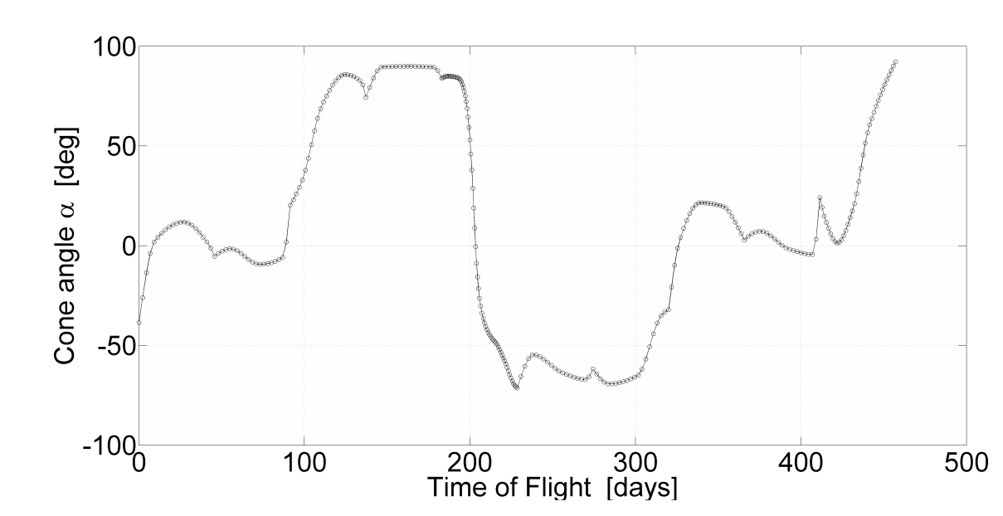
Multiple NEO Rendezvous Mission: First Sequence (6/7)
4th leg of the 5 NEO rendezvous mission
Departing orbit
Arrival orbit
Transfer trajectory

Slide 20
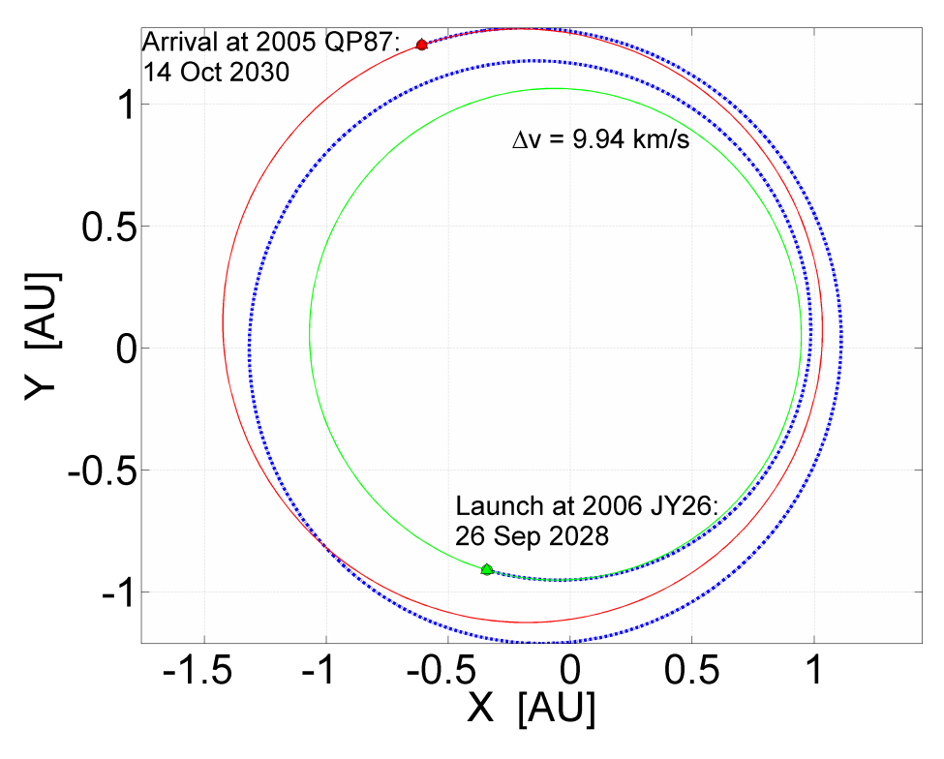
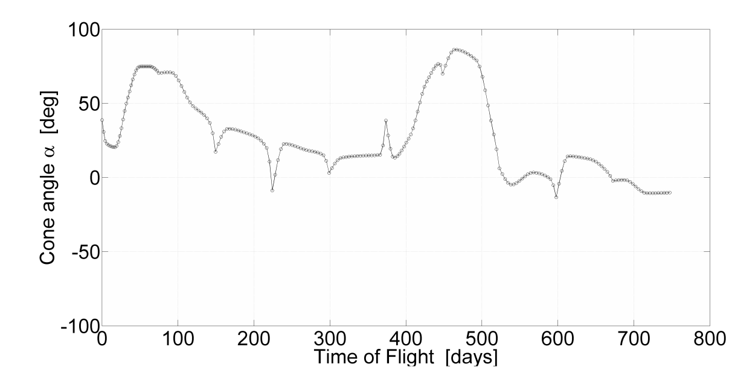
Multiple NEO Rendezvous Mission: First Sequence (7/7)
5th leg of the 5 NEO rendezvous mission
Departing orbit
Arrival orbit
Transfer trajectory

Slide 21
Multiple NEO Rendezvous Mission: Second Sequence
Mission parameters for 4 NEO rendezvous:
Mission Duration: 8.5 years
 | Start | End | Duration [days]
Transfer leg 1: Earth → 2001 GP₂ | 18 Dec 2019 | 08 Sep 2021 | 631
Transfer leg 2: 2001 GP₂ → 2007 UN₁₂ | 05 Apr 2022 | 23 Aug 2023 | 504
Transfer leg 3: 2007 UN₁₂ → 2009 YF | 17 Jan 2024 | 18 Apr 2026 | 822
Transfer leg 4: 2009 YF → (99942) Apophis | 03 Sep 2026 | 21 Jun 2028 | 657

Slide 22
Multiple NEO Rendezvous Mission: Summary of results
 | Required | Sequence 1 | Sequence 2
Mission duration | $≈$10 years | $$10.8 \text{years}$$ | $$8.5 \text{years}$$
Number of rendezvous | At least 3 | $$5$$ | $$4$$
Stay time [days] | At least few days | $$∈\left[119, 181\right]$$ | $$∈\left[139, 209\right]$$
Rendezvous with PHO | At least 1 | $$0$$ | $$1$$
Rendezvous with NHATS | At least 1 | $$1$$ | $$1$$
Last object | H > 25.5 | $$\text{H}=27.7$$ | $$\text{H}=19.7$$
Characteristic acceleration [ mm/s² ] | $$≤0.3$$ | $$0.3$$ | $$0.3$$
Total Δv [ km/s ] | // | $$52.3$$ | $$45.0$$

Slide 23
Conclusions and Future work
Conclusions
Solar sailing is a good way to perform missions with high $∆v$ requirements, such as a multiple NEO rendezvous mission, due to its propellantless characteristic
Sequences of NEOs have been found with the method shown
Future work
Improve the selection of PHOs
Implement a 3D algorithm
Use the same method in order to minimise the characteristic acceleration

Slide 24
a.peloni.1@research.gla.ac.uk
Thank you!

