Slide 1
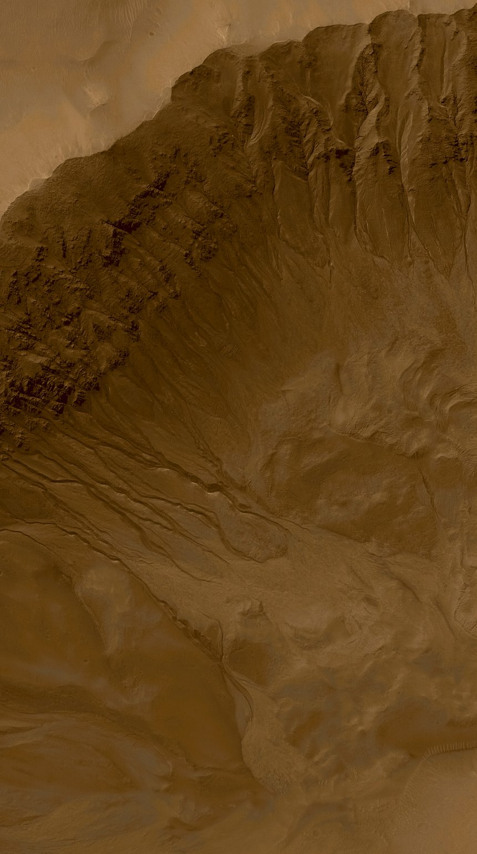



D/H AND WATER SOURCES IN TISSINT
L. J. Hallis, G. R. Huss, K. Nagashima, G. J. Taylor, D. Stöffler, C. L. Smith, M. R. Lee

Slide 2
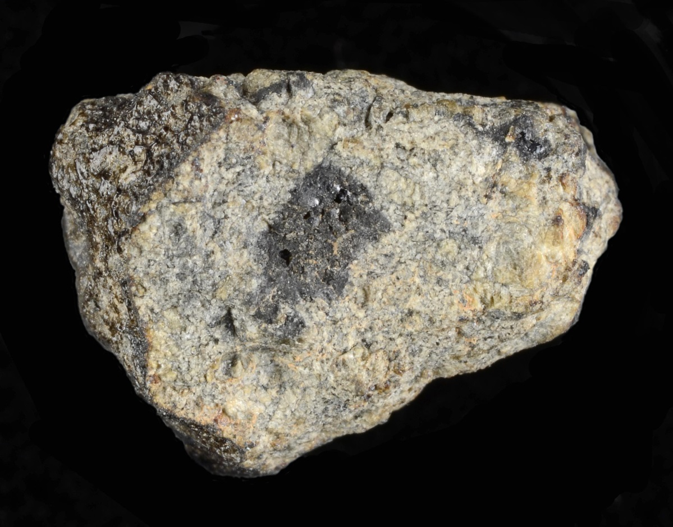
Shock in Tissint
The shock history of Tissint has been widely studied, with reports of various shock effects in the primary igneous minerals, as well as high pressure polymorphs and shock-induced melt.
The aim of this study was to measure the hydrogen isotope ratio and water content of a number of Tissint phases that have experienced differing apparent shock pressures, in order to determine how hydrogen is affected by shock in martian meteorites.
As current estimates of the water content of Mars’ interior are based on the water content of martian meteorites, it is vital to know whether impact-related shock can significantly change the amount of water in these samples before they reach Earth.
Image credit: Andy Tindle, The Open University

Slide 3
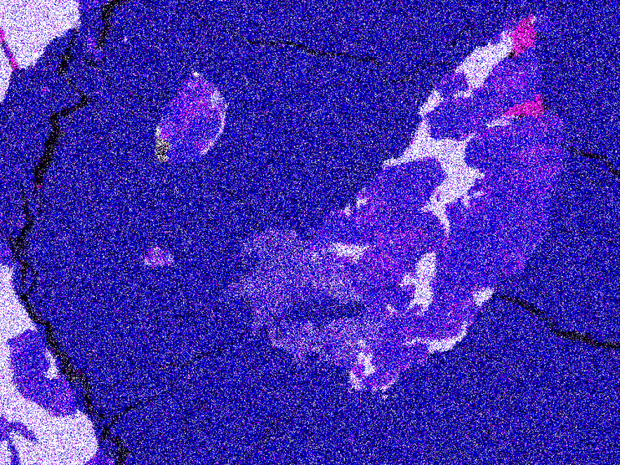
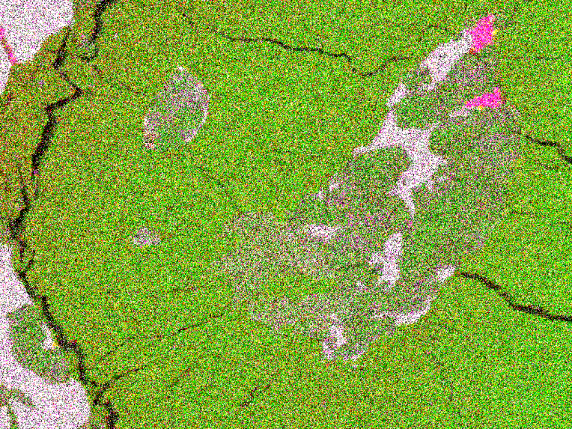
Target Areas
MASK
Area 3
Area 2
CPX
Area 2
OLV
MASK
MELT
CPX
OLV
250 µm
MELT
Area 2
OLV
MELT
CPX
100 µm
MASK
100 µm
MELT
OLV
50 µm
Area 2
PHOS
Tissint P19494
Area 1
Area 2
Area 3
100 µm
AlCaSi
100 µm
AlCaMg
2 mm

Slide 4
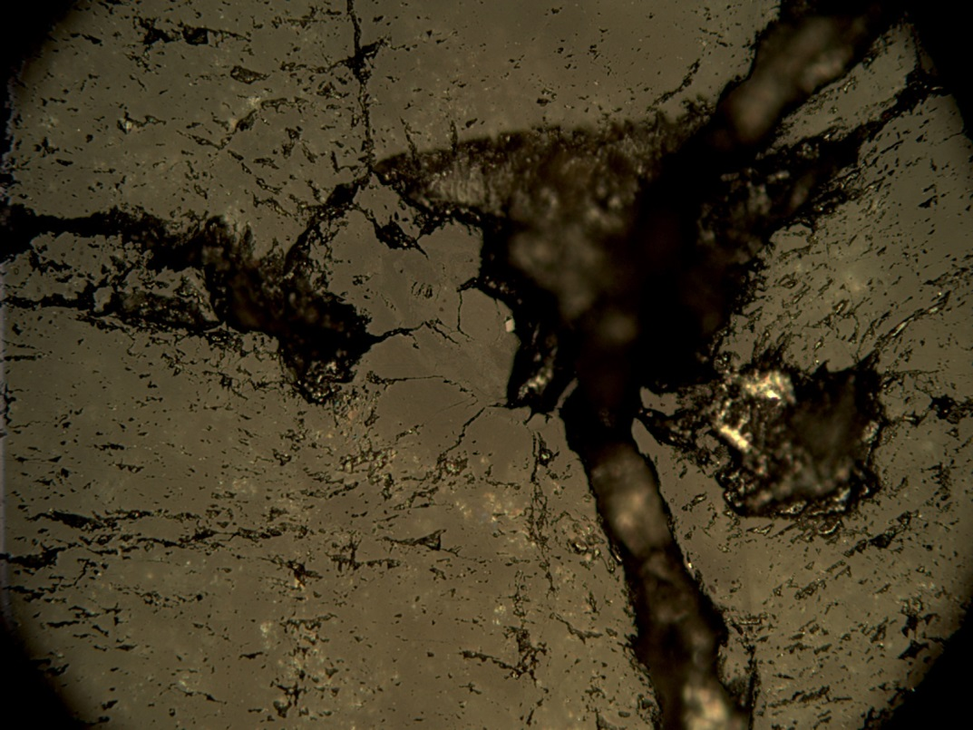
Target Areas
OLV
OLV
MELT
MELT
100 µm
Indium
100 µm
To check the affects of epoxy mounting on the D/H ratio of sample P19494 a single Tissint olivine phenocryst, containing shock-formed black glass, was mounted in indium metal and also analyzed.
MELT
100 µm

Slide 5
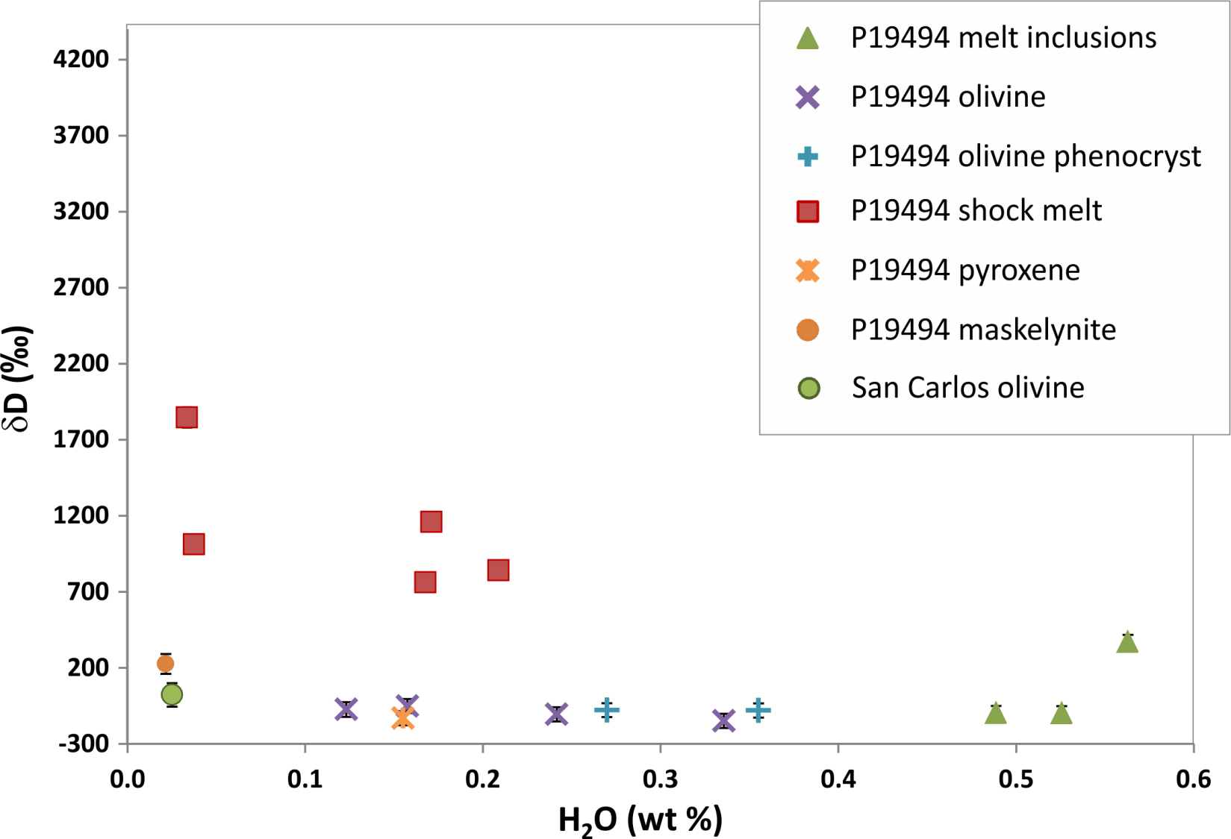
D/H Results

Slide 6
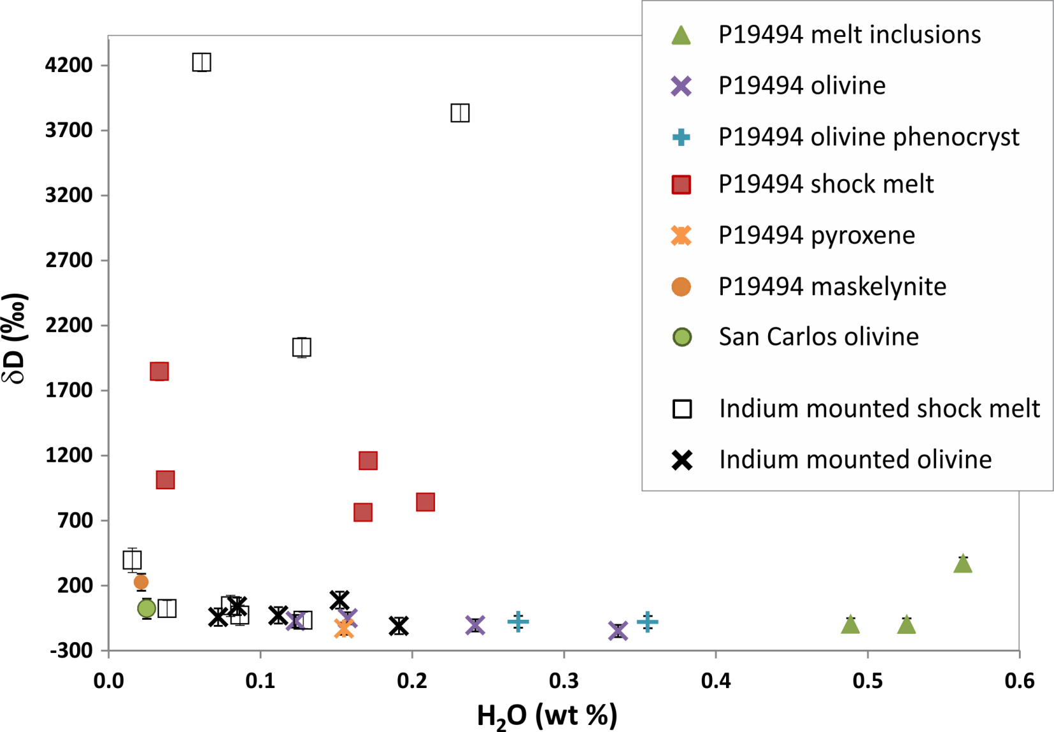
D/H Results

Slide 7
Target Areas
OLV
OLV
MELT
MELT
100 µm
Indium
100 µm
To check the affects of epoxy mounting on the D/H ratio of sample P19494 a single Tissint olivine phenocryst, containing shock-formed black glass, was mounted in indium metal and also analyzed.
MELT
100 µm

Slide 8
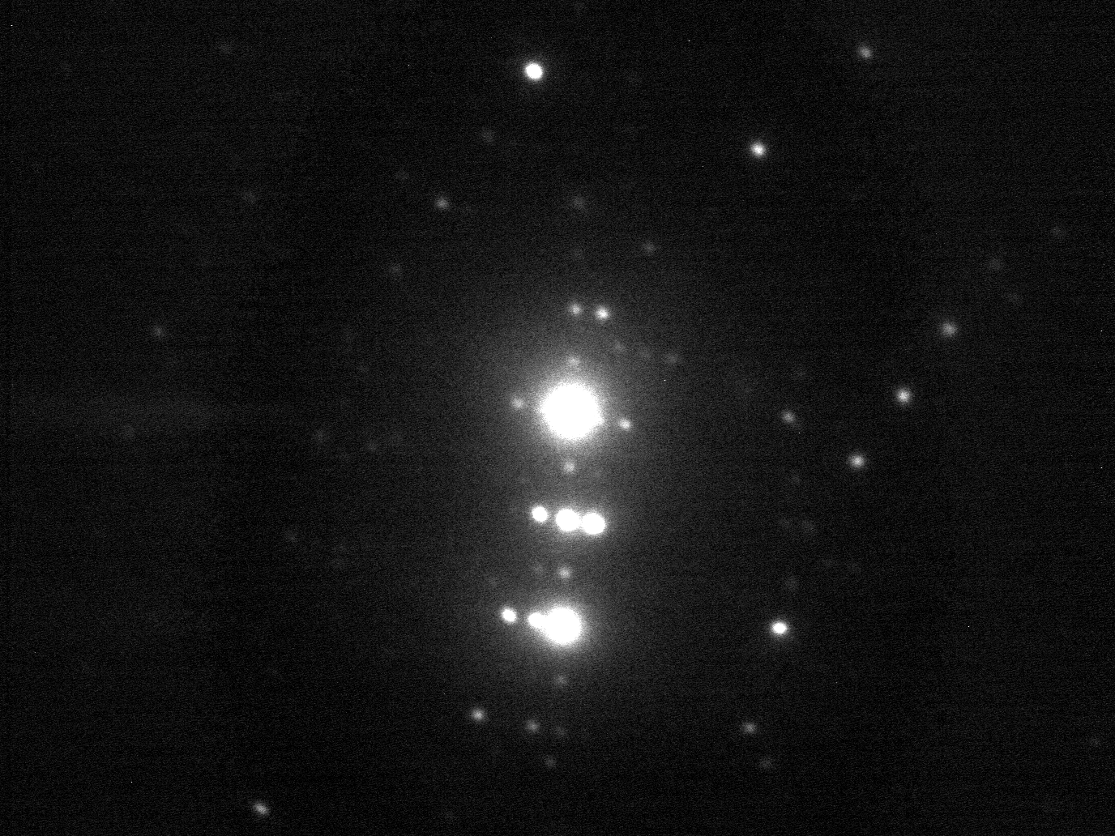
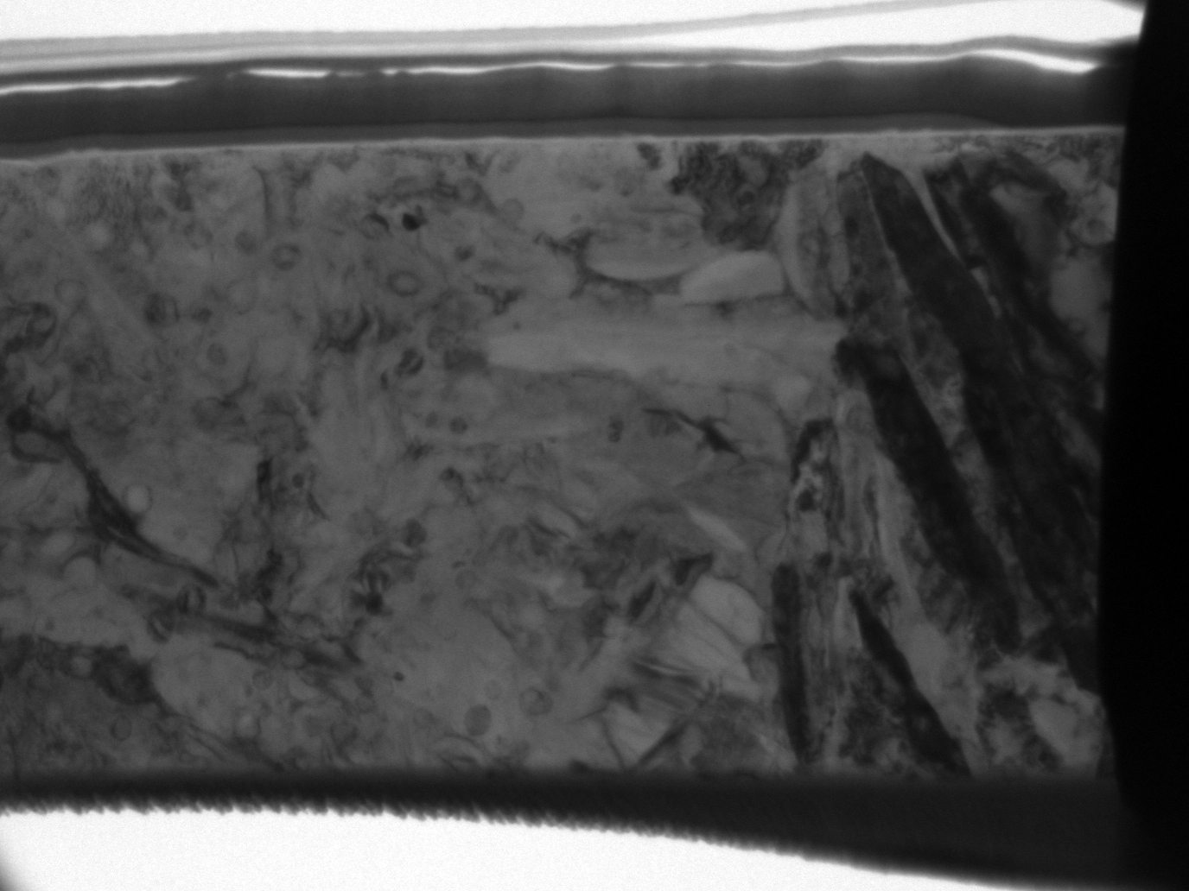
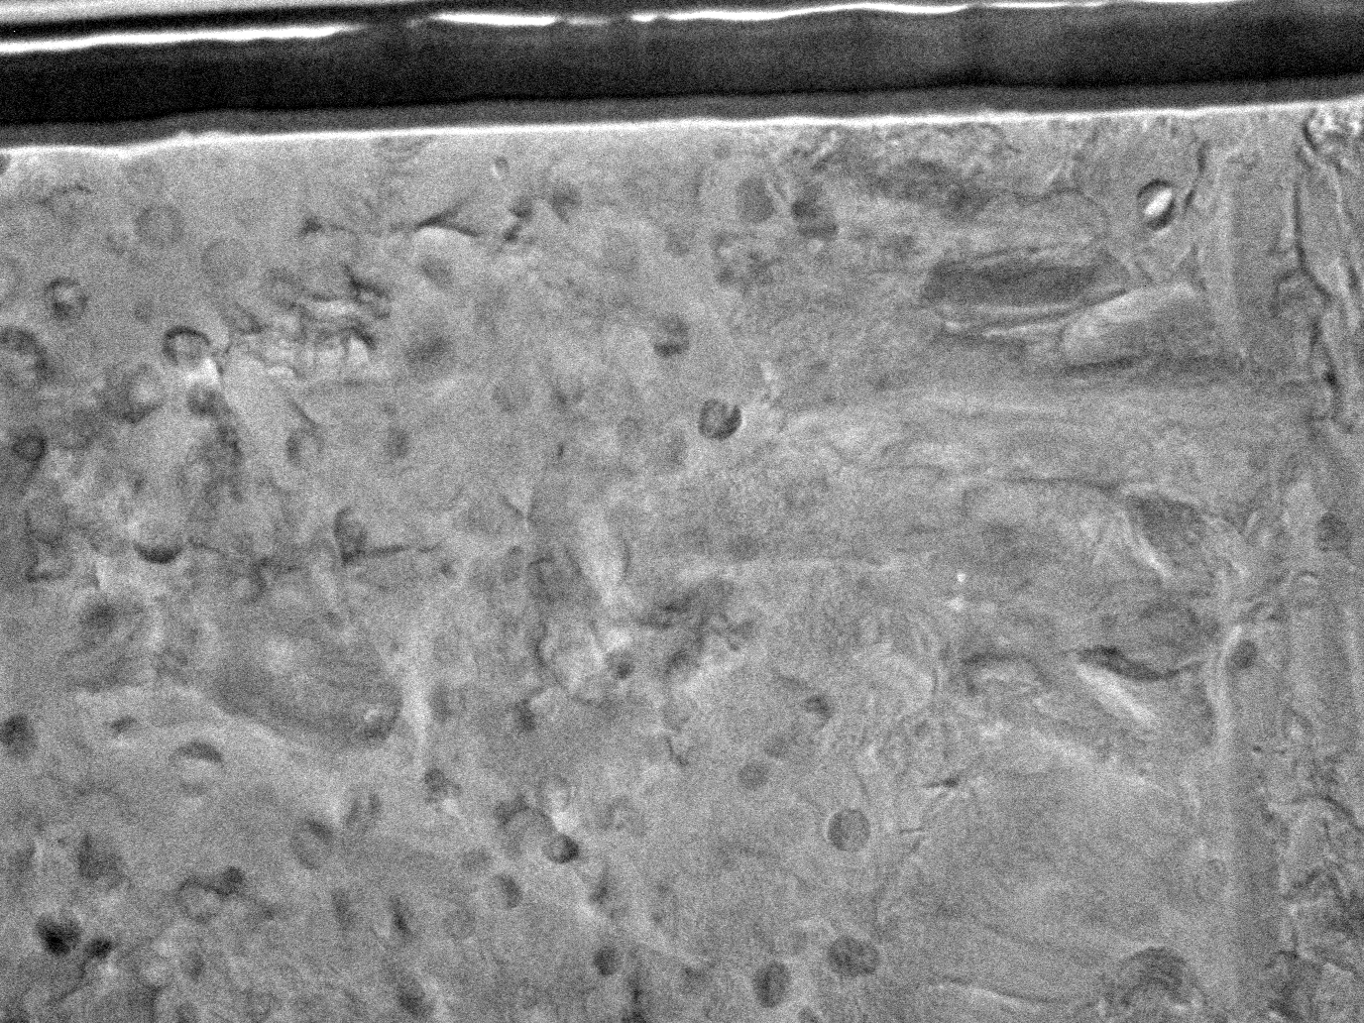
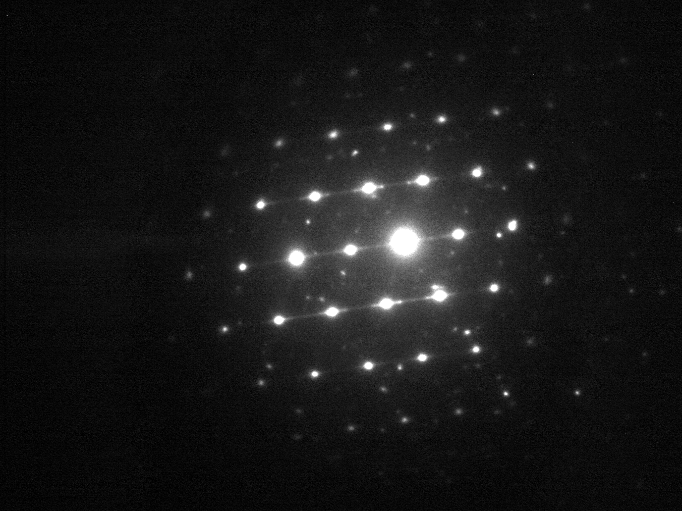
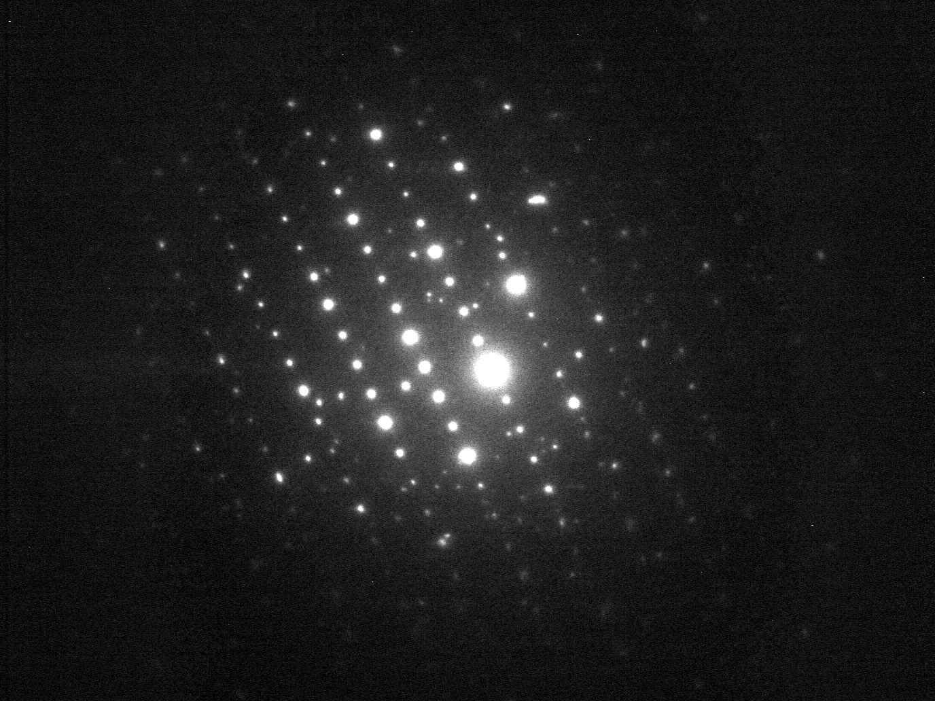
TEM Results: ‘Black Glass’
Spherical inclusions
Subgrains
Olivine

Slide 9
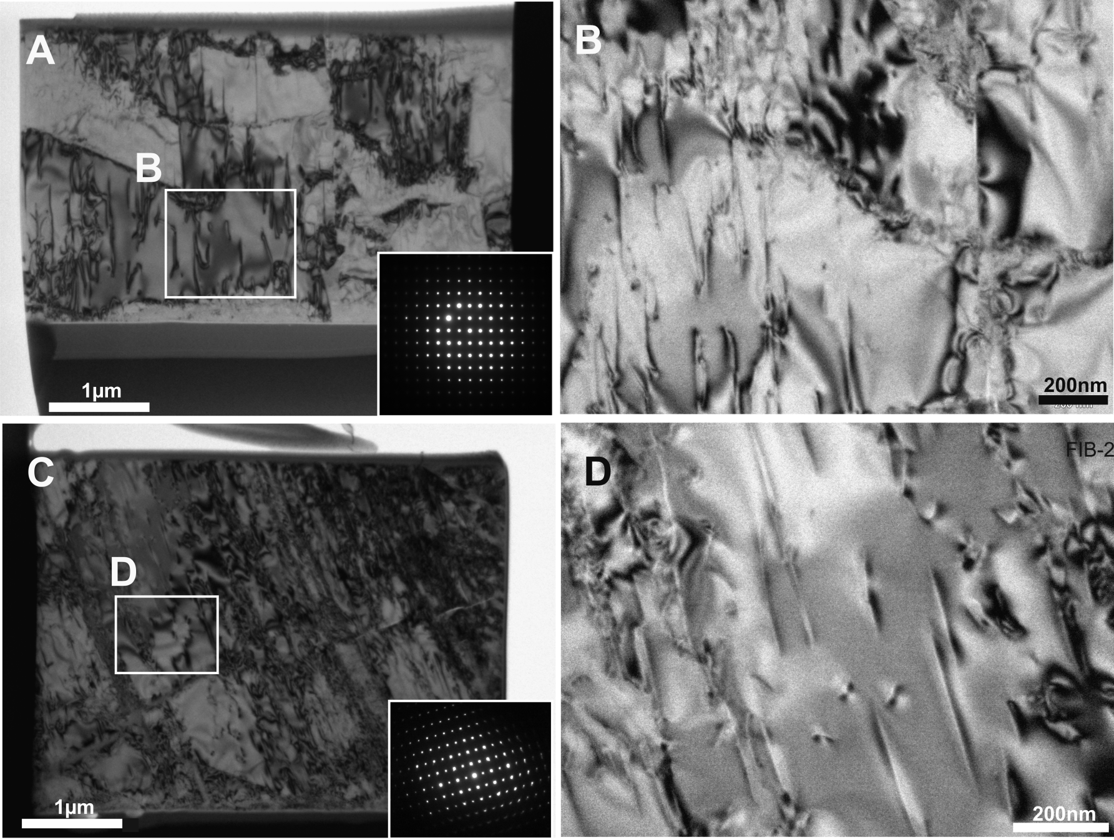
TEM Results: Olivine
A-B = olivine FIB section 1, C-D = olivine FIB-section 2

Slide 10
Tissint Shock Pressure
Dislocation densities = 3.21x10¹³ m⁻² for FIB 1 and 3.64x10¹³ m⁻² for FIB 2
Slightly lower than that reported for the Tenham L6 chondrite (2×10¹⁴ m⁻²), which is reported to show evidence for heterogeneous shock pressures between 25 and 45 GPa (Langenhorst et al., 1995).
Other observed shock features in Tissint include:
  Very strong mosaicism and planar fractures in olivine
  Shock induced mosaicism and mechanical twinning in clinopyroxene
  Maskelynite compositions ranging in An-content from ~ 58 to 66 %
  Localized melt pockets
  Shock blackening
  Plagioclase glass within or near to melt regions exhibiting small vesicles and minor flow textures
All these factors indicate the bulk of the Tissint meteorite was affected by an equilibration shock pressure of 35-40 GPa, with localized regions in which pressure excursions of 45-50 GPa occurred (these pressures are required for localized melting of olivine and plagioclase).

Slide 11
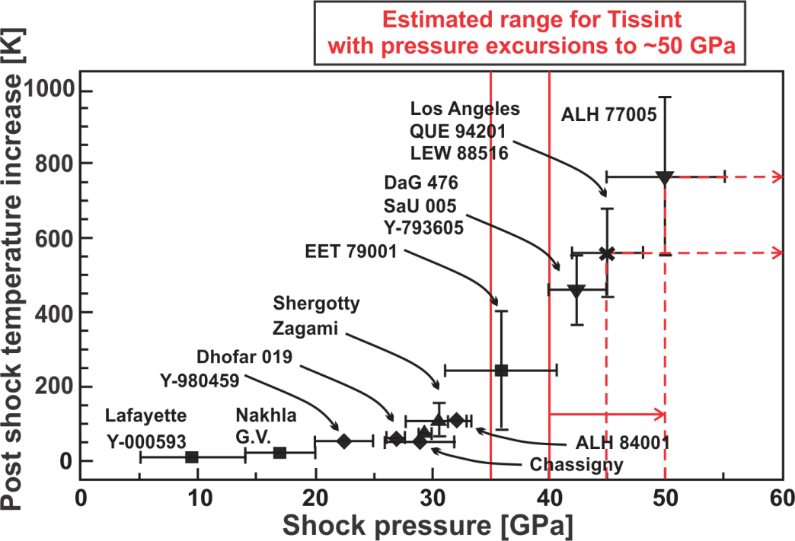
Tissint Shock Pressure
All these factors indicate the bulk of the Tissint meteorite was affected by an equilibration shock pressure of 35-40 GPa, with localized regions in which pressure excursions of 45-50 GPa occurred (these pressures are required for localized melting of olivine and plagioclase)

Slide 12
Conclusions
Olivine and pyroxene in Tissint are water rich, as are olivine-bound melt inclusions, suggesting a water-rich primary melt.
The D/H ratios of water in the above primary phases are low, supporting previous reports that the martian mantle has a D/H ratio similar to Earth.
The water content and D/H ratios of shock melted phases in Tissint are widely variable, but do not correspond to simple dehydration of the water-rich primary phases.
TEM imaging of an area of olivine-bound shock-produced ‘black glass’ indicate it has a crystalline structure, containing spherical inclusions of a separate crystalline phase.
Dislocation densities in olivine are in line with textural observations suggesting Tissint experienced an equilibration shock pressure of 35-40 GPa, with localized regions in which pressure excursions of 45-50 GPa occurred.

Slide 13
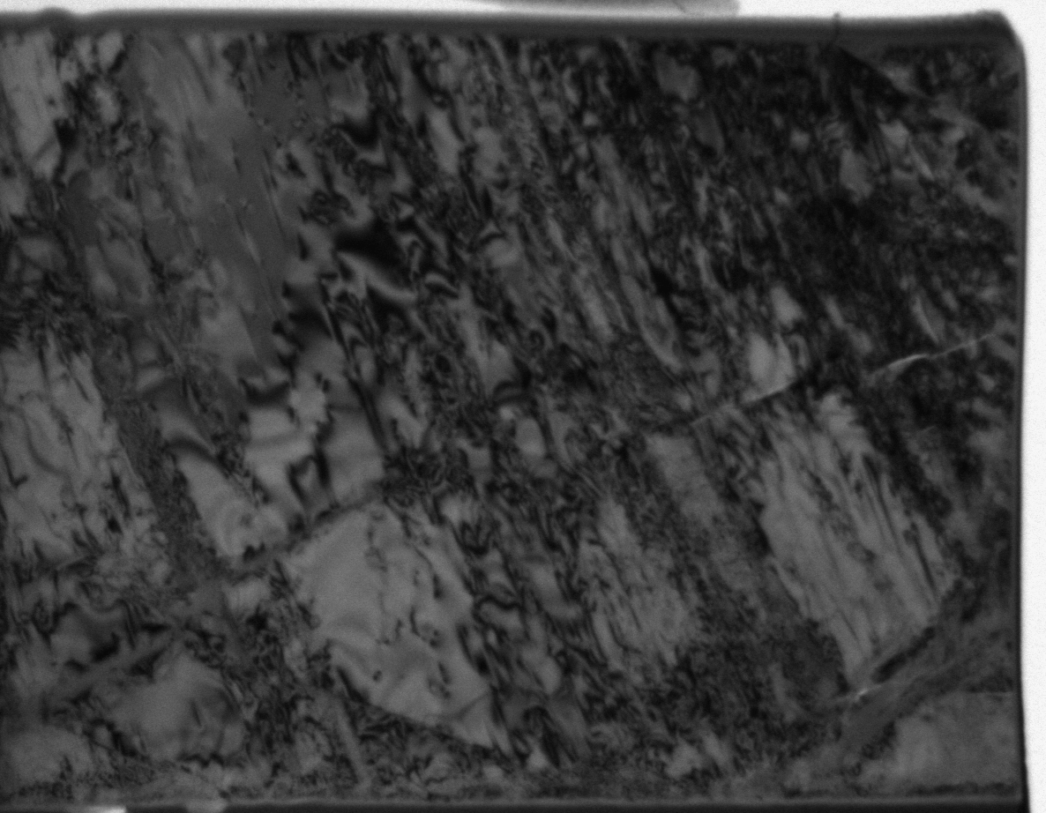
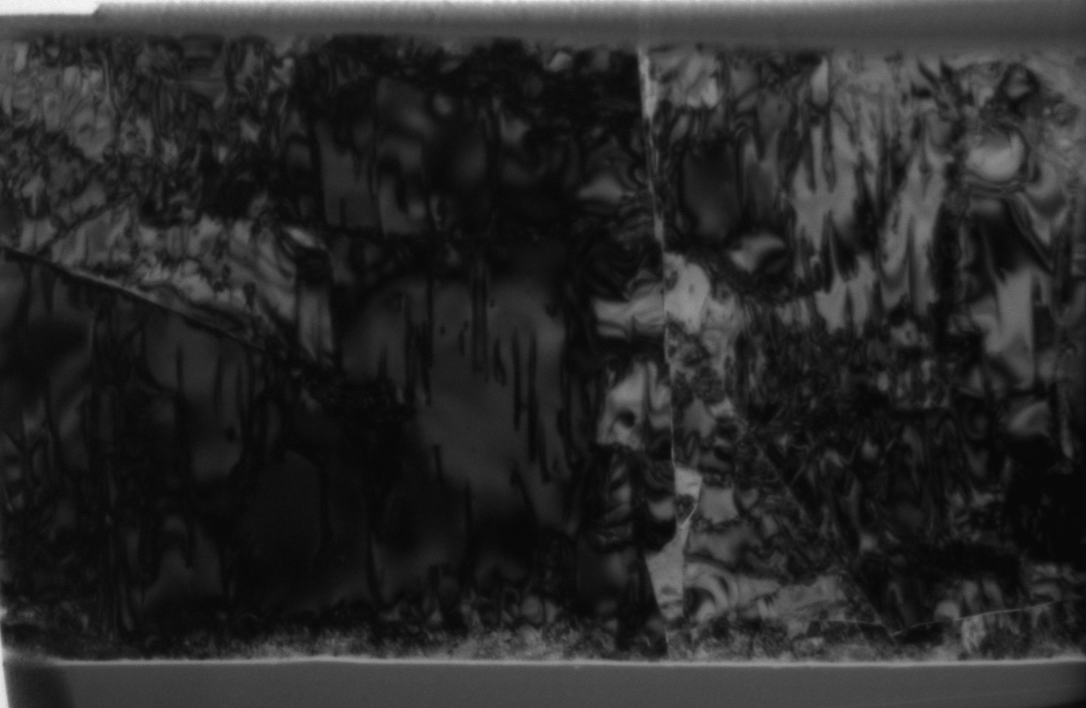
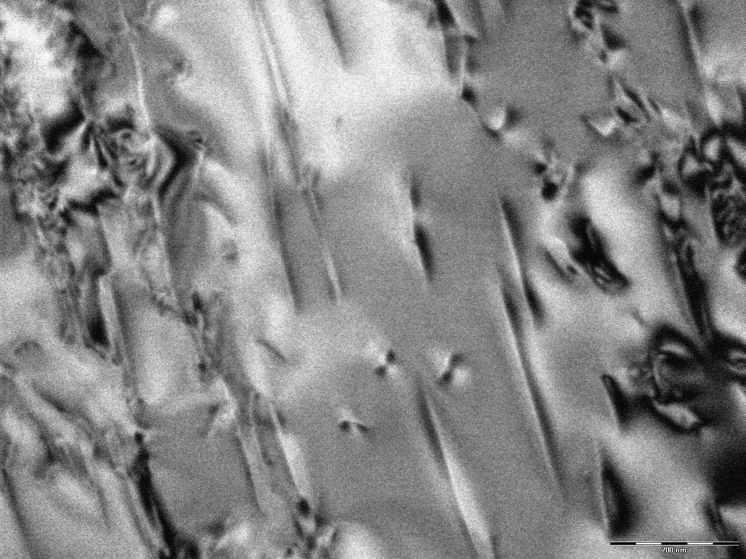
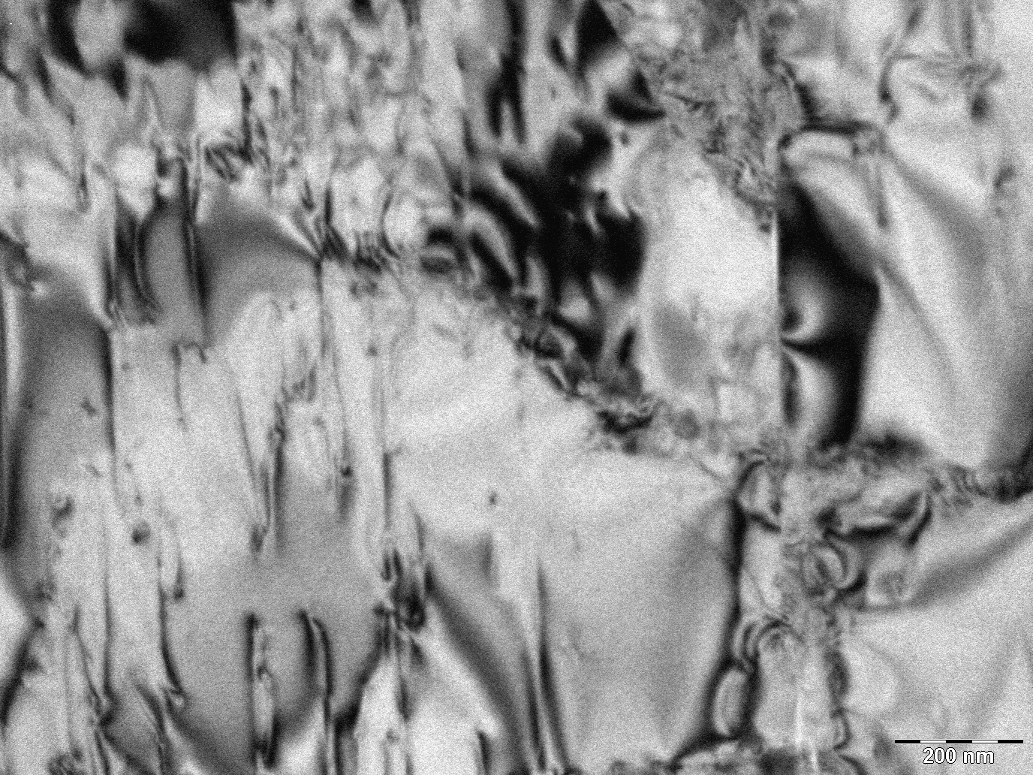
TEM Results
Olivine FIB section 1
Olivine FIB section 2
Dislocation densities = 3.21x10⁹ and 3.64x10⁹

