Slide 1
The Ayrshire Enlightenment
Introduction to Professor Kidd’s slide presentation:
At the inaugural meeting in December Professor Colin Kidd presented a paper based on these slides. The aim was to provide a context both for the religious milieu in Irvine and Greenock at the time Galt was growing up and how that came to inform some of his best-known works. The slides illustrate:
- How central religious debate was to the communities of the west of Scotland;
- That it was not confined solely to clergymen but permeated every stratum of society;
- The fierceness of the struggle between the Auld Lichts, or traditional strict Calvinists and the New Lichts or more theologically liberal who were (relatively) more tolerant, more accommodating of government direction, and more receptive to the ideas generated by the Enlightenment; and
- How hypocritical some of the debate was, a point seized on by Burns in, for example, ‘Holy Willie’s Prayer’ and ‘The Holy Fair’ and by Galt in the portrayal of the Elder, Mr Craig, in The Ayrshire Legatees.
It was not made explicit in the talk but it is not difficult to see that these doctrinal arguments were part of the legacy bequeathed to Scotland by the characters, beliefs and struggles of the sixteenth and seventeenth centuries and which were the themes of Galt’s Ringhan Gilhaize.

Slide 2
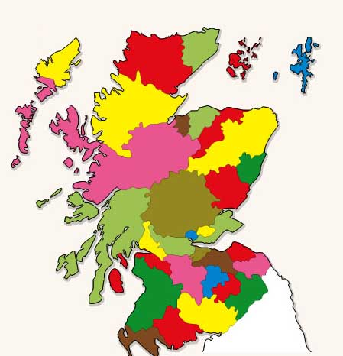
Scottish Counties

Slide 3
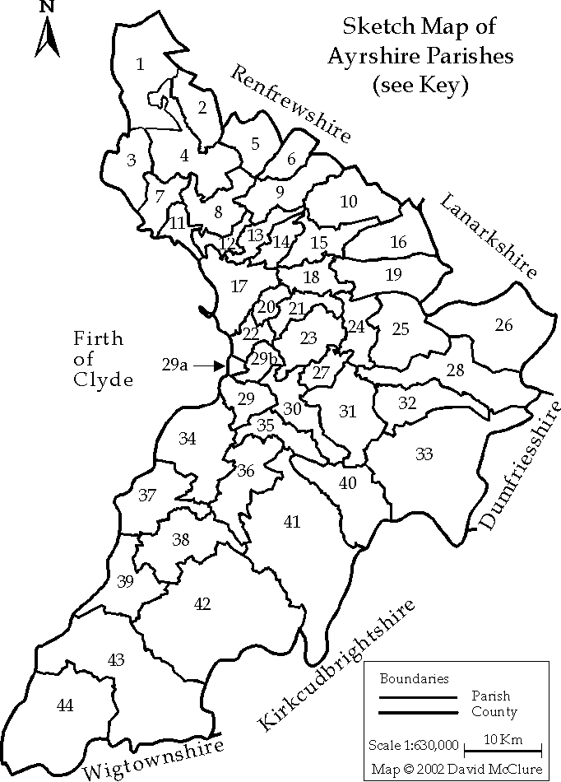

Slide 4
Ecclesiastical Context
Presbytery of Ayr
Presbytery of Irvine
both within Synod of Glasgow and Ayr

Slide 5
New Lichts
William Leechman (1706-85), minister in Beith parish, 1736-44; later professor of divinity, Univ of Glasgow and then Principal.
Alexander Fergusson (1689-1770), minister of Kilwinning parish; prosecuted through church courts 1767-9 for apparent denial of validity of Westminster Confession of Faith. Charge dismissed 1769 on account of Fergusson’s age and infirmity.
John Graham (1732-1815), minster of Dunlop parish from 1763; educated Univ of Glasgow, MA 1753; supporter of Fergusson and author of The religious establishment in Scotland examined upon Protestant principles (1771) in aftermath of Fergusson affair; and author of sequel, Subscription to human articles of faith examined (1775) in reply to Walker. In 1779 Graham left Dunlop for parish of Kirkinner in Presbytery of Wigtown.

Slide 6
New Lichts (contd.)
John Goldie (1717-1809), Kilmarnock cabinet-maker and wine merchant; astronomer and religious controversialist; abortive project for canal between Kilmarnock and port at Troon; author of Essays on various subjects, moral and divine (1779), known as ‘Goudie’s Bible’; 2nd edn 1785, as The Gospel recovered from its Captive State.
Robert Burns (1759-96), poet, farmer and excise-man, among poems ‘An Epistle to John Goldie in Kilmarnock, Author of The Gospel Recovered’, ‘Holy Willie’s Prayer’, ‘The Kirk of Scotland’s Garland, or the Kirk’s Alarm’ (in defence of McGill). Much of his poetry satirizes Auld Licht Calvinists and their hypocrisies.
Gavin Hamilton (1751-1809), lawyer in Mauchline, charged by Rev William Auld, a doctrinal opponent, of embezzlement of poor fund. Innocence upheld. Then accused of neglect of sabbath. Appeared before Presbytery of Ayr in 1785, and then, on appeal, Synod of Glasgow and Ayr. Both upheld Hamilton’s case. Burns wrote on behalf of his friend Hamilton, including a character sketch in ‘Epistle to John McMath’.

Slide 7
New Lichts (contd.)
James Wodrow (1730-1810), minister of Dunlop parish, 1757-9, and then Stevenston parish 1759; previously Librarian of Glasgow University 1750-5; son of Rev. Robert Wodrow, a leading auld licht of early eighteenth century; author of memoir of Leechman.
Patrick Wodrow (1713-93), minister of Tarbolton parish from 1738, son of Rev. Robert Wodrow.
John McMath (1755-1825), minister of Tarbolton parish from 1782. Resigned charge 1791 after drink problem. Burns composed ‘Epistle to McMath’.

Slide 8
New Lichts (contd).
William Dalrymple (1723-1814), minister of Ayr first charge, author of A history of Christ for the use of the unlearned (1787) and numerous other works.
William McGill (1732-1807), minister of Ayr second charge from 1761; educ Glasgow Univ, MA 1753; apptd assistant to minister of Kilwinning 1760 [Fergusson]; married 1763 Elizabeth Dunlop (d. 1785), niece of William Dalrymple, minister of the first charge in Ayr. Author of A practical essay on the Death of Christ (1786) and of anti-subscriptionist appendix to his published sermon on centenary of Glorious Revolution in 1788, which led to his heresy trial 1789-91.

Slide 9
Auld Lichts
John Witherspoon (1723-94), minister of Beith parish 1745-57, author of Ecclesiastical Characteristics (1753); later, minister of Paisley Laigh parish, then President of College of New Jersey, Princeton.
John Adam (1720-92), minister of West Kilbride parish, 1751-69. Letter to whom from Fergusson brought about Fergusson’s heresy trial.
James Macconnel, town drummer of Beith, brought prosecution against Fergusson.
Thomas Walker (1704-80), minister of Dundonald parish; critic of pagan immorality of ‘Shakespearomania’; author of several works upholding Auld Licht orthodoxy, including letter on subscription in Scots Magazine (Jan 1768) under pseudonym Philalethes and A vindication of the discipline and constitutions of the Church of Scotland (1774) in reply to Graham.

Slide 10
Auld Lichts (contd.)
William Auld (1709-91), minister of Mauchline; persecutor of New licht, Gavin Hamilton.
John Russel (1740-1817), minister of Kilmarnock High Kirk 1774-1800, author of attack on McGill, The reasons for our Lord’s agony in the garden (1787); familiarly known as ‘Black Russel’.
William Peebles (1753-1826), minister of Newton-upon-Ayr; previously assistant to Walker at Dundonald parish; his sermon on centenary of Glorious Revolution, 1788, provoked response from McGill and led to the latter’s heresy trial; author of posthumous attack on Burns in Burnomania (1811)

Slide 11
Fergusson Heresy Case
Identified as author of anonymous letter in Scots Magazine justifying dissimulation in subscription to Confession.
Case for prosecution submitted by Macconnel to Synod of Glasgow and Ayr 1767.
Matter referred to Presbytery of Irvine for investigation.
Presbytery of Irvine stalled and Oct 1768 Macconnel appealed to Synod against lower court’s prevarication.
Fergusson attacked by Philorthodoxus, Kilwinning Divinity weighed and found wanting (1768)
Synod 1769 denounced letter but in respect of Fergusson’s age remitted matter back to Presbytery of Irvine.
Fergusson died 1770.
Graham and Walker continued the debate over Fergusson and subscription into 1770s long after end of process and Fergusson’s death.

Slide 12
McGill Heresy Case
arising from McGill’s Practical Essay on the Death of Christ (1786)
attacked by John Russel, The reasons of our Lord’s agony in the garden (Kilmarnock, 1787)
and other pamphleteers both within Ayrshire and beyond
McGill’s debate with Peebles 1788 on anniversary of Glorious Revolution
McGill heresy case Presbytery of Ayr 1789-90, with interventions in Synod and Assembly.
Synod of Glasgow and Ayr reached compromise position 1790, whereby McGill in interview with panel of ministers formulated an apology.
Synod appointed Dalrymple to give prayer of thanks for eirenic conclusion of process.
Criticism by Seceders of errors of McGill and of laxity of the Kirk on doctrinal matters.
James Ramsay, A clear, scriptural detection of Satan transformed into an Angel of Light (1790) attack on both McGill and Dalrymple as ‘Socinian Doctors of Ayr’.
1791-2 Associate Synod of Glasgow and Presbytery of Kilmarnock denounced McGill and Moderatism within Kirk.

