Slide 1

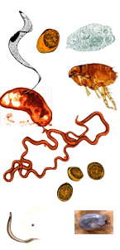
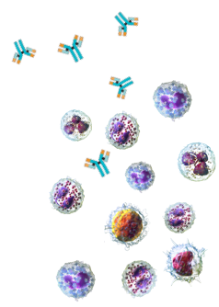
Simon Babayan
Background & Research interests:
  Immunoparasitologist, with main background on protective immunity and vaccine development against parasitic nematodes. Study system: laboratory mice.
  More recently, Wild Immunology – how natural variation (in resource availability, coinfection, demographics) affects the ability of hosts to generate protective immune responses: fundamental understanding of how immune system integrates diverse and complex inputs; analytical approaches to identify best predictors of protective immunity; ‘nature-proofing’ medical interventions.
Aims for this workshop:
  learn about bTB current research, its transmission, and potentially unmet needs for diagnosis and prevention.
  Consolidate and expand collaborations.

