Slide 1


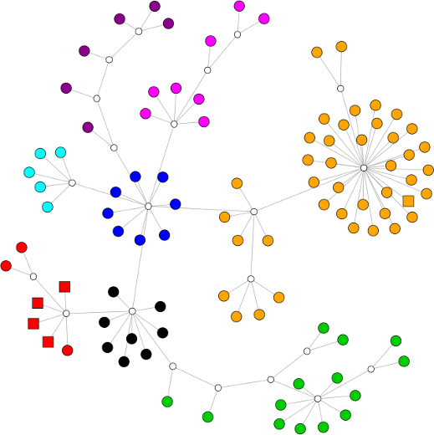
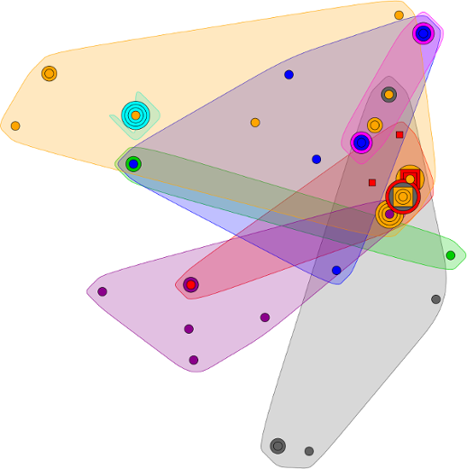
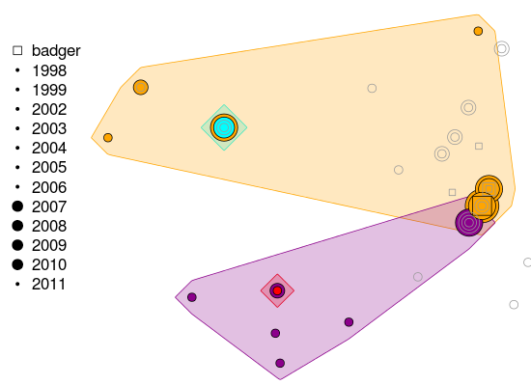
Daniel Balaz
Computational Ecology`
Boyd Orr Centre for Population and Ecosystem Health
Daniel.Balaz@glasgow.ac.uk
Correlation between genetic and spatio-temporal clustering
Can control of a strain in one host species lead to emergence of another strain in another host species?
No control
Control
host 1
host 2
host 1
host 2
strain 1
strain 1
strain 2
strain 2
Strain 1 outcompetes strain 2 in host 1
Strain 2 cannot persist (needs both hosts)
Strain 2 coexists with strain 1
Strain 2 can persist and emerges in host 2

