Slide 1
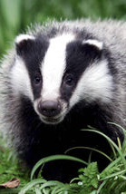
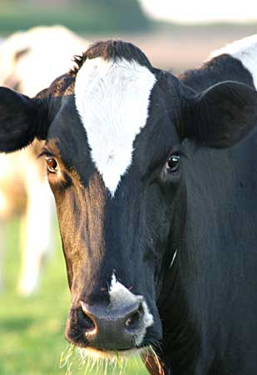
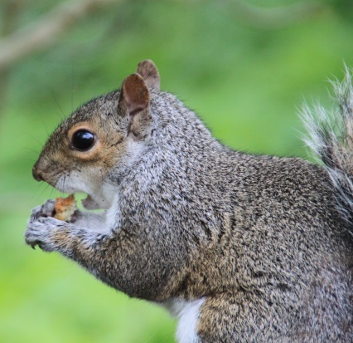
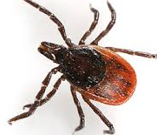
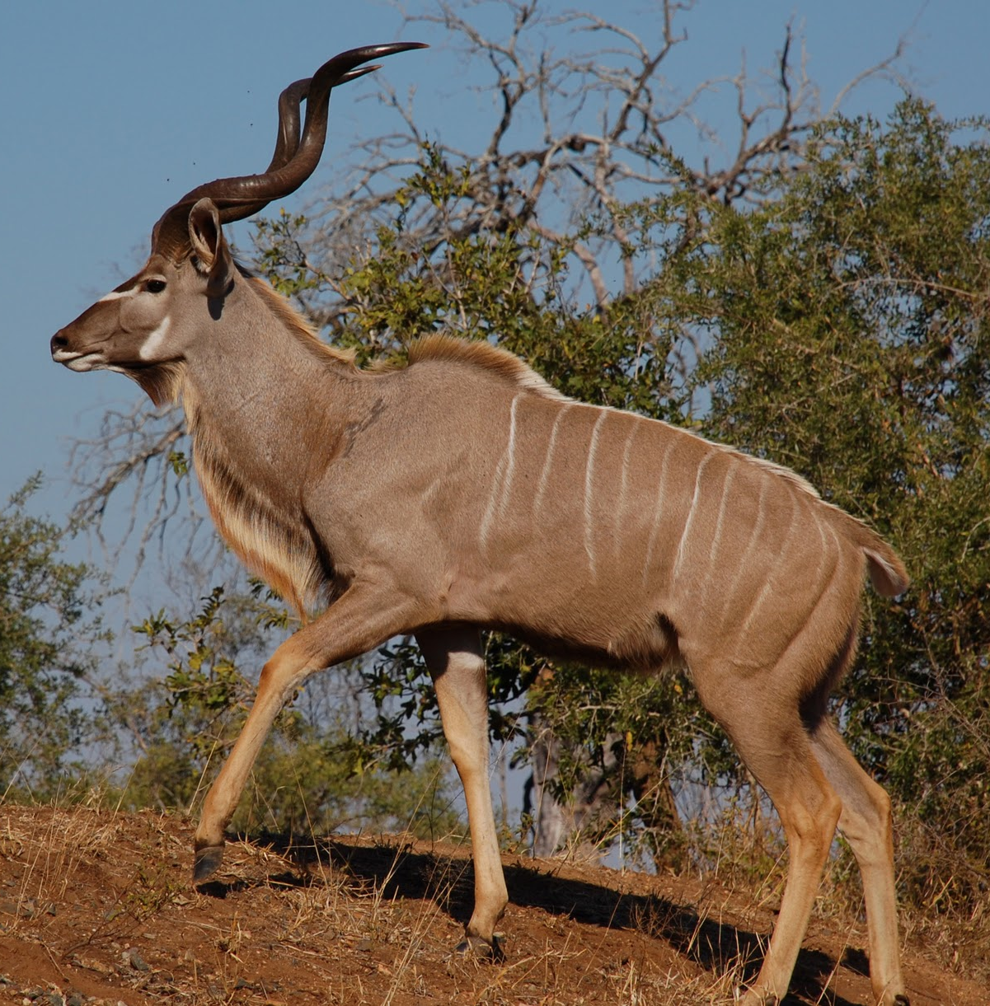
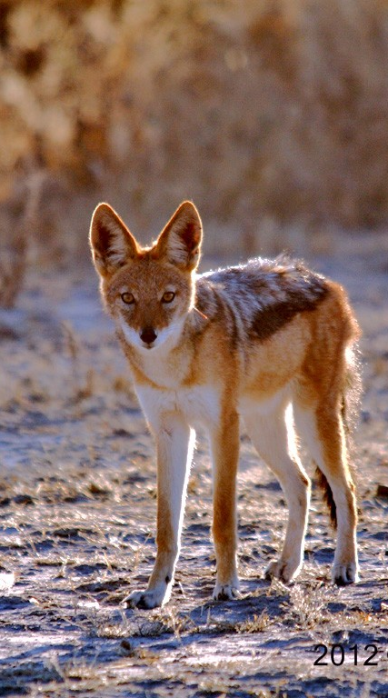
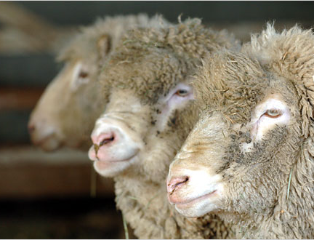
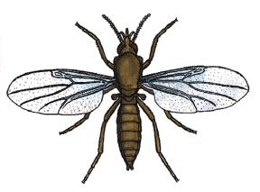
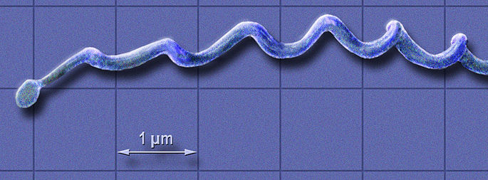
Roman Biek, University of Glasgow
Cross-species transmission
Pathogen genomics
& evolution
Emergence, spread & persistence
Bovine TB
R Kao (Univ Glasgow)
AFBI (N Ireland)
National Wildlife Management Centre
APHA
National Health Service
Hutton Institute
Salford University
INRA (FRA)
K Hampson & rabies group (Univ Glasgow)
APHA
Emory University
Canadian Food Inspection Agency
Rabies
M Palmarini (Univ Glasgow)
Pirbright Institute
Sanger Institute
Lyme
Bluetongue

