Slide 1
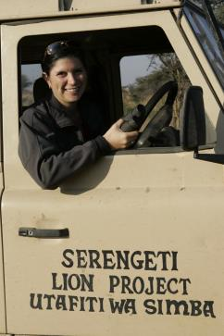
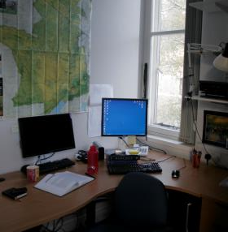
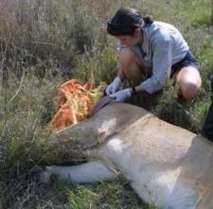
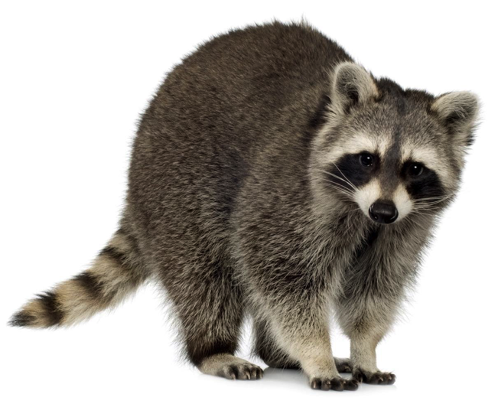
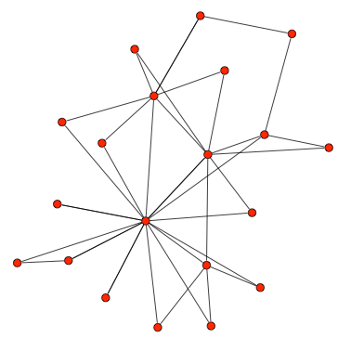
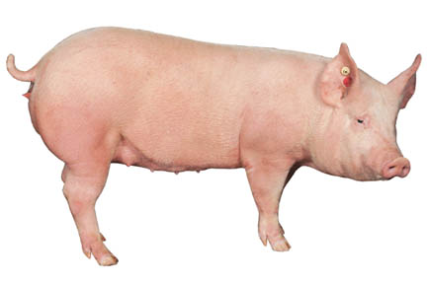
Modeling/Theory
Empirical data
University of Glasgow:
Simulation modeling
Statistical modeling
Disease ecologist:
FIV in African lions
Raccoon rabies
Urban coyote pathogens
Influenza and PEDv in swine
bTB in cattle
Serengeti:
Realities of field data
How does social & spatial structure influence pathogen dynamics?
How to identify reservoirs of infection in multihost systems?
Notes:
I use empirical data to parameterize theoretical disease models to address real-world problems.
Can easily slide between the modeling and the field based data collection.
My PhD was focused on field techniques & data collection and I collaborated with modelers. However, I wanted to learn to do the whole package, so for my post docs I left the field and focused on programming and modeling skills.
This way I can an see how the data needs to be collected to inform the models, and how the models can be used to inform the data collection.
Now at University of Minnesota
How does social structure influence disease dynamics?
How to identify reservoirs? Where do diseases persist in an ecosystem?

