Slide 1
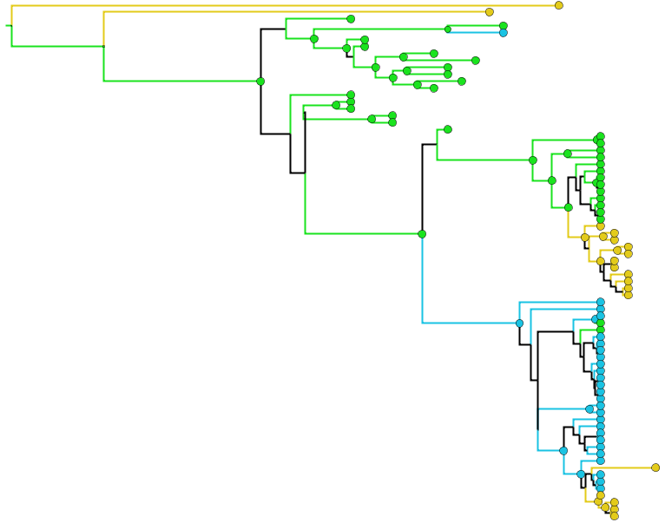
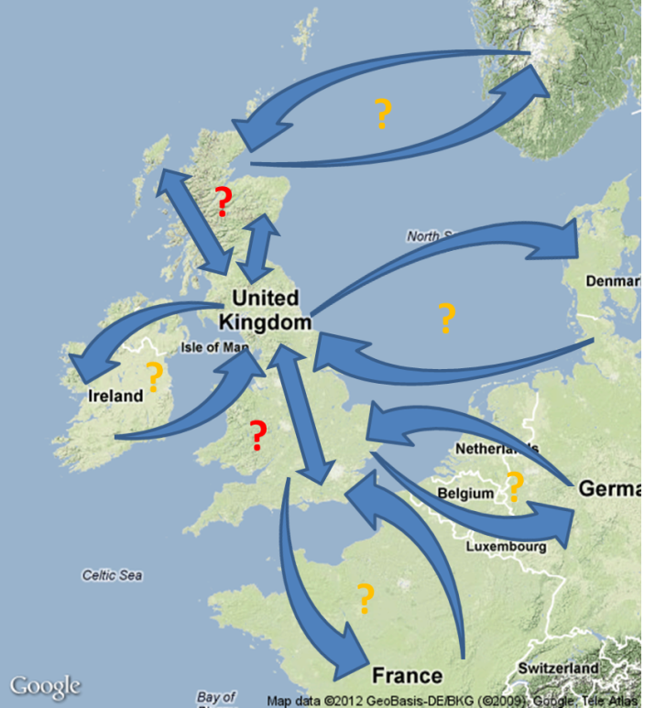
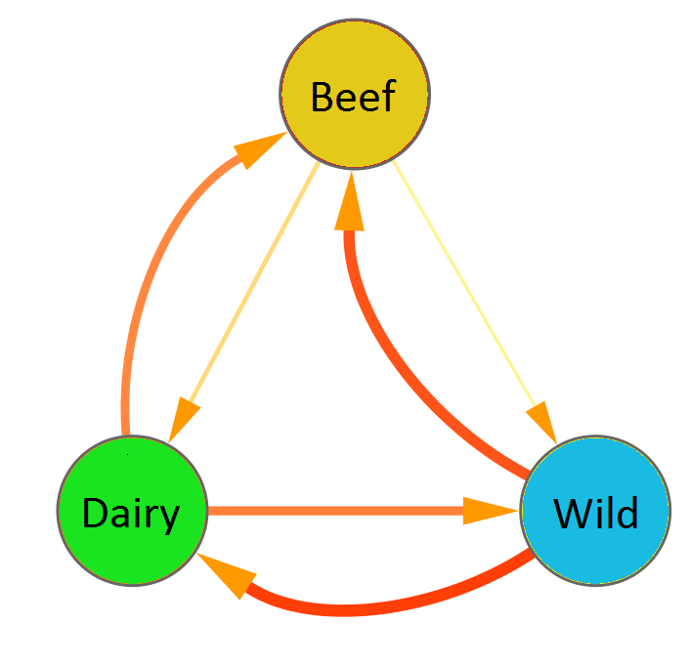
Sam Lycett - Phylodynamics
Interests
Inferring transmission patterns using sequence and epidemiological data
between locations and host species
Questions
Sources, routes and speed of spread
Cross species transmission rates
Predicting hot spots and future risk areas
Samantha.Lycett@ed.ac.uk

