Slide 1
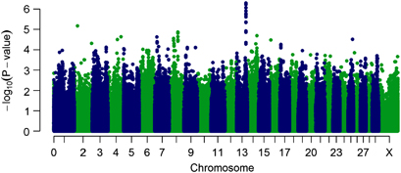
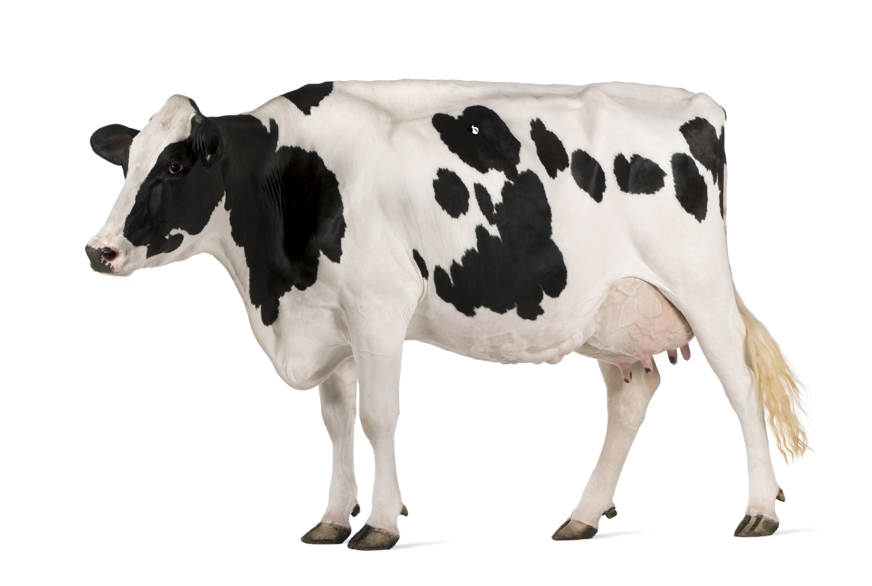
Role of Host-Pathogen Genetics in early bTB
Lukas Mühlbauer, PhD Student, Glass/Hope Group
What causes variation in cattle bTB susceptibility and M. bovis virulence/pathogenicity?
Study of susceptibility-associated genes (i.e. identified from GWAS data, literature review, RNA-seq data)
  Macrophage-M. bovis interactions during gene knockdown
Study of M. bovis strains with differences in pathology severity
Workshop aims:
Getting to know other people in the field and their work

