Slide 1
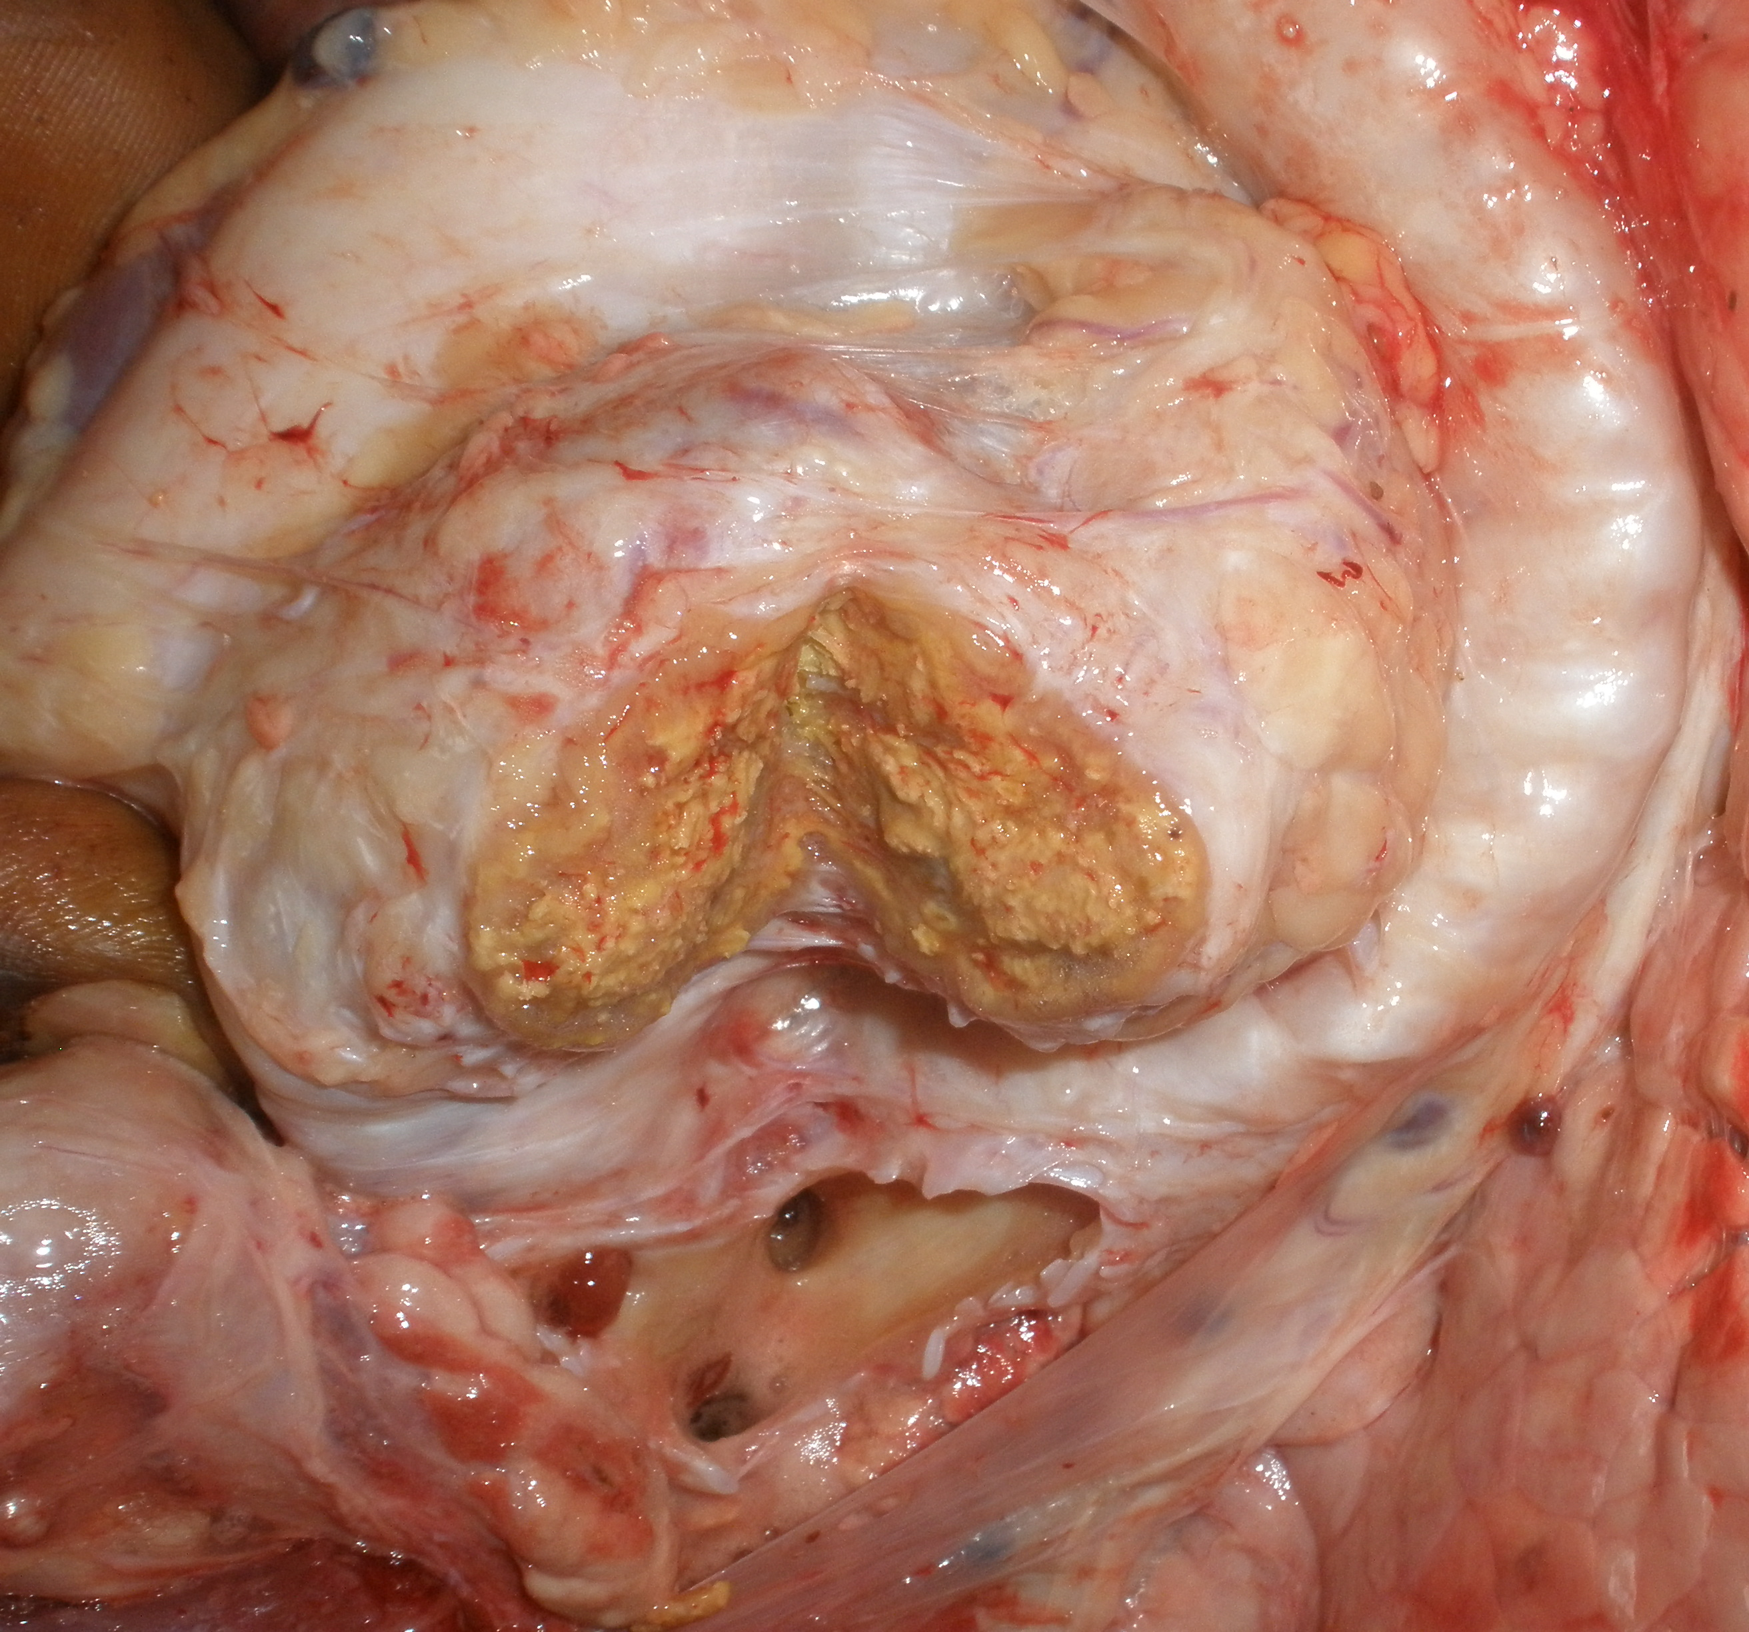
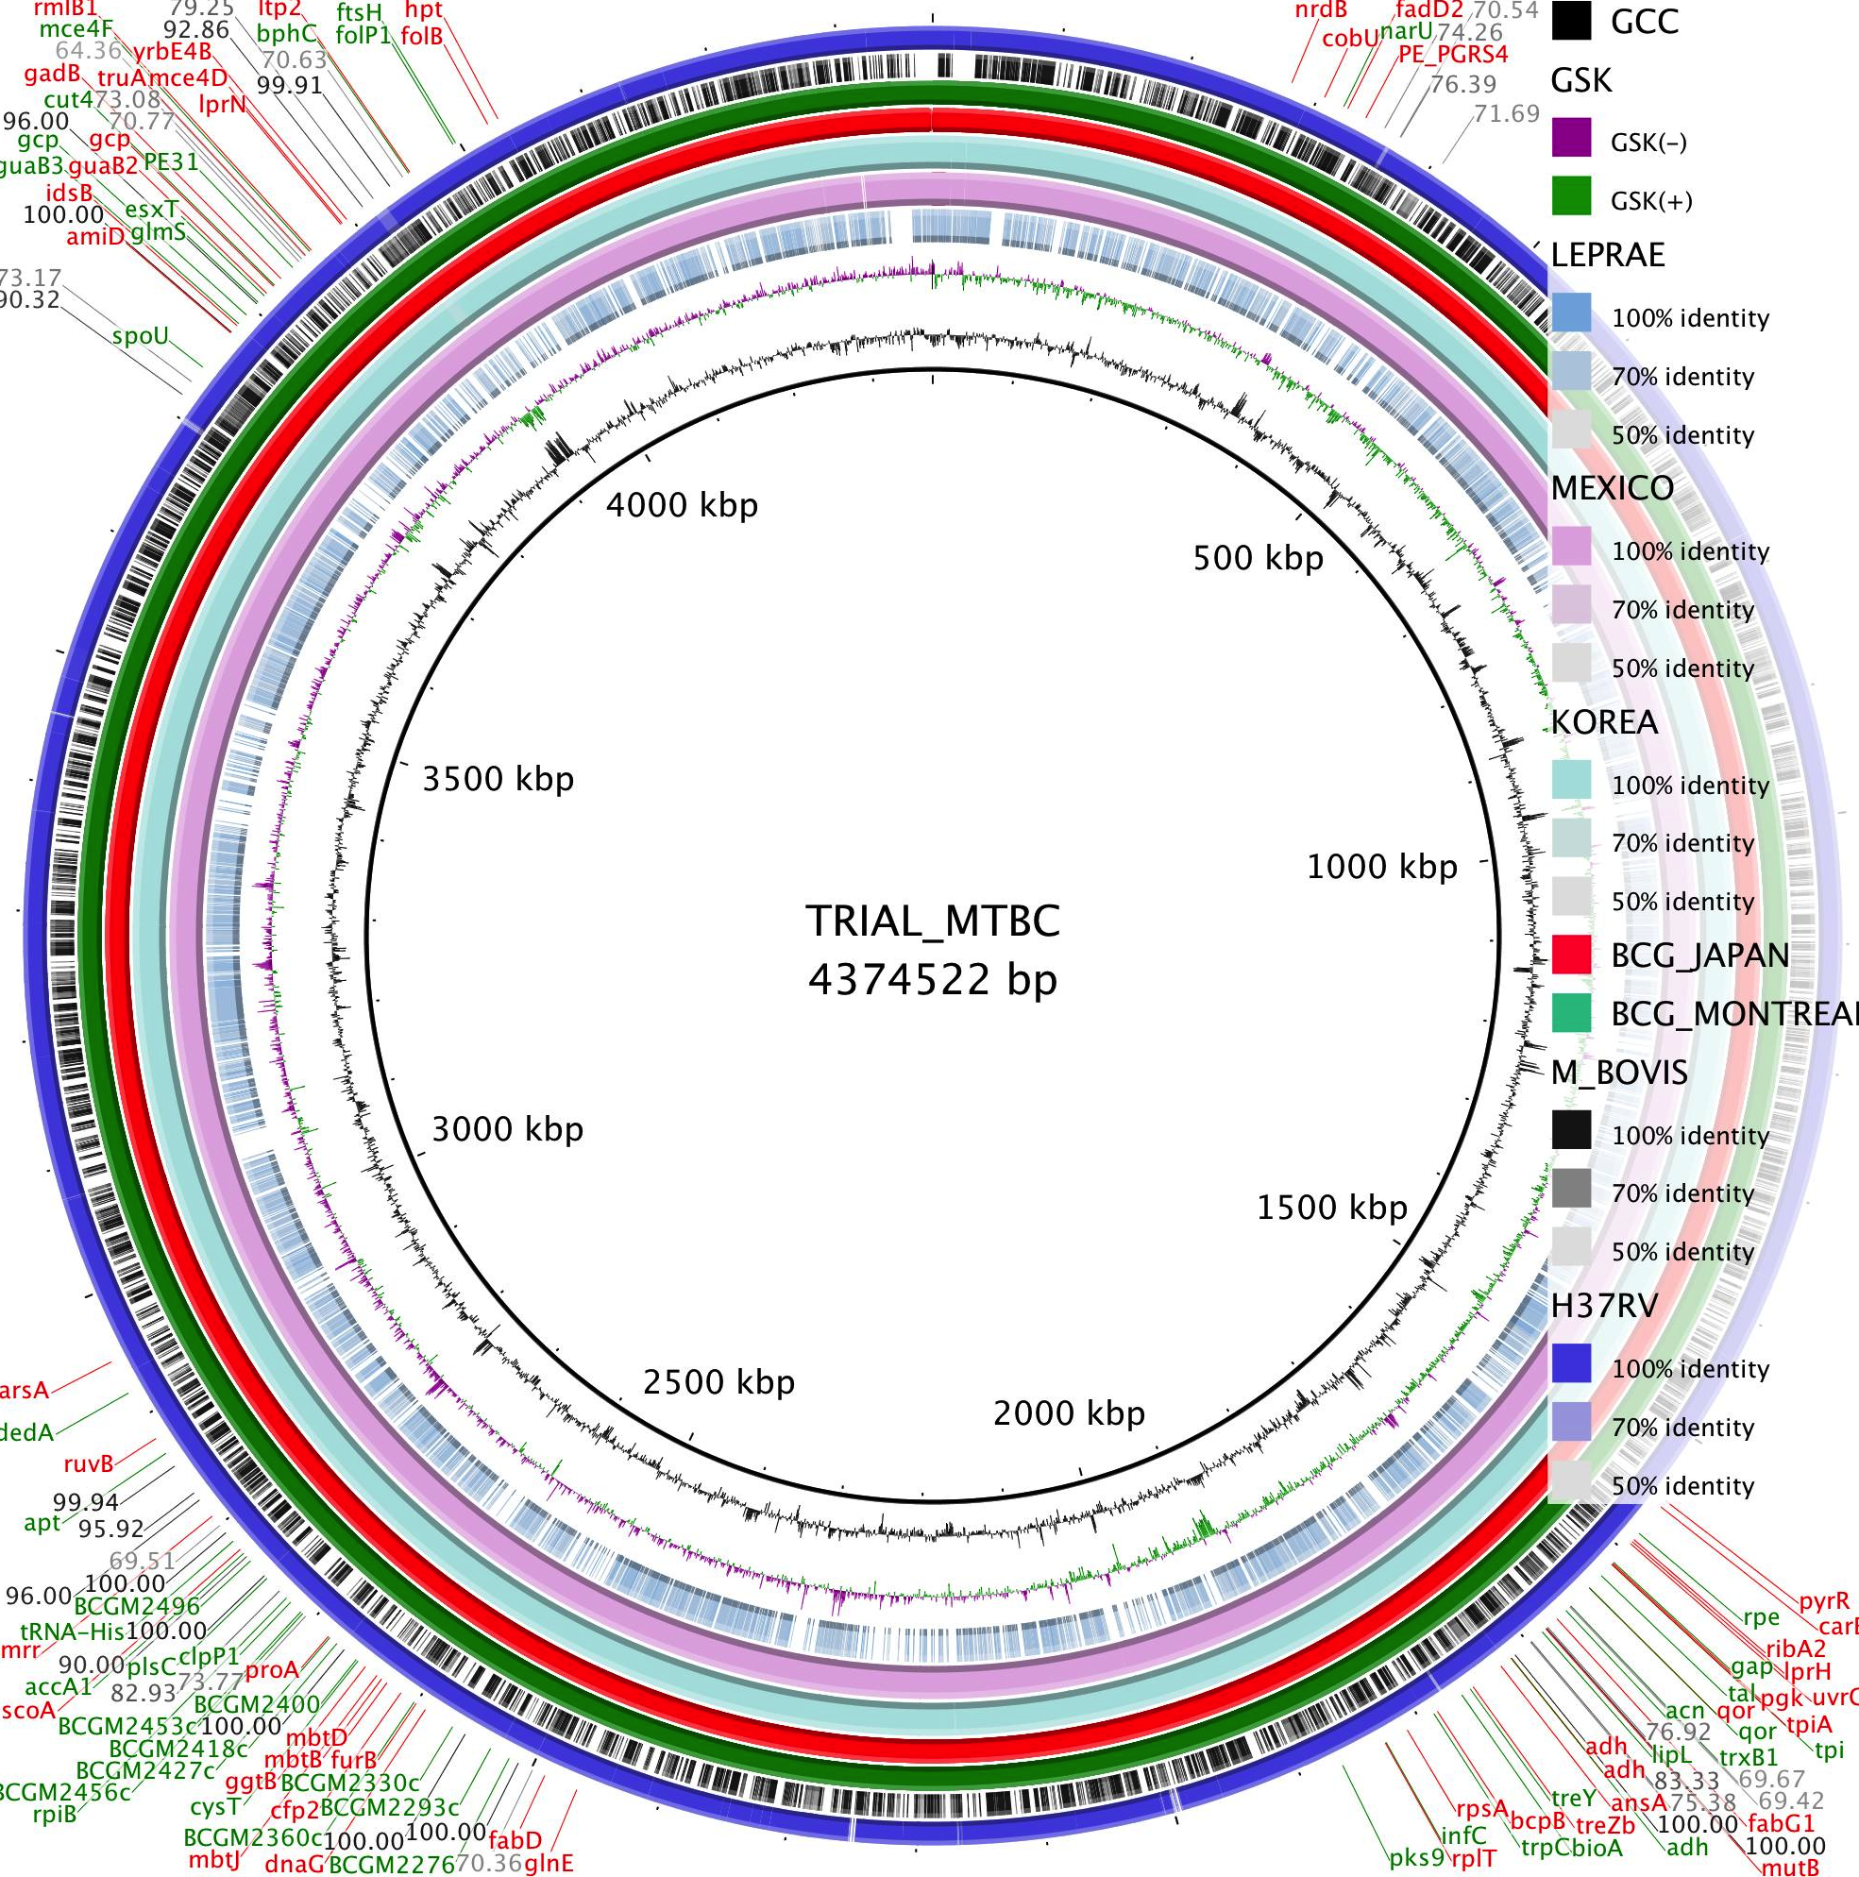
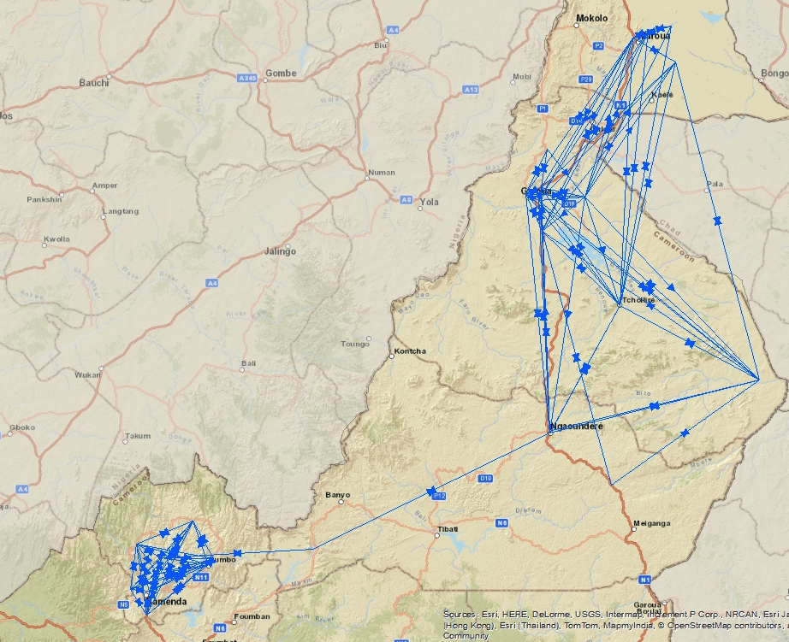
Adrian Muwonge
Post Doc-Epidemiology Economics and Risk Assessment group led by Mark Bronsvoort
Programme secretary for zoonotic tuberculosis section at the Union- Paris
Research Interests
Population based studies of zoonotic diseases
With special interest in the molecular epidemiology of M.bovis and Brucella
Host movement network analysis
Evolution of M.bovis
Current projects
Epidemiology of BTB in Cameroon –Wellcome Trust
Genomics of M.bovis isolates from Cameroon –Roslin Trust
Genomics of M.bovis isolates from Africa – USDA, RI,NVI, UP,UOI,MU,MAK,UNZA
Epidemiology of BTB and Brucella in Bahl el Ghazel, Southern Sudan- NORAD
TB caused by M.bovis in patients in Mubende district, Uganda – Colorado State University
Global awareness of zoonotic tuberculosis – WHO, OIE, CDC, UNION, FAO and Stop-TB
Field
Policy

