Slide 1

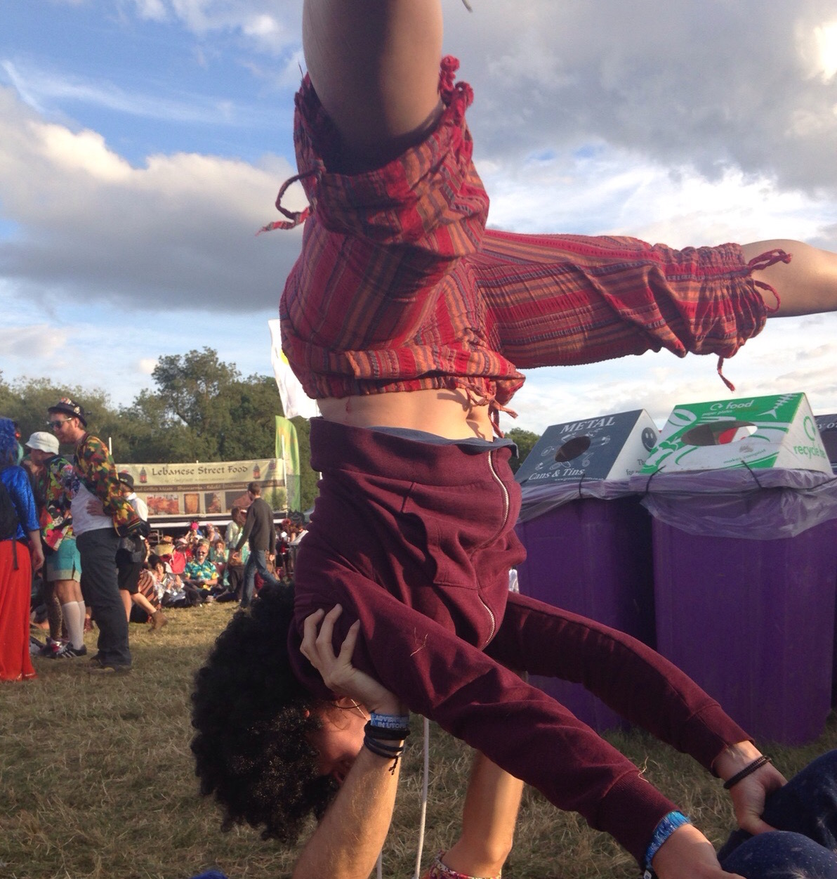
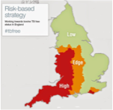
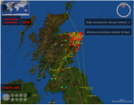






Liliana Salvador
Computational Ecology
Boyd Orr Centre for Population and Ecosystem Health
liliana.salvador@glasgow.ac.uk
Understanding the Transmission Patterns of Mycobacterium bovis
Risk-based surveillance
1. risk factors
2. surveillance strategies
Farm-to-farm transmission
1. within-herd transmission
2. cattle movement network
Multi-host species transmission
  1. WGS of M. bovis isolates
2. phylodynamics/phylogeography
How to correctly estimate rates of infection intra- and inter-species?
How to solve the problem of data sampling biases?
Is bTB genetic diversity related to bTB host susceptibility?

