Slide 1
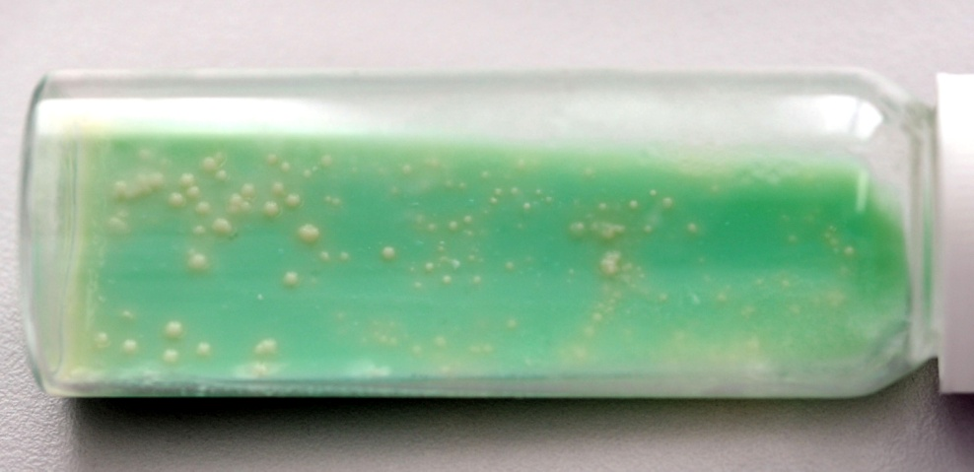
Robin Skuce – PI @AgriFood and Biosciences Institute (Afbi), Belfast
Afbi - the major science service and research provider for DARD(NI)
Bacteriology Branch:
  Experimental infection models
  TB cellular immunology, IFNg, sub-unit vaccine/adjuvant, co-infections
  Badger sett survey, ecology, genetics
PI – mostly bovine TB molecular biology, molecular and genetic epidemiology research
Lab confirmation of field and abattoir diagnosis in Statutory TB, RTA and TVR studies
Developed and validated molecular epidemiology tools (MLVA) to investigate bovine TB epidemiology, population structure and evolution (collaboration with APHA)
  Molecular typing surveillance = all TB cases
Investigating the impact of host and pathogen genetic variation on bovine TB susceptibility (Roslin-led). Prospects for genetic and genomic selection.
Investigating bovine TB transmission dynamics using molecular typing, mathematical modelling and bacterial-whole genome sequencing (Glasgow-led)
DARD-led Badger Test, Vaccinate or Remove (TVR) study
This symposium?
  To better understand the potential and limitations of (genome) epidemiology to understand how TB persists and spreads in the landscape
  Translation to interventions?
The enemy...M. bovis

