Slide 1
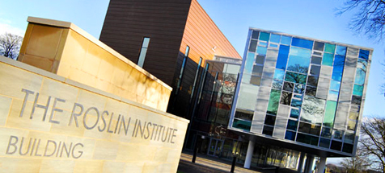
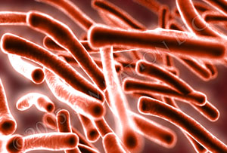
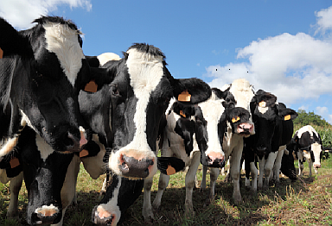
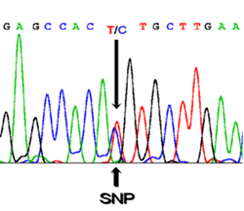
Breeding for bTB resistance
Samantha Wilkinson (PhD)
Research Fellow
Genomic selection for bovine tuberculosis resistance in dairy cattle
Dissecting the genetic basis of variation in phenotypic traits
  Identify genomic regions underlying resistance to disease
  Identify causal/linked mutations
  Breeding for bTB resistance
Questions
  Virulence of pathogen strains? Any interaction with host genetics?

