Slide 1
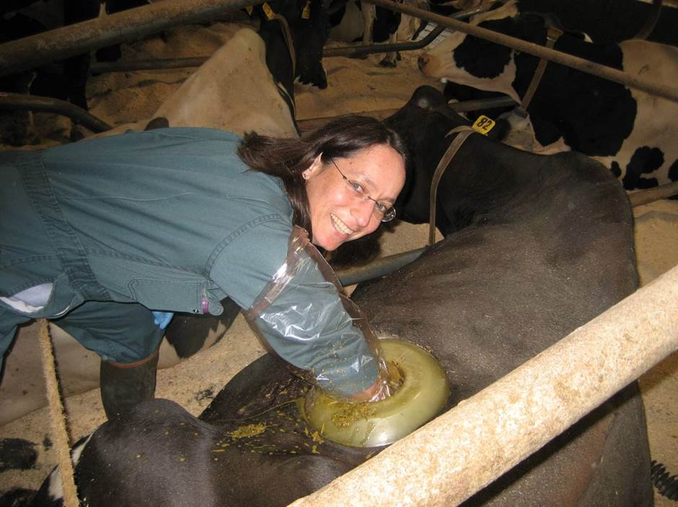
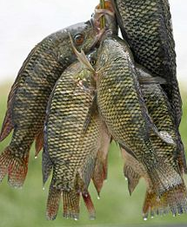
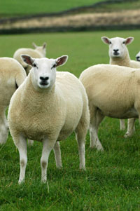
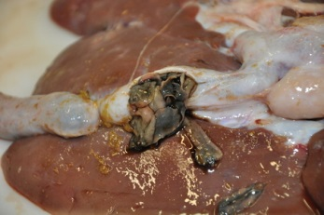
Ruth Zadoks – Molecular Epidemiology
IBAHCM, University of Glasgow
S. aureus
MRSA
GBS
Klebsiella
Pasteurella
MAP
bTB
….
Liver fluke, rumen fluke, sheep scab, BVDV

