Slide 1


Bovine Tuberculosis Workshop 2015
Exploiting opportunities generated by new (and old) technologies
Rowland Kao
Boyd Orr Centre for Population and Ecosystem Health

Slide 2




Introduction Slide (Rowland Kao)
Mathematical models of multi-host pathogens
Spatial spread of epidemics
Statistical inference using mathematical models
Network analysis
Network based alternatives to coalescent-based models
Epidemiological Model-based phylodynamics
AgResearch-NZ (mathematical models of bTB in cattle and possums)
IAH (Compton) – some work on mathematical models of experimental shedding data
Oxford – livestock movement networks including role of movements in bTB
Glasgow – integration of bacterial sequence (and hopefully host transcriptome) info into models used to fit data (cattle and badgers)

Slide 3
Why are we here?
Identification of key problems in understanding bovine TB persistence in livestock
  Interactions between the within-host (immunological) and between-host (epidemiological) scales
  Challenges presented by multi-host pathogens (wildlife in particular)
Opportunities presented by 'omics technologies (in combination with others)
  Increasing ability to generate dense datasets

Slide 4
What are we aiming to do
For me to talk as little as possible!
Series of presentations
  General presentation of two subject areas (broader perspectives)
  Bovine TB specific talks
  Scientific overviews of approaches to analysis
  "Practical" examples of analysis
Group discussions and synthesis
  Identification of problems and opportunities

Slide 5
What are we aiming to do
Day One
  Scientific Challenges and Opportunities
  What do we most need to know to understand/control disease in livestock and wildlife?
  How difficult is it to know them, and what are
Day Two
  Technical Approaches and Requirements
  Practical and specific
  Pitfalls and assumptions

Slide 6

Aims and outcomes?
KE for two research projects
Generate new interactions
Education (for us too)
Looking to the future for possible research directions
(One or more reviews?)

Slide 7
Social Media
Tweet using
  #boydorr_btb
If you do not want your contributions on twitter, etc., do let us know

Slide 8
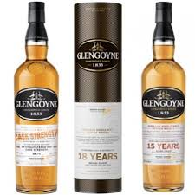
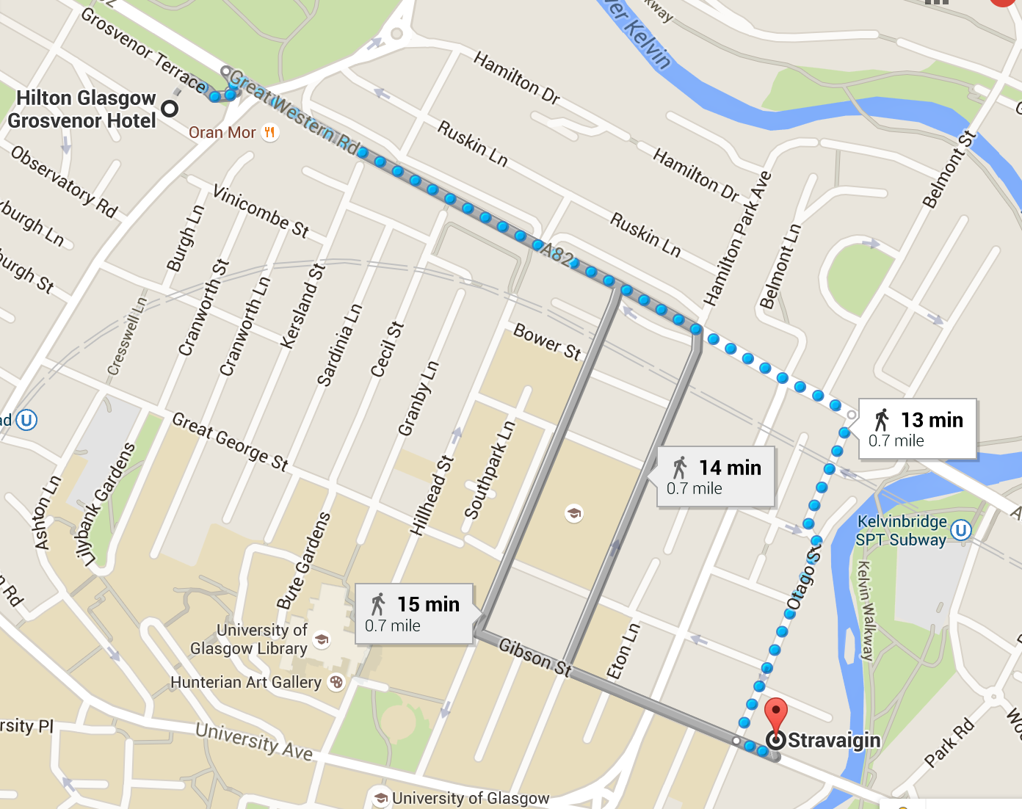
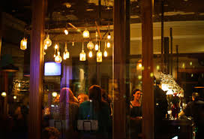
Social events
Whiskey tasting at end of today (here at Hilton, on us)
Dinner at Stravaigin Restaurant (on you)

Slide 9
Acknowledgements
Daniel Balaz and Liliana Salvador
Boyd Orr Centre for Population and Ecosystem Health

