Slide 1


Next Generation Mycobacterium bovis genomics
Stephen Gordon
School of Veterinary Medicine
School of Medicine and Medical Science
School of Biomolecular and Biomedical Science
University College Dublin
Ireland…not UK.. ☺
Notes:
Une presentation
C’est un grand honneur pour moi

Slide 2
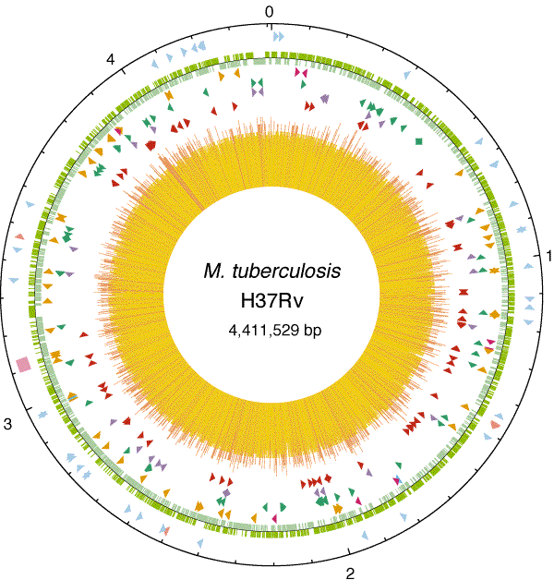
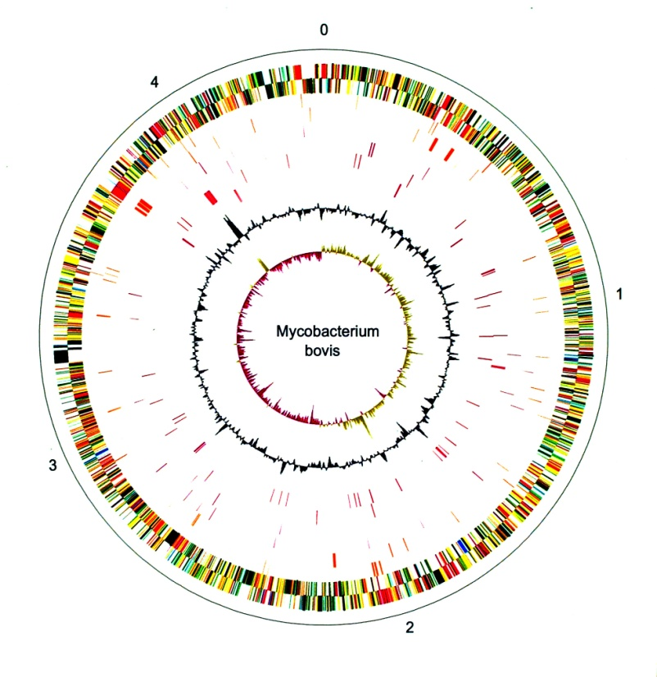
Host preference
Define molecular basis of host preference across the Mycobacterium tuberculosis complex
  Reveal host tropic virulence factors for both human and animal infection/disease

Slide 3

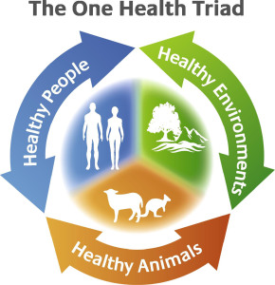

Slide 4
Comparative genomics
M. tuberculosis H37Rv
4.4 Mb genome
3,995 genes
M. bovis 2122
4.34 Mb genome
3,951 genes
2,347 single nucleotide polymorphisms (SNPs)

Slide 5
Functional annotation
M. tuberculosis H37Rv
4.4 Mb genome
3,995 genes
Annotation v27
M. bovis 2122
4.34 Mb genome
3,951 genes
Annotation v1

Slide 6
Rapid Annotation Transfer Tool (NAR 2011; 39; 9; e57)
Tool (NAR 2011; 39; 9; e57)
M. tuberculosis H37Rv genome sequence + annotation
R27
M. bovis genome sequence
R1
RATT
Python script:
Find new and altered M.bovis features
Automatically transferred annotation
New M.bovis annotation
Mapping between M.bovis and H37Rv locus tags

Slide 7
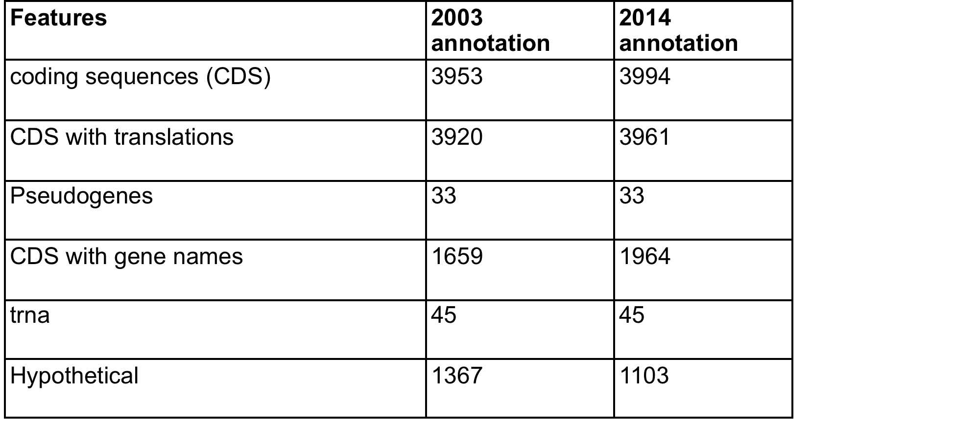
Updated annotation
Added 41 new CDS
Removed Mb0062 and replaced with Mb0062A (as Rv0062c replaced Rv0061). Changed 16 features (new coords/start sites) Updated/added 1370 product names.
Added 318 gene names.
For new features added identities and overlap for local alignment to H37Rv translation as in all other current features.

Slide 8
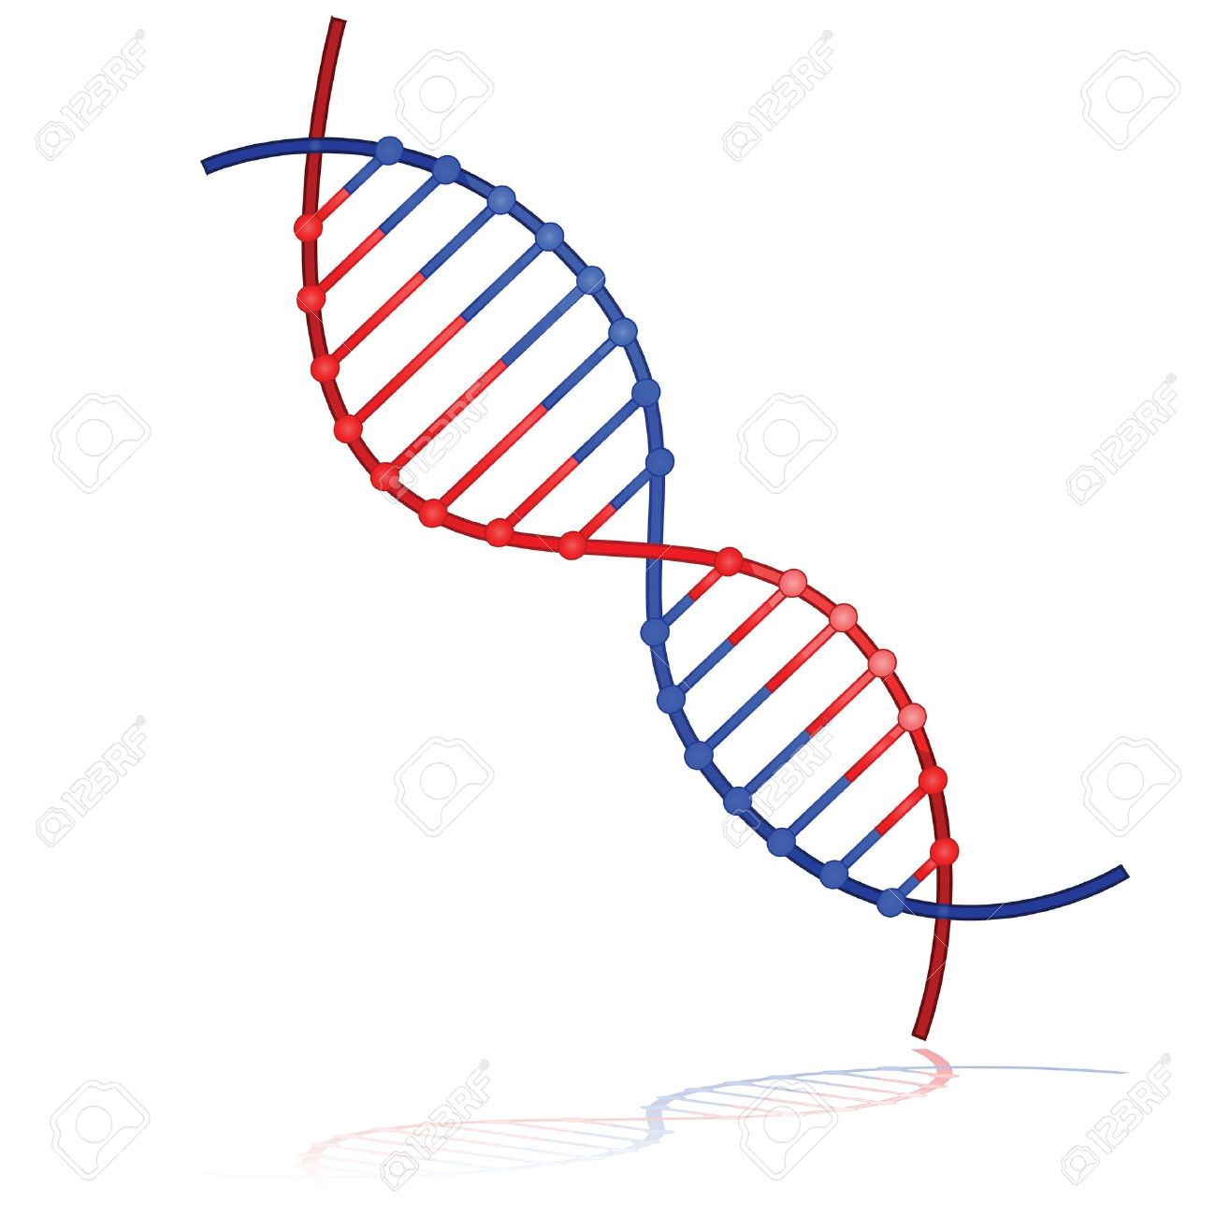

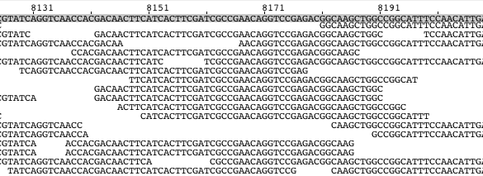
NGS Re-Sequencing of M. bovis 2122
Sequencing
alignment
???
Unmapped
Illumina sequencing
Mapped
M. bovis AF2122/97 (v. 2003)
De novo assembly
???
Resulting 3Kb contig
21 variants (Q > 250)
  10 SNPs
  8 insertions
  3 deletions

Slide 9
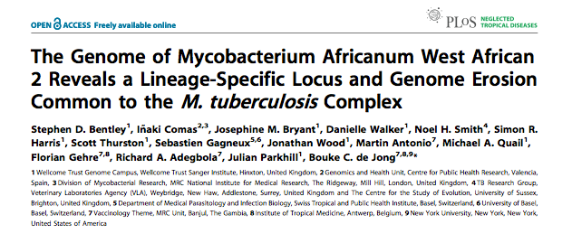
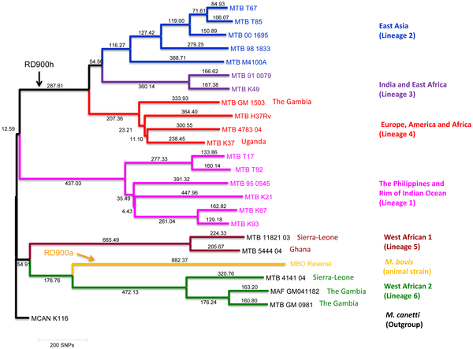
RD900: a ‘lineage specific’ locus

Slide 10
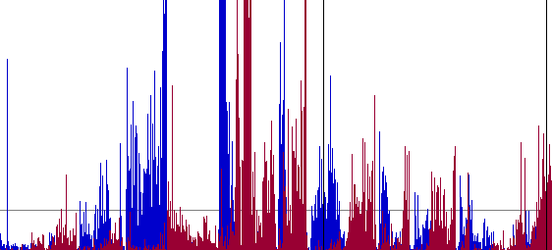
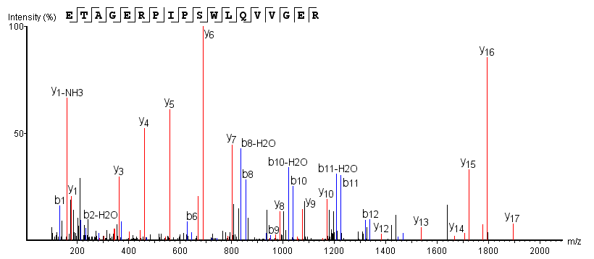
‘Omics integration for improved annotation
Mass
spectrometry
RNA-seq
Transcriptome
Proteome
Genome of
interest
New CDS

Slide 11
M. bovis transcriptomics
mBio 2014 Aug
‘Noisy’ transcriptome in M. bovis
Transcriptional start sites
  6550 total in M. bovis (3951 genes)
  Multiple intergenic and antisense transcripts
Multiple Transcripts with 5’ and 3’ UTR
Conservation of sRNA between M. bovis and M. tuberculosis

Slide 12
Synthetic Proteome Library
The Mtb Proteome Library
3931 proteins (98%)
39,479 peptides
Characteristic spectra
Schubert et al. Cell Host & Microbe 2013: The Mtb Proteome Library: A Resource of Assays to Quantify the Complete Proteome of Mycobacterium tuberculosis.

Slide 13
Conclusion I
Beware the RefSeq!
Updated M. bovis annotation
  More updates in next release
    RD900: present
RNA-seq and TSS mapping available for
M. bovis 2122
Quantitative proteomics
  M. bovis 2122 vs M. tuberculosis H37Rv

Slide 14
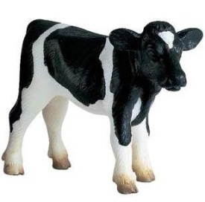
Experimental infections of M. bovis and M. tuberculosis
(Whelan et al, PLoS One, 2010)
M.tuberculosis (H₃₇Rv)
M. bovis (2122/97)
(10⁶ CFU i.t.)
(10⁶ CFU i.t.)
x 5
Blood
Blood
x 5
Monitor immune responses in blood
over a 16 week period.
IFN-γ (whole blood ELISA/ELISPOT)
LTA
Serum (IgG)
cell pellets for RNA
Skin test at wk 15
Post mortem at wk 16
Culture and histo-path investigation of tissue samples.

Slide 15
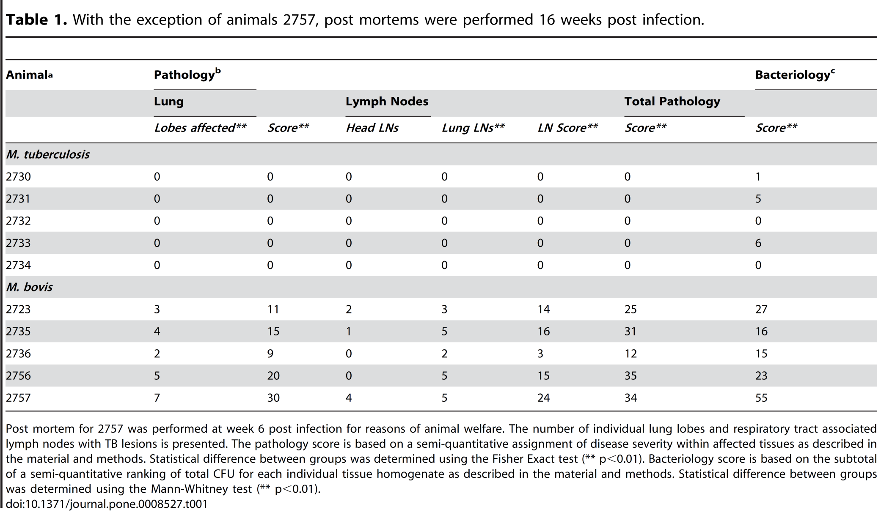
Post-mortem data from calf infections
Whelan et al. (2010). PLoS ONE 5(1): e8527

Slide 16
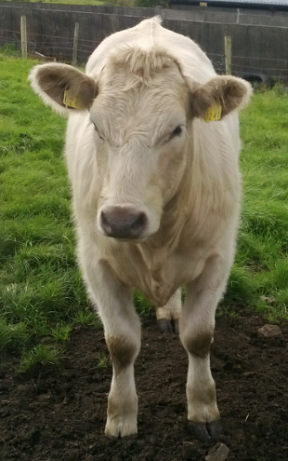
Macrophage interactions
RNA-seq analysis over macrophage infection time course
  RNA samples from 2, 4, 6, 24, 48 hours alveolar macrophage infections with M. bovis and M. tuberculosis
    (n= 10)
  Systems-level analysis of response

Slide 17
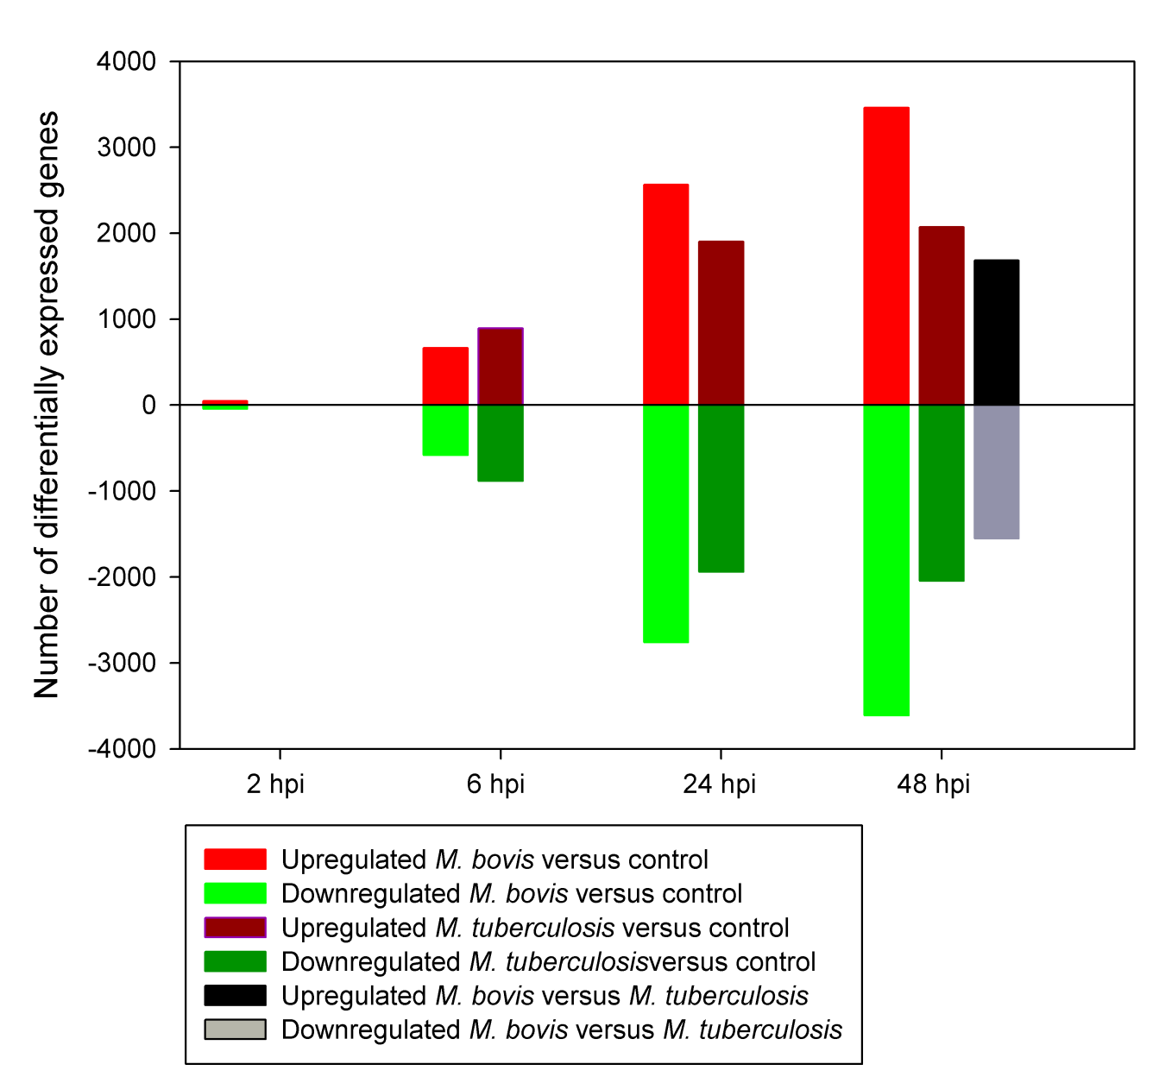
Number of differentially expressed genes (RNA-seq data)

Slide 18
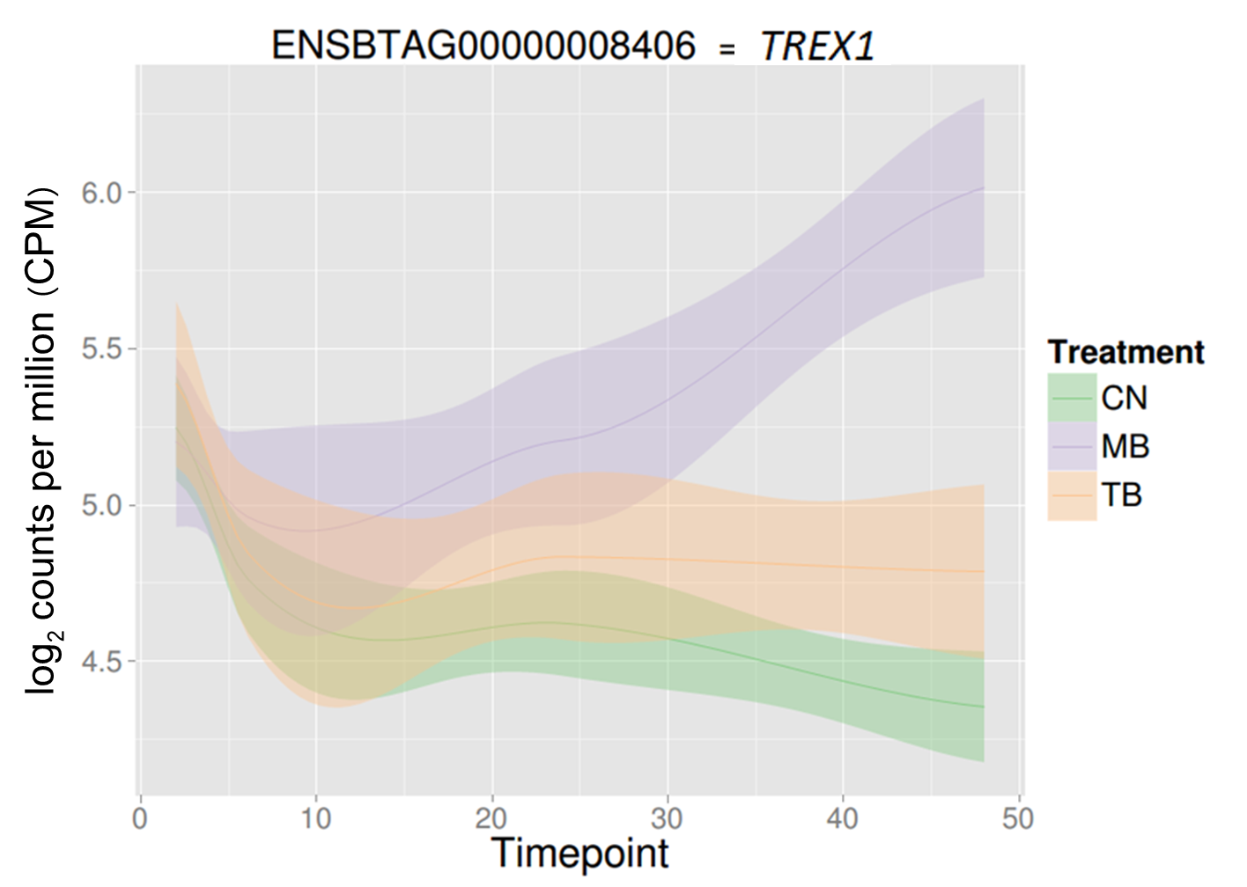
Three prime Repair Exonuclease 1
Kevin Rue
Notes:
The second most significantly DE gene between M. bovis and M. tuberculosis-infected macrophages at 48 hpi is TREX1, a cytosolic DNase. [next slide for more]

Slide 20








Acknowledgements
Univ. College Dublin
David MacHugh
Eamonn Gormley
Kerri Malone
John Browne
Damien Farrell
Kevin Rue
Kevin Conlon
Claire Healy
Lorraine Carr
Ronan Shaughnessy
Alicia Smyth
David Magee
Trinity College Dublin
Ed Lavelle
Corinna Brereton
AHVLA Weybridge, UK
Martin Vordermeier
Bernardo Villareal
Adam Whelan
Stefan Berg
Javier Salguero
Francis Crick Institute, UK
Max Gutierrez
NVSL, Ames USA
Suelee Robbe-Austerman
ETH Zurich
Olga Schubert
INRA, Tours France
Pierre Saradin
Nathalie Winter
Sebastien Holbert
Florence Carrera
Armauer Hansen
Research Institute, Ethiopia
Abraham Asseffa
Addis Ababa University,
Ethiopia
Gobena Ameni

