Slide 1
Host disease genetics: bovine tuberculosis resistance in
dairy cattle
Samantha Wilkinson
4th September 2015
Bovine Tuberculosis Workshop, Glasgow

Slide 2
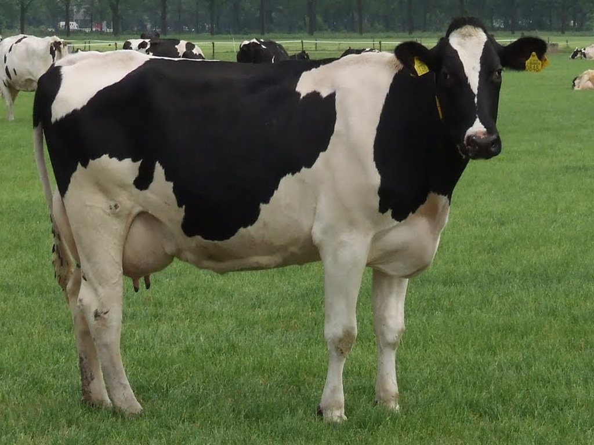
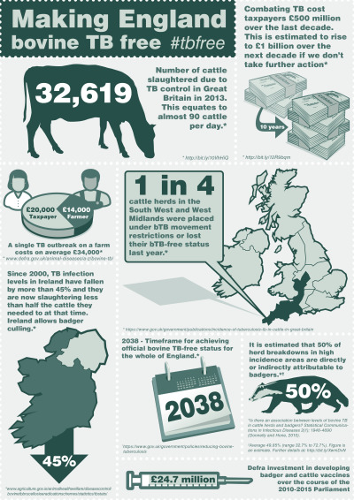
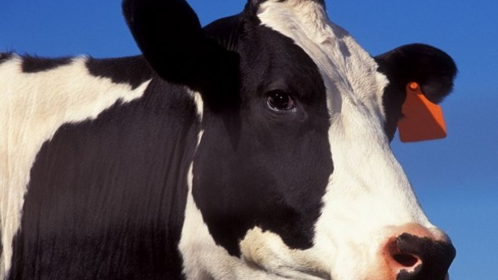
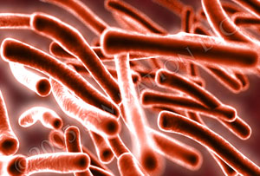
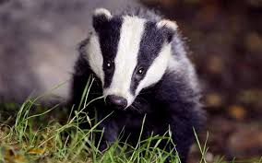
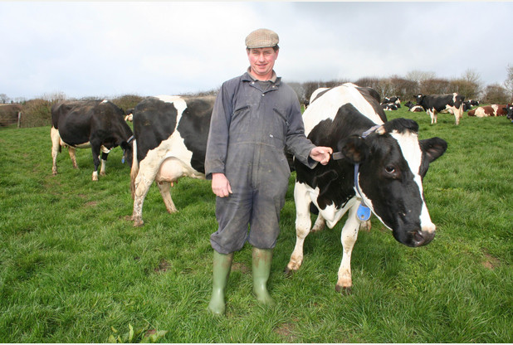
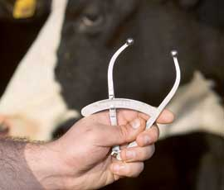

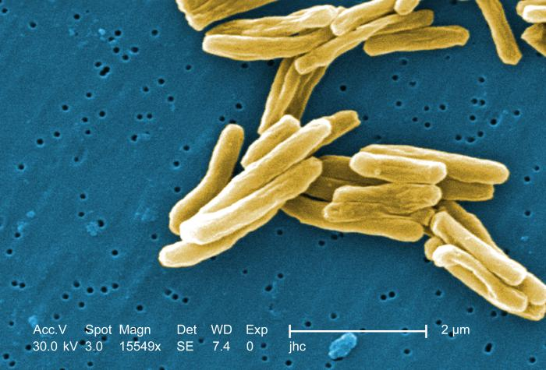
Bovine tuberculosis (bTB)
Bovine tuberculosis:
Host disease genetics and phenotypes
Describing genetic variation underlying resistance
  heritability and estimated breeding values
Genome-wide markers
  GWAS, Genomic selection

Slide 3
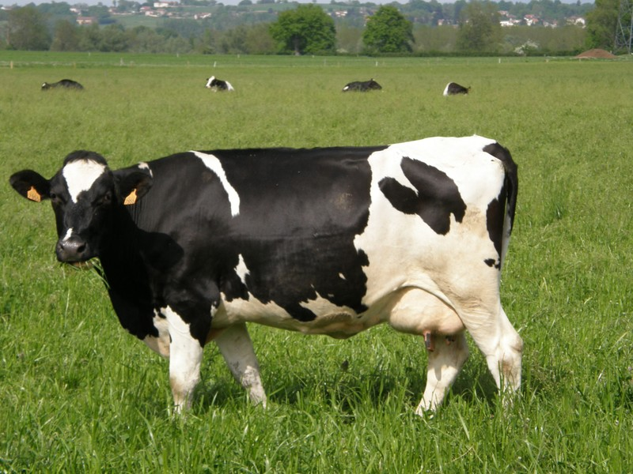
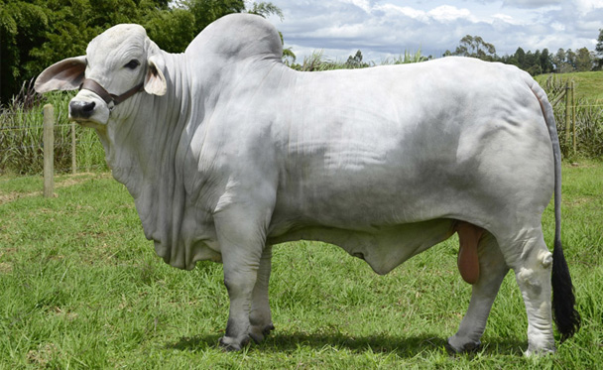
Host disease genetics
Observed variability in host response on exposure to infectious disease
  in part, due to host genetic variation in resistance
Early evidence of a genetic component of bTB resistance (review: Allen et al. 2010)
  B.taurus cattle more susceptible than B.indicus

Slide 4
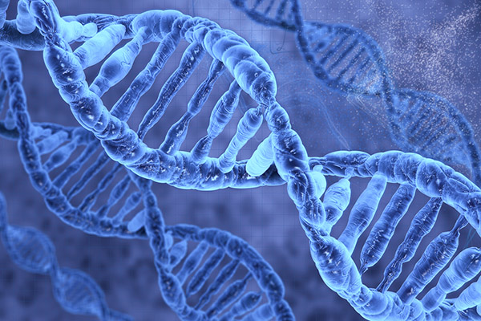
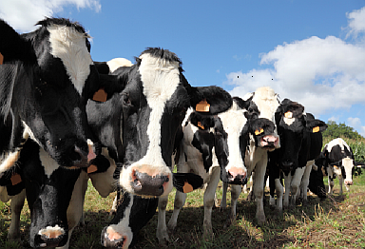
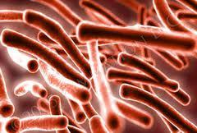
Dissecting genetics of resistance
Quantitative genetic studies
  quantify genetic variation underlying resistance
Genome-wide association studies
  Identify candidate genomic regions associated with resistance

Slide 5
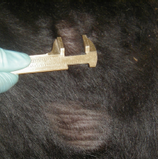
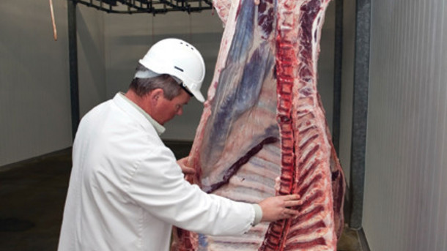
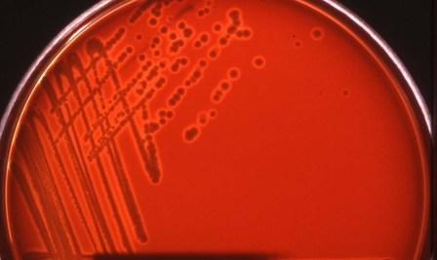
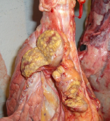
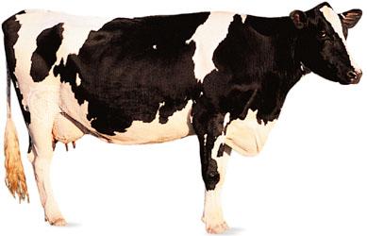
Defining bTB phenotypes
Definition of phenotypes in diagnostic test context:
  Diagnose animal health status using diagnostic test
  Animals need to be exposed to the infectious disease
bTB: Herd surveillance
  1. Skin test: 2. Post-mortem examination & culturing:
  confirming M. bovis infection
Phenotype | skin test | confirmed M.bovis infection test
Cases | +ve | +ve
Controls | -ve | n/a or -ve

Slide 6
Heritability studies
Case – control phenotype
Aim to estimate the proportion of observed variation attributable to genetics (linear mixed model)
Use national pedigree and bTB test results to estimate h²
Study | Population | h² – responsiveness to the skin test | h² - confirmed M.bovis infection
Bermingham et al. 2009 | Republic of Ireland dairy cattle | 0.14 ± 0.03 | 0.18 ± 0.04
Brotherstone et al. 2010 | Britain dairy cattle | 0.16 ± 0.02 | 0.18 ± 0.04
Moderate significant genetic variation for susceptibility to bTB dairy cattle

Slide 7
Genetics of host resistance
Presence of genetic variation underlying host susceptibility to bTB
Breed for bTB resistance in national herds

Slide 8
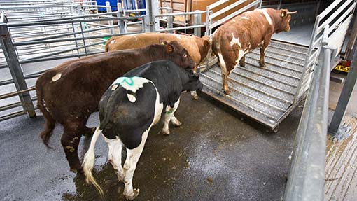
Breeding for bTB resistance
Breed for bTB resistance in national herds
  a complementary strategy to the current surveillance protocols
Advantages:
  bTB EBV can be incorporated into an overall weighted breeding index for a farmer
  Green, sustainable
  Tailored to regions: uptake higher in SW
  Should reduce herd prevalence

Slide 9
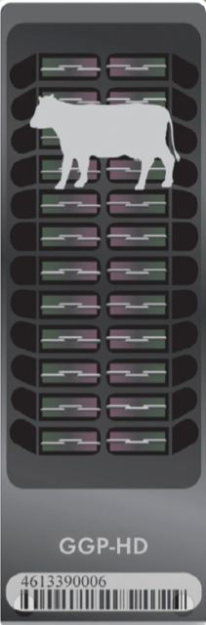
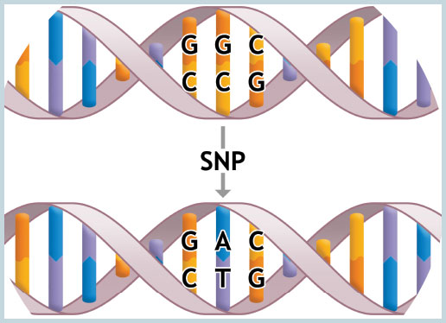
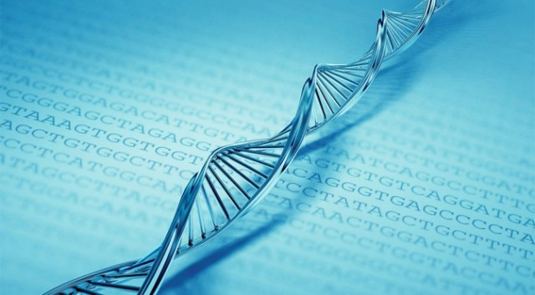
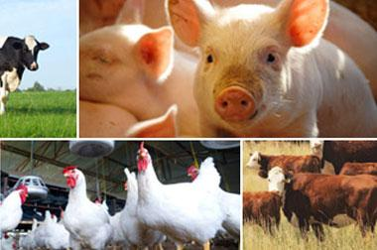

Have GBs/TBs of genotypes
Genotype ’000s animals

Slide 10
GWASs
Scan the genome with ‘000s SNPs for genetic variations associated with disease/phenotypes
  Which SNPs explain phenotype differences?
  Assumption: they reside within or are linked to a QTL
There are many methods
  In animal studies: regression of SNP on phenotype
  Software: GenABEL, GEMMA, GCTA, DISSECT
Phenotypes
  Binary
  Continuous

Slide 11
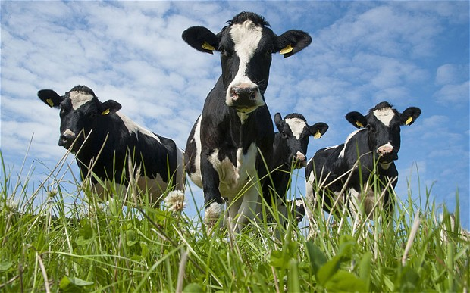
GWAS: population structure
Presence of genetic (sub)structure could lead to false positives
  Population stratification
  Relatedness ( livestock tend to be more related
  e.g. compared to humans)
Accounting for genetic structure:
  Genomic control: adjusts inflated observed p-values
  Principal components: use PCs to correct stratification
  Mixed model: use genomic kinship matrix to account for relatedness (e.g. GRAMMAR)
Significance levels: multiple tests due to number of SNPs so need to correct for multiple testing

Slide 12
I: bTB GWAS - case control
Phenotype: case-control 1,200 Northern Ireland cows
  A binary trait
  Cases: double positive for lesions and skin test
  Controls: negative for skin test multiple times and age- and herd-matched to cases and high prevalence herds
Genotyped with BovineHD Chip: ~700,000 SNPs
Analysis:
  GRAMMAR approach: linear mixed model, a 2 step method
  1st step: linear mixed model that includes fixed effects and the genomic kinship matrix
  2nd step: single SNP associations using the residuals from the mixed model as the phenotype
  Accounts for
  population structure
  The residuals capture much
  of the SNP effect and are
  independent of familial structure
Bermingham et al (2014) Genome-wide association study identifies novel loci associated with resistance to bovine tuberculosis. Heredity 112(5):543-51

Slide 13
I: bTB GWAS - case control
Significant SNPs on BTA13
  Lie within intron of protein tyrosine phosphatase receptor T, shown to be associated with cancer and diabetes
Bermingham et al (2014) Genome-wide association study identifies novel loci associated with resistance to bovine tuberculosis. Heredity 112(5):543-51

Slide 14
II: bTB GWAS - EBVs
Phenotype: bTB EBVs for 300 Irish sires
  A continuous trait
  summarising daughter information
Genotyped with BovineSNP50 Chip: ~ 55,500 SNPs
Analysis:
  egscore: regression of SNP on phenotype
  Principal components calculated using the genomic kinship matrix
  adjust both the genotypes and phenotypes onto these axes of genetic variation (the principal components)
  then, association between the phenotype and each SNP is computed
  Accounts for
  population structure
Finlay et al (2012) A genome-wide association scan of bovine tuberculosis susceptibility in Holstein-Friesian Dairy Cattle. PLoS One 7(2):e30545

Slide 15
II: bTB GWAS - EBVs
Significant SNPs on BTA22
  Lie within intron of taurine transporter gene SLC6A6 (or TauT), which has a function in the immune system.
Finlay et al (2012) A genome-wide association scan of bovine tuberculosis susceptibility in Holstein-Friesian Dairy Cattle. PLoS One 7(2):e30545

Slide 16
bTB GWAS summary
2 studies
  2 different putative QTL regions
  Suggestive significance levels
  Inconsistent results
Too few animals?
Polygenic trait?
Marker-assisted selection may not be the way

Slide 17
Genomic prediction
Genomic selection: Genomic estimated breeding value
  Genotype sires with daughter records and estimate SNP effects
  SNP effects are used as a prediction equation to produce the GEBV for any animal
  Advantages –
    Potentially more accurate than EBVs
    Not reliant on ongoing collection of phenotypic records
  Tsairidou et al 2014:
    probability of correctly classifying cows as cases or controls was 0.58
      In line with population size used in study (1,200 Northern Ireland cows)

Slide 18
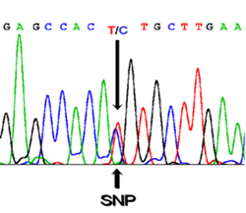
AHRC BBSRC project
Genomic selection for bTB resistance in dairy cattle
GWAS meta-analyses: genotype more cases (NVLs), acquire other datasets
Genomic prediction: develop GEBVs for bTB resistance
Genome sequencing: identify closely linked SNPs, putative causative genes and mutations underlying bTB resistance

Slide 19
Talk summary
Definition of bTB phenotypes for genetics studies
Genetic variation in bTB susceptibility exists
GWAS: a few putative regions but inconsistent results
  Polygenic trait?
Selection for bTB susceptibility feasible
BBSRC project to further address this

Slide 20





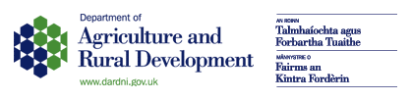
Thank you!
Liz Glass, Steve Bishop, John Woolliams, Samantha Wilkinson, Lukas Mühlbauer,
Kethusegile Raphaka
Robin Skuce, Adrian Allen
Mike Coffey, Raphael Mrode, Georgios Banos
With thanks to:

