Slide 1

Toolbox Talk: Chemical Safety
02: Laboratory Security

Slide 2

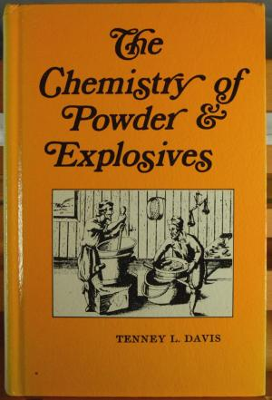
Laboratory Security
Assess your laboratory or work area for substances or materials that may be of interest to terrorists or criminals*
  Toxic or infectious substances
  Explosive precursors
  Illegal drug precursors
  Equipment that could be used in a clandestine laboratory
  Sensitive documents
  Computers and personal property
Laboratory security and laboratory safety should interconnect to form an interlocking layer of protection
*Further guidance on specific materials is available from SEPS
Notes:
XXX

Slide 3
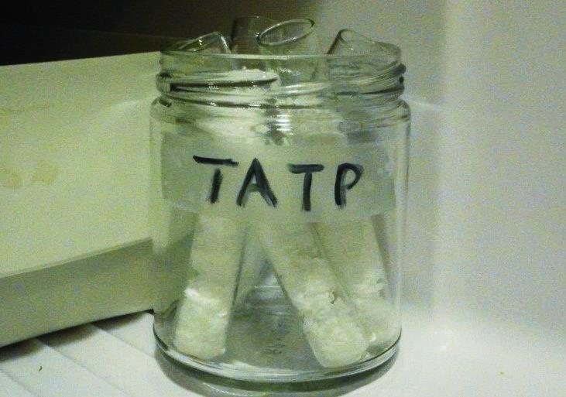
Managing Laboratory Security
Make sure everyone is aware of the hazards in your laboratory
Consider building an inventory of equipment / substances
Highlight any particular security risks
Develop (and implement) laboratory security procedures
Assign responsibilities for security
Train your research group on security requirements
Have a protocol for reporting and investigating unusual behaviour and incidents (without placing people at risk)
Notes:
XXX

Slide 4
Access Control
Secure access to laboratories
  Keypad / keycard access
  Lock laboratories and offices when not in use
Consider a logbook for signing in and out (especially for larger research groups)
Discourage “tailgating” when entering laboratories
Restrict access to laboratories to authorised personnel only
Restrict out of hours access and follow out of hours procedures
Don’t be afraid to approach people you don’t recognise and ask if they need help
If you have concerns about security raise them!
Notes:
XXX

Slide 5
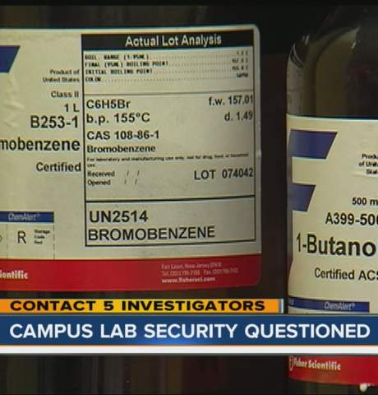
Stock Control / Management
Know what hazardous substances you have in stock (and how much of each)
Dispose of unused stock when no longer required
Control access to hazardous substances
  Close and lock laboratories
  Use of lockable freezers / cabinets for high risk substances
  Don’t leave hazardous substances unattended
Consider signing in and out of highly toxic materials
Report missing stock to security and/or the police!
Notes:
XXX

Slide 6
Prepare an Emergency Plan
Access control can make emergency response more difficult
Evaluate your emergency plan with safety and security personnel
Consider consulting with outside agencies for high risk areas
Review emergency plans regularly
Ensure everyone is familiar with what to do in the event of an emergency
Provide information on serious hazards to emergency responders
Most importantly, make sure that security arrangements do not impede escape in the event of a fire or other emergency!
Notes:
XXX

Slide 7

For Further Information Contact:
Dr. Phil Rodger (Chemical Safety Adviser)
E: Philip.Rodger@glasgow.ac.uk
T: 0141 3302799

