Slide 1

Toolbox Talk: Chemical Safety
01: Picric Acid and 2,4-DNP

Slide 2

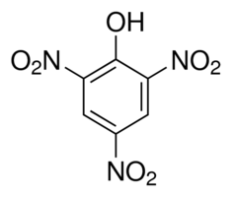
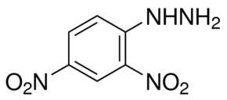
Where are they found?
2,4,6-trinitrophenol (Picric Acid)
  Organic synthesis
  Detection of urine (Jaffe Test)
  Histology laboratories (fixing and staining)
  Etching of metal alloys
  Yellow dyes (historical uses)
2,4-dinitrophenylhydrazine (2,4-DNP)
  Organic synthesis
  Brady’s Reagent (for ketones and aldehydes)
  Histology laboratories (staining and fixing)
Picric Acid
2,4-DNP
Notes:
XXX

Slide 3
What are the risks?
Picric Acid
  Toxic by skin contact and inhalation
  Shock sensitive explosive (when dry)
  React with metals to form unstable metal picrate compounds
  May react with concrete floors to form calcium picrate (also unstable)
2,4-dinitrophenylhydrazine (2,4-DNP)
  Harmful if swallowed
  Shock sensitive explosive (when dry)
Both substances must be licensed under the Explosives Regulations 2014
Notes:
XXX

Slide 4
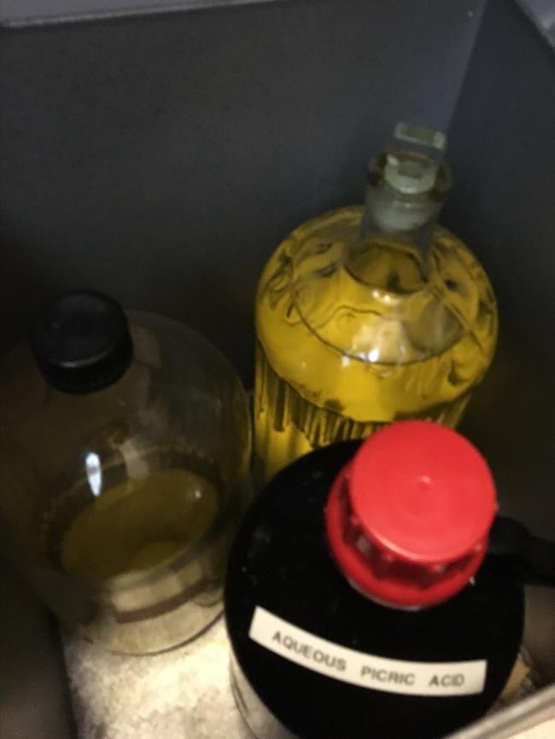
Safety precautions
Purchase the minimum amount required
Consider purchasing low concentrations (<2% in water)
Consider sharing stocks between groups
Store safely and securely
Check stocks regularly to ensure they don’t dry out
Keep an inspection register
Dispose of unused material after 2 years
Inform the SEPS team to assist with licensing
Notes:
Both compounds have a number of legitimate uses and there will be a need for some people to use them on a regular basis

Slide 5
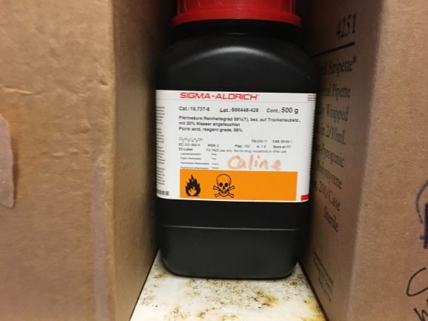
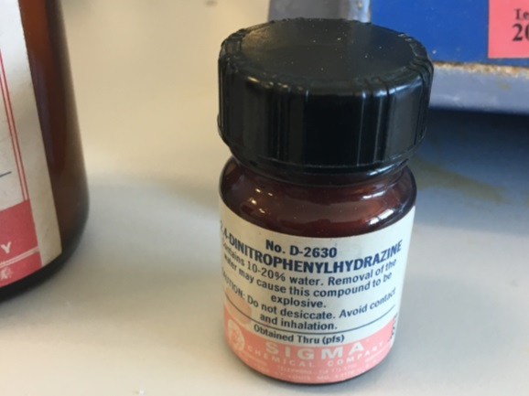
What to look out for*
Check any historical or abandoned chemicals
The general condition and age of the container
Amount of material
Listed concentration / dilution of the substance
Condition of the substance (is it dry?)
The presence of crystals on the neck or screw threads
Metal stoppers or caps
Owner and age of the sample if possible
*Checks should be carried out without opening container
Notes:
XXX

Slide 6
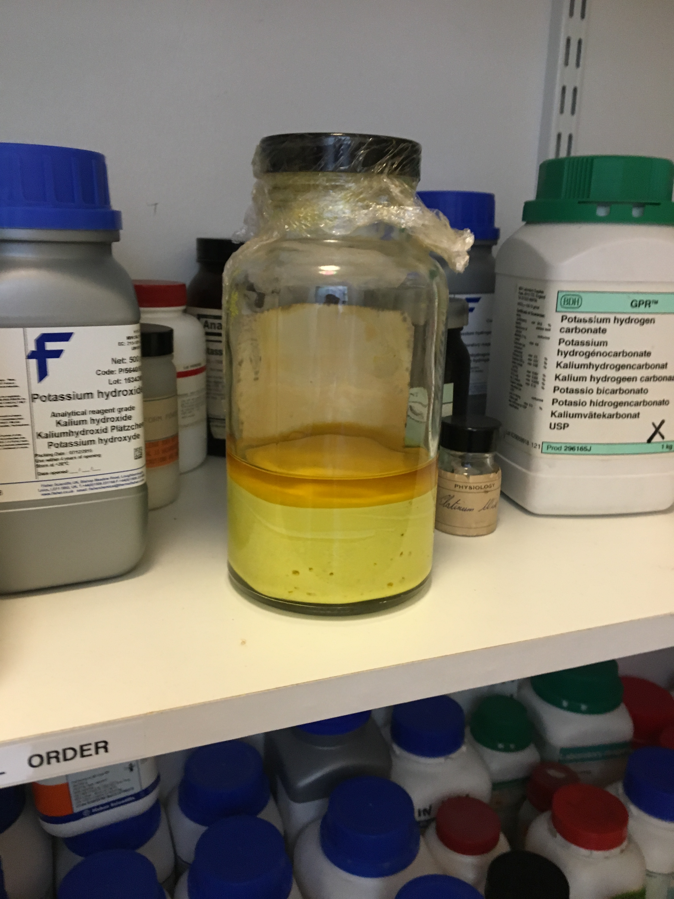
What to do about it?
Examine the container carefully
Ensure it is clearly labelled and stored securely
Ensure sample is not disturbed
Inform PI / Safety Rep
Arrange for disposal if substance no longer required
  2,4-DNP (wet) via Veolia
  2,4-DNP (dry) will require rehydration or specialist on-site disposal
  Picric Acid (wet) via Veolia
  Picric Acid (dry) will require rehydration or specialist on-site disposal
Don’t open the bottle unless you are certain it is safe to do so
Notes:
XXX

Slide 7
Rehydration procedure*
Fill a plastic bucket or deep basin with ice water (sufficient depth to cover neck of bottle)
Place the bucket in a fume hood (with lowered sash or blast shield if available)
Place the bottle in water upside down (use non-metallic weights to ensure immersion)
Leave overnight (remember to label the fume hood)
Check success of procedure after 24h (preferably leave the container for longer)
Check rehydration visually (especially threads of container)
Only if rehydration has been successful carefully open container and add water
*This procedure should only be carried out by a competent person using the correct PPE (gloves, safety glasses and face shield, and lab coat is the minimum requirement) in a fume cupboard.

Slide 8

For Further Information Contact:
Dr. Phil Rodger (Chemical Safety Adviser)
E: Philip.Rodger@glasgow.ac.uk
T: 0141 3302799

