Slide 1

Toolbox Talk: Chemical Safety
04: Contractor Safety in Laboratories

Slide 2


Introduction
This presentation is designed to help contractors working in the Joseph Black Building work safely and covers the following:
  Confirming that an area has been cleared and is safe to enter
  Identification of the possible risks in a working area
  Safety checklist to be completed before starting work
  Simple safety rules to reduce the risk of exposure to hazardous substances
  Ensuring good hygiene when working in laboratories
  Knowing what to do in the event of an emergency
  Emergency contacts
Notes:
Scientific research and teaching laboratories can hold a variety of hazards, some easy to spot and some which may not be obvious.

Slide 3




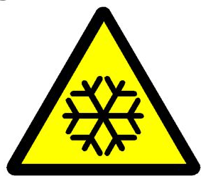

Types of Laboratory
The Joseph Black Building contains a variety of laboratories:
  Teaching laboratories
  Chemical research laboratories
  Biological containment laboratories
  Radiation laboratories
  Chemical / solvent stores
  Compressed gas storage cages
  Cryogenic storage
  Other specialist laboratories or storage areas (e.g. NMR laboratories)
Remember that not all hazards in the laboratory will be immediately obvious to the naked eye!
Notes:
XXX

Slide 4
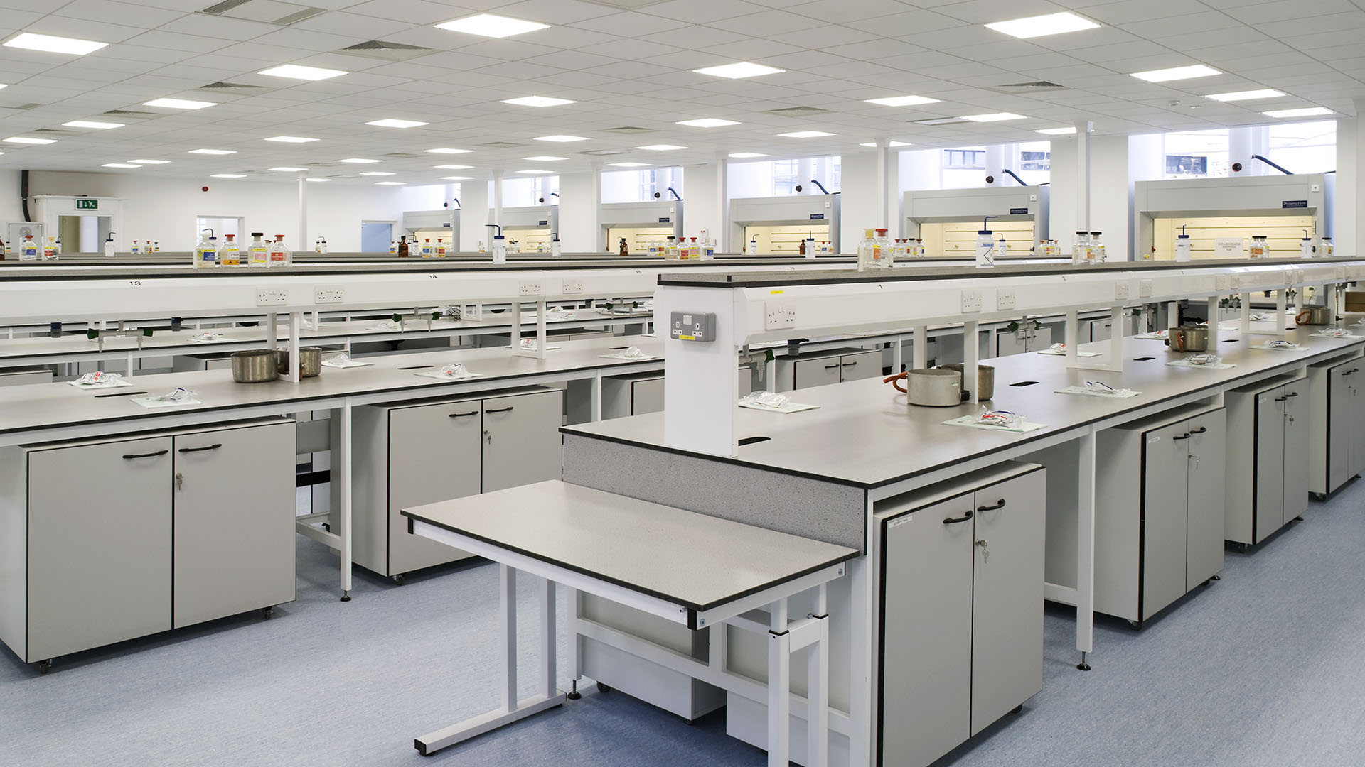
Sample Laboratory Hazards
Toxic, corrosive or harmful chemicals
Biological agents
Radioactive substances
Sharps (glass, needles etc.)
Compressed gas cylinders
Cryogenic materials
Hot surfaces
Electrical equipment
Slips, trips, falls etc.
Notes:
XXX

Slide 5

Before Starting Work in a Laboratory
Identify local contact / responsible person for the laboratory
Confirm that the working area has been cleared
Familiarise yourself with any hazards in the area
Ensure you are familiar with warning signals, alarms etc.
Identify areas that are off-limits (and respect these)
Make sure isolations have been carried out (permit system)
Locate first aid kits and emergency exits
Ensure you know what to do in an emergency!
Notes:
XXX

Slide 6
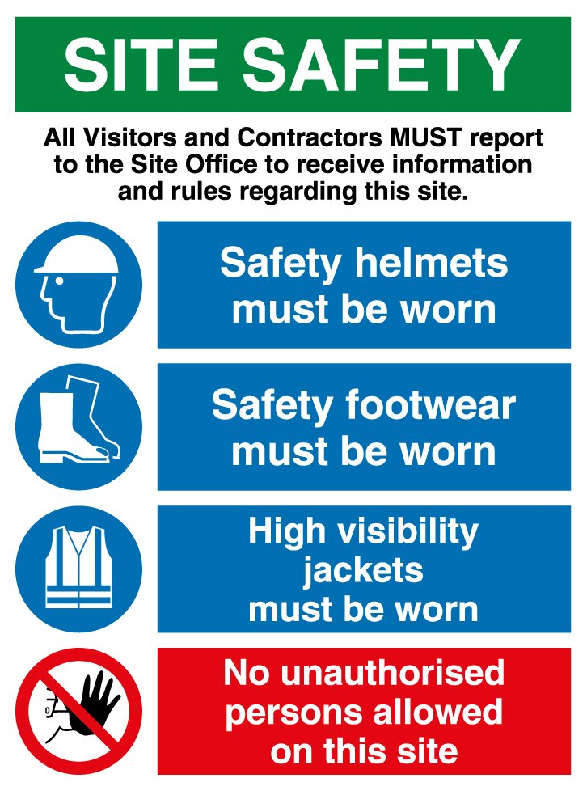
Simple Safety Rules for Contractors
No unauthorised entry to laboratory areas
Wear the correct PPE as directed by laboratory staff
Follow all instructions from laboratory staff
Work safely, stored materials, tools, trailing power cables
Only approved power sockets should be used for tools etc.
Don’t touch anything other than what you are working on
Don’t unplug or switch anything off without permission
Isolations (permit to work)
If you see something untoward, tell someone!
If something is leaking, broken or spilled, tell someone!
Notes:
XXX

Slide 7


Laboratory Hygiene Rules
Do not eat or drink in any laboratory
Do not take food, drink, cigarettes etc. into a laboratory
Smoking is not permitted in any university buildings
Never put anything in your mouth (e.g. pencils, fingers etc.)
Cover all cuts or wounds with a waterproof dressing
Do not place personal items (e.g. phones, keys etc.) on any work surfaces in laboratory or storage areas.
Do not touch any chemical containers, spillages or equipment
Always wash your hands before leaving the laboratory, smoking, eating or going to the lavatory.
Notes:
XXX

Slide 8
What to do in an Emergency
Immediately report any accidents, spills, leaks or breakages
Evacuate the laboratory calmly and do not re-enter until told to do so
DO NOT attempt to clean up after a spillage or leak of any chemical
DO NOT pick up broken glass with your fingers
If you come into contact with ANY chemical wash the area with cold water for 15min
Inform the local safety coordinator of ALL incidents
In the event of a fire actuate the nearest alarm call point and evacuate the building
Contractor Assembly Point?
Notes:
XXX

Slide 9


Contact Information
Local Emergency Contacts (Joseph Black Building)
  Graham Tobasnick 0141 330 2841
  James Tweedie 0141 330 6585
Emergency / Fire / Ambulance
  Campus Security 0141 330 4444
  In the event of an emergency you should call 4444 from an internal phone to inform security who will dial 999 and direct the emergency service to your location.
Notes:
XXX

Slide 10

For Further Information Contact:
Dr. Phil Rodger (Chemical Safety Adviser)
E: Philip.Rodger@glasgow.ac.uk
T: 0141 3302799

Slide 11
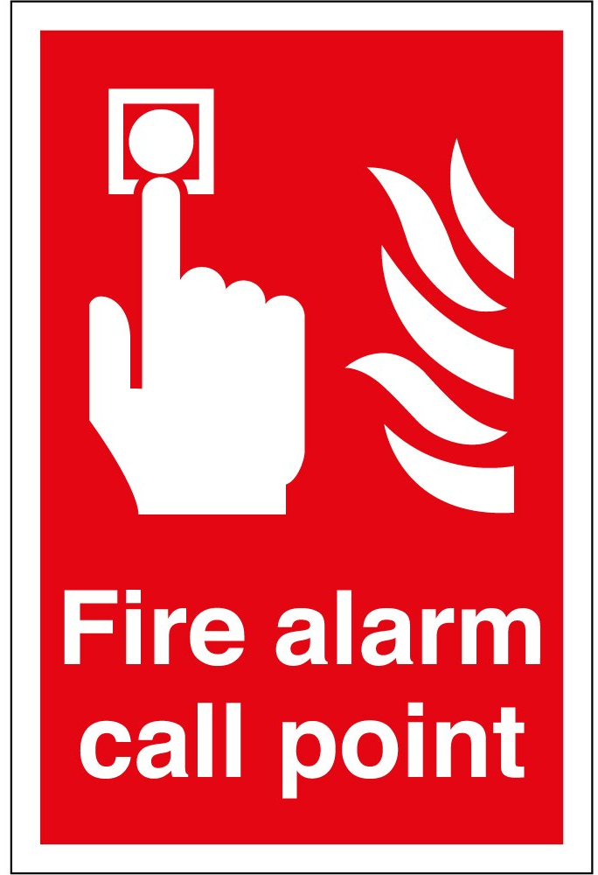
Fire Safety Considerations
Do you know the Fire Safety Procedures for the Joseph Black Building?
Where can I get this information?
Does my planned work have any effect on the building fire safety procedures?
Who do I speak to regarding this?
Does my work require a permit? (i.e. hot works or Fire Alarm Isolation)
How do I get a permit for this?
What do I do if I discover a fire?
What are the consequences if I set of the fire alarm during class time?
What should I do if the fire alarm activates whilst I am in the building?
Notes:
XXX

Slide 12
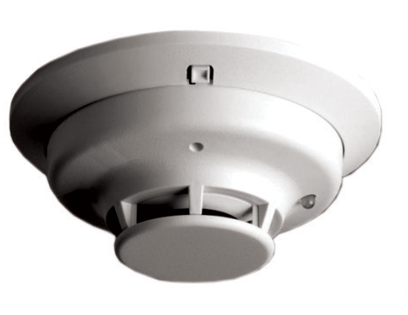
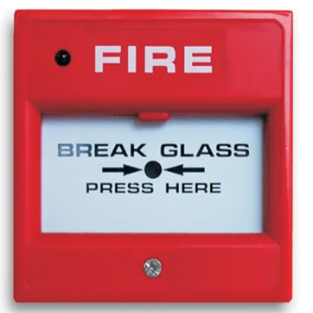
Isolation Permit System
Before carrying out any work involving isolation / disablement of a heat / smoke detector head a permit must be obtained.
Permits will only be issued by James Tweedie following receipt of a correctly completed of a permit request.
At the conclusion of works the detector head must be reinstated before leaving the area.
Once the detector has been reinstated, James Tweedie should be informed immediately and the isolation permit formally cancelled.
Isolations should last for the minimum period practical and where possible all detector heads should be reinstated by the end of the working day (5pm).
Notes:
XXX

