Slide 1


James Gray - BA (Hons), RPA, RWA, CRadP, MSRP
Radiation Protection Adviser
James.Gray@glasgow.ac.uk

Slide 2
S T A T U T O R Y I N S T R U M E N T S
2016 No. 588
HEALTH AND SAFETY
The Control of Electromagnetic Fields at Work Regulations 2016
(CEMFAW)

Slide 3
Guidance
Non-binding guide to good practice for implementing Directive 2013/35/EU Electromagnetic Fields Vols 1&2 http://ec.europa.eu/social/publications
A guide to the Control of Electromagnetic Fields at Work Regulations 2016 – HSE http://www.hse.gov.uk/pubns/books/hsg281.htm
Guide for SMEs

Slide 4
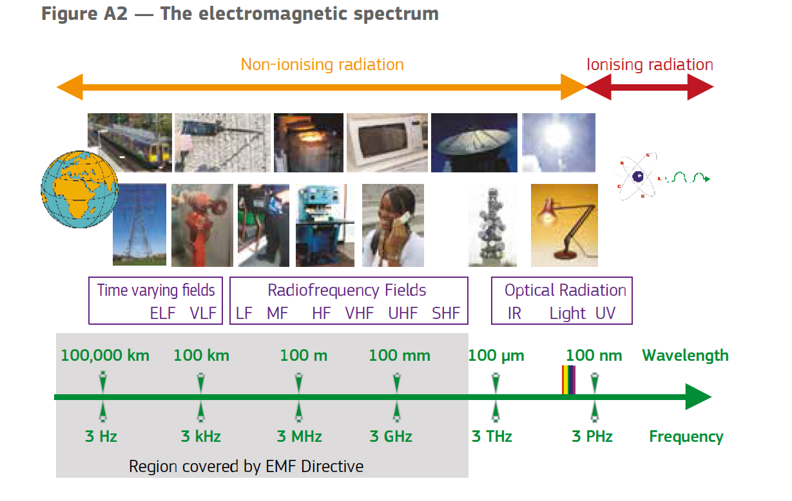

Slide 5
Definition
EMFs are static electric, static magnetic and time-varying electric, magnetic and electromagnetic (radio wave) fields with frequencies up to 300 GHz.

Slide 6
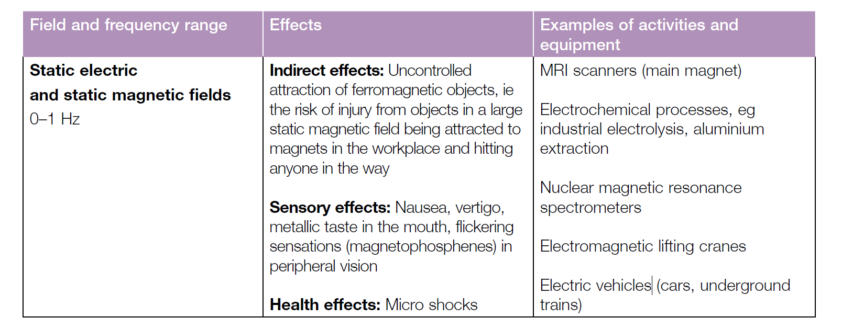
Health Effects
Two Categories of health effect
Thermal Effects – a body absorbs the radiation leading to localised tissue heating
Non-thermal Effects – more subtle effects

Slide 7
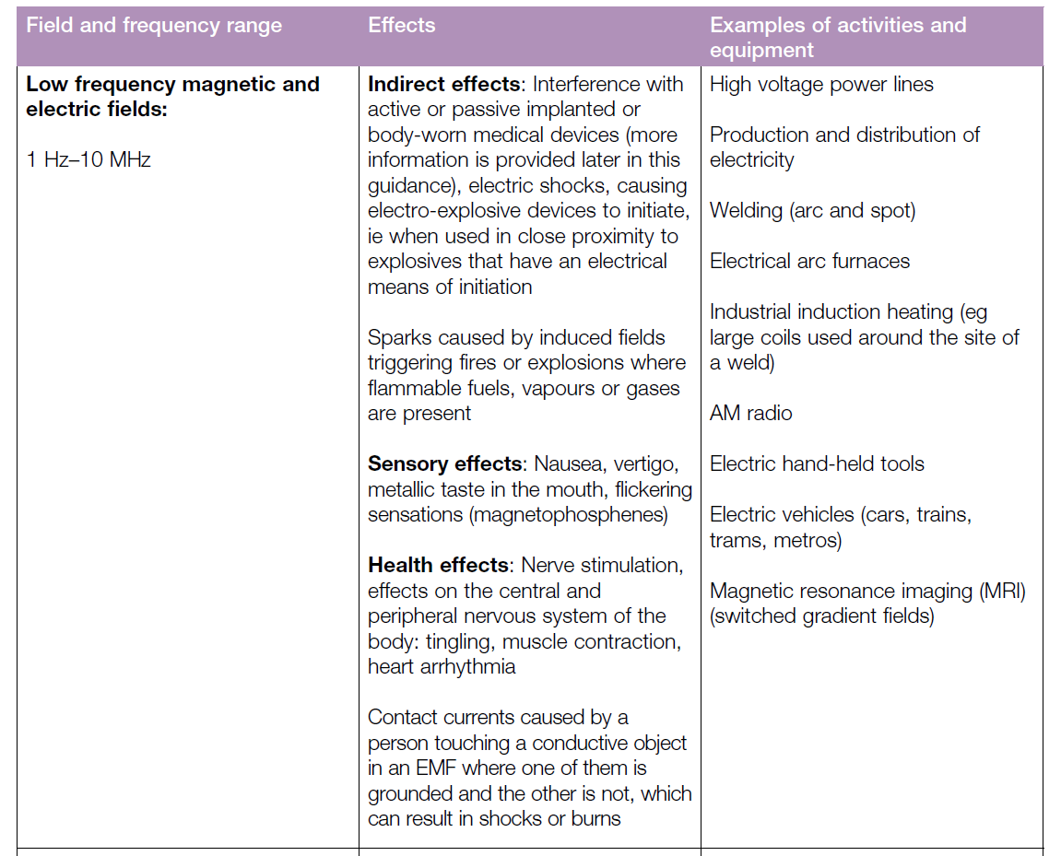

Slide 8
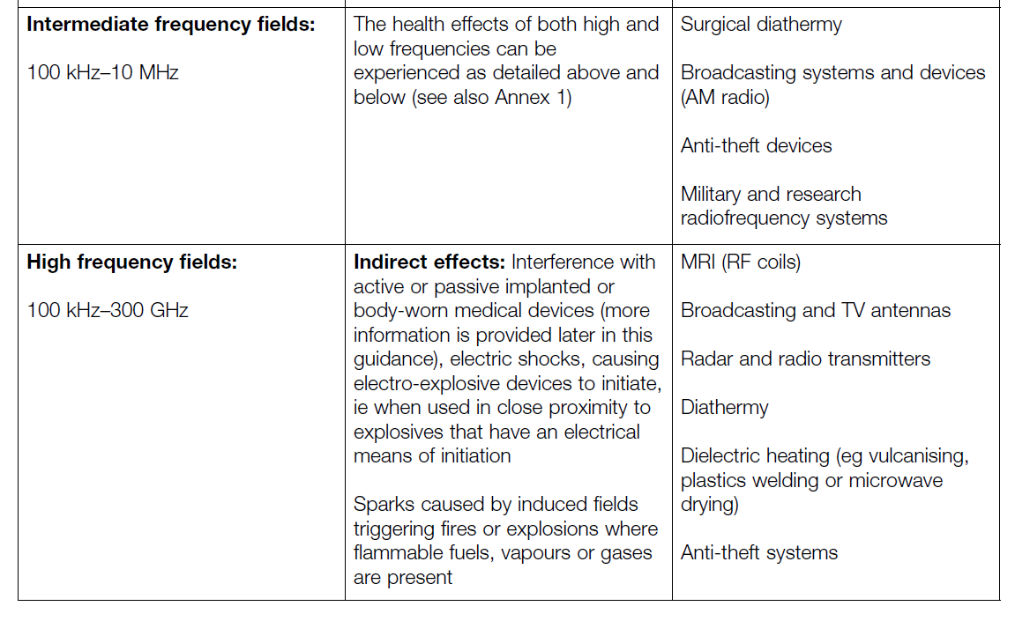

Slide 9
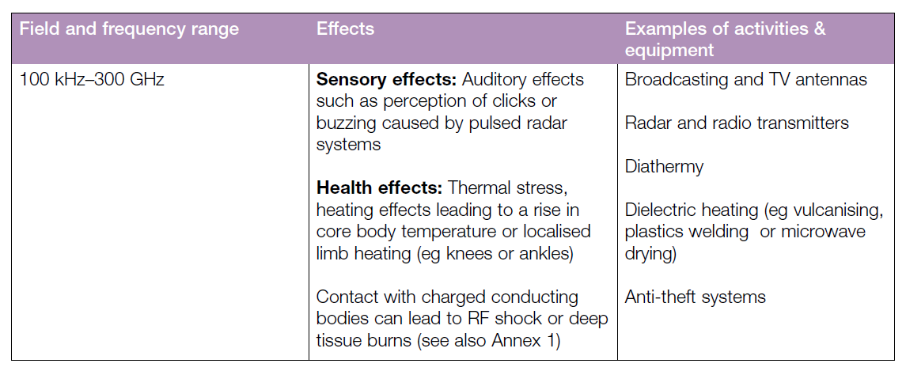

Slide 10
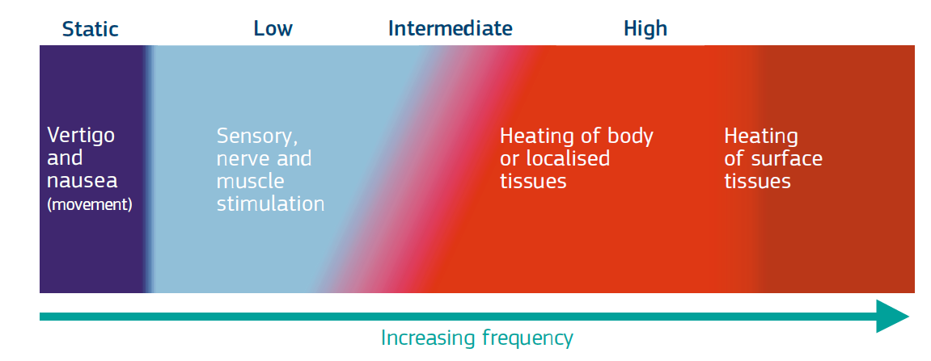
Direct Effects
Indirect Effects
Interference with active or passive medical devices
Projectile risks from ferromagnetic objects
Electric shocks or burns from a conductive object in an EM field
Ignition of electrical detonators / fires / explosions

Slide 11
What you need to do
assess the levels of EMFs to which your employees may be exposed
ensure that exposure is below a set of ELVs, ‘Exposure limit values’
when appropriate, devise and implement an action plan to ensure compliance with the exposure limits
when appropriate, assess the risks of employees’ exposure and eliminate or minimise those risks. You must make sure you take employees at particular risk, such as expectant mothers and workers with active or passive implanted or body-worn medical devices, into account.
provide information and training on the particular risks (if any) posed to employees by EMFs in the workplace and details of any action you are taking to remove or control them. This information should also be made available to their safety representatives, as appropriate
take action if employees are exposed to EMFs in excess of the ELVs
provide health surveillance or medical examination, as appropriate.

Slide 12
Action Levels and Exposure Limit Values
ELVs are the legal limitations on the exposure of employees to EMFs and primarily relate to the levels of exposure to EMFs within the body.
ALs have been produced relating to quantities which can be measured more easily.

Slide 13
In Practice
Use the available guidance to check if you need to do anything – e.g. table 3.2
Identify those workers at potential risk
Any practice not noted in the guidance will have to be assessed
If the business has more than 5 employees then a record of assessment must be kept
Some practices are exempt

Slide 14
Employees at particular risk
an employee who has declared to their employer a condition which may lead to a higher susceptibility to the potential effects of exposure to EMFs. This includes expectant mothers who have informed you of their condition and workers who have declared the use of active implanted medical devices (AIMDs), passive implanted medical devices (PIMDs) or body-worn medical devices (BWMDs)
an employee who works in close proximity to electro-explosive devices, explosive materials or flammable atmospheres.

Slide 15
Assessment
5.—(1) The employer must make a suitable and sufficient assessment of the levels of
electromagnetic fields to which employees may be exposed.
(2) Where regulation 4(1) applies—
(a) the assessment must demonstrate whether that regulation is complied with, if necessary
through the use of calculations and measurements; and
(b) the employer may, in accordance with the Schedule(c), assess exposure against the ALs
in order to determine that specific ELVs are not exceeded.
(3) The assessment may take into account—
(a) emission information and other safety related data provided by the manufacturer or
distributor of equipment;
(b) industry standards and guidelines;
(c) guidance produced by the European Commission; and
(d) guidance produced by the Executive.
(4) The employer must review the assessment when—
(a) there is reason to suspect it is no longer valid; or
(b) there has been a significant change in the matters to which it relates,
and make such changes to it as are necessary to ensure it remains suitable and sufficient.

Slide 16
Assessment
Action Level (AL) – level at which a formal assessment is required
Exposure Limit Value (ELV) – legal exposure limits for employees
Measurement is a last resort
Information from Manufacturer
Calculations

Slide 17
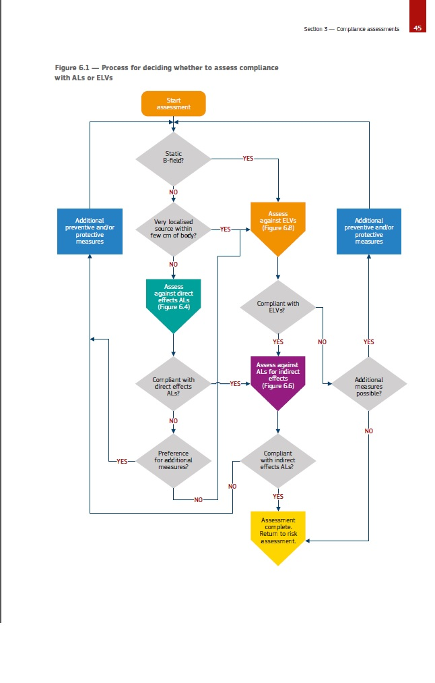

Slide 18
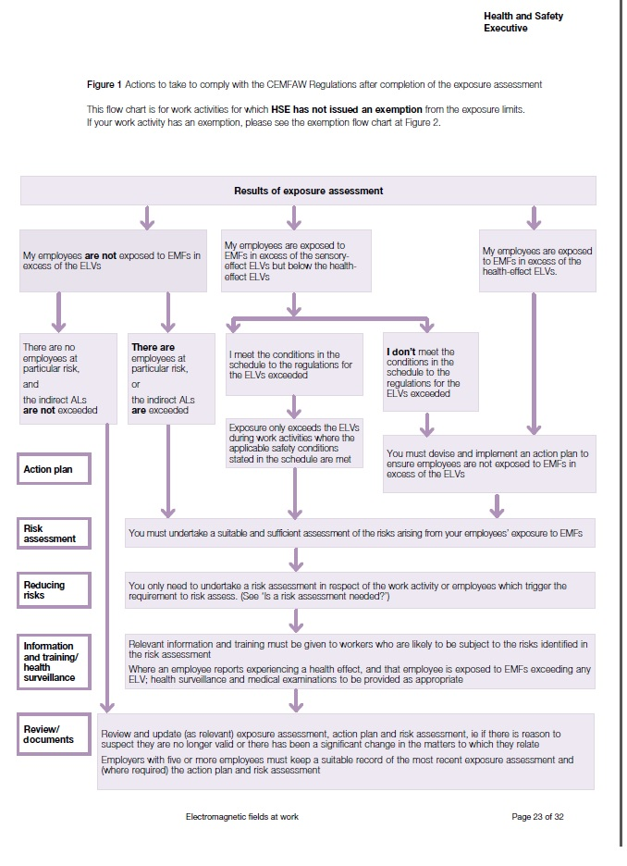

Slide 19
Summary
Most employers won’t need to do anything
Workers at particular risk
AL’s and ELV’s
Guidance – EU & HSE
James.gray@glasgow.ac.uk

