Slide 1


Teaching Excellence Initiative
Using Technology Enhanced Learning and Teaching (TELT) for Assessment and Feedback
Sarah Honeychurch
Teaching Fellow
Adam Smith Business School
Sarah.Honeychurch@Glasgow.ac.uk

Slide 2
Self-regulated learners
Research in higher education shows that learning is deeper, more sustainable and satisfying when students become responsible partners in their learning. The most powerful way to achieve this is to involve students actively in assessment and feedback processes, that is, by giving them regular opportunities to make judgements about their own work and the work of others and to provide rationalisations for these judgements. In this way, students will develop their own ability to monitor, evaluate and regulate their own learning, The ability to self-regulate your own learning is necessary for the development of all graduate attributes and for learning that is sustainable beyond graduation. (Nicol 2018)

Slide 3
Principles of Assessment and Feedback
Good assessment and feedback practice that promotes self-regulation requires that students gain practice in:
Formulating goals for learning and identifying standards
Making evaluative decisions about their own and others' work
Generating explicit feedback for self and others
Responding to and/or acting on feedback
Discussing work and its evaluation with others (e.g. with peers and teachers)

Slide 4
Yet Another Class Response System (YACRS)
YACRS can be used to enhanced interaction in the classroom between the teacher and students, by encouraging students to actively reflect on potential solutions to a particular question.
The teacher can get feedback to find out if the students have been understanding the material in the classroom,
Students also get immediate feedback and clarification on their answers.
YACRS can also promote peer interaction in the classroom is used in the context of peer instruction. This is a technique developed and popularised by Eric Mazur.
https://www.gla.ac.uk/myglasgow/leads/staff/telt/telttech/#/classresponse(yacrs)
https://www.gla.ac.uk/colleges/arts/informationforstaff/e-learning/tools/classresponseyacrs/classresponseguides/

Slide 5
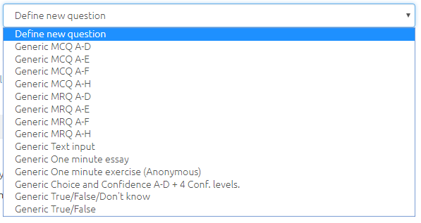
Yet Another Class Response System (YACRS)

Slide 6
Teaching Excellence Initiative
Using Technology Enhanced Learning and Teaching (TELT) for Assessment and Feedback
Sarah Honeychurch
Teaching Fellow
Adam Smith Business School
Sarah.Honeychurch@Glasgow.ac.uk

