Slide 1


Teaching Excellence Initiative
Marking Rubrics
Sarah Honeychurch
Teaching Fellow
Adam Smith Business School
Sarah.Honeychurch@Glasgow.ac.uk

Slide 2
Principles of Assessment and Feedback
Good assessment and feedback practice that promotes self-regulation requires that students gain practice in:
formulating goals for learning and identifying standards
making evaluative decisions about their own and others' work
generating explicit feedback for self and others
responding to and/or acting on feedback
discussing work and its evaluation with others (e.g. with peers and teachers)

Slide 3
What is a rubric?
A rubric is an assessment tool that lists the criteria for a piece of work or what counts (for example, purpose, organization, details, voice, and mechanics often are what count in a written essay) and articulates gradations of quality for each criterion, from excellent to poor. (Andrade 2005)

Slide 4
What is a rubric?
Criteria
Definitions
Grading strategy
(Dawson 2017)

Slide 5
Teacher and learner motivations
Why are you using a rubric?
Teacher marking
Teacher feedback
“A good rubric allows me to provide individualized, constructive critique in a manageable time frame.” (Andrade 2005)
Understanding a task
Self assessment
Peer assessment
Using to teach

Slide 6
Learner engagement
How will you ensure student engagement?
Course documents
Moodle
In class

Slide 7
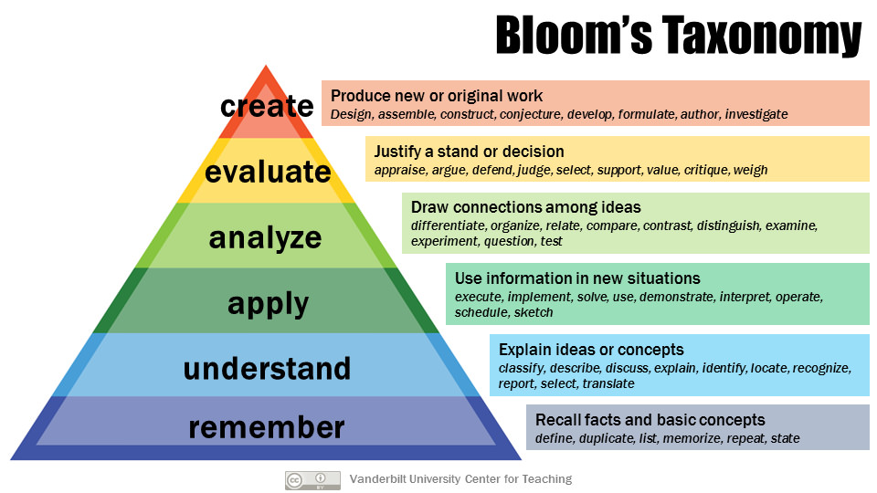
Writing rubrics

Slide 8
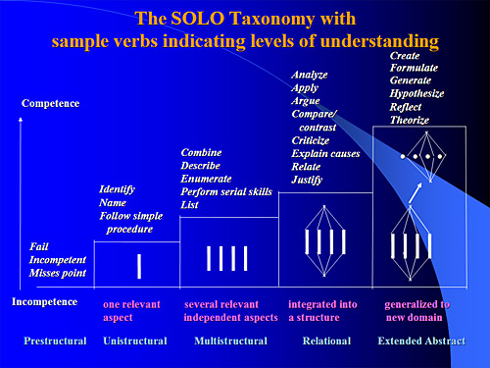
Writing rubrics

Slide 9
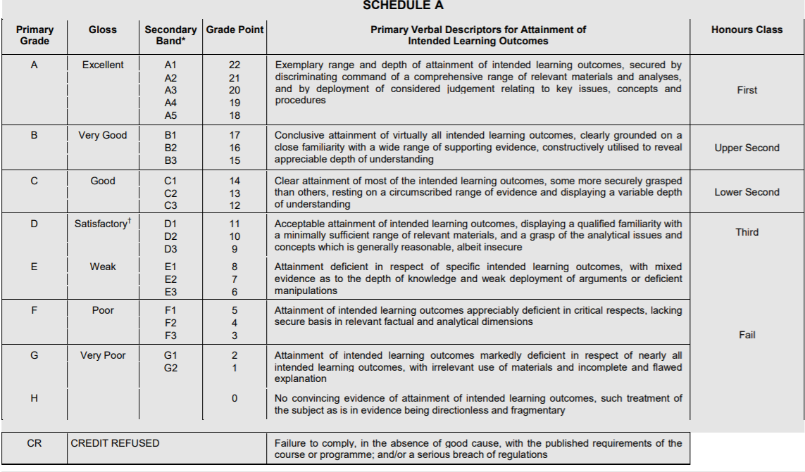
Writing rubrics

Slide 10
References
Heidi Goodrich Andrade (2005) Teaching With Rubrics: The Good, the Bad, and the Ugly, College Teaching, 53:1, 27-31, DOI: 10.3200/CTCH.53.1.27-31
Phillip Dawson (2017) Assessment rubrics: towards clearer and more replicable design, research and practice, Assessment & Evaluation in Higher Education, 4
2:3, 347-360, DOI: 10.1080/02602938.2015.1111294
Peter Grainger, Michael Christie, Glyn Thomas, Shelley Dole, Deborah Heck, Margaret Marshman & Michael Carey (2017) Improving the quality of assessment by using a community of practice to explore the optimal construction of assessment rubrics, Reflective Practice, 18:3, 410-422, DOI: 10.1080/14623943.2017.1295931
Anastasiya A. Lipnevich, Leigh N. McCallen, Katharine Pace Miles and Jeffrey K. Smith (2014) Mind the gap! Students' use of exemplars and detailed rubrics as formative assessment. Instructional Science 42:4 539-559 https://www.jstor.org/stable/43575435

Slide 11
References
Y. Malini Reddy & Heidi Andrade (2010) A review of rubric use in higher education, Assessment & Evaluation in Higher Education, 35:4, 435-448, DOI: 10.1080/02602930902862859
D. Royce Sadler, (1987) Specifying and promulgating achievement standards. Oxford Review of Education, 13, 191–209.
D. Royce Sadler, D. R. (2009) Indeterminacy in the use of preset criteria for assessment and grading in higher education. Assessment and Evaluation in Higher Education, 34, 159–179.

Slide 12
Teaching Excellence Initiative
Marking Rubrics
Sarah Honeychurch
Teaching Fellow
Adam Smith Business School
Sarah.Honeychurch@Glasgow.ac.uk

