Slide 1

Assessment, feedback and self-regulation:
Do you get what you give
Minmin Du and Alvise Favotto
Notes:
Intro slide - If your presentation does not relate solely to student recruitment, please use this version

Slide 2
Background
Need for improving feedback quality (NSS 2018)
    Promptness of assessment feedback?
    Quality and quantity of information / content?
Increased attention on formative feedback provision from professional qualification bodies (ACCA, 2017; Tan & Laswad, 2018)
Research concentrates on methods for designing/ administering different types of feedback yet less attention to feedback ‘reception’ (Mayo et al. 2012; Nicol 2010)
Engagement and satisfaction with feedback are mediated by self-regulation mechanisms (Nicol & McFarlane-Dick 2006)

Slide 3

What we did
Three quasi-experimental interventions to explore whether and how self-regulation affects students’ perception of assessment feedback:
  Commented solutions
  (peer) Marking and commenting exercise
  Dialogical (peer) review

Slide 4

Theoretical Framework
Regulatory Focus theory (Higgins 1997; 1998):
Promotion focus:
  Emphasizes on growth and advancement needs
  Goals are viewed as ideals, there is a strategic concern with obtaining gains and avoiding non-gains
Prevention focus:
  Emphasizes safety, security needs.
  Goals are viewed as ‘oughts’ and there is a strategic concern with obtaining non-losses and avoiding losses.
“Our concern is the happiness or misery of those who are the object of what we call our affections: our desire to promote the one and to prevent the other are either the actual feeling of that habitual sympathy or the necessary consequences of that feeling” (TMS 2000: 323)
Notes:
Self regulation is the process with which people align their behaviour to goals and standard. For higgins goals have to do with achieving pleasure and avoiding pain, in this respect people follow in 2 categories
Promotion focus
Needs
Growth and development needs predominate for those who are promo- tion focused
Goals/standards.
As Higgins (1987) suggested, certain standards represent people’s beliefs of their ideal selves and thus reflect their hopes, wishes, and aspirations
Psychological Situation
The presence and absence of positive outcomes are salient for people who are promotion focused. Upon bringing themselves into alignment with their ideal selves people experience the pleasure of a gain. When people fall short of their ideal self they experience the pain of a nongain.
Prevention
Needs
security needs drive those who are prevention focused
Goals/ standards
people’s beliefs about their ought selves and as such refer to their felt duties, obligations, and responsibilities
Psychological situation
The absence and presence of negative outcomes are salient for people who are prevention focused. That is, the goals and standards associated with the ought self represent the absence of negative outcomes (e.g., safety or security). Upon bringing themselves into alignment with the ought self people experience the pleasure of a nonloss (i.e., they avoid a negative outcome). Failure to reach the ought self, in contrast, elicits the experience of the pain of loss.
IMPORTANTE:
Goals/standards. As Higgins (1987) suggested, certain standards represent people’s beliefs of their ideal selves and thus reflect their hopes, wishes, and aspirations (e.g., a manager who wishes to be seen as charismatic or the sales- person who intrinsically wants to reach his/her ambitious quarterly perfor- mance goals). Other standards represent people’s beliefs about their ought selves and as such refer to their felt duties, obligations, and responsibilities (e.g., the manager who is trying to conduct performance reviews in a timely fashion or the senior executives who believe that their company must comply with the guidelines imposed on them by a governmental regulatory agency). Promotion-focused people seek to attain the goals or standards associated with the ideal self, whereas prevention-focused people seek to attain the goals or standards associated with the ought self.
Feeling of ‘rightness’ from sustained regulatory focus affects perceived persuasiveness of medium

Slide 5
Overview of findings
Findings (based on our work so far):
  Perceived informativeness of feedback does not seem to correlate with the level of details given (for promotion-focused students)
  Promotion framing triggers harsher evaluations (v. prevention framing)
  Students enjoy participating in building feedback (peer review) and they feel more satisfied:
    when they give feedback than when they receive feedback
    When they are paired-up with classmates with same RF

Slide 6
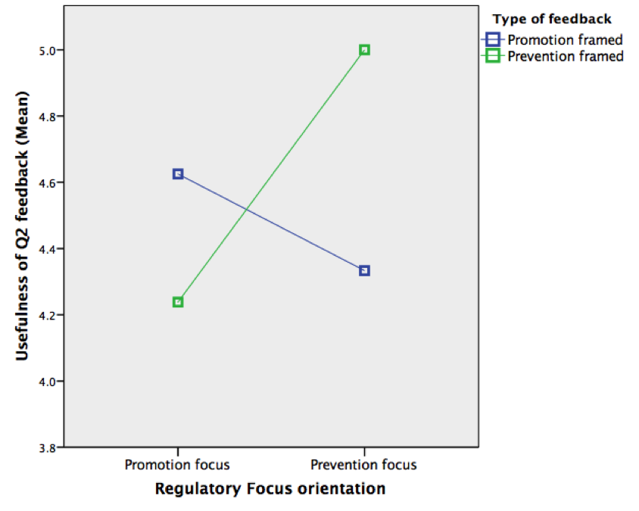
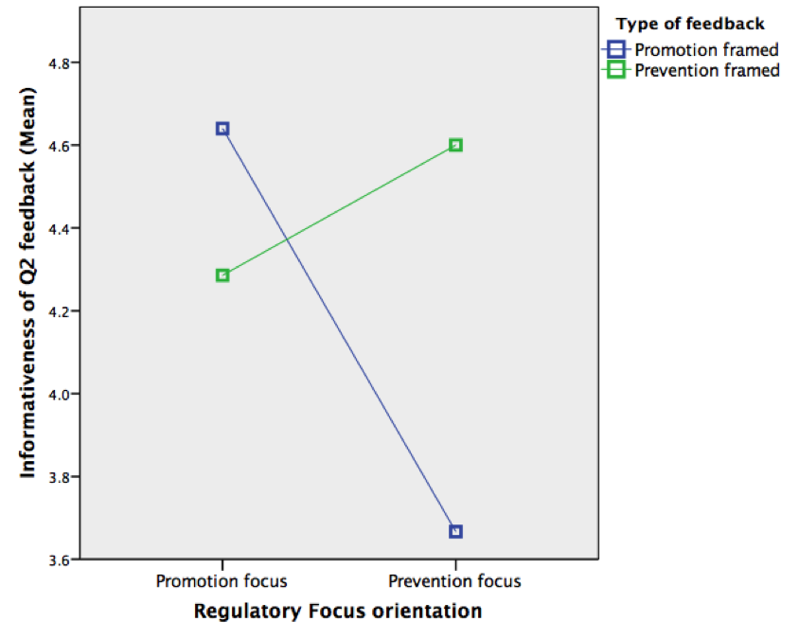
Is it all about the content of feedback?
Avoiding mistakes (prevention focus) and making hits (promotion focus)
Two versions of feedback (suggested solutions)
    Version A (Green): Showing common mistakes
    Version B (Blue): Demonstrating the optimal solution
Students concerned about avoiding mistakes are more satisfied with A
    They consider A being more useful/ informative than version B
Students concerned about making hits are more satisfied with version B
    They consider B being more useful/ informative than version A
Same content but with two different instructions using regulatory focus framing
    Similar effect on students satisfaction with the feedback received

Slide 7

Assessment marking criteria
Results of assessment (Grade + Comments)
    What the student has done well or poorly?
    What can be improved?
Evaluative judgment (peer-review) improves students own understanding of the topic (Nicol, Thomson and Breslin, 2014)

Slide 8
Helping students understand marking criteria
Design and procedure:
  Question attempted in class
  Stage 1: Voluntary submission of answer scripts for review (N = 34)
  Stage 2: Review 2 scripts (1 good and 1 bad – randomly picked) (N = 51)
  Grade awarded to script (5 point nominal scale)
  Two versions of instructions framed using regulatory focus.
Overall students find the grading exercise very useful.

Slide 9
Helping students understand marking criteria
RF framing (of instruction) has significant impact on grading.
Promotion-focused framing triggers harsher grading than prevention-focused framing
    T = 2.050, Sig. = 0.043, p < 0.05 T = 2.656, Sig. = 0.011, p < 0.05

Slide 10

Dialogical (peer) feedback
Students build feedback themselves
Design and procedure
Students work in pairs and attempt question in a tutorial setting
Swap answer scripts and give feedback
(Within pairs) Respond to the feedback received

Slide 11

Giving feedback is perceived as more useful than receiving feedback irrespective of RF
T = 2.327, Sig. = 0.011, p < 0.05

Slide 12

Peer groups with matching RF show higher satisfaction with the task
    T = 2.531. Sig. = 0.014, p < 0.05

Slide 13

What we’ve learned:
  Giving feedback adds to the student learning experience
  Task instructions (framing) matter
  Free pairing to be preferred (v. pre-arranged pairs/groups)
  Time management issues

Slide 14

Future research:
  Match with students’ performance
  Explore use of marking rubrics
  Extend to lecturers’ RF

Slide 15









Thank you!
Contacts:
  minmin.du@glasgow.ac.uk
  alvise.favotto@glasgow.ac.uk
/glasgowuniversity
@UofGlasgow
@UofGlasgow
UofGlasgow
Search: University of Glasgow

