Slide 1

Putting the ‘e’ into learning: ebooks for learning and teaching
Lynn Irvine, College Librarian

Slide 2

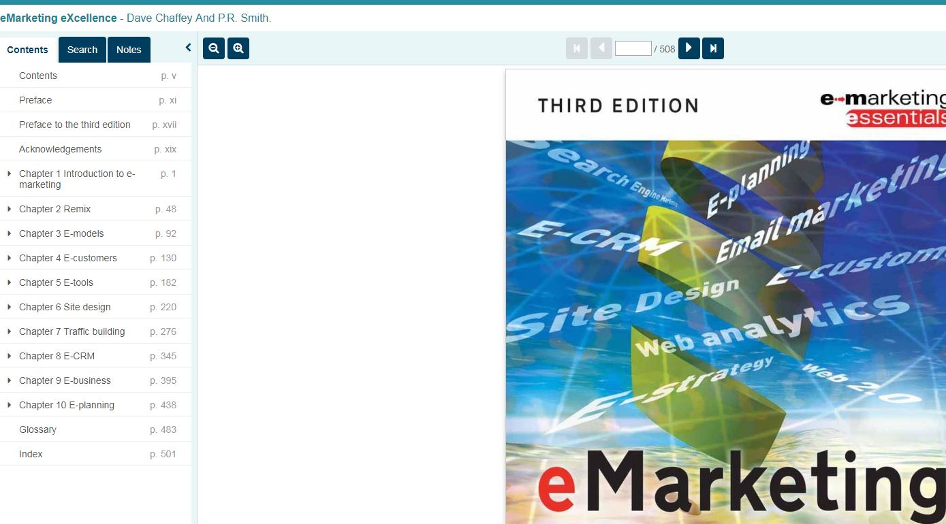
Agenda
Library budget for ASBS
Ordering material
Reading lists
Support for teaching and research
Ebooks – access models

Slide 3
Library budget
College allocations are determined by the library formula (approved by Library Committee each November). The formula was reviewed 3 years ago by a sub-group of the LC.
The formula is weighted by:
  Staff/PG numbers
  REF income
  Estimates of book and serials inflation in the previous year (and forecasts)
Estimates for expected CoSS serial expenditure, continuations and a discretionary fund are worked out and this amount is deducted from the budget.
The remaining amount is allocated to schools (and for the School of Political and Social Sciences, departments) using another formula. This takes into account staff FTE, UG, PGT and PGR FTE.

Slide 4
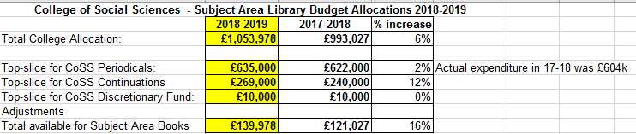
CoSS and ASBS library budget 2018-19
There is a budget of £149,978 (subject area books + discretionary fund) to be allocated to the 4 schools. The ASBS allocation for 2018-19 is £45,259. Email your College Librarian or use the online order form.
Books for reading lists are paid for from the top-sliced Course Materials Budget (CMB). Books for the School of Interdisciplinary Studies are ordered separately (by UWS staff).

Slide 5

ReadingLists@Glasgow
talis is a cloud-based reading list application, accessible to users online and via mobile devices.
The system is open but requires GUID to access any eresources (journal articles, ebooks digitised material)
Provides information and access to print and digital material
Link your reading list from Moodle using a unique URL for your list (data shows that over 90% of traffic to reading lists is via Moodle)
See usage of the list on a dashboard
In June each year lists are rolled over and new session dates assigned to them. Any changes can be made by list owners over the summer. Old lists are still on the system but can be archived by list owners.

Slide 6
Reading list lifecycle
List creation
Resource collection
Include digitized requests
Send for review
Each June lists are rolled over
Update as required and send for review

Slide 7
Digitised readings service
What is it?
Scanning of in-copyright extracts
Under terms of the CLA HEA licence
What can be scanned?
1 chapter/1 article or 10% from a book or journal issue per course
Books and journals published in 26 countries
How does it work?
Make requests via ReadingLists@Glasgow
Readings can be viewed online, downloaded or printed
Allow 10 days
Requires GUID to access

Slide 8
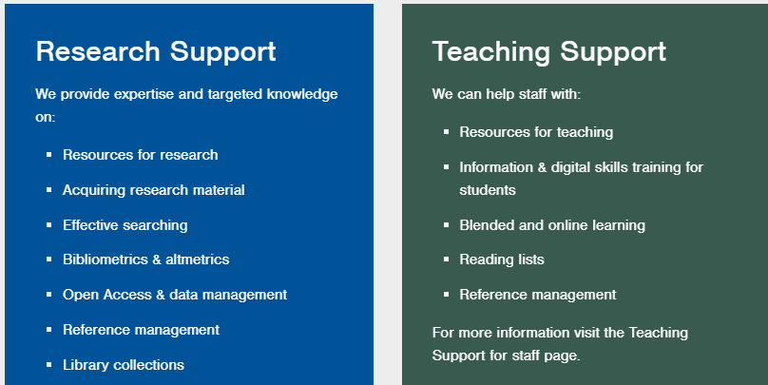
Support for teaching (and research)

Slide 9
ebooks – purchasing individual titles
Usually high demand textbooks for large student cohorts, reference items and increasingly research monographs.
For the purchase of individual ebook titles, we are part of a Scottish-wide consortial deal on ebooks (from Feb 2018). We get discounts and in return are obliged to order from suppliers in a ranked order.
Traditionally it was only possible to buy aggregator copies from ebook suppliers. Within the new contract in 2018, we are able to buy publisher direct copies. Publisher-direct copies have no DRM (Digital Rights Management) restrictions built in to them. This means they have no restrictions on printing, copying or downloading.

Slide 10
Aggregators
VLeBOOKS
Publisher direct
De Gruyter Rittenhouse
DawsonERA
Ebook Central
Elsevier Sage
IGI Global Taylor & Francis
Karger Wiley
OUP World Scientific

Slide 11
Ebook advantages
Unlimited access
Ebook disadvatages
Different platforms
Always available
Personalised experience (highlights, add notes)
Good for targeted reading
Searchable
Embedded dictionary (optional)
Read aloud feature (optional)
Different access models (concurrent use models, single user)
In-built DRM (restrictions on printing, copying, downloading)
Confusion between download and read online
System downtime
Not good for lengthy reading

Slide 12
ebooks – demo
Fisher, C.M., Lovell, A., Valero-Silva, N. & Dawson Books 2013, Business ethics and values: individual, corporate and international perspectives, Fourth edn, Pearson Education Ltd, Harlow, Essex.
Wildman, J.L., Griffith, R.L., Armon, B.K. & SpringerLink (Online service) 2016, Critical Issues in Cross Cultural Management, Springer International Publishing, Cham.

Slide 13
Ebook collections – a selection
Oxford Scholarship Online (UG, Graduate, Research)
Oxford Handbooks Online (Business and Management)
Business Expert Press (PG, MBA)
Routledge Handbooks Online
Routledge Companions
Edward Elgar Collections (Economics 2015-2018 and Business and Management 2017-2018)
Elsevier Science Direct (all ebooks from 2010 onwards as part of SHEDL)
Wiley Online Library
The library currently has over 300,000 ebooks in the collection. In 2017-18 we ordered 30% more books in this format and usage of ebooks increased by 40%. All of these books are on our catalogue and can be easily found.

Slide 14
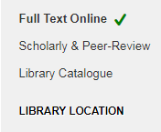
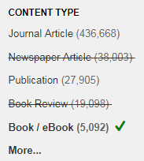
How do I find ebooks?
Use Library Search. Search by keyword.
Use the left filters to REFINE YOUR SEARCH. Choose Full text Online and Book/eBook
Click on the book title or Full Text Online to access it. You will be prompted for your GUID.

Slide 15
Or…
browse on the native platforms
Oxford Scholarship Online (UG, Graduate, Research)
Oxford Handbooks Online (Business and Management)
Business Expert Press (PG, MBA)
Routledge Handbooks Online
Routledge Companions
Edward Elgar Collections (Economics 2015-2018 and Business and Management 2017-2018)
Elsevier Science Direct (all ebooks from 2010 onwards as part of SHEDL)
Wiley Online Library

Slide 16
Databases
Subject specific
Business Source Premier
Company
Amadeus
Market and industry
Market Intelligence (banking and finance)
Multidisciplinary and general
Data
Econlit
Emerald Insight
FAME
Eikon/Datastream
Nexis
Marketline Advantage
Mintel
Passport
SCOPUS
Web of Science
Sage Research Methods
OECD Library
OECD Statistics
UK Data Service
World Development Indicators

Slide 17

Google Scholar – Full Text@Glasgow
https://scholar.google.co.uk/
Click the hamburger menu at the top-left
Choose Settings, then
Library Links
in the search box, enter University of Glasgow and press the search button
Choose the tick box beside the result University of Glasgow – Full text from Glasgow
All your results on Google Scholar will now show a link (on the right) to link directly to the full text:

Slide 18
Databases
Subject specific
Business Source Premier
Company
Amadeus
Market and industry
Market Intelligence (banking and finance)
Multidisciplinary and general
Data
Econlit
Emerald Insight
FAME
Eikon/Datastream
Nexis
Marketline Advantage
Mintel
Passport
SCOPUS
Web of Science
Sage Research Methods
OECD Library
OECD Statistics
UK Data Service
World Development Indicators

Slide 19

lynn.Irvine@glasgow.ac.uk

