Slide 1

A Moodle-based Peer Assessment Tool
Lisa Baker, Educational Technologist
Learning, Enhancement and Development
City, University of London

Slide 2
Peer Assessment
Two main types:
  Students assess the coursework produced by fellow students.
  Assessment of the contribution of each member of the group to the group work.
May include self-assessment, for self-reflection.
A reviewed and moderated process to ensure fairness.

Slide 3
City’s Peer Assessment tool
Based on a form of Peer Assessment that 'allows for the contribution of individuals to a group project to be evaluated, and enhances the learning experience of students’ (Johnson & Miles, 2004).
City’s Cass Business School uses group work in many programmes, which had previously caused some issues if a minority of students did not fully engage. Peer Assessment was introduced to incentivise engagement through the redistributive nature of the grading.
Peer Assessment encourages all students in a group to engage with the exercise and addresses the “bad feeling” caused by group members who do not contribute to the group exercise by empowering fellow students to do something about it.
Reference:
Johnston, L. & Miles, L., 2004. Assessing contributions to group assignments. Assessment & Evaluation in Higher Education, 29(6), pp.751-768.

Slide 4
Some background
Peer Assessment scheme was originally introduced for Cass Business School MSc students to:
  Support group interaction and encourage groups to work effectively together.
  Promote equal participation by all group members and avoid issues caused by students who contribute less than their peers to group-based coursework.
Administratively time-consuming – not linked to other administrative software.
Impact on degrees varied, depending on the nature of the assessments across the programmes. Percentage of coursework marks were for group participation in several modules.
Student feedback indicated that they generally felt their work was assessed more fairly when Peer Assessment was used.

Slide 5
Moodle Peer Assessment Activity
Group assignment submission combined with peer grading on Moodle.
Peer Assessment applied to individual modules – students get peer-moderated marks for each module.
Students assess the performance and contribution of each individual member of their group, and, if enabled, themselves, in relation to a group assignment submission.
All group members must complete peer grading including providing reasons for their ratings. Advice is provided on Moodle about how to assess each other student’s contribution.

Slide 6
Peer Assessment Process
One member of the group submits the group assignment.
Students award a mark out of 5 and a written comment for each of their group members and, if enabled, themselves.
The group assignment submission is graded by the lecturer.
Individual final grades are calculated based on the difference between the individual and group average grade. Students can score higher or lower than the group average grade.

Slide 7
Peer Grading Criteria
0 =
  No attendance at meetings.
  No engagement in the project
  Does not complete assigned tasks.
  No input into the group assignment.
5 =
  Attends all meetings and engages enthusiastically.
  Well organised and motivated.
  Able to negotiate with and motivate others.
  Contributes effectively and shows creativity and initiative.
  Significant and valuable input into the assignment.

Slide 8
The Peer Assessment Activity
Allows students to participate in the assessment process.
Encourages engagement with their own learning.
Promotes fairness by asking group members themselves to compare the contributions of each group member and to reward significant contributions.
Encourages group participation as students know their own contribution will be assessed.

Slide 9

Add as a Moodle Activity

Slide 10

Peer Assessment Options
Self grading
Default = Off
Self-grading is not currently used at City.
If enabled, students will be able to give themselves a peer grade and feedback, along with the other members of their group. This will then be counted towards their and the overall group’s peer grade averages.

Slide 11

Peer Assessment Options
0 as a grade
Default = Yes
If enabled, students will be able to submit 0 as a valid grade. Otherwise, 0 means "not graded" and is not used for calculation.

Slide 12

Peer Assessment Options
(Added Summer 2017)
Groupings
Previously Peer Assessment would not work if students were in more than one group on a module.
Groupings were introduced to:
  Allow students to be in multiple groups on a module.
  Allow Peer Assessment to be applied to certain groups.

Slide 13

Peer Assessment Options
(Added Summer 2017)
Default = Simple (original calculation)
Uses the actual peer grades, together with the mark awarded by the lecturer to calculate each student’s final grade.
A student’s final grade might be higher or lower than the group mark awarded by the lecturer if the average of their peer grades is higher or lower than the group average peer grade.
2 calculation options

Slide 14

Peer Assessment Options
(Added Summer 2017)
2nd calculation option introduced.
Outlier - Uses standard deviation to remove any large inconsistencies between peer grades from the calculation. It also smooths out minor differences between grades.
Outlier calculation option

Slide 15
Outlier
Being piloted on one MSc Programme.
The multiplier is 4, rather than 5
Algorithm checks for outlier scores (Standard Deviation greater than 1.15) – These grades are then ignored and students receive the group average grade.
Algorithm then carries out the standard calculation between group and individual averages – if the resulting differentiator is less than 2 then this is ignored as statistically insignificant.
Largely reduces the number of grades impacted by Peer Assessment.
No impact when there is a split in the group and no agreement on whether a student has contributed or not. (SD)

Slide 16
Simple and Outlier calculations
Each student is given an individual final grade which is worked out by:
Simple:
taking the average of the students' peer grades;
subtracting the group average peer grade from this;
multiplying this by 5*;
Outlier:
Taking into account any grades that are inconsistent with the grading from the rest of the group:
taking the average of the students' peer grades;
if the student has any outliers (large inconsistencies between grades) this is set to the group average;
subtracting the group average peer grade from this;
multiplying this by 4* (if the result is between -2 and 2 this is set to zero);
*4 and 5 are multipliers used to make the grading meaningful. The number used depends on how much of a difference they want to make to the final grade and does not relate to how many people are in a group.
In both cases, the calculation (which could be a negative number if the student have been scored worse than the average) is added to the lecturer's overall grade.

Slide 17
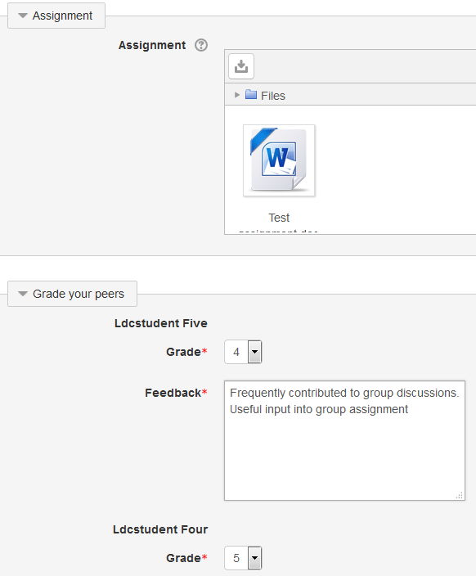
Student view of Peer Assessment

Slide 18
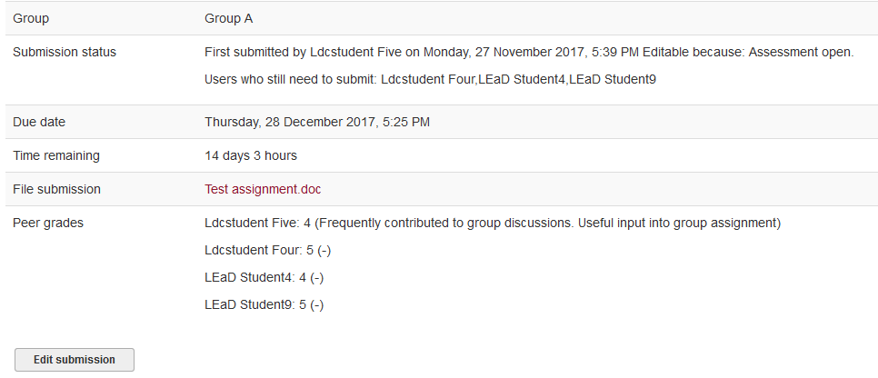
Student view of Peer Assessment

Slide 19
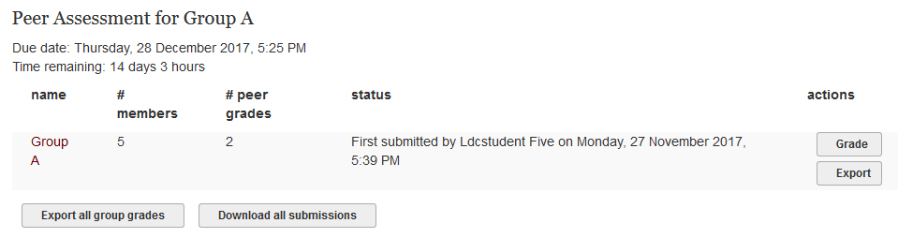
Lecturer view of Peer Assessment

Slide 20
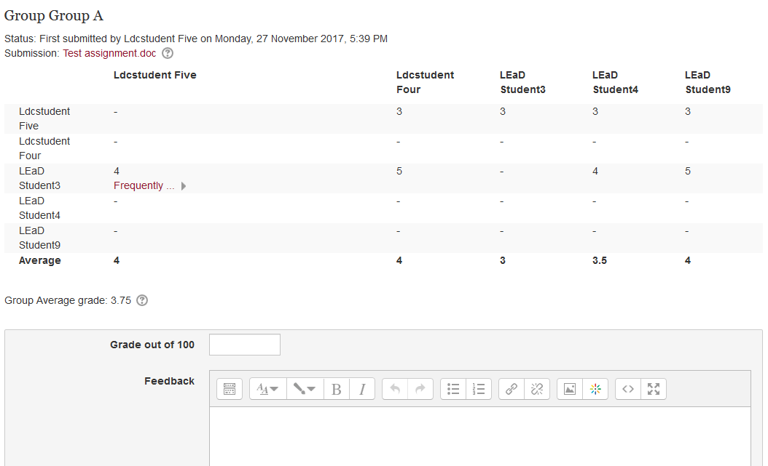
Lecturer view of Peer Assessment

Slide 21
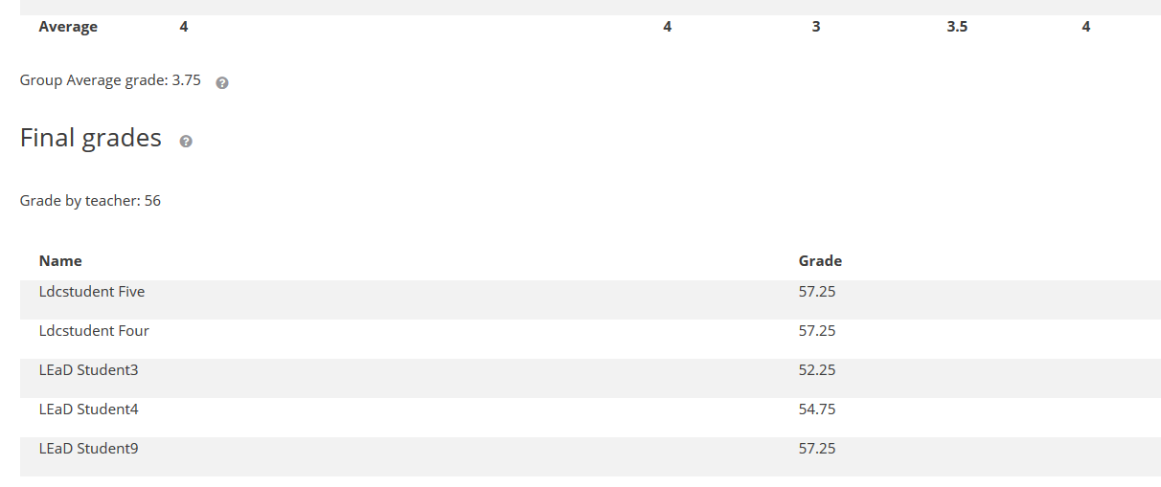
Lecturer view of Peer Assessment

Slide 22
Limitations of Peer Assessment tool
No ability to re-run the calculation after the lecturer has added their grade and feedback. Currently there is a manual process to re-calculate the grade using a spreadsheet.
No ability to enable Turnitin.

Slide 23
Limitations of Peer Assessment process
(Based on feedback from the MSc Course Office team)
There is no penalty if students do not complete peer assessment – they get the overall average and their grade is not counted towards peer assessment.
Clarification of guidance criteria is needed – e.g. 0 should only be used when somebody has not contributed at all.
Peer assessment is more effective when groups are pre-allocated and students are not working with their friends.
Students who award peer grades between 0 and 2 could be asked to provide more justification in addition to the standard comments to ensure they understand the possible implications of giving their peers a low grade.

Slide 24
Observations about the Outlier calculation
(Based on feedback from members of the MSc Course Office)
During the Outlier pilot, the amount of feedback from students who think they should have got a higher mark than someone else has increased.
When standard deviation kicks in there can be conflict if some students feel they should have got a higher grade to reflect the work they have put in.
The Outlier calculation has seemingly addressed issues where one group member marks lower than others, but it can be difficult to know who is telling the truth.
Some problems have been caused by the new calculation – is it better to give the students differentiated grades?
Outlier only makes a difference where there are notable grade discrepancies.

Slide 25
Planned Continued Development
Evaluation with staff and students to consider:
  The benefits and drawbacks of Peer Assessment.
  If and how the process could be improved.
  The continued use of Outlier.
  Extending to other post-graduate programmes at Cass Business School.
Consider introducing peer assessment to undergraduate programmes at Cass Business School. A study by Gibbs (2009) indicated that peer assessment is “no more reliable on advanced level courses than it is on introductory levels”.
Investigate the introduction of a re-calculation option to allow peer grades to be amended after the work has been marked.
Reference: Gibbs, G. (2009), “The assessment of group work: lessons from the literature”. Centre for Excellence in Teaching and Learning in Higher Education, School of Business, Oxford Brookes University.

Slide 26
Questions?

Slide 27
Lisa Baker
Educational Technologist
Learning, Enhancement and Development
City, University of London
Northampton Square
London
EC1V 0HB
United Kingdom
T: +44 (0)20 7040 3080
E: l.k.baker@city.ac.uk
www.city.ac.uk/lead
Twitter: @CityUniLEaD

