Slide 1
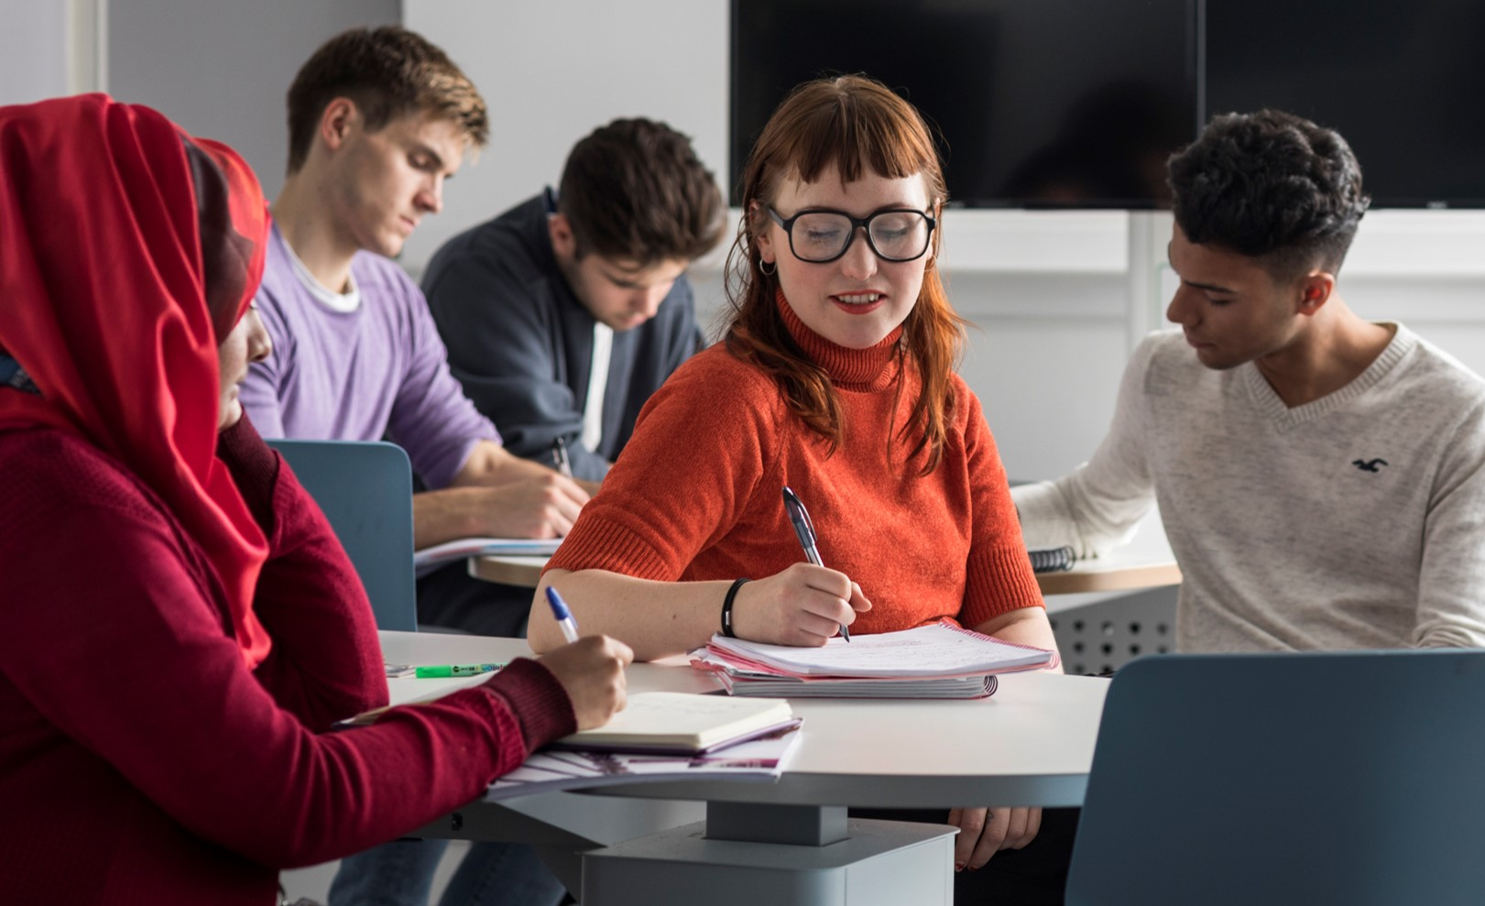

Learning through Doing, Learning through Sharing
Linking Museum Theory and Practice through
Professional Work Placements
Dr Rosie Spooner
Rosemary.Spooner@glasgow.ac.uk

Slide 2
Museum Studies at the University of Glasgow
Interdisciplinary approach to museum history, theory and practice
Museum Studies MSc established in 2009
largest PGT programme in the School of Humanities
current cohort of 60 students from Scotland and wider UK, Europe, North America and Asia
led by academic staff in Information Studies who bring diverse teaching and research expertise across Galleries, Libraries, Archives and Museums (GLAMs)
significant contributions from sector professionals with varied local, national and international experience
Programme aims
equip students with knowledge, understanding and skills required of versatile and progressive museum professionals
foreground collections-based teaching and practical hands-on learning
encourage critical awareness of the role that international, national and local contexts play in shaping museum policy and practice
situate the place of museums within the wider cultural heritage landscape
provide a theoretical framework for understanding the role of museums in society

Slide 3
Museum Studies
Work Placement
Museum Studies Work Placement
  20-credit optional course in second semester
  29 students at 13 host organisations (museums, art galleries, cultural heritage trusts, historic homes)
  varied collections (women’s history, art history, medicine, military, zoology)
  range of museum operations (collections management, education and learning, interpretation and display, accessibility)
Foster greater active learning, knowledge exchange and student confidence through:
  Moodle discussion groups
  real-time work diaries
  conference-style presentations and panel discussions
  co-authored bibliography
Working to a project defined by a cultural heritage organisation, students gain:
  knowledge of the demands of the professional environment
  skills required to produce work of professional standards
  experience applying theoretical concepts learnt in the classroom to real-life scenarios
  ability to critically reflect on and evaluate individual development and progress
  opportunities to establish professional contacts and networks

Slide 4
Thank you
12th Annual University of Glasgow Learning & Teaching Conference
Rosemary.Spooner@glasgow.ac.uk

