Slide 1


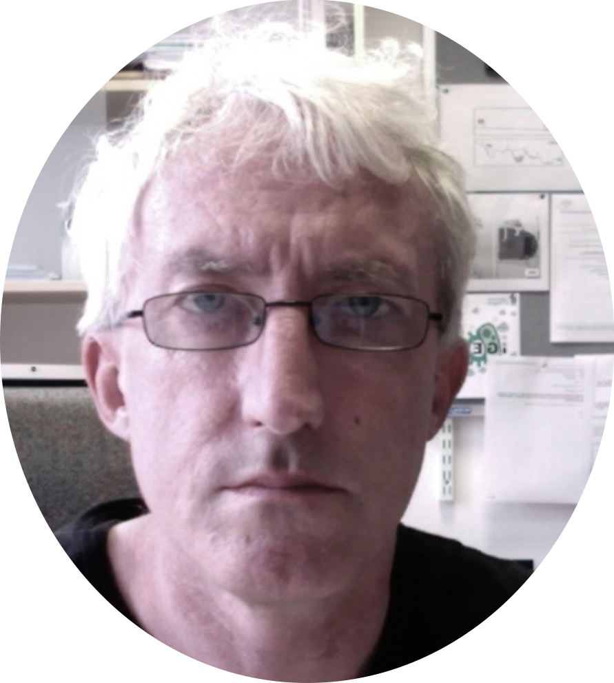
Live sampling of data and ideas in large classes using SLIDO increases participation and student engagement
maureen.griffiths@glasgow.ac.uk
joseph.gray@glasgow.ac.uk
darren.monckton@glasgow.ac.uk

Slide 2
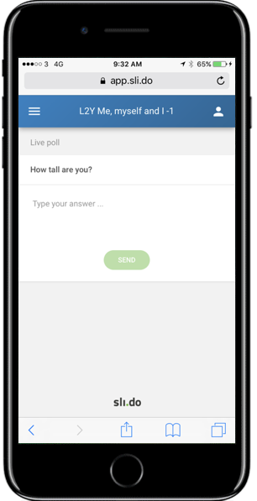






SLIDO allows for simple data entry, display and (live) analyses (quantitative and qualitative)

Slide 3
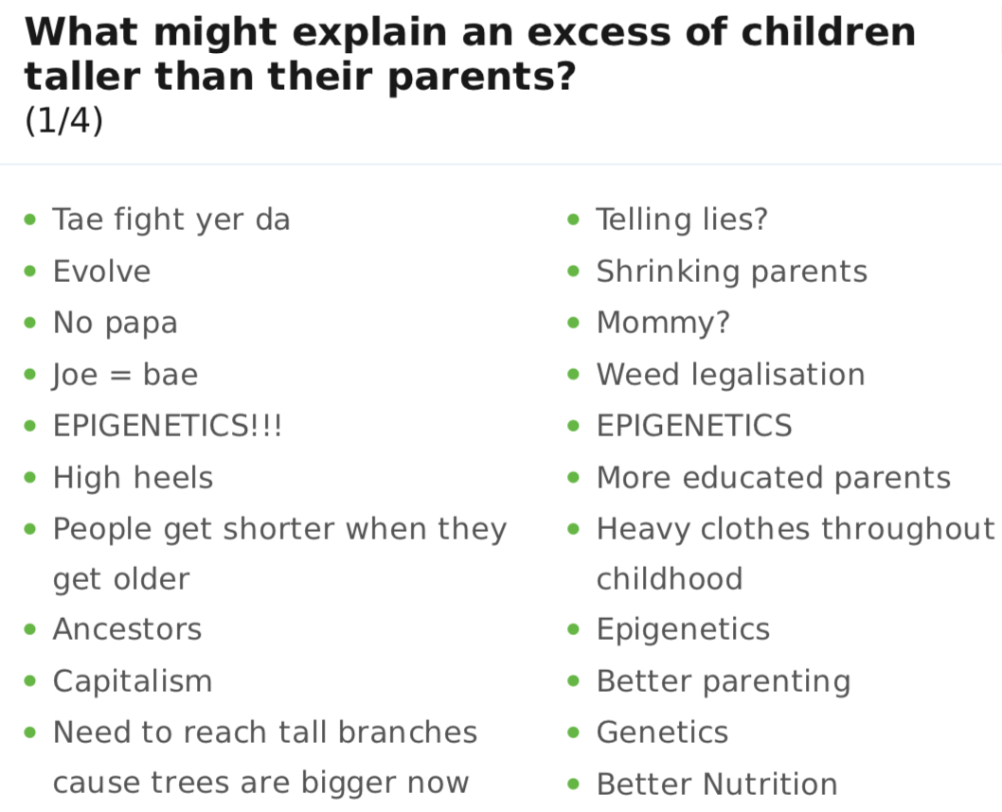

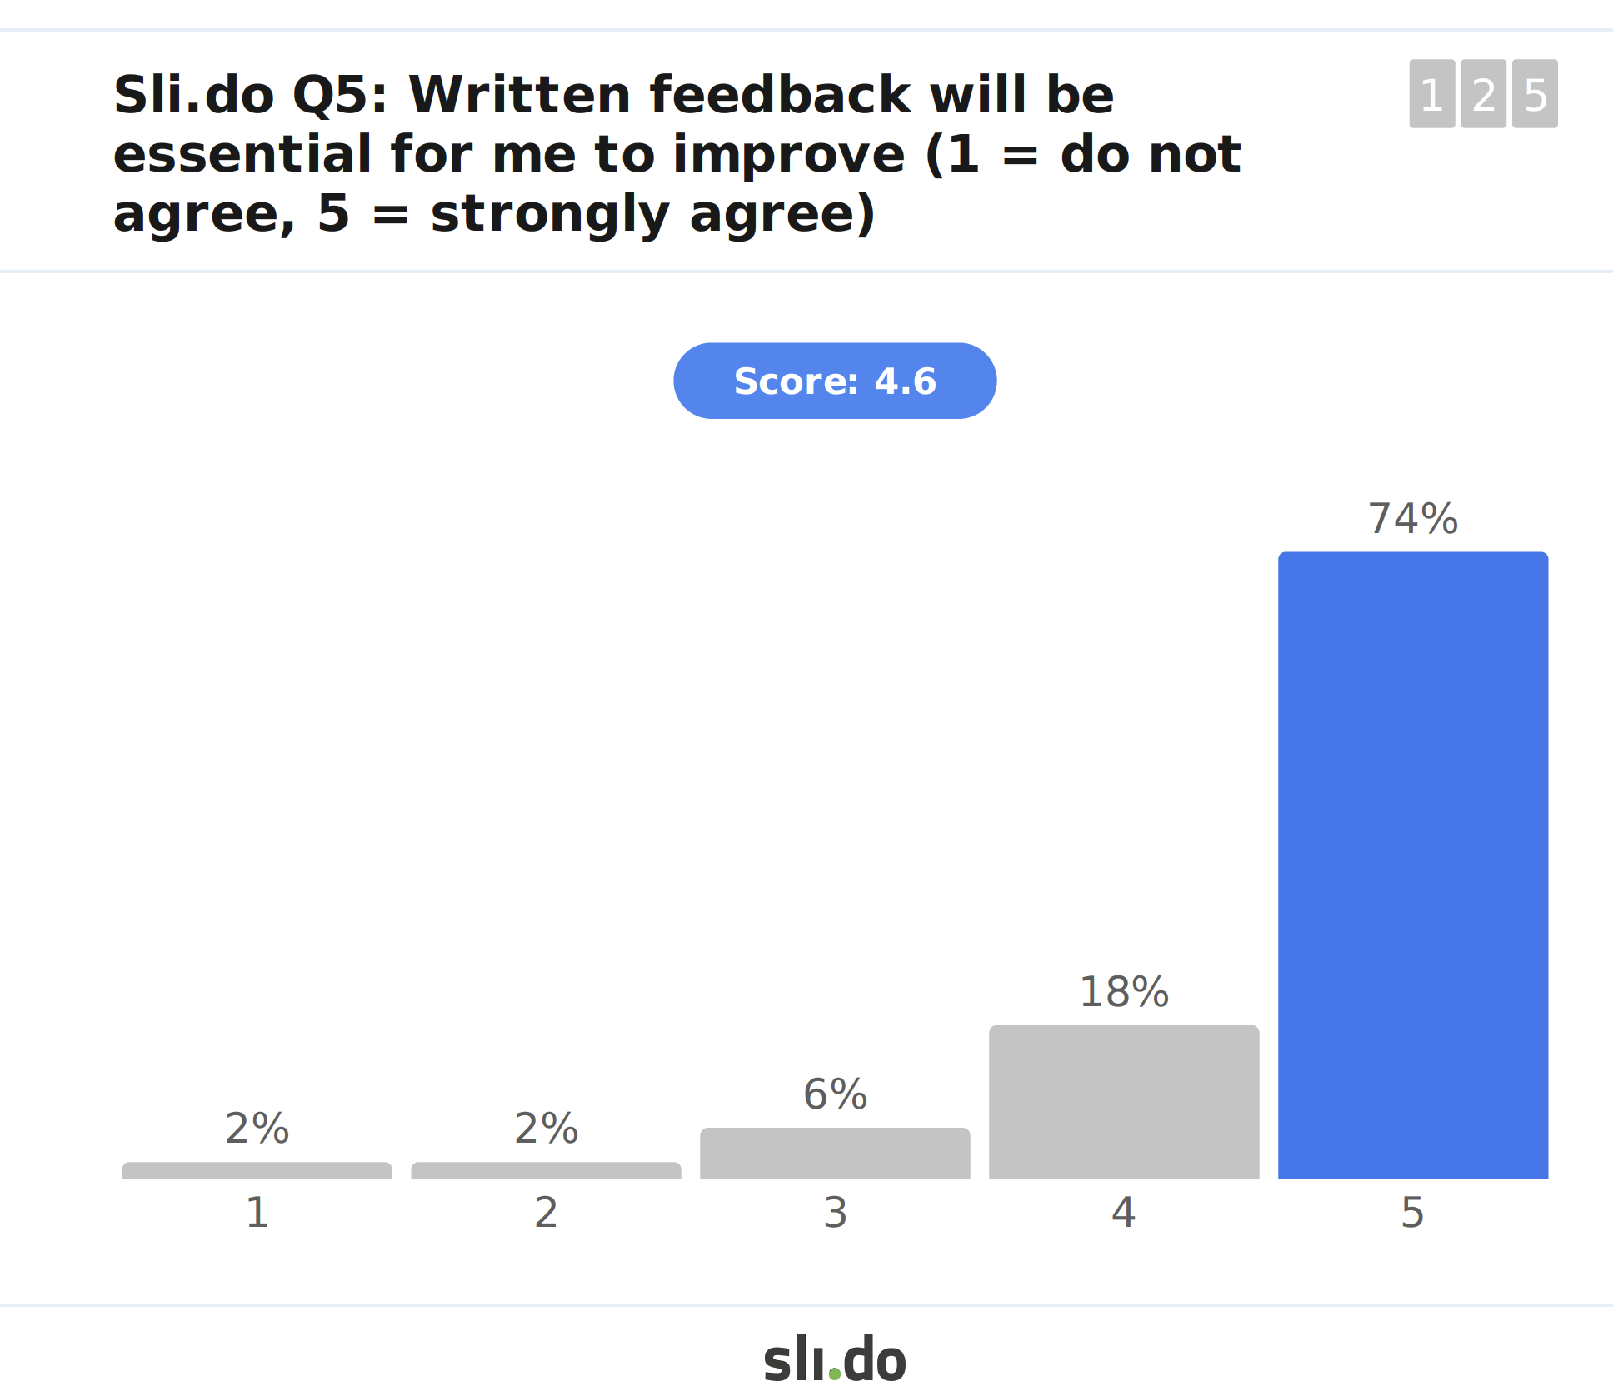
SLIDO allows for gathering ideas and facilitates very high levels of student participation in large classes
• over 90% participation is typical

Slide 4
12th Annual University of Glasgow Learning & Teaching Conference
maureen.griffiths@glasgow.ac.uk
joseph.gray@glasgow.ac.uk
darren.monckton@glasgow.ac.uk

