Slide 1
Mapping and Visualising Thematic Links within an UG Engineering Degree
Ian Taylor
Ian.Taylor@glasgow.ac.uk

Slide 2
Degree Connections
Course and credit structure of Engineering degrees has “pros” and “cons”.
+ can structure courses to build on prior knowledge
- students (and staff) either forget or are unaware of where previous material taught
Commonly means unnecessary repetition of material in some classes – reduced time for new material
LTDF Funded project to develop an online graphical resource to visualise subject connections.
Thermodynamics 1
Thermodynamics 2
Aerospace Propulsion Systems

Slide 3
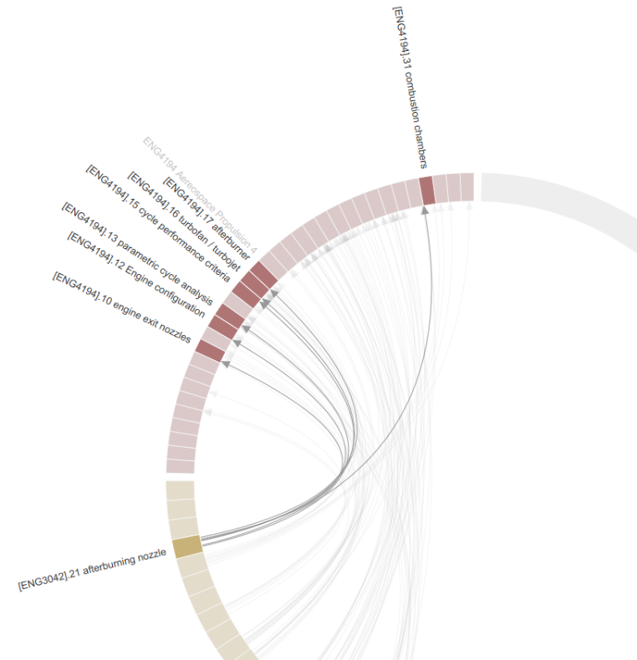
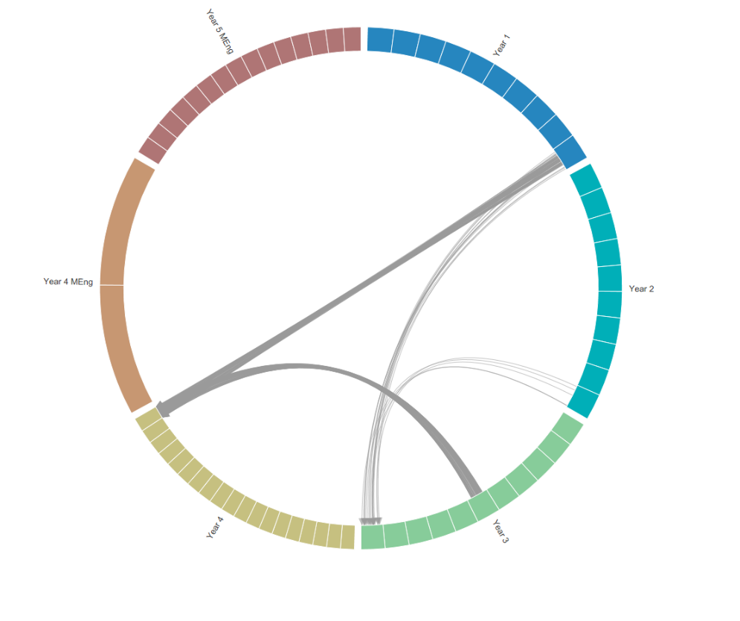
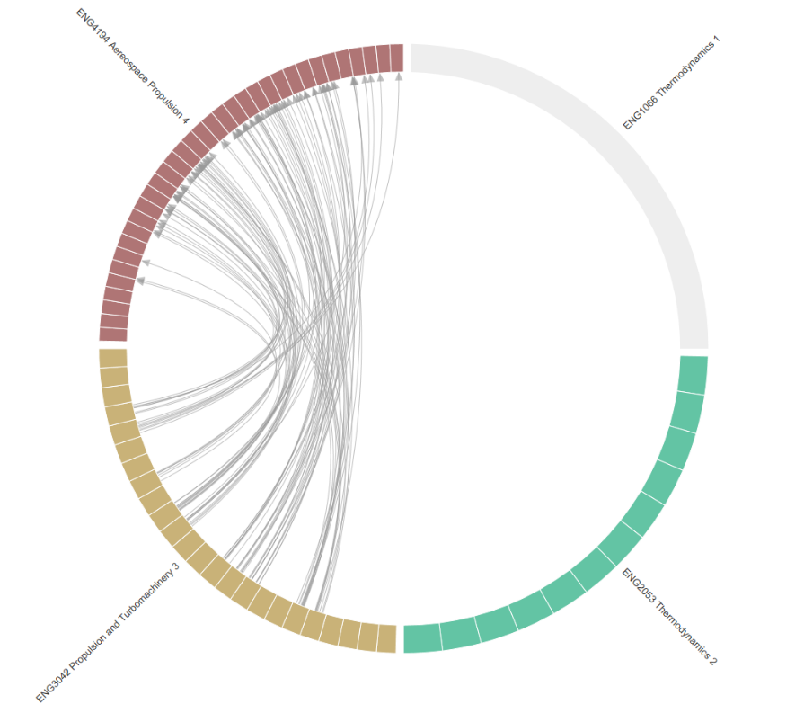
Visualisation
Graphical resource based on an open source tool, “Xoces” from MIT.
Intended to provide graphical illustration of subject connections. Preliminary results …
Year View
Aeronautical Eng.
“Theme” View
Aeronautical Eng.
Next stage – Implement for a small number of engineering degrees in 2019/20.
Followed by wider range of degrees in following sessions.

Slide 4
12th Annual University of Glasgow Learning & Teaching Conference
Ian.Taylor@glasgow.ac.uk

