Slide 1


Assessment and Feedback to Support Active Learning
(panel session)
Joseph Gray
Joseph.Gray@glasgow.ac.uk

Slide 2
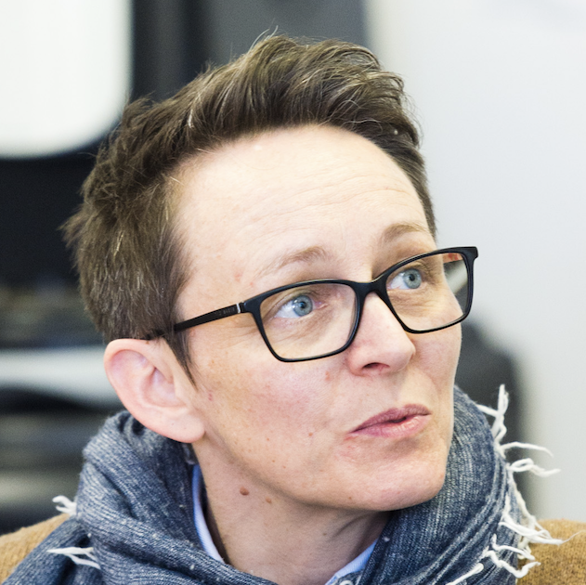
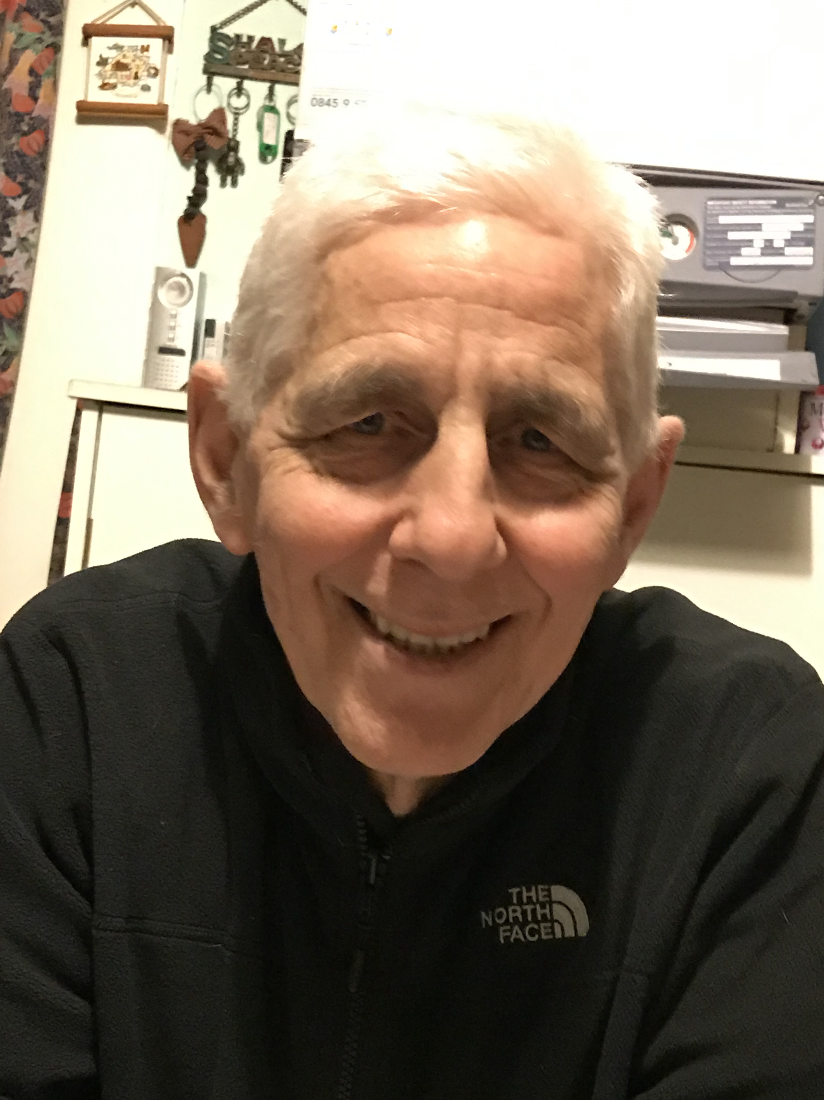
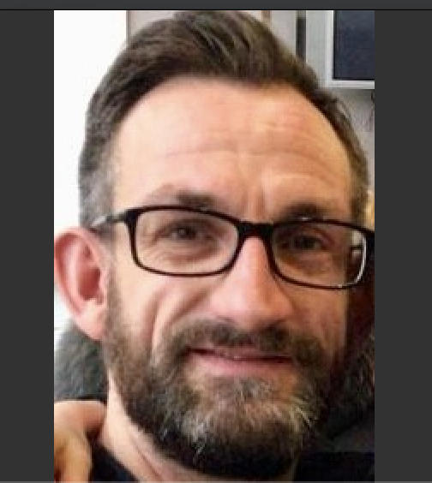
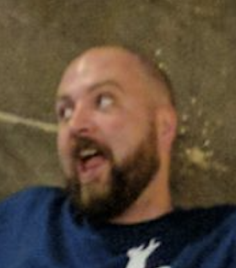
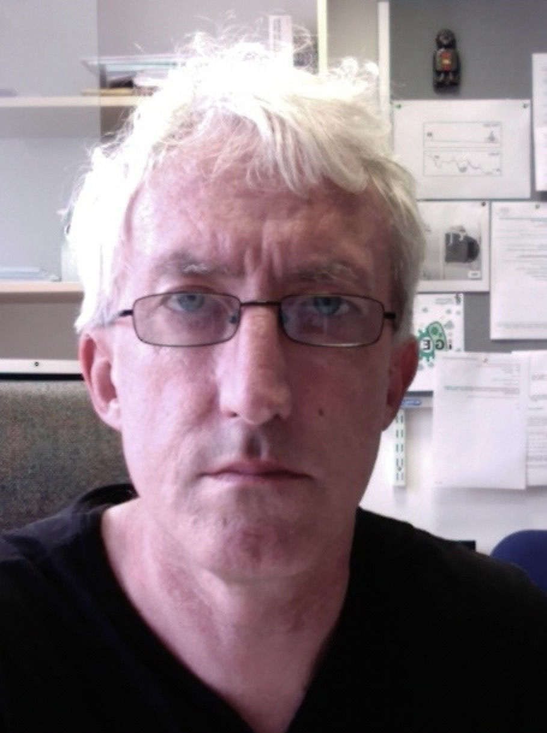
Panel
Amanda: “authentic”, “transparent”, “ipsative”
Amanda.Sykes@glasgow.ac.uk
David: “self-regulation”, “peer review”, “workload”
David.Nicol@glasgow.ac.uk
Nairn: “work-based”, “internships”, “portfolio”
Nairn.Scobie@glasgow.ac.uk
Sìm: “student ownership”, “curriculum co-creation”
Sim.Innes@glasgow.ac.uk
Joe: “programmatic assessment”, “grading”, “analytics”
Joseph.Gray@glasgow.ac.uk

Slide 3
Fair point
What?
Q: Isn't 'active learning' an oxymoron? Isn't all learning active?
Cognitively engaged
Doing/practicing key things
Teacher-centered to student-centered
For student to improve and teacher to focus (effective and efficient support of student)
Oxymoron?

Slide 4
The
Big picture
Hitting the nail on the head
Q: What are the benefits to staff of changing the way we assess students?
Q: How do we get students who are often motivated by grades to "buy in" to active learning and see it as a valuable use of their time?
Workload
Q: Is the university going to give us more staff so that we can mark all of these extra assignments they want us to do?
Q: Let's be realistic. Better assessment/feedback means more work for lecturers. Is senior management willing to hire new lecturers as part of the 1£ billion plan?

Slide 5
Jumping in
How to get going
Q: How can I introduce active learning into my classes?
Q: What online tools should we be using for active learning?
Q: How can we make our teaching more "authentic”?

Slide 6
Practical
Challenges/
Inclusion
How to engage diverse audiences
Q: How do we encourage non-native speakers to participate in active learning?
Q: How do we leave space to acknowledge and support students with mental health issues in an active learning situation?
Q: How do we help home students feeling isolated during group discussions in classes with large number of foreign students?
Q: How can we design active learning into our distance learning courses?
Q: Many students cannot engage in active learning because of their disabilities. How are we meant to make learning inclusive?

Slide 7
Assessment
Assessment FOR learning
Q: Do we assess what we REALLY want a student to learn?
Q: Has the essay had its day?
Q: Almost all examinations and feedback use writing as a means to an end. Shouldn't we work hard to find a balance btw oral and written examination and feedback?
Q: To what extent can peer assessment develop students' own self-perception?
Q: Could student peer-review of previous (years) projects, enable active learning by giving them context/something to compare it too?

Slide 8
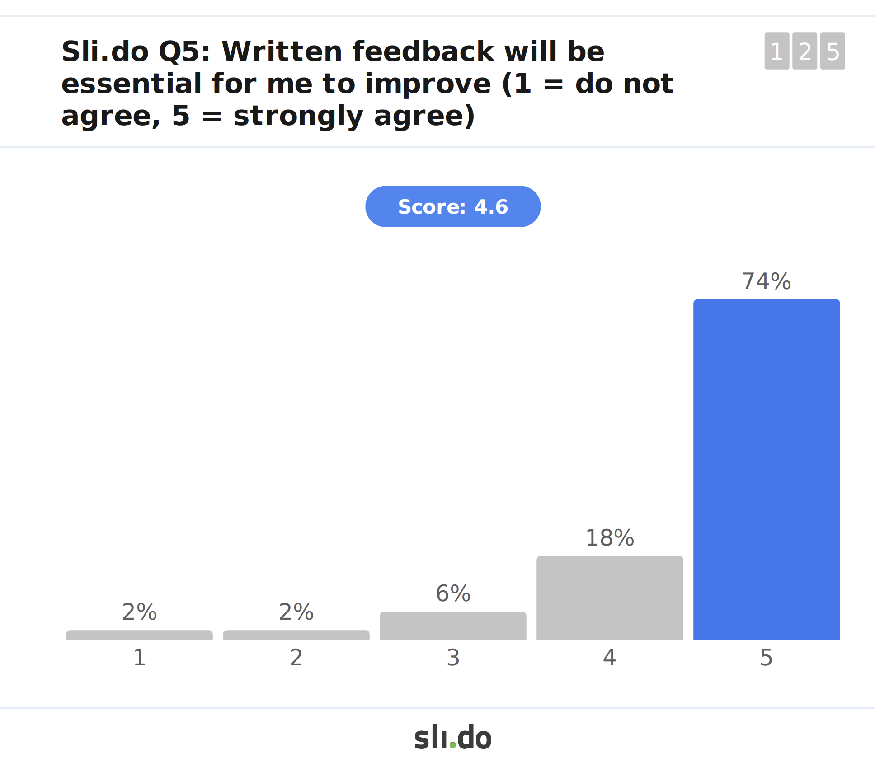
Frightening Slide

Slide 9
Effective and
Sustainable
Feedback a good use of all our time
Feedback
Q: How to we get students to actively engage in the feedback they receive on coursework/exams?
Q: What is best practice for (staff) writing feedback?
Q: Written feedback: what is an ideal length/wordcount?
Q: How can we streamline assessment and feedback in active learning with large number of students (e.g. 500+)?
Q: Why do we bother adding feedback comments to summative assessments at the end of modules?
Q: Shouldn't we work hard to find a balance btw oral and written examination and feedback?
Q: How plausible is it to introduce face-to-face feedback , particularly, large courses?

Slide 10
Resources
Follow-up:
A short, annotated list of references
  Updated to slides
  E-mailed to attendees
(Investigating) Online forum
Panelists: welcome to contact

Slide 11
Open
Microphone
Questions/comments

Slide 12
Practical
Challenges/
Inclusion
How to engage diverse audiences
Q: How do we encourage non-native speakers to participate in active learning?
Q: How do we leave space to acknowledge and support students with mental health issues in an active learning situation?
Q: How do we help home students feeling isolated during group discussions in classes with large number of foreign students?
Q: How can we design active learning into our distance learning courses?
Q: Many students cannot engage in active learning because of their disabilities. How are we meant to make learning inclusive?

Slide 13
12th Annual University of Glasgow Learning & Teaching Conference
Firstname.Surname@glasgow.ac.uk

