Slide 1


Alternative (Authentic) Assessments: Professional skill enhancement and development of graduate attributes.
Langan-Martin, Julie
Sharp, Laura
Karadzhov, Dimitar
Laura Sharp
Laura.Sharp@glasgow.ac.uk

Slide 2
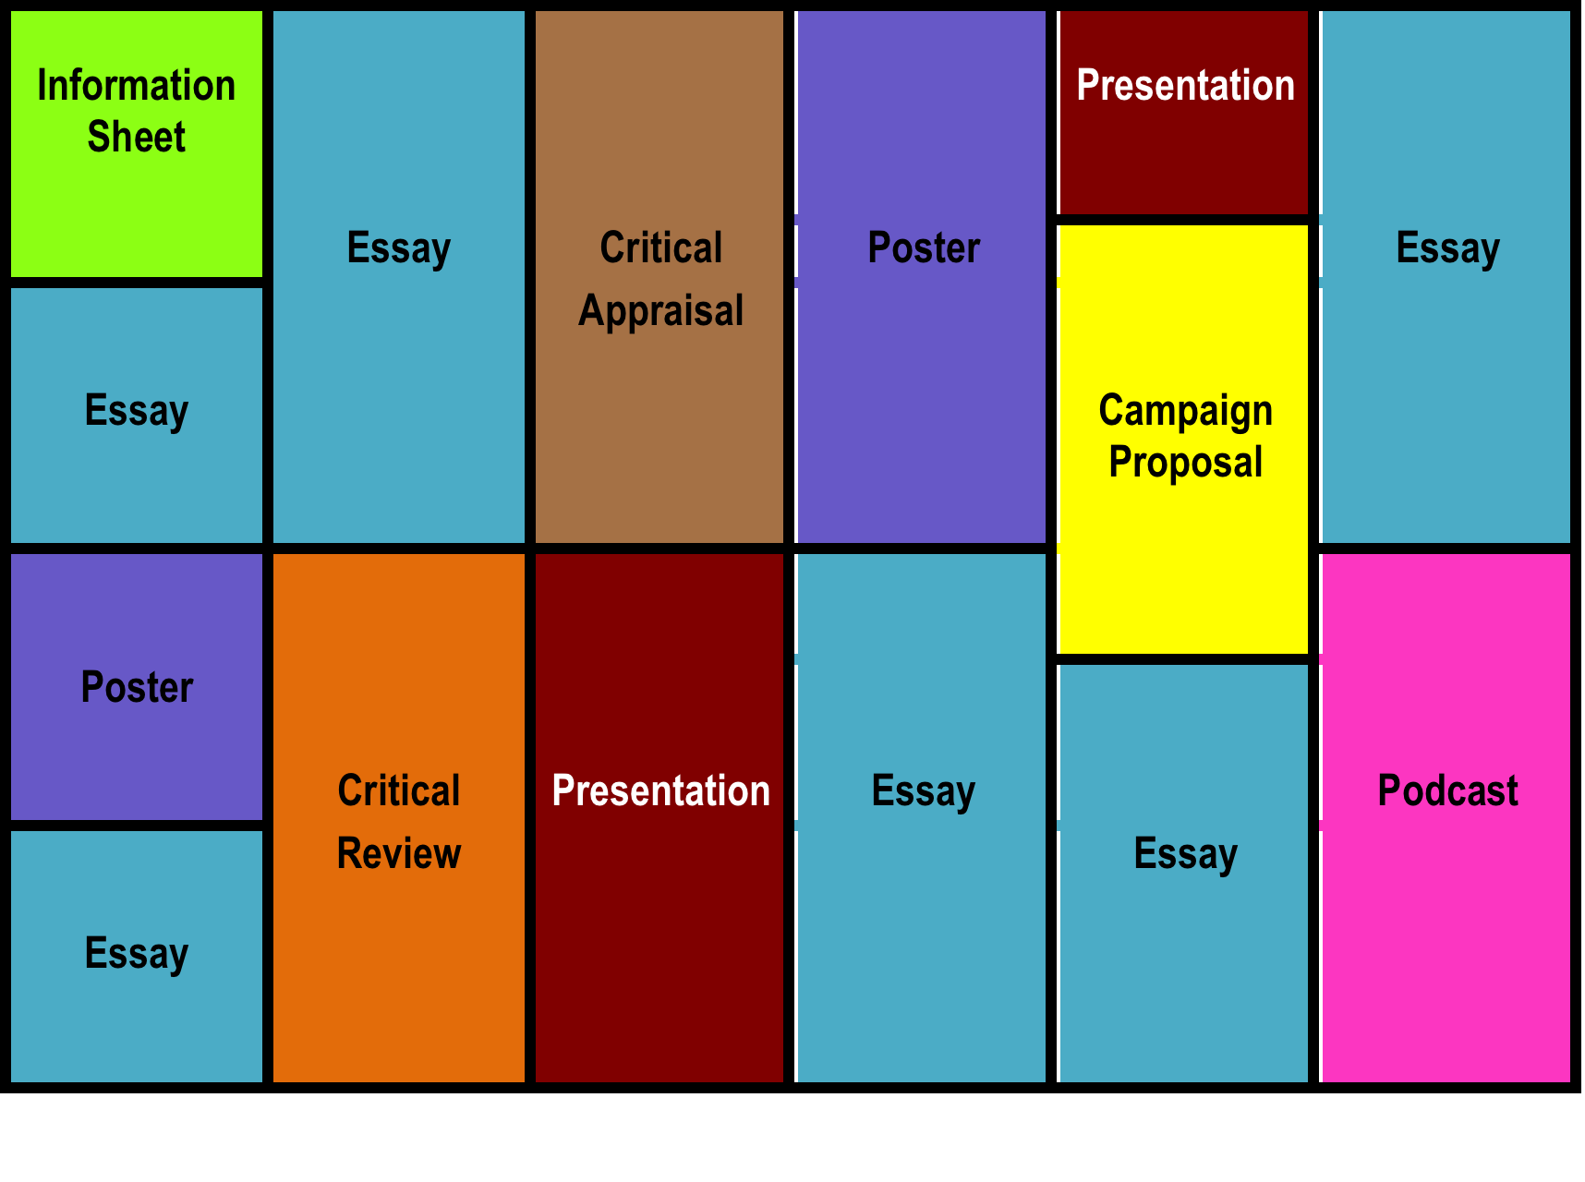
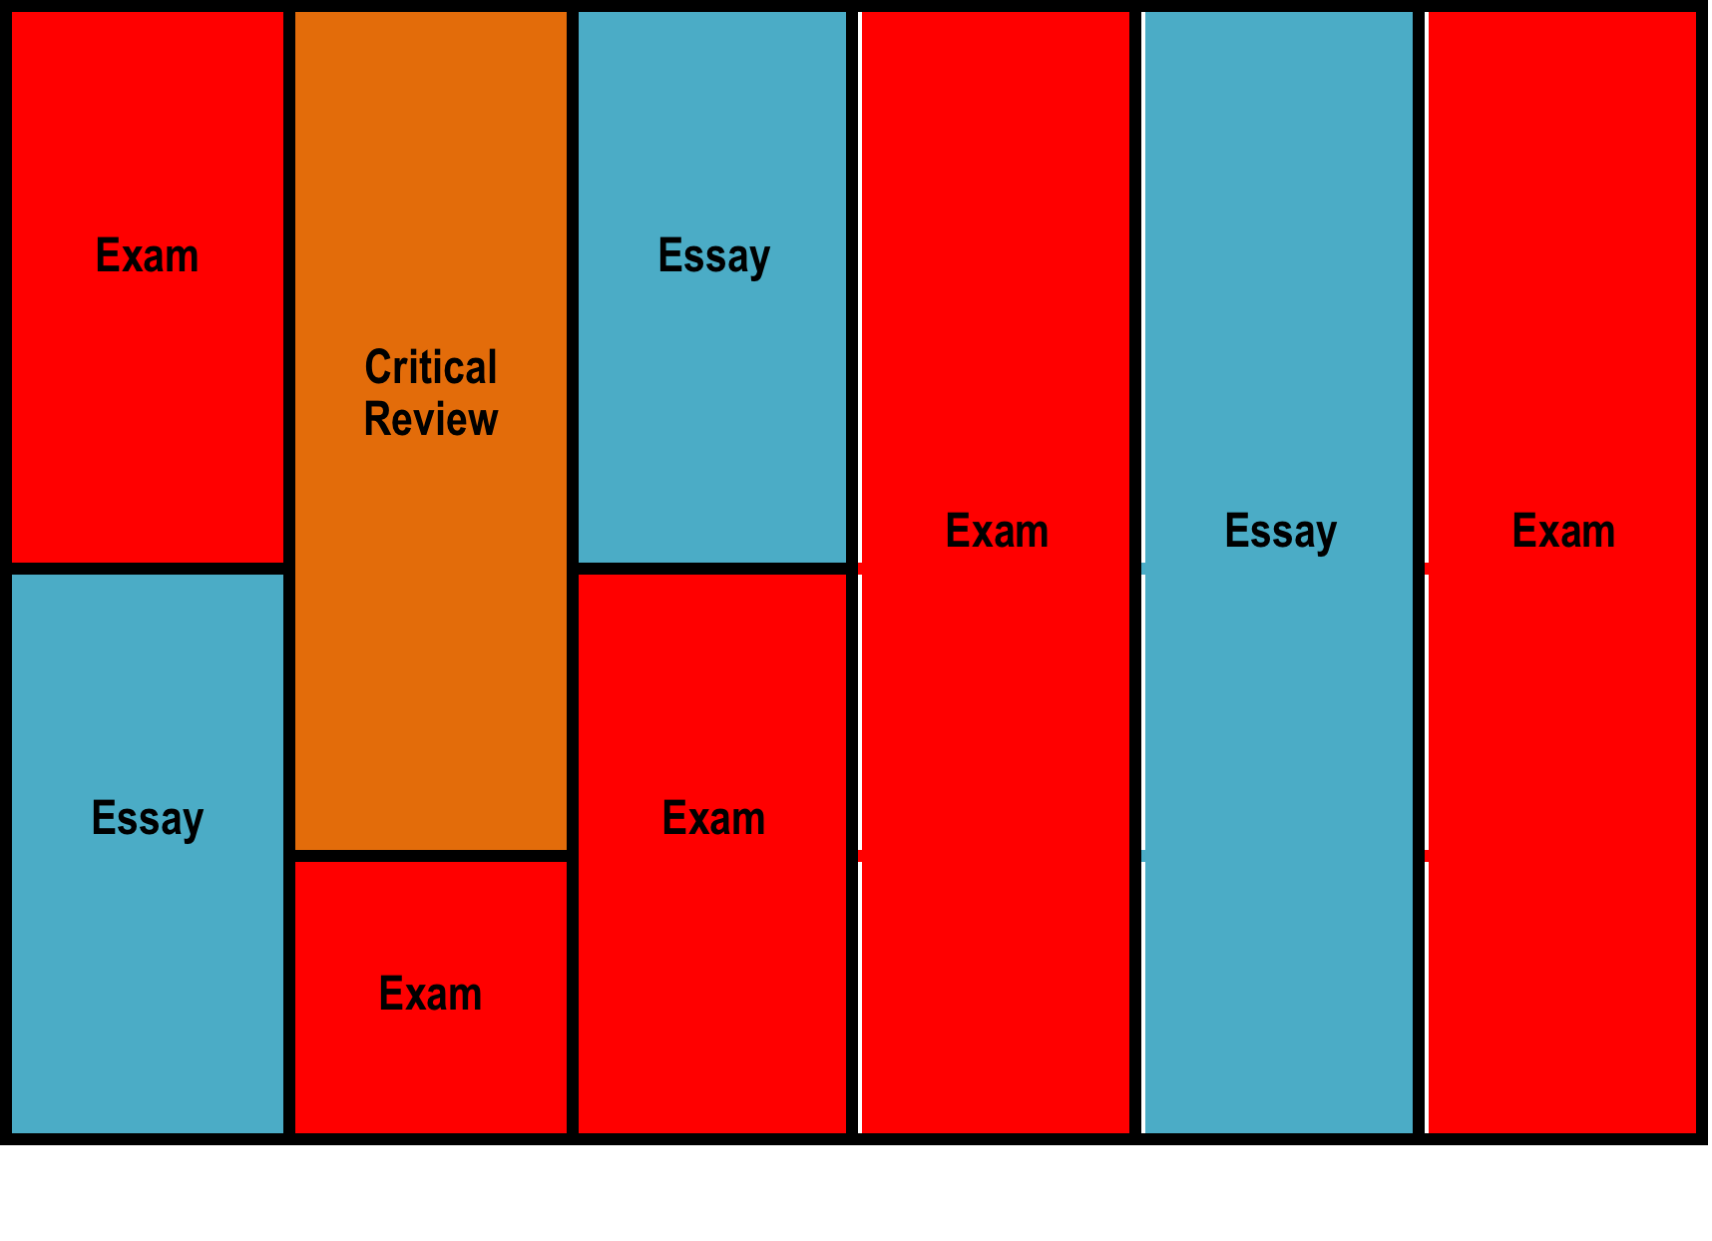
Assessment Breakdown
2012-13
-
2016-17
2017-18 onwards

Slide 3
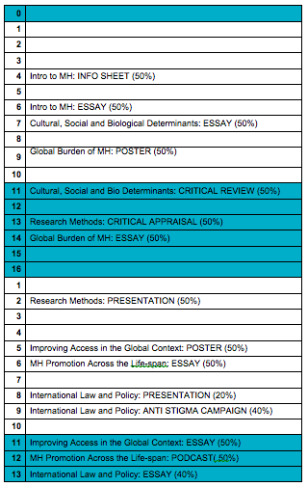
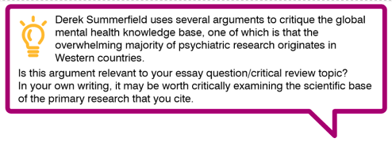
Collating Assessment Information

Slide 4
12th Annual University of Glasgow Learning & Teaching Conference
Laura.Sharp@glasgow.ac.uk

